Slide 1
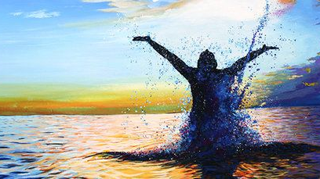


Romans 10:1-17

Slide 2

WHAT IS SALVATION?
Many have misconceptions of what salvation is, and therefore misconceptions of when and how it occurs.
Justification / forgiveness / cleansing of sin (Romans 3:21–26; 5:1; James 2:14-26; Acts 2:38; 22:16; Col. 2:11–13),
Regeneration / new birth / New Life / Family of God (John 3:3–5; Titus 3:5; 1 Peter 1:3, 23; Rom. 6:3–5; Gal. 3:26–27; Col. 2:12),
Sanctification (1 Cor. 6:11; Heb. 10:10, 14),
Reconciliation with God / in the body of Christ / IN CHRIST /(Acts 2:38; 1 Corinthians 12:13; Eph. 1:3-14; 2:16),

Slide 3



Hebrews 11:6 (NKJV)
⁶ But without faith it is impossible to please Him, for he who comes to God must believe that He is, and that He is a rewarder of those who diligently seek Him.
“For by it the elders obtained a good testimony”

Slide 4

Defining Faith
  FAITH (N) / BELIEVE (V)
  FAITHFUL / BELIEVING (Adj.)
  4102. πίστις pistis, pis´-tis; from 3982;
  "...used especially of the faith by which a man embraces Jesus, i.e., a conviction, full of joyful trust, that Jesus is the Messiah -- the divinely appointed author of eternal salvation in the kingdom of God, conjoined with obedience to Christ."
  (Thayer's Greek-English Lexicon, p. 511)

Slide 5
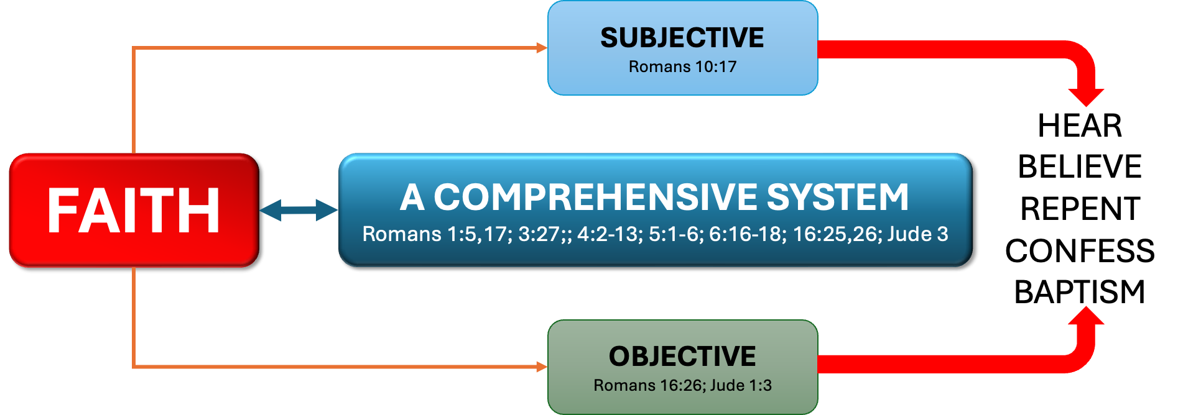
Defining Faith
  FAITH (N) / BELIEVE (V)
  FAITHFUL / BELIEVING (Adj.)

Slide 6
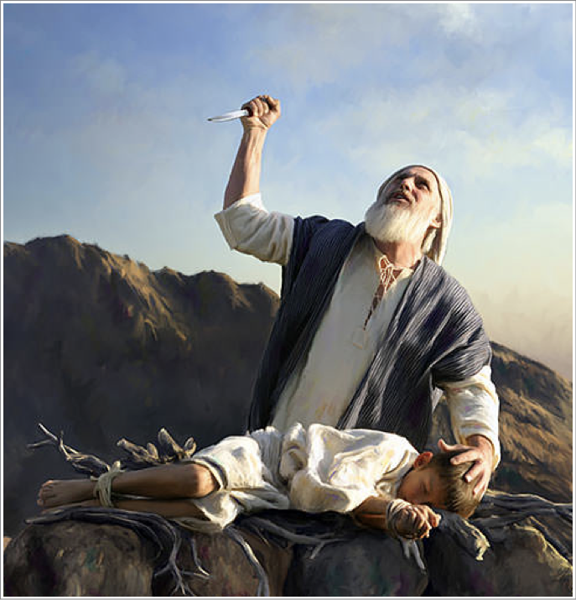
Defining Faith
  NOT FAITH plus WORKS, but FAITH that WORKS
COVICTION
Hebrews 11:6 (NKJV)
⁶ But without faith it is impossible to please Him, for he who comes to God must believe that He is, and that He is a rewarder of those who diligently seek Him.
TRUST
OBEDIENCE
believe that He is
He is a rewarder
diligently
seek

Slide 7
Defining Faith
  NOT FAITH plus WORKS, but FAITH that WORKS
Hebrews 11:6 (NKJV)
⁶ But without faith it is impossible to please Him, for he who comes to God must believe that He is, and that He is a rewarder of those who diligently seek Him.
believe that He is
He is a rewarder
diligently
seek

Slide 8
Defining Faith
  NOT FAITH plus WORKS, but FAITH that WORKS
James 2:22 (NKJV)
²² Do you see that faith was working together with his works, and by works faith was made perfect?

Slide 9
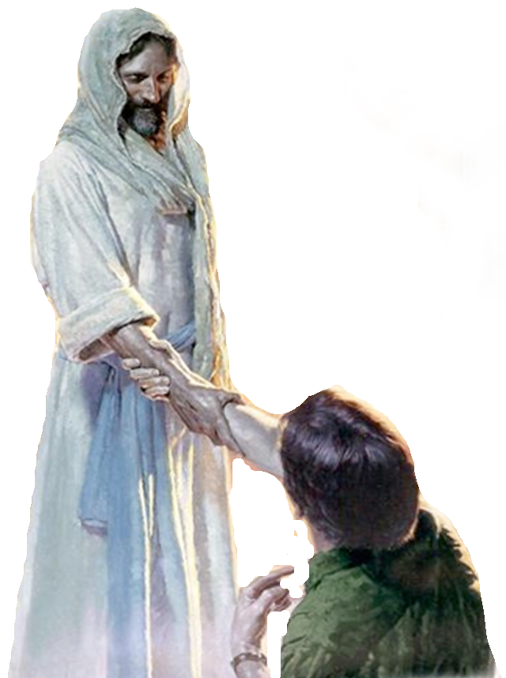
“WHEN DOES FAITH SAVE?”
Defining Faith
  FAITH (N) / BELIEVE (V)
  FAITHFUL / BELIEVING (Adj.)
FAITH (N) pistis (πίστις, 4102), “faith,” is translated “belief” (2 Thess. 2:13).
      BELIEVE (V) pisteuo (πιστεύω, 4100), “to believe,” also “to be persuaded of,” and hence, “to place confidence in, to trust,” signifies, in this sense of the word, reliance upon, not mere credence.
          BELIEVER (ADJ.) pistos (πιστός, 4103), (a) in the active sense means “believing, trusting”; (b) in the passive sense, “trusty, faithful, trustworthy.”
Vine’s Complete Expository Dictionary

Slide 10
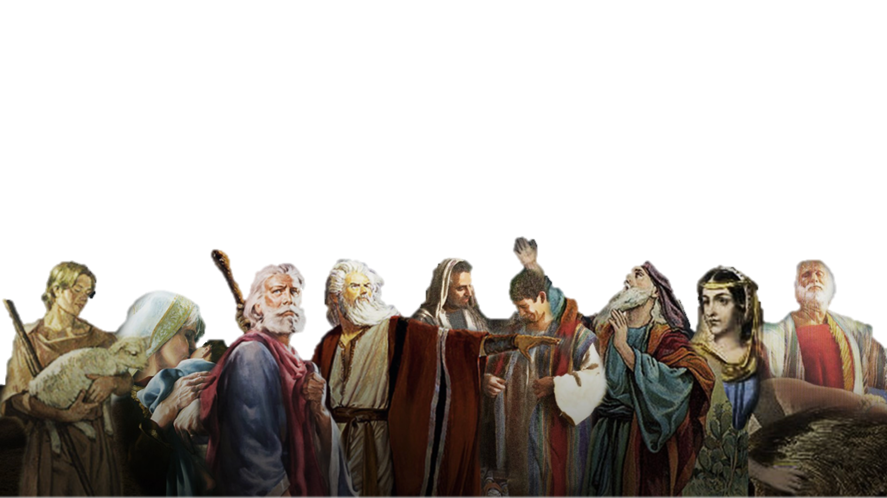
HEBREWS 11 / By FAITH …
  NOT FAITH plus WORKS, but FAITH that WORKS
Hebrews 11:1–3 (NKJV)
¹ Now faith is the substance of things hoped for, the evidence of things not seen. ² For by it the elders obtained a good testimony. …

Slide 11
HEBREWS 11 / By FAITH …
  NOT FAITH plus WORKS, but FAITH that WORKS
Abel offered - (4)
Enoch pleased God - (5)
Noah built the ark - (7)
Abraham obeyed - (8-10)
Sarah conceived - (11,12)
Abraham’s sacrifice (17-19)

Slide 12
HEBREWS 11 / By FAITH …
  NOT FAITH plus WORKS, but FAITH that WORKS
Isaac Blessed sons (20)
Joseph’s sons blessed (21)
Moses left Egypt (23-27)
Kept passover (28)
Israel crossed R. S. (29)
Wall of Jericho fell (30)
Rahab Spared- (31)
Judges, Kings, Prophets others- (32-38)

Slide 13
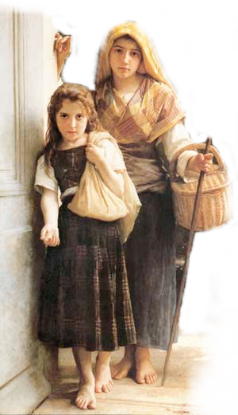
NOT ALL FAITH is SAVING FAITH
James 2:14-17 (NKJV)
¹⁴ What does it profit, my brethren, if someone says he has faith but does not have works? Can faith save him? ¹⁵ If a brother or sister is naked and destitute of daily food, ¹⁶ and one of you says to them, “Depart in peace, be warmed and filled,” but you do not give them the things which are needed for the body, what does it profit? ¹⁷ Thus also faith by itself, if it does not have works, is dead.

Slide 14
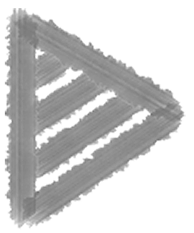
NOT ALL FAITH is SAVING FAITH
What does it profit?
Hearers but not doers? (1:22-25)
Believers who will not confess? (John 12:42; Rom. 10:9,10)
Professors who will not obey? (Luke 6:46; Mat 7:21-23)
Is it saving faith if it will not confess? repent? be baptized? (Luke 7:7:29,30; 2 Thes. 1:7-9)
James 2:17 (NKJV)
Thus also faith by itself, if it does not have works, is dead.

Slide 15
NOT ALL FAITH is SAVING FAITH
What does it profit?
Demons believe in the one true God (Mk 1:24; 5:7; Lk 4:34; Ac. 19:15)
Demons believe in the deity of Jesus (Mark 3:11,12; Luke 8:30,31)
Demons believe in hell (Mt 8:29)
Demons believe Jesus is judge and will condemn (Mark 5:1-13)
James 2:19 (NKJV)
You believe that there is one God. You do well. Even the demons believe—and tremble!

Slide 16
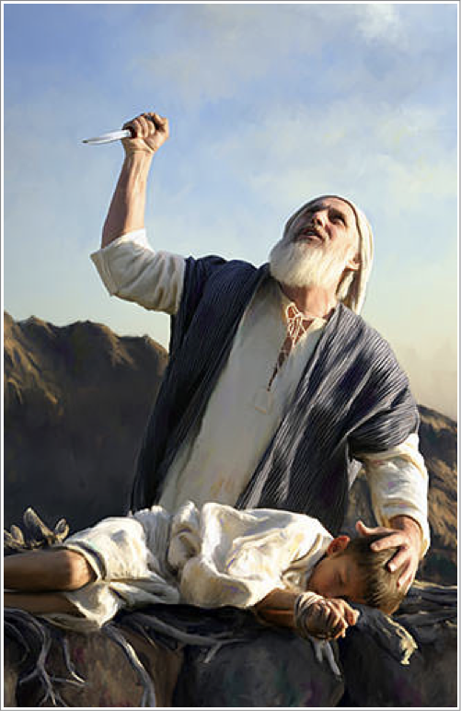
THE FAITH THAT SAVES
James 2:21 (NKJV)
Was not Abraham our father justified by works when he offered Isaac his son on the altar?
Abraham was JUSTIFIED by works - (justified, [dikaiosune - δικαιοσύνη] same term as in Rom 4:2,3,5,6; 6:16)
Abraham trusted God to the max when he obeyed God by offering Isaac! - (Heb 11:17; Rom 4:19-22; Gen 22:1-19)

Slide 17
THE FAITH THAT SAVES
NOT Saved By Works,
“WORKS used in two different senses
Saved By Works,
Romans 4:1-6
Justified
Counted for
righteousness
Fulfilled
Genesis 15:6
Strong
Not of works
James 2:21-24
Justified
Counted for
righteousness
Fulfilled
Genesis 15:6
Perfect
By works
WHAT Kind of FAITH did Abraham Have?

Slide 18
THE FAITH THAT SAVES
NOT Saved By Works,
“WORKS used in two different senses
Saved By Works,
Of MERIT Ephesians 2:8,9; Titus 3:5
Of the Law Romans 3:19,27; 4:1-8; 11:6
WORKS OF FAITH
Recognizing our dependance upon God.
When God says do something - we do it because we trust Him.
WHAT Kind of FAITH did Abraham Have?

Slide 19
THE FAITH THAT SAVES
James 2:21 (NKJV)
²² Do you see that faith was working together with his works, and by works faith was made perfect?
Faith motivated his obedience, which rendered his faith complete, therefore effectual (22; Heb 11:17-19; Gal 5:6).
What good is faith without obedience?
What good is obedience without faith?

Slide 20
THE FAITH THAT SAVES
James 2:23 (NKJV)
²³ And the Scripture was fulfilled which says, “Abraham believed God, and it was accounted to him for righteousness.” And he was called the friend of God.
Abraham’s faith was credited to him as righteousness when he obeyed! (23a; Gen 15:6; Rom 4:3; Gal. 3:6-8)
Abraham was called the friend of God! - (23b; Is 41:8; 2 Chron 20:7)

Slide 21
THE FAITH THAT SAVES
James 2:24 (NKJV)
²⁴ You see then that a man is justified by works, and not by faith only.

Slide 22
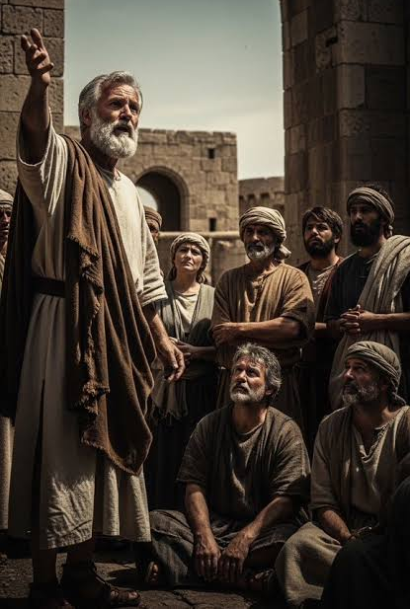
WHEN FAITH OBEYS THE GOSPEL
Acts 2:21–41 (NKJV)
²¹ And it shall come to pass That whoever calls on the name of the Lord Shall be saved.’ ²² “Men of Israel, hear these words: Jesus of Nazareth, a Man attested by God to you by miracles, wonders, and signs which God did through Him in your midst, as you yourselves also know—

Slide 23
WHEN FAITH OBEYS THE GOSPEL
Acts 2:21–41 (NKJV)
³⁷ Now when they heard this, they were cut to the heart, and said to Peter and the rest of the apostles, “Men and brethren, what shall we do?” ³⁸ Then Peter said to them, “Repent, and let every one of you be baptized in the name of Jesus Christ for the remission of sins; and you shall receive the gift of the Holy Spirit.

Slide 24
WHEN FAITH OBEYS THE GOSPEL
Acts 2:21–41 (NKJV)
³⁹ For the promise is to you and to your children, and to all who are afar off, as many as the Lord our God will call.” ⁴⁰ And with many other words he testified and exhorted them, saying, “Be saved from this perverse generation.” ⁴¹ Then those who gladly received his word were baptized; and that day about three thousand souls were added to them.

Slide 25

WHEN FAITH OBEYS THE GOSPEL
Romans 6:3–5 (NKJV)
³ Or do you not know that as many of us as were baptized into Christ Jesus were baptized into His death? ⁴ Therefore we were buried with Him through baptism into death, that just as Christ was raised from the dead by the glory of the Father, even so we also should walk in newness of life. ⁵ For if we have been united together in the likeness of His death, certainly we also shall be in the likeness of His resurrection,

Slide 26
WHEN FAITH OBEYS THE GOSPEL
Romans 6:16–18 (NASB95)
¹⁶ Do you not know that when you present yourselves to someone as slaves for obedience, you are slaves of the one whom you obey, either of sin resulting in death, or of obedience resulting in righteousness? ¹⁷ But thanks be to God that though you were slaves of sin, you became obedient from the heart to that form of teaching to which you were committed, ¹⁸ and having been freed from sin, you became slaves of righteousness.

Slide 27
WHEN FAITH CALLS ON THE NAME OF THE LORD
For “whoever calls on the name of the Lord shall be saved.” (Romans10:13; Cf. Joel 2:32; Acts 2:21; Jer. 29:11-13)
Romans 10:14–17 (NKJV)
¹⁴ How then shall they call on Him in whom they have not believed? And how shall they believe in Him of whom they have not heard? And how shall they hear without a preacher? ¹⁵ And how shall they preach unless they are sent? As it is written: “How beautiful are the feet of those who preach the gospel of peace, Who bring glad tidings of good things!” ¹⁶ But they have not all obeyed the gospel. For Isaiah says, “Lord, who has believed our report?” ¹⁷ So then faith comes by hearing, and hearing by the word of God.

Slide 28

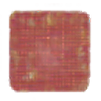
WHEN FAITH CALLS ON THE NAME OF THE LORD
One can’t call until they first believe (14)
One can’t believe until they have heard (14)
One can’t hear without the message being proclaimed (14)
The message can’t be proclaimed until it is sent (15)
But they have not all obeyed the gospel (16)
For Isaiah says, “Lord, who has believed our report?” (16)
So then faith comes by hearing, (17)
and hearing by the word of God (17)

Slide 29
WHEN FAITH CALLS ON THE NAME OF THE LORD
For “whoever calls on the name of the Lord shall be saved.” (Romans10:13; Cf. Joel 2:32; Acts 2:21; Jer. 29:11-13)
Acts 2:38 (NKJV)
³⁸ . . . "Repent, and let every one of you be baptized in the name of Jesus Christ for the remission of sins; and you shall receive the gift of the Holy Spirit.
Acts 22:16 (NKJV)
¹⁶ And now why are you waiting? Arise and be baptized, and wash away your sins, calling on the name of the Lord.'
1 Peter 3:21 (NASB77)
²¹ And corresponding to that, baptism now saves you—not the removal of dirt from the flesh, but an appeal to God for a good conscience—through the resurrection of Jesus Christ,

Slide 30
WHEN FAITH CALLS ON THE NAME OF THE LORD
For “whoever calls on the name of the Lord shall be saved.” (Romans10:13; Cf. Joel 2:32; Acts 2:21; Jer. 29:11-13)
“To Invoke The Lord’s Blessings By Doing What He Says”
Luke 6:46–47 (NKJV)
⁴⁶ “But why do you call Me ‘Lord, Lord,’ and not do the things which I say? ⁴⁷ Whoever comes to Me, and hears My sayings and does them, I will show you whom he is like:
Acts 2:38 (NKJV)
³⁸ . . . "Repent, and let every one of you be baptized in the name of Jesus Christ for the remission of sins; and you shall receive the gift of the Holy Spirit.
Acts 22:16 (NKJV)
¹⁶ And now why are you waiting? Arise and be baptized, and wash away your sins, calling on the name of the Lord.'
1 Peter 3:21 (NASB77)
²¹ And corresponding to that, baptism now saves you—not the removal of dirt from the flesh, but an appeal to God for a good conscience—through the resurrection of Jesus Christ,

Slide 31

WHEN FAITH CALLS ON THE NAME OF THE LORD
Ephesians 2:8–9 (NKJV)
⁸ For by grace you have been saved through faith, and that not of yourselves; it is the gift of God, ⁹ not of works, lest anyone should boast.
“you have been saved through faith”
Salvation is a gift of God which no man deserves (Rom 3:23)
Salvation is received by the means of faith (John 3:16; 8:24; Heb 11:6; Rom 10:17).
Salvation not earned by our own merits (Rom. 11:6)
No man can boast (Rom. 4:2; 3:23)

Slide 32
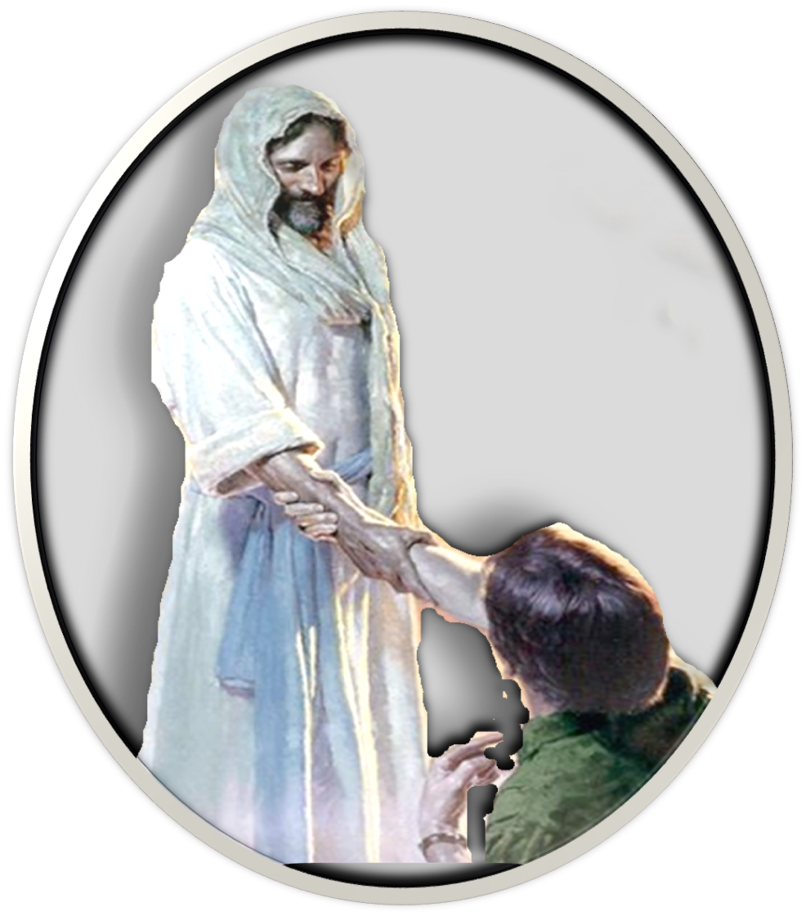
BASIS / GROUNDS
Jn 3:16; Rom. 5:8-11
PROVISION / MEANS
Rom. 1:16; 2 Tim 1:8-12
God's Universal Kindness, Love & Mercy manifested in Christ
The Gracious Gift of God’s Son & The FAITH (Gospel)
HEARING / BELIEVING
REPENTING / CONFESSING
BAPTISM / FAITHFUL
CONDITIONAL
via a SUBMISSIVE FAITH!
RECEPTION
Romans 6:3-7; 16-18

Slide 33

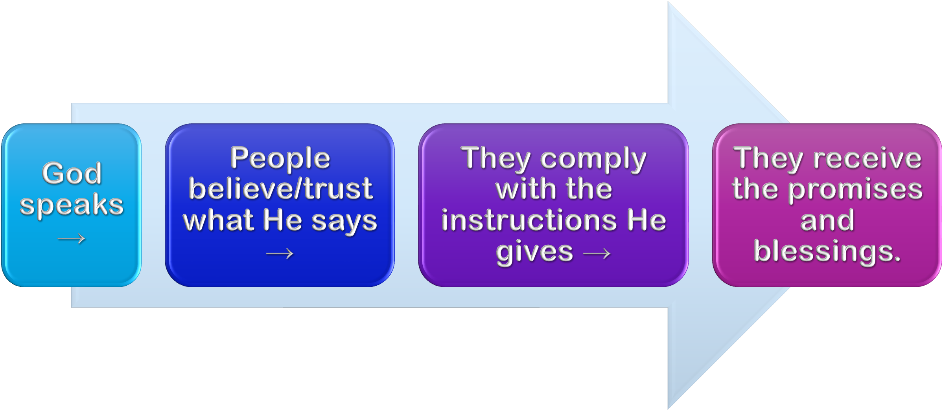
Noah (Gen. 6:8,13-17; 22; 7:5; Heb 11:7; 1 Pet 3:20,21)
Abraham (Gen 12:4; 15:6; 17:10,23; 22:3,16-18)
Israel (Ex. 12:13; 14:30; Dt 30:15-19; 1 Cor 10:1-13)
WALLS OF JERICHO (Jos 6; Heb. 11:30)
NAAMAN (2 Kings 5:1-19; Luke 4:27)
Noah (Gen. 6:8,13-17; 22; 7:5; Heb 11:7; 1 Pet 3:20,21)
Abraham (Gen 12:4; 15:6; 17:10,23; 22:3,16-18)
Israel (Ex. 12:13; 14:30; Dt 30:15-19; 1 Cor 10:1-13)
WALLS OF JERICHO (Jos 6; Heb. 11:30)
NAAMAN (2 Kings 5:1-19; Luke 4:27)

Slide 34
THE SAME PRINCIPLE IS TRUE FOR Us
(Mark 16:16; Acts 2:38; 8:12,37; Rom 6:3-6; 10:9-13; Gal. 3:26,27; Col. 2:11-13; 1 Pet 3:21; 1 Jn 1:9; Rom. 2:5-11)

Slide 35

Meeting the conditions established by God, such as faith, repentance, baptism, or “doing good,” does not, (nor can it), earn, merit, or pay for the forgiveness of our sins and the GIFT of eternal life (Luke 17:10; Eph. 2:8; Titus 3:4,5; Rom. 4:1-12; 5:8,9; 6:3-23; etc.)
The premise that “if we have to do anything at all to receive salvation we would earn salvation,” is a premise that despises the value of salvation and the value of the sacrifice of Christ (Heb. 10:26-31).

Slide 36

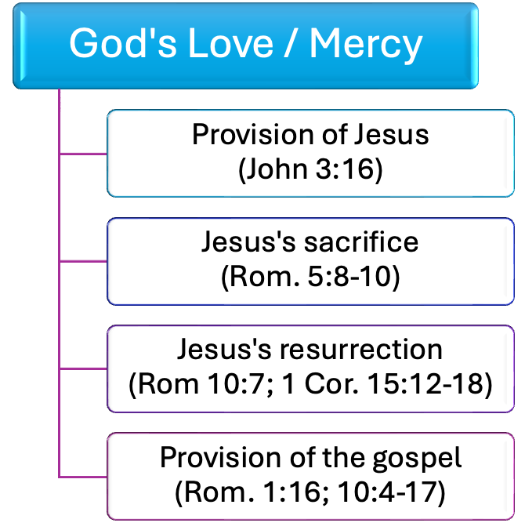
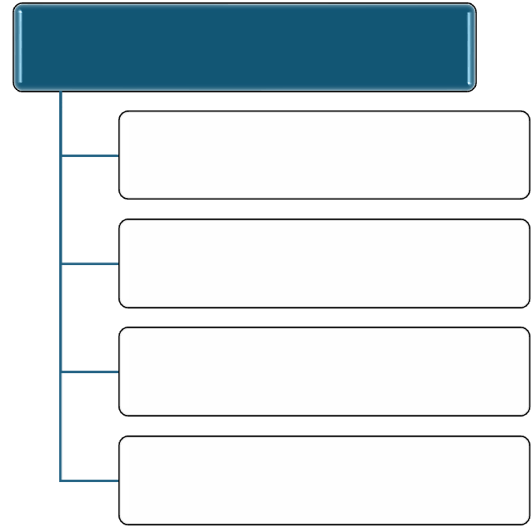
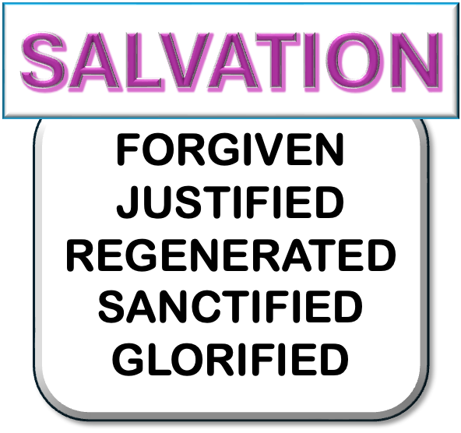
•Accept / Trust / Obey
Believe in Jesus
(John 8:24)
Confess Jesus
(Rom. 10:9,10)
Repent unto Jesus
(Acts 17:30; 26:20)
Baptism into Jesus
(Acts 2:38; Rom. 6:3-6; etc.)

Slide 37
WHO SAVES?
WHAT SAVES?
HOW ARE WE SAVED?
WHEN ARE WE SAVED?

Slide 38
HAVE YOU BEEN:
Forgiven of your sins, washed, cleansed (Acts 2:38; 22:16; Col. 2:11–12; Rom. 6:6–7, 17–18)?
United with Christ in His death, burial, and resurrection (Rom. 6:3-6; Col. 2:12; Gal. 3:27)
Regenerated / made alive / made a child of God (Rom 6:4; Col. 2:12; Gal. 3:26–27; Titus 3:5)
Added by the Holy Spirit to the body of Christ (Acts 2:38, 41, 47; 1 Corinthians 12:13)
Saved by calling on the name of the Lord (Mark 16:16; 1 Peter 3:21; Acts 22:16)

Slide 40
Acts 2:21-41; Romans 6:3-18; 10:1-17
Charts by Don McClain
Preached October 18, 2026 / Alexander church of Christ
Phone: 501-568-1062 / Email – donmcclain@sbcglobal.net
www.alexanderchurchofchrist.com

Slide 41

2 Kings 5:9–14 (NKJV)
⁹ Then Naaman went with his horses and chariot, and he stood at the door of Elisha’s house. ¹⁰ And Elisha sent a messenger to him, saying, “Go and wash in the Jordan seven times, and your flesh shall be restored to you, and you shall be clean.” ¹¹ But Naaman became furious, and went away and said, “Indeed, I said to myself, ‘He will surely come out to me, and stand and call on the name of the Lord his God, and wave his hand over the place, and heal the leprosy.’

Slide 42
2 Kings 5:9–14 (NKJV)
¹² Are not the Abanah and the Pharpar, the rivers of Damascus, better than all the waters of Israel? Could I not wash in them and be clean?” So he turned and went away in a rage. ¹³ And his servants came near and spoke to him, and said, “My father, if the prophet had told you to do something great, would you not have done it? How much more then, when he says to you, ‘Wash, and be clean’?” ¹⁴ So he went down and dipped seven times in the Jordan, according to the saying of the man of God; and his flesh was restored like the flesh of a little child, and he was clean.

