Slide 1
Partially Faithful, Yet Fully Disobedient
Judges 1:1-Judges 2:5

Slide 2
Judges in Sections
Section 1 – The Condition of Israel Under the Judges (1:1 – 3:6)
Israel fails to drive out all the inhabitants of the Promised Land (1:1-2:5)
Gives a summary of Israel under the Judges (2:6-3:6)... like an introduction
Section 2 – Israel under the Judges (3:7-16:31) = Main Body
Section 3 – Very disturbing events that demonstrated just how sinful the nation of Israel had become (17-21)

Slide 3
Judges in Sections
Two institutions solved this problem later, although Israel time and time again fell away from the Lord: 1) Prophecy – beginning with Samuel, provided individual guidance & 2) The rule of a righteous King, beginning with David, provided national guidance… later the King of Kings (Jesus) would solve this problem of sin for the world

Slide 4
Overview
The History and Prologue to Judges
Written sometime in the 11th Century (~1370 BC-1020 BC)
From the death of Joshua until Saul became the first king of Israel was approximately 350-380 year period of the Judges in Israel
Talmudic tradition, although fallible, gives credit to Samuel as the author
the book was written before David took Jerusalem (1:21; cf. 2 Samuel 5:6-9) but after Israel had a king (17:6; 18:1; 21:25)
This would fit the time of Samuel, and Samuel was a prophet of God (1 Samuel 3:19-21), so Samuel probably wrote Judges
The book of Judges picks up at the death of Joshua, as Judges 1:1 reveals
As you study through Judges there are several themes, but the one I want us all to remember comes from one specific verse:
In those days there was no king in Israel. Everyone did what was right in his own eyes. (Judges 21:25)

Slide 5
Lesson For Everyone
There was no rule of law. The result was a time of anarchy: outward oppression and inward decay (Judges 17:6; 21:25)
→ This shows the results for both individuals and nations when people simply do what they feel is right without regard for divine law… but let it be known that even in such an environment, it is 1000% possible to do what is right, because the book of Ruth contrasts a woman who is able to live righteously in the midst of an evil time

Slide 6
The 6 Cycles & Judges
Israel falls into sin and idolatry
God punishes Israel by allowing them to fall into a captivity
What is the typical response from Israel or really any of us when we are in trouble?...
We cry out, God help us!

Slide 7
The 6 Cycles & Judges
4) God hears the cry of the people, and he responds by sending someone to rescue them… remember something, it’s NEVER God who doesn’t uphold his end of the bargain (2 Tim. 2:13; 2 Thes. 3:3; Lam. 3:22-23; etc.), it’s us who fail
5) Israel is delivered from those who are oppressing them
6) Israel and peace are restored and the people serve the Lord again… happens quite often, perhaps in our own lives today. Best advice I can give yourself and myself, don’t wait until there’s a tragedy to decide you need God in your life
The Judges (12-15) – Othniel; Ehud; Shamgar; Deborah; Gideon; Abimelech (more of an oppressor); Tolah; Jair; Jephthah; Ibzan; Elon; Abdon; Samson – Eli and Samuel (1 Sam.)

Slide 8
A Decaying Cycle at Best
Idolatry → Captivity → Judge comes into the picture → Prosperity → Repeat

Slide 9
Things Started off Good
The book of Joshua is arguably the most positive book of the OT, while Judges is arguably the most negative
Joshua chronicles the successful conquest campaigns led by Joshua, the fulfillment of God’s promise to Abraham to give his descendants a land of inheritance, and the allotment of the inherited Promised Land.
Joshua begins with notes of hope and ends with notes of peace. The book of Joshua portrays God fighting for his people and his people living in covenant relationship with him

Slide 10
Things Started off Good
After Moses died, Joshua immediately stepped into the leadership role. Now, upon his death, there was no leader. What the people do now provides us with the testimony of the kind of leadership Joshua had provided. He had trained them to seek the Lord, and the first thing they do is inquire of him on how to move forward. How they asked of the Lord is not revealed and probably unimportant. The Lord responds to their inquiry, identifying Judah to lead the way against the Canaanites (Judges 1,2)
God assures them, I have handed the land over to (you). So, from the beginning, the book of Judges opens with optimism

Slide 11
Things Started off Good
(4-18) – Judah is joined by the tribe of Simeon in it’s campaigns against the Canaanites and Perizzites and they’re very successful and you almost get the feeling that God is a very vicious God…
But to change that narrative consider what scripture says:
Deuteronomy 9:4–6 & Deuteronomy 18:9-14 – The Canaanites didn’t fall out of some sort of favoritism over one people for another, they fell because it was time for them to fall due to how wicked they were! God’s judgment was and still is righteous

Slide 12
The Campaign Around Jerusalem 3-10
Judah attacked the Perizzites, who are residents of the hill country north of Jerusalem (Gen. 13:7), around Bethel and Ai. It is believed that Bezek was somewhere in this area, although its exact location is unknown, Adoni-bezek was the leader of the Perizzites. When the Israelites caught him, they cut off his thumbs and big toes. Adoni-bezek acknowledged the fairness of his fate.
Over the years, he had debilitated seventy kings by severing their thumbs and toes

Slide 13
The Campaign Around Jerusalem 3-10
After his death, Jerusalem didn’t hold out long and was taken by the sons of Judah, who captured the city, killed its inhabitants, and burned it. Next, Judah conquered Hebron, about 19 miles SW of Jerusalem, once called Kiriath-Arba.
The Book of Joshua highlights Caleb's significant involvement in this campaign. Did Caleb win this battle all on his own? No, but it’s clear that he had a major hand in the success of the conquest and doing what the Lord required

Slide 14
Debir and Other Campaigns 11-18
Located 7-8 miles SW of Hebron
Othniel emerges as the victor of the campaign. He was motivated by a romantic challenge set by Caleb, who offered his daughter's hand in marriage to anyone who could conquer the city. Caleb's younger brother, Othniel, succeeded (sets him up to become a judge later on)

Slide 15
First Signs of Trouble 19-21
The people were unable to drive out the people due to “iron chariots”
Now, my question is this? Do you really believe that God was unable to defeat iron chariots?
Joshua told the people that they could have this land and it would be given to them despite the fact that these people possessed iron chariots (Joshua 17:16-18; 21:43)

Slide 16
First Signs of Trouble 19-21
So, what happened?
The people have their eyes on the physical rather than on the all-powerful God who can conquer anything. They are looking at the iron chariots rather than looking to God who can give the victory in any circumstance. They are not trusting in the strength of the Lord. They are relying on their own strength. They are calculating that they cannot be victorious. The people are right if they are to rely only on their own strength
This is why God calls us to rely on the strength of the Lord and not our own strength (Ephesians 6:10-18)

Slide 17
Initial Success Met With Defeat 22-36
The house of Joseph experiences success using divine help from the Lord to spy out Bethel and take the city (22-26)
And here is where everything falls apart…
Going back to verse 21 and then skipping to verse 27ff., we have a repeated phrase over and over:
“did not drive out the inhabitants”

Slide 18
Initial Success Met With Defeat 22-36
As you get to verse 34 not only do you see the tribes unable to drive the people out, but they themselves are being driven back!
Instead of doing fully what the Lord said to do, the people did what was convenient
Allowed the Canaanites and others to dwell among them (27-36)
It wasn’t a matter of tribal strength, but rather a matter of convenience or possibly fear of losing more men

Slide 19
The Reality of the Situation
The author of Judges holds the the northern tribes accountable for their failure, pointing out that while Israel might have achieved military and economic dominance over the Canaanites, evidenced by forced labor, they
failed spiritually by disobeying God's command to expel the Canaanites. It wasn’t that they could not remove the enemy, but they made a deliberate choice not to. While the physical occupation of Canaan could be seen as a success, spiritually, it was a significant failure
In other words, in the standards of their own eyes… they had done enough
That is also a major issue in the book of Judges (Jer. 10:23; Isa. 55:8,9; Ps. 19; 2 Tim. 3:16,17; Proverbs 3:5,6; 14:12; 16:25)

Slide 20
They Had Ignored God’s Expectations
They knew what God had said concerning the pagan tribes in the Promised Land!
Deut. 7:1-4 – Clear the nations away from you
Numbers 33:51-56 – The remaining inhabitants would become like barbs in the eyes of the Israelites
Lev. 18:24–25 – He told them to not become like these other nations
But they failed… and the result:
Deuteronomy 4:15-31, The Lord is a consuming fire
Psalm 79:5, He is a jealous God → Delivered and sold them into the hand of their enemy. The hand of the lord was against them for evil. Opposite of Romans 8:28

Slide 21
Conclusion: 2:1-5
Therefore, the angel of the Lord comes from Gilgal (2:1), the place where the people made a covenant with God (Joshua 5:9) right after crossing the Jordan River, and makes the Lord’s declaration because of their partial faith.
There are two powerful messages God makes to the people:

Slide 22
Conclusion: 2:1-5
God says partial obedience is not obedience at all. God says, “You have not obeyed my voice” (2:2). In Judges 1:19 the text says that the people could not drive out the inhabitants
God’s perspective is that the people would not drive them out. The people would not obey
God takes our “could not” and says that we “would not”
Humans like to make excuses for why they could not obey. God looks at it and calls it what it truly is (Rom. 2:1; Prov. 24:12; Lk. 14:16-18)… we just didn’t feel like doing what He said

Slide 23
Conclusion: 2:1-5
2) God upholds his end of the deal always!
Whether it be that he punishes us because we failed, or that he rewards us because we succeeded in doing what he commanded… He is faithful (2 Tim. 2:11-13) — (Judges 2:3-10) Is a flashback for the people of Israel which shows the consequences of their incomplete conquest and disobedience, which sets the stage for the upcoming apostasy of the people
Lev. 26 & Deut. 28 makes this quite clear… God says IF you do what I say, here is the result… IF you do not do what I say, here is the result
John 15:14 & 1 John 2:4– I don’t know about you, but when it’s all said and done, I’d prefer to be called a friend of God and not an enemy

Slide 24
Invitation
Disobedience causes the forfeiting of God’s blessings. The writer of Hebrews makes that point often in his sermon (Hebrews 4:1; 6:11-12; 10:23; 10:36-39). We need full faith which will lead to a greater determination for full obedience
Either you’re all in, or you’re completely out
the pitfalls of partial obedience → The Israelites' incomplete adherence to God's commands led to spiritual compromises, a scenario that Christians are urged to avoid. Total commitment to God's will is crucial, as anything less can weaken faith

Slide 25
Invitation
Don’t get up in the cycle of sin like Israel and so many others in this world… you have the opportunity to break that cycle with Jesus:
The invitation has gone forth → The feast is prepared and ready now for everyone (Matt. 22:4,9 & Luke 14:17)
Will you, by faith, respond to the gospel call:
2 Corinthians 5:17: “Therefore, if anyone is in Christ, he is a new creation. The old has passed away; behold, the new has come”

Slide 26
A New Creation
Will you become a new creation in Christ?
A saving faith is culminated in your response to the truth, will you by faith through the hearing of the gospel:
Believe – Repent – Confess – Be baptized into Christ – Live faithfully in Christ and confess guilt to your God when you fall short?
The ball is in your court just as it was in the court of the Israelites and all those who have come after them since
Will you obey it?

Slide 27
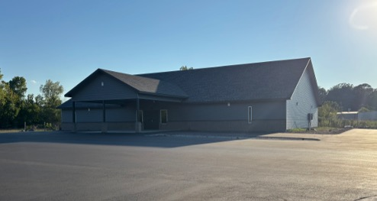

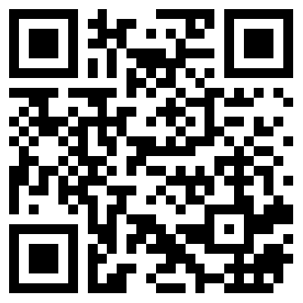
100 CORNERSTONE ALEXANDER AR, 72002
You Are Welcome At Any And All of Our Services!
Meeting Times:
Sunday A.M. Bible Study: 9:00
Sunday A.M. Assembly: 10:00
Sunday P.M. Assembly: 4:00
Wed. P.M. Bible Study: 7:00
ALEXANDERCHURCHOFCHRIST.COM

Slide 29

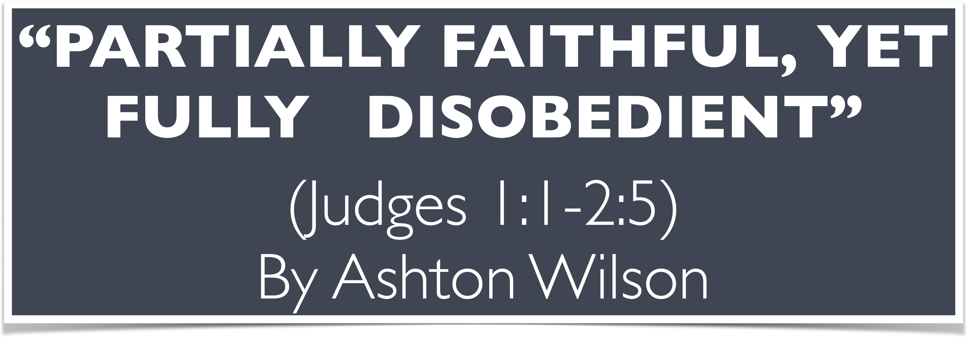
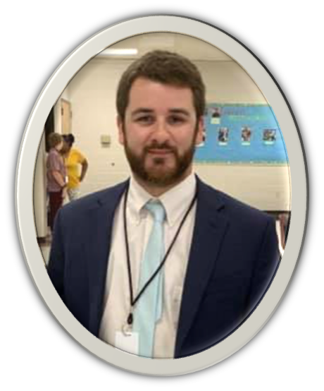
“Church of Christ MEETING @ 100 CORNERSTONE, Alexander AR. 72002”
TODAY’S LESSON
Sunday evening lesson live stream 4:00 PM ^{CDT} October 18, 2026
https://www.youtube.com/user/donmcclain11/live / WWW.ALEXANDERCHURCHOFCHRIST.COM

