Slide 1

1 Corinthians 13:4-13

Slide 2
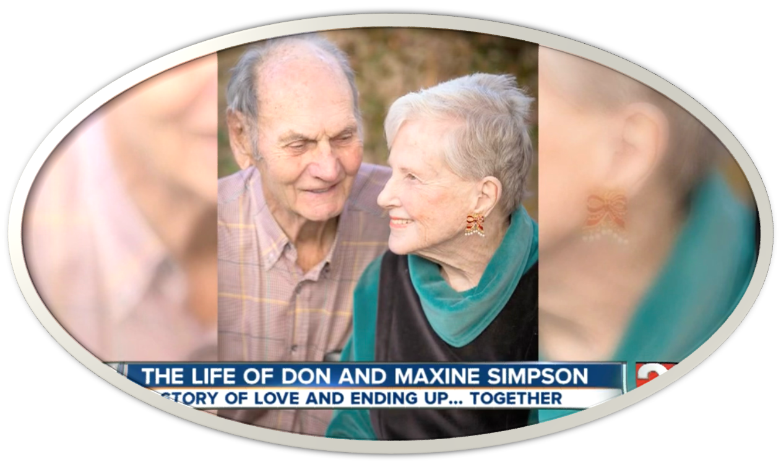
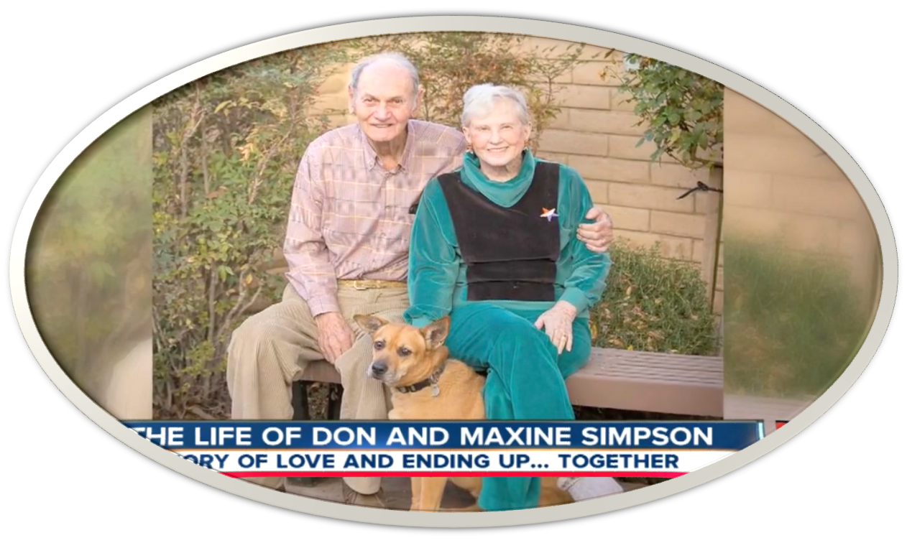
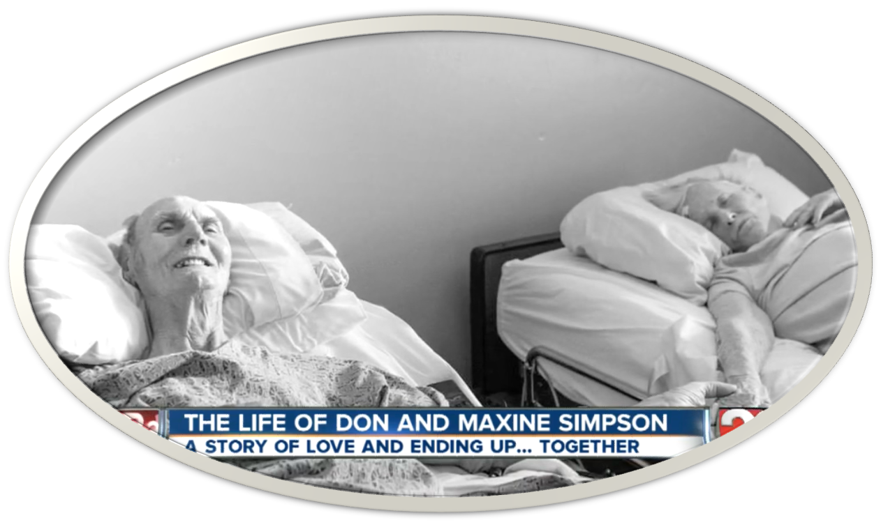
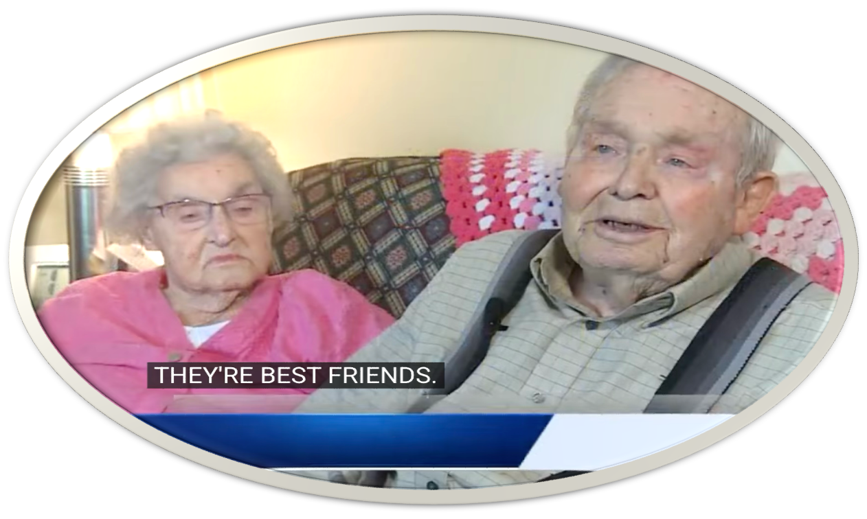
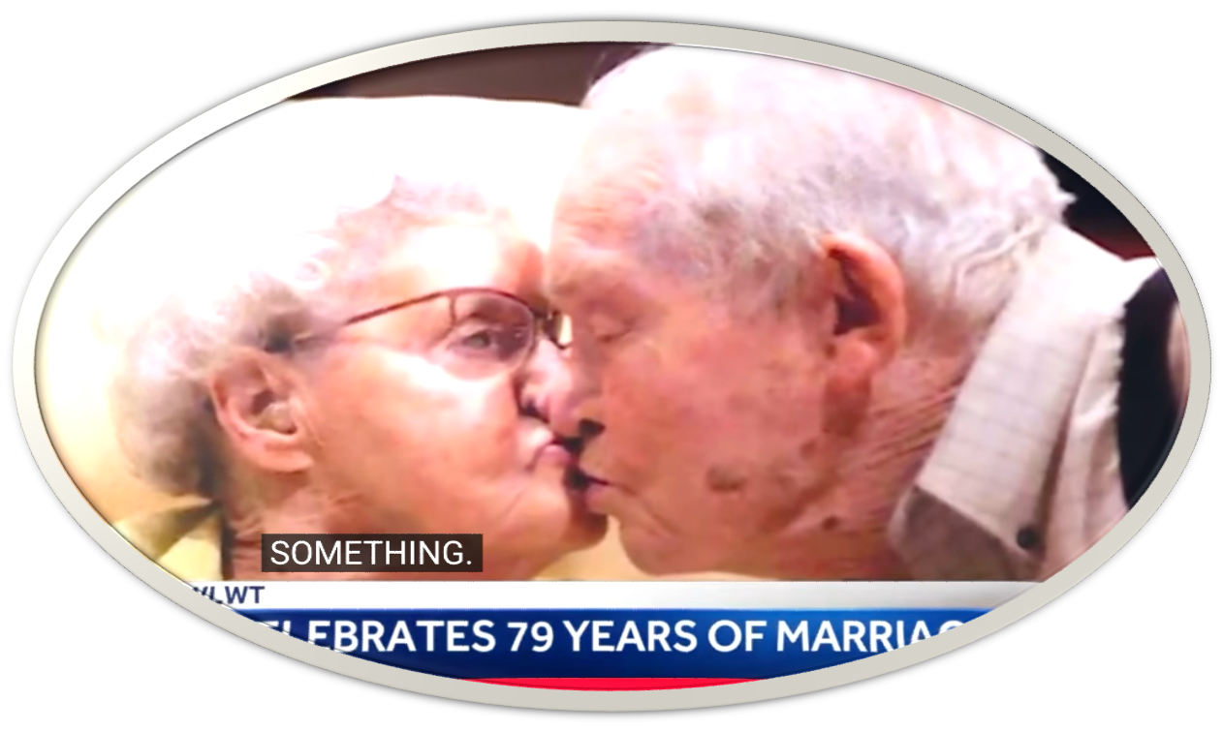
Hubert and June Malicote
100 yrs old / Married 79 yrs
Married 62 Years Die Together
Married 62 Years Die Together
Hubert and June Malicote
100 yrs old / Married 79 yrs

Slide 3

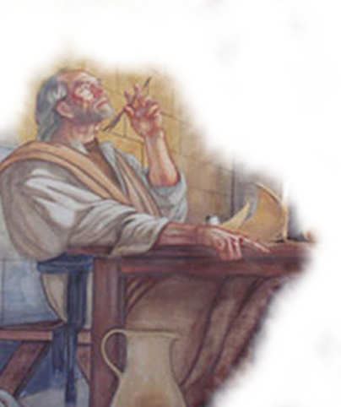

The Circumstances @ Corinth
Carnality / Selfishness & Pride
Sectarianism - 1:10-13
Worldly wisdom - 1:18-3:23
Toleration of immorality - 5:1-13
Suing one another - 6:1-11
Prideful knowledge - 8:1-10:33
Corrupted worship - 11:1-34
Carnal view of gifts - 12-14

Slide 4


Seen in the vanity of all things done without it (1 Cor 13:1-3)
Seen in its character and fruit (1 Cor 13:4-7)
Seen in its durability and greatness (1 Cor 13:8-13)

Slide 5
1 Corinthians 13:1–13 (NKJV)
¹ Though I speak with the tongues of men and of angels, but have not love, I have become sounding brass or a clanging cymbal. ² And though I have the gift of prophecy, and understand all mysteries and all knowledge, and though I have all faith, so that I could remove mountains, but have not love, I am nothing. ³ And though I bestow all my goods to feed the poor, and though I give my body to be burned, but have not love, it profits me nothing.

Slide 6
1 Corinthians 13:1–13 (NKJV)
⁴ Love suffers long and is kind; love does not envy; love does not parade itself, is not puffed up; ⁵ does not behave rudely, does not seek its own, is not provoked, thinks no evil; ⁶ does not rejoice in iniquity, but rejoices in the truth; ⁷ bears all things, believes all things, hopes all things, endures all things.

Slide 7
1 Corinthians 13:1–13 (NKJV)
⁸ Love never fails. But whether there are prophecies, they will fail; whether there are tongues, they will cease; whether there is knowledge, it will vanish away. ⁹ For we know in part and we prophesy in part. ¹⁰ But when that which is perfect has come, then that which is in part will be done away. ¹¹ When I was a child, I spoke as a child, I understood as a child, I thought as a child; but when I became a man, I put away childish things. ¹² For now we see in a mirror, dimly, but then face to face. Now I know in part, but then I shall know just as I also am known. ¹³ And now abide faith, hope, love, these three; but the greatest of these is love.

Slide 8

Greek Words For Love
Eros : Carnal, sensual, selfish - Not used in NT
Stergein : Not specifically used in NT, but ἄστοργος astorgos is (without natural affection) Rom. 1:31; 2 Tim. 3:3
Phileo : Friendly, love - More nearly represents tender affection.
Agapao : Love which seeks the highest good of others.

Slide 9

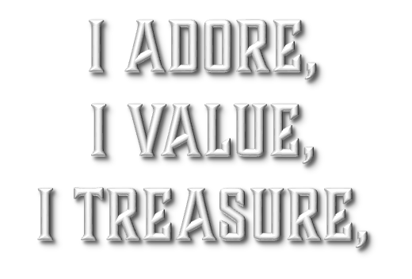
agape (ἀγάπη, 26)
25.43 ἀγαπάωª; ἀγάπηª, ης f: to have love for someone or something, based on sincere appreciation and high regard—‘to love, to regard with affection, loving concern, love.
Louw, J. P., & Nida, E. A. (1996). Greek-English lexicon of the New Testament: based on semantic domains (electronic ed. of the 2nd edition., Vol. 1, p. 292). New York: United Bible Societies.
I Adore YOU,
I Value YOU,
And I Treasure YOU

Slide 10
agape (ἀγάπη, 26)
Agapao— “Love which is awakened by a sense of value in an object which causes one to prize it . . . It is a love of esteem and approbation” (Weust).
I Adore YOU,
I Value YOU,
And I Treasure YOU

Slide 11
agape (ἀγάπη, 26)
Act of the will – not emotion (Mt. 5:43-48; Mk 12:29-31; Jn. 3:16; Luke 10:27-37)
Does NOT occur by chance / We do NOT just “fall into” agape / love (Mk 12:29-31; John 13:34; 15:12; Col 3:14; 1 Thes. 4:9-10; 1 Jn 3:23; 4:21)
The opposite of selfishness (Phili 2:1-10)
Only when I love God as I should will I be able to love others as He commands.
I Adore YOU,
I Value YOU,
And I Treasure YOU

Slide 12
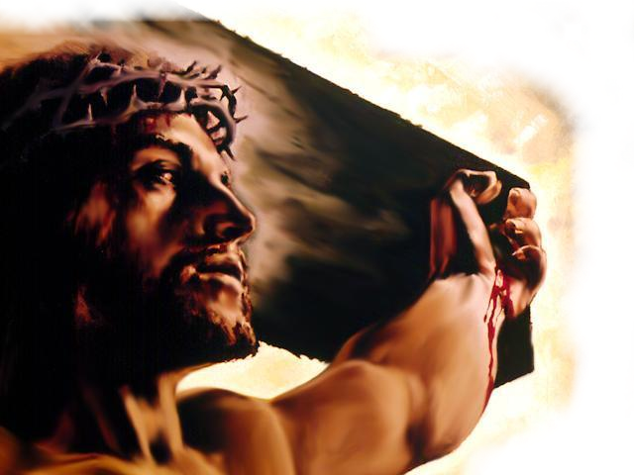
Our Perfect Example of Love
Expressed to the undeserving! (Rom. 5:8)
Not Exclusive (Mat. 5:44-48)
A Caring Love, (John 11:33-35)
Concentrated Exercise of Will
(Mark 1:40,41; 12:29-30; Mat. 22:34-40)
Does Not Overlook or Excuse sin (John 2:13-22; Mark 10:21)
I Adore YOU,
I Value YOU,
And I Treasure YOU

Slide 13
JESUS COMMANDS LOVE
Jesus’ Instructions To His Disciples (Jn 13:31-35; 15:9-12)
Followers of Christ Are To Have A Deep And Abiding Love For Each Other (Heb 13:1; 1 Peter 1:22)
A Test of Discipleship (1 John 3:10,11,14-23; 4:7,8,20-5:3)
I Adore YOU,
I Value YOU,
And I Treasure YOU

Slide 14
1 Corinthians 13:1–13 (NKJV)
¹ Though I speak with the tongues of men and of angels, but have not love, I have become sounding brass or a clanging cymbal. ² And though I have the gift of prophecy, and understand all mysteries and all knowledge, and though I have all faith, so that I could remove mountains, but have not love, I am nothing. ³ And though I bestow all my goods to feed the poor, and though I give my body to be burned, but have not love, it profits me nothing.

Slide 15
Seen in the vanity of all things done without it (1 Cor 13:1-3)
1 Corinthians 13:1–13 (NKJV)
¹ Though I speak with the tongues of men and of angels, but have not love, I have become sounding brass or a clanging cymbal. ² And though I have the gift of prophecy, and understand all mysteries and all knowledge, and though I have all faith, so that I could remove mountains, but have not love, I am nothing. ³ And though I bestow all my goods to feed the poor, and though I give my body to be burned, but have not love, it profits me nothing.

Slide 16
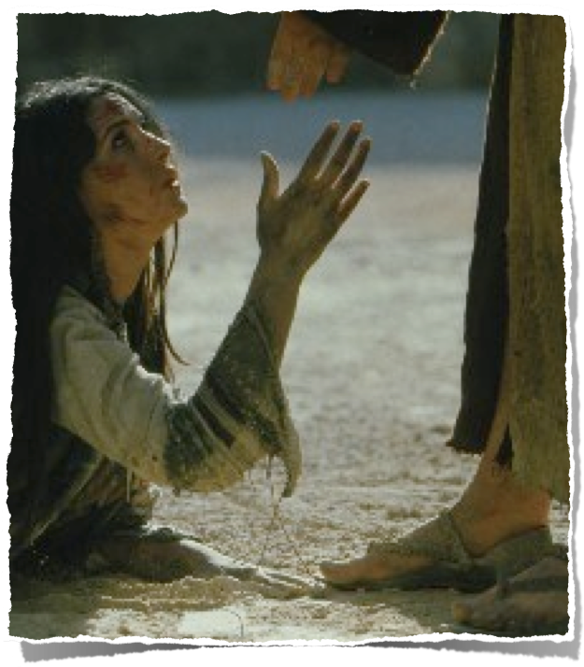
Seen in the vanity of all things done without it (1 Cor 13:1-3)
If the highest possible manifestation of tongues, prophecy, knowledge, faith, benevolence and sacrifice are rendered pointless by lovelessness, then so are all other words & deeds.
1 Corinthians 13:3 (NKJV)
³ And though I bestow all my goods to feed the poor, and though I give my body to be burned, but have not love, it profits me nothing.

Slide 17
Seen In Its Character and Fruit (1 Cor 13:4-7)
1 Corinthians 13:1–13 (NKJV)
⁴ Love suffers long and is kind; love does not envy; love does not parade itself, is not puffed up; ⁵ does not behave rudely, does not seek its own, is not provoked, thinks no evil; ⁶ does not rejoice in iniquity, but rejoices in the truth; ⁷ bears all things, believes all things, hopes all things, endures all things.

Slide 18
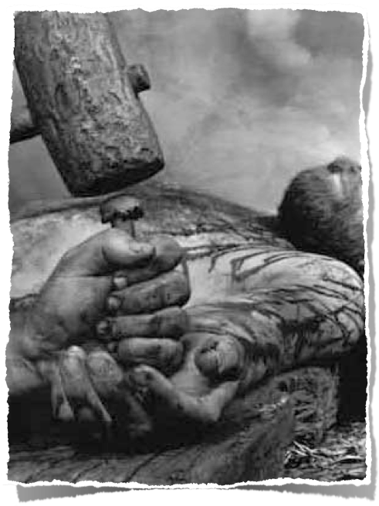
Are We Willing To Love Like Jesus Loved?
Jesus’ Instructions To His Disciples – Jn 13:31-35; 15:9-12
Followers of Christ Are To Have A Deep And Abiding Love For Each Other – Heb 13:1; 1 Peter 1:22
A Test of Discipleship – 1 John 3:10,11,14-23; 4:7,8,20-5:3

Slide 19
All Is Vanity Without LOVE (13:1-3)
“The tongues of men” –The tongues of chapters 12-14, same gift of Acts 2:6-11 and 10:46, i.e., the ability to speak in a human language, which one had never learned. (Acts 2:7) - The gift the Corinthians were exalting & emphasizing.
“And (even) of angels” - even if one could speak exhaustively in every language of both earth & heaven -
Without love - all is defiled!
1 Corinthians 13:1 (NKJV)
¹ Though I speak with the tongues of men and of angels, but have not love, I have become sounding brass or a clanging cymbal.

Slide 20
All Is Vanity Without LOVE - 13:1-3
'The characteristic of heathen worship, especially the worship of Dionysus and Cybele, was the clashing and the clanging of cymbals and the braying of trumpets. Even the coveted gift of tongues was no better than the uproar of heathen worship if love was absent.' (Barclay p. 131)
1 Corinthians 13:1 (NKJV)
¹ Though I speak with the tongues of men and of angels, but have not love, I have become sounding brass or a clanging cymbal.

Slide 21
All Is Vanity Without LOVE - 13:1-3
Prophecy, understanding, knowledge & faith were ALL important & necessary - (12:8-10; 14:1; Mat 17:20; 21:21; Col 1:9,10)
There is NO profit in any gift for those using it unless accompanied by sincere love for God and man? (Mark 12:29-31; 1 Cor 8:1)
1 Corinthians 13:2 (NKJV)
² And though I have the gift of prophecy, and understand all mysteries and all knowledge, and though I have all faith, so that I could remove mountains, but have not love, I am nothing.

Slide 22
All Is Vanity Without LOVE - 13:1-3
'Those who make sacrifices to benefit others without love, must have some hidden selfish recompense that they count upon.' (Gr. Ex. N.T. p. 898)
Charitable deeds can be self-centered (cf. Matt. 6:2),
Even the ultimate sacrifice, (cf. Dan. 3:17–18); is ultimately futile without the proper type & object of love.
1 Corinthians 13:3 (NKJV)
³ And though I bestow all my goods to feed the poor, and though I give my body to be burned, but have not love, it profits me nothing.

Slide 23
All Is Vanity Without LOVE - 13:1-3
If the highest possible manifestation of tongues, prophecy, knowledge, faith, benevolence and sacrifice are rendered pointless by lovelessness, then so are all other words & deeds.
1 Corinthians 13:3 (NKJV)
³ And though I bestow all my goods to feed the poor, and though I give my body to be burned, but have not love, it profits me nothing.

Slide 24
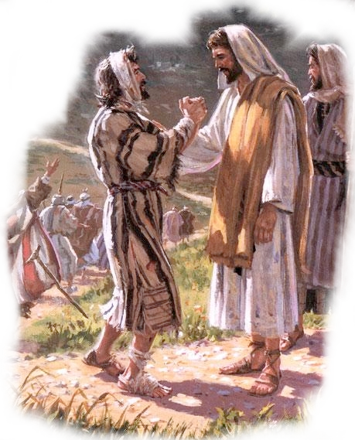
Seen In Its Character and Fruit (1 Cor 13:4-7)
“Suffers long” - Not quick to punish or retaliate wrongs incurred – associated with mercy.
“Is kind” - sympathetic sweetness of temper, compassionate, goodness, supporting, helpful, — instead of hurt.
Is not jealous, is not boastful or arrogant – but is meek and humble.
1 Corinthians 13:4 (NKJV)
⁴ Love suffers long and is kind; love does not envy; love does not parade itself, is not puffed up;

Slide 25
Seen In Its Character and Fruit (1 Cor 13:4-7)
“Does not behave rudely” — conducts itself with proper decorum – not with contempt.
“Is not selfish” — but rather a genuine concern for the well being of other people.
“Not provoked” — does NOT go around with a chip on its shoulder.
“Thinks no evil” — does not dwell on evils it has incurred (fertile soil for resentment / bitterness)
1 Corinthians 13:5 (NKJV)
⁵ does not behave rudely, does not seek its own, is not provoked, thinks no evil;

Slide 26

Seen In Its Character and Fruit (1 Cor 13:4-7)
Love does not rejoice in iniquity:
Love finds NO pleasure in hearing of the moral weakness of another, / Sin hurts the sinner & all who love them (Rom 6:23).
Love never encourages another in sin / does not tempt another to do evil / refrains from that which may lead another into evil (Rom. 1:32; 14:13-15).
1 Corinthians 13:6 (NKJV)
⁶ does not rejoice in iniquity, but rejoices in the truth;

Slide 27
Seen In Its Character and Fruit (1 Cor 13:4-7)
Love rejoices in the truth:
Love is never ashamed to speak or accept the truth. (Romans 1:16)
Love will speak the truth, in the most difficult of situations, in the best way possible (Eph. 4:15; 2 Tim. 2:2)
Love rejoices when the truth is obeyed, returned to, propagated . . .
1 Corinthians 13:6 (NKJV)
⁶ does not rejoice in iniquity, but rejoices in the truth;

Slide 28
Seen In Its Character and Fruit (1 Cor 13:4-7)
“Bears all things” : To remain steady under trial, to hold another up (Gal. 6:2; 1 Pet 4:8).
“Believes all things” : believes the best until evidence proves otherwise / Just / Honest.
“Hopes all things” : When evidence is adverse – still hopes for the best / Optimistic.
“Endures all things” - love sticks it out . . . It doesn’t quit under adverse circumstances.
1 Corinthians 13:7 (NKJV)
⁷ bears all things, believes all things, hopes all things, endures all things.

Slide 29
Seen In Its Character and Fruit (1 Cor 13:4-7)
Colossians 3:12–14 (NKJV)
¹² Therefore, as the elect of God, holy and beloved, put on tender mercies, kindness, humility, meekness, longsuffering; ¹³ bearing with one another, and forgiving one another, if anyone has a complaint against another; even as Christ forgave you, so you also must do. ¹⁴ But above all these things put on love, which is the bond of perfection.

Slide 30
Seen In Its Character and Fruit (1 Cor 13:4-7)
Galatians 5:22–26 (NKJV)
²² But the fruit of the Spirit is love, joy, peace, longsuffering, kindness, goodness, faithfulness, ²³ gentleness, self-control. Against such there is no law. ²⁴ And those who are Christ’s have crucified the flesh with its passions and desires. ²⁵ If we live in the Spirit, let us also walk in the Spirit. ²⁶ Let us not become conceited, provoking one another, envying one another.

Slide 31
Seen In Its Durability and Greatness (1 Cor 13:8-13)
1 Corinthians 13:1–13 (NKJV)
⁸ Love never fails. But whether there are prophecies, they will fail; whether there are tongues, they will cease; whether there is knowledge, it will vanish away. ⁹ For we know in part and we prophesy in part. ¹⁰ But when that which is perfect has come, then that which is in part will be done away.

Slide 32
Seen In Its Durability and Greatness (1 Cor 13:8-13)
1 Corinthians 13:1–13 (NKJV)
¹¹ When I was a child, I spoke as a child, I understood as a child, I thought as a child; but when I became a man, I put away childish things. ¹² For now we see in a mirror, dimly, but then face to face. Now I know in part, but then I shall know just as I also am known. ¹³ And now abide faith, hope, love, these three; but the greatest of these is love.

Slide 33
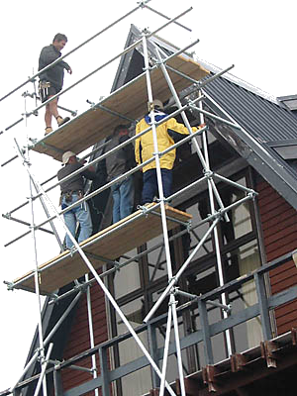
Seen In Its Durability and Greatness (1 Cor 13:8-13)
Love is the BETTER way in contrast to miraculous gifts (12:27-31)
Miraculous gifts were temporary, and would cease when they accomplished their purpose in revealing and confirming God’s revelation.
God’s word produces faith and hope (13:1-12; Rom. 10:17; Titus 1:2)
1 Corinthians 13:8 (NKJV)
⁸ Love never fails. But whether there are prophecies, they will fail; whether there are tongues, they will cease; whether there is knowledge, it will vanish away.

Slide 34
The Durability of Love - 1 Cor 13:8-13
“That which is perfect” and “that which is in part” are contrasted with each other . . .
“That which is in part” brings about “that which is perfect”

Slide 35



The Durability of Love - 1 Cor 13:8-13
Miraculous Gifts:
Fail, Cease, Vanish Away (vs. 8)
Partial knowledge (vs. 9)
Childish speaking, understanding & thinking to be put away (vs. 11)
Darkly see, know in part (vs. 12)
Will not abide (vs. 13)
God’s Word:
Not Pass Away (Mt. 24:35)
Complete knowledge (2 Tim. 3:16-17; 2 Pet. 1:3)
Provides maturity (2 Tim. 3:16-17;Heb. 5:12-6:5)
Clearly see & know fully
(Eph. 3:3-5; Rom. 16:25-26; Heb. 4:12)
Abides Forever (1 Pet. 1:23)

Slide 36




The Durability of Love - 1 Cor 13:8-13
At That Time
Our Current Time
Prophecy
Tongues
Knowledge
Immaturity
A Dim Mirror
Partial Knowledge
Fail (has)
Cease (has)
Vanish Away (has)
Can Be Mature
Can See Self As Seen
Can Know Self As Known
νυνί - nyni
Μένω - menō
Faith, Hope & Love
Romans 8:24; 2 Cor 5:7; Heb 11:1; 1 Pet 1:8

Slide 37
Seen In Its Durability and Greatness (1 Cor 13:8-13)
Faith and hope continue to depend upon that which miraculous gifts produced - God’s confirmed revelation, the scriptures.
Love, however, is supreme — it outlasts even faith and hope, and will be perfected in eternity.
1 Corinthians 13:13 (NKJV)
¹³ And now abide faith, hope, love, these three; but the greatest of these is love.

Slide 38


PLEASE EXAMINE YOUR CHARACTER, YOUR FRUIT …
envious?
boastful?
puffed up?
rude?
selfish?
easily provoked?
focussed on evil?
happy with iniquity?
Long suffering?
kind?
Joyful in the truth?
Supportive & protective of the righteous & weak?
Looking for the good?
Hopeful, optimistic?
Enduring?
UNLOVING
LOVING

Slide 39
PLEASE EXAMINE YOUR CHARACTER, YOUR FRUIT …
Are we merciful? Patiently enduring the wrongs done to us? Willing, desiring & ABLE to forgive?
Do we do good to those who do us wrong? What do we DESIRE?
Are we genuine with others? Honest? Forthright? Doing right?
Long suffering?
kind?
Joyful in the truth?
Supportive & protective of the righteous & weak?
Looking for the good?
Hopeful, optimistic?
Enduring?

Slide 40
PLEASE EXAMINE YOUR CHARACTER, YOUR FRUIT …
Long suffering?
kind?
Joyful in the truth?
Supportive & protective of the righteous & weak?
Looking for the good?
Hopeful, optimistic?
Enduring?
Do we seek to help the weak, support those who stumble so they can get back up?
Do we look for the good in others and strive to encourage them - patiently helping them?

Slide 41
PLEASE EXAMINE YOUR CHARACTER, YOUR FRUIT …
Long suffering?
kind?
Joyful in the truth?
Supportive & protective of the righteous & weak?
Looking for the good?
Hopeful, optimistic?
Enduring?
Do we think the best of others - optimistically encouraging spiritual success?
Do we refuse to give up on those who will accept our help - in spite of their frequent failures?

Slide 42

PLEASE EXAMINE YOUR CHARACTER, YOUR FRUIT …
Colossians 3:12-14 (NKJV)
¹² Therefore, as the elect of God, holy and beloved, put on tender mercies, kindness, humility, meekness, longsuffering; ¹³ bearing with one another, and forgiving one another, if anyone has a complaint against another; even as Christ forgave you, so you also must do. ¹⁴ But above all these things put on love, which is the bond of perfection.

Slide 43
PLEASE EXAMINE YOUR CHARACTER, YOUR FRUIT …
Galatians 5:22–26 (NKJV)
²² But the fruit of the Spirit is love, joy, peace, longsuffering, kindness, goodness, faithfulness, ²³ gentleness, self-control. Against such there is no law. ²⁴ And those who are Christ’s have crucified the flesh with its passions and desires. ²⁵ If we live in the Spirit, let us also walk in the Spirit. ²⁶ Let us not become conceited, provoking one another, envying one another.

Slide 44
WHAT IF WE ALL LOVED AS WE SHOULD?
How would our families be affected?
How would our community be affected?
How would this congregation be affected?
1 Corinthians 13:4-13

Slide 45
WHAT IF WE ALL LOVED AS WE SHOULD?
God loves you so much that He gave His only begotten Son for you and invites you to obey Him (John 3:16; Mark 16:16)
God asks for your love in return, (Mat. 22:34-40; 1 Jn 5:4; Jn 14:24)
Only when I love God as I should will I be able to love others as He commands.
1 Corinthians 13:4-13

Slide 47
Charts by Don McClain
Preached January 24, 2016
West 65th Street church of Christ
Preached January 11, 2026 @ Alexander church of Christ, 100 Cornerstone, Alexander AR 72002
501-568-1062
Prepared using Keynote
Email – donmcclain@sbcglobal.net
More PPT & Audio Sermons:
http://w65stchurchofchrist.org/coc/sermons/
1 Corinthians 13:4-13

