Slide 1

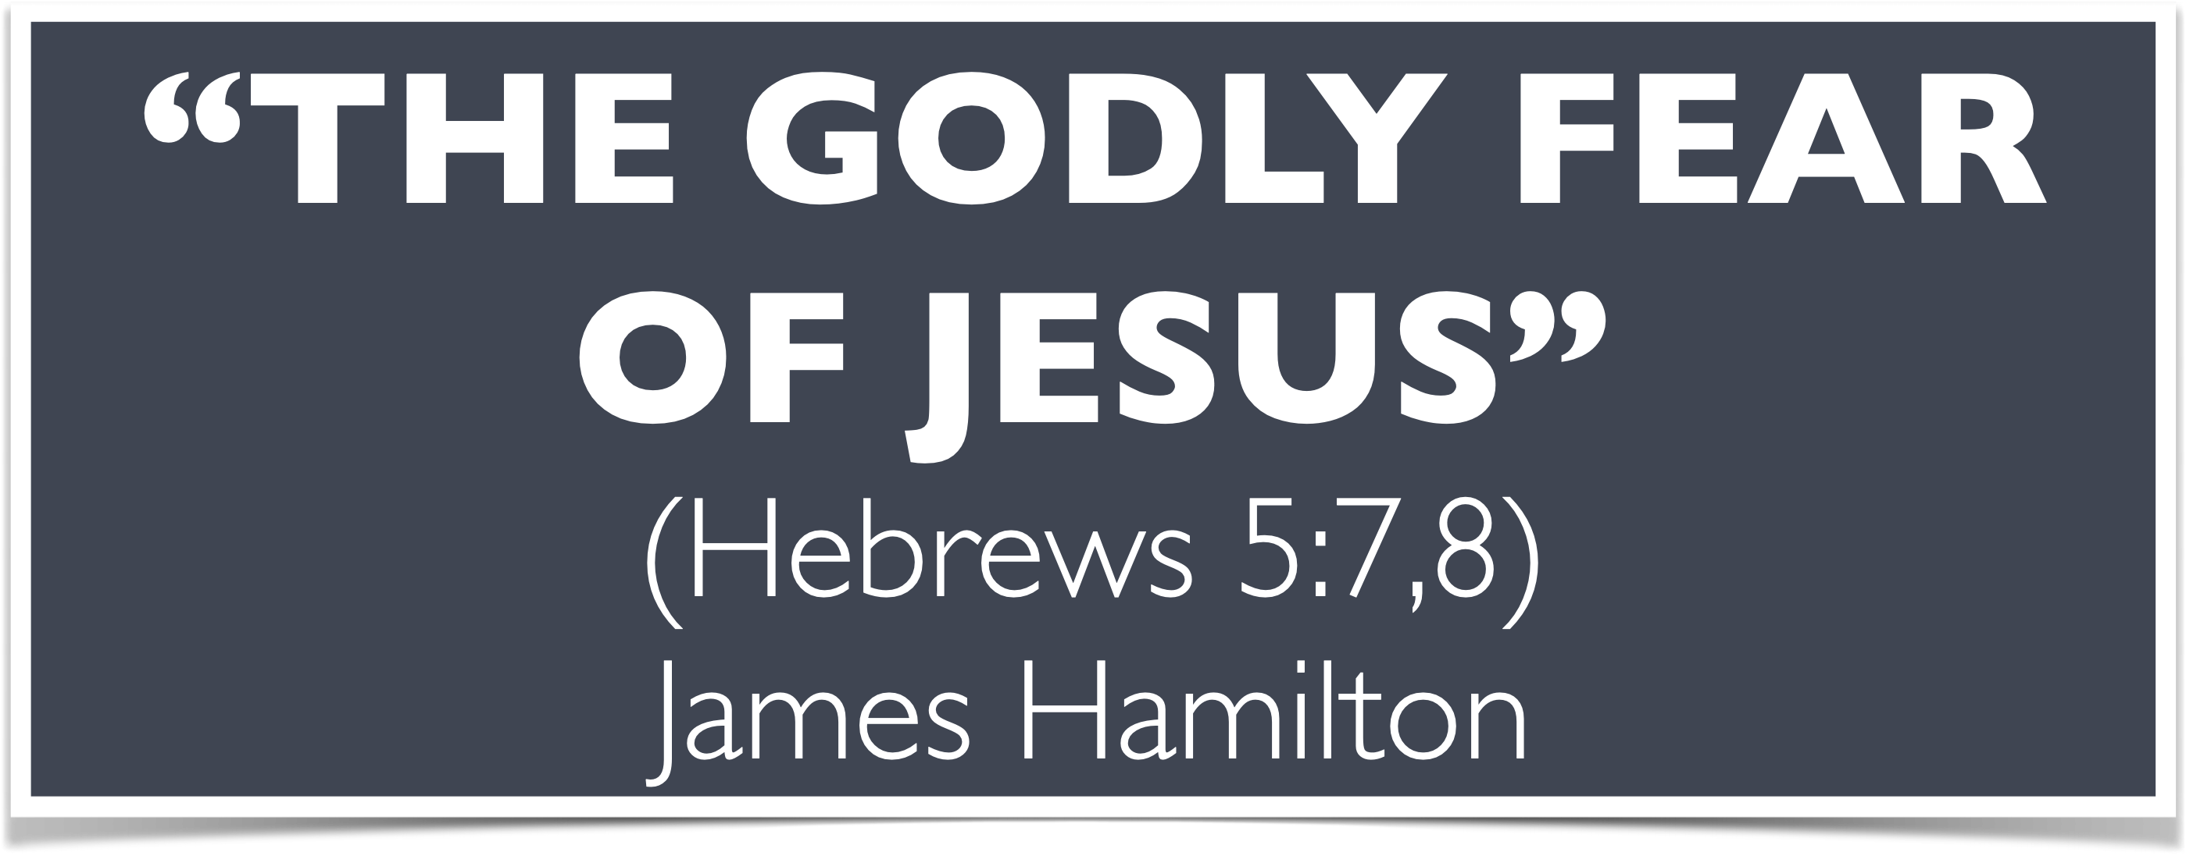

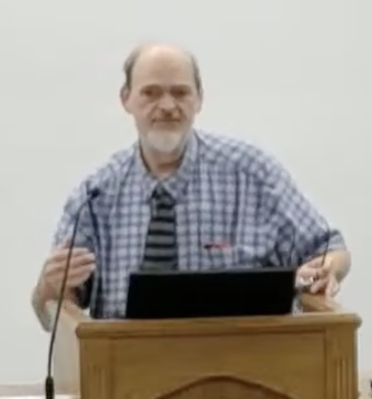
“Church of Christ MEETING @ 100 CORNERSTONE, Alexander AR. 72002”
TODAY’S LESSON
Sunday Morning Live Stream 10:00 AM ^{CT} April 12, 2026
https://www.youtube.com/user/donmcclain11/live / WWW.ALEXANDERCHURCHOFCHRIST.COM

Slide 2
THE GODLY FEAR OF JESUS
HEBREWS 5:7-9

Slide 3
Jesus Is Our Lord and Supreme Example
Hebrews 5:7-9
⁷ …in the days of His flesh, when He had offered up prayers and supplications, with vehement cries and tears to Him who was able to save Him from death, and was heard because of His godly fear ⁸ though He was Son, yet He learned obedience by the things which He suffered. ⁹ And having been perfected, He became the author of eternal salvation to all who obey Him...

Slide 4
Godly Fear
(Fear that Honors God)
Greek word group found only in Luke’s writing (if Luke wrote Paul’s sermon in Hebrews)
Adjective EULABES Luke 2:25; Acts 2:5; 8:2; 22:12
Verb EULABEOMAI Heb. 11:7
Noun EULABEIUS Heb. 5:7; 12:29

Slide 5
Ungodly Fear
(Fear that DIShonors God)
Greek word DEILEIA timidity
John 14:27 “Let not your heart be troubled, nor let it be afraid”
2 Timothy 1:7 “God has not given us a spirit of fear, but of power, love, and a sound mind”
Revelation 21:8 “The fearful…shall have their part in the lake of fire…the second death”

Slide 6
PHOBIA Fear
(Fear that May Honor OR Dishonor God)
Depends on cause and motive John 3:1; 4:1-3; 7:1-10; 7:13; 9:22; 12:42-43; 19:38; 20:19
Matthew 10:28 Do not be frightened by those who can slay the body but cannot slay the soul; but be frightened by the One that is able to destroy both soul and body in Gehenna

Slide 7
Jesus Is Our Lord and Supreme Example
Hebrews 5:7-9
⁷ …in the days of His flesh, when He had offered up prayers and supplications, with vehement cries and tears to Him who was able to save Him from death, and was heard because of His godly fear ⁸ though He was Son, yet He learned obedience by the things which He suffered. ⁹ And having been perfected, He became the author of eternal salvation to all who obey Him...

Slide 8
Serve God With Grace, Reverence and Godly Fear
Hebrews 12:28-29
²⁸ Therefore, since we are receiving a kingdom which cannot be shaken, let us have grace, by which we may serve God acceptably with reverence and godly fear. ²⁹ For our God is a consuming fire.

Slide 9
Daily Renewing the Heart with Godly Fear
Deuteronomy 13 love includes fear, obedience, service
Joshua 24:14-31 choose to fear the LORD
Proverbs 1:20-33 not choosing the fear of the LORD
Proverbs 9:7-12 the beginning of wisdom
Ecclesiastes 12:9-14 what man is to do
Isaiah 11:1-5 prophecy of Jesus’ godly fear
Hebrews 5:1-10; 12:12-29

Slide 10
“Church of Christ MEETING @ 100 CORNERSTONE, Alexander AR. 72002”
TODAY’S LESSON
Sunday Morning Live Stream 10:00 AM ^{CT} April 12, 2026
https://www.youtube.com/user/donmcclain11/live / WWW.ALEXANDERCHURCHOFCHRIST.COM

