Slide 1



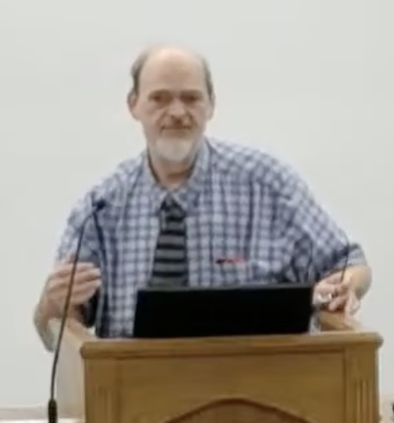
“Church of Christ MEETING @ 100 CORNERSTONE, Alexander AR. 72002”
TODAY’S LESSON
Sunday evening lesson live stream 4:00 PM ^{CDT} June 14, 2026
https://www.youtube.com/user/donmcclain11/live / WWW.ALEXANDERCHURCHOFCHRIST.COM

Slide 2
THE INFLUENCE BY THE KINGDOM OF HEAVEN ON THE WORLD
MATTHEW 11-12

Slide 3
The Gospel According To Matthew
Simple Outline
The Introduction Of The Kingdom 1-7
The Intent Of The Kingdom 8-10
The Influence By The Kingdom 11-13
Instructions For The Kingdom 14-18
Intransigence Against The Kingdom 19-25
The Ingress Of The Kingdom 26-28

Slide 4
The Introduction Of The Kingdom 1-7
Narrative 1
Introducing The King 1-4
Discourse 1
Introducing The Citizen 5-7
“And so it was, when Jesus ended these sayings…” 7:28-29

Slide 5
The Intent Of The Kingdom 8-10
Narrative 2
Signs and Sayings 8-9
Discourse 2
The Limited Commission 10
“Now it came to pass, when Jesus finished commanding His twelve disciples…” 11:1

Slide 6
The Influence By The Kingdom 11-13
Narrative 3
Overcoming the World 11-12
Discourse 3
The Parables of Jesus 13:1-52
“Now it came to pass, when Jesus had finished these parables…” 13:53

Slide 7
Instructions For The Kingdom 14-18
Narrative 4
The Training of the Twelve 13:54-17:35
Discourse 4
Fundamentals for the Faith 18
“Now it came to pass, when Jesus had finished these sayings…” 19:1-2

Slide 8
Intransigence Against The Kingdom 19-25
Narrative 5
The Jews’ Rejection of God 19-22
Discourse 5
God’s Rejection of the Jews 23-25
“Now it came to pass, when Jesus had finished all these sayings…” 26:1-2

Slide 9
The Ingress of the Kingdom 26-28
Narrative 6
The Betrayal, Trial, Death, Burial, and Resurrection of Christ 26-28
Discourse 6
We must complete the cycle by preaching the gospel to the world 28:18-20

Slide 10
Overcoming Doubt and Its Causes 11
John and/or his disciples doubted; Jesus responded (Isaiah 42) 11:1-6

Slide 11
Isaiah 42:6-7
I, the LORD, have called You in righteousness, and will hold Your hand; I will keep You and give You as a covenant to the people, as a light to the nations, to open blind q, to bring out prisoners from the prison, those who sit in darkness from the prison house.
spiritual light for spiritual blindness
spiritual darkness in spiritual prison

Slide 12
Overcoming Doubt and Its Causes 11
John and/or his disciples doubted; Jesus responded (Isaiah 42) 11:1-6
John’s disciples should have become disciples of Jesus!
Jesus confronted those who did not listen to Him or John 11:7-15
People doubted John and Jesus in spite of evidence (kingdom sought by violence)
Jesus rebuked those that did not repent after hearing the word 11:16-19
Jesus exposed their hypocrisy

Slide 13
Overcoming Doubt and Its Causes 11
Woes to three Galilean cities that did not repent 11:20-24
Warning of impenitence in contrast to those He calls to follow Him
Jesus’ prayer of thanks to the Father 11:25-27
Jesus’ meek plea to Jews weary of sin to find His rest 11:28-30
The rest that Jesus offers Hebrews 4:10
Speaking of the Sabbath Day not being God’s rest…

Slide 14
Overcoming Opposition 12
Sabbath controversies 12:1-14
Cowardly condemnation of the innocent 12:1-8
Cowardly silence concerning doing good on the Sabbath 12:9-14
They determined to kill Jesus to silence Him!
Jesus withdrew from Pharisees (Isaiah 42) 12:15-21
Jesus is the Servant of the LORD (Acts 3:26)

Slide 15
Overcoming Opposition 12
Depravity of the opposition 12:22-45
Blasphemed the Holy Spirit by calling Him Beelzebub 12:23-24,31-32
Jesus illustrated the foolishness of their accusation 12:25-30
Jesus rebuked their hard hearts 12:31-45
They audaciously asked for another sign after rejecting His sign!
Rejecting Jesus after His resurrection is inexcusable

Slide 16
Overcoming Opposition 12
Jesus identified His spiritual family that will inherit the Kingdom 12:46-50
He invites you to do God’s will and become part of His family Luke 15; Romans 8:29
Hear Matt. 13:9
Learn Matt. 11:28-29; 8:10-12
Repent Matt. 4:17
Confess Christ To Others Matt. 10:32-33
Be Baptized Matt. 28:18-20
Grow Matt. 28:19-20
*Pray for Forgiveness “this day” Matt. 6:9-15

Slide 17
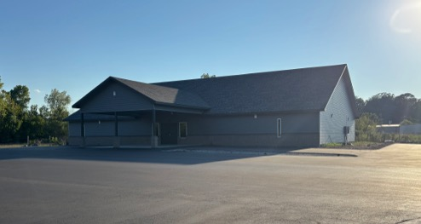

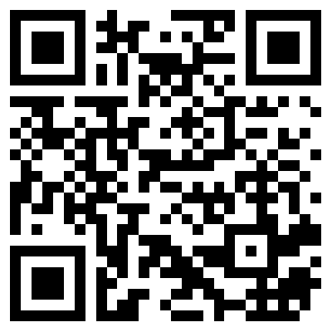
100 CORNERSTONE ALEXANDER AR, 72002
You Are Welcome At Any And All of Our Services!
Meeting Times:
Sunday A.M. Bible Study: 9:00
Sunday A.M. Assembly: 10:00
Sunday P.M. Assembly: 4:00
Wed. P.M. Bible Study: 7:00
ALEXANDERCHURCHOFCHRIST.COM

