Slide 1


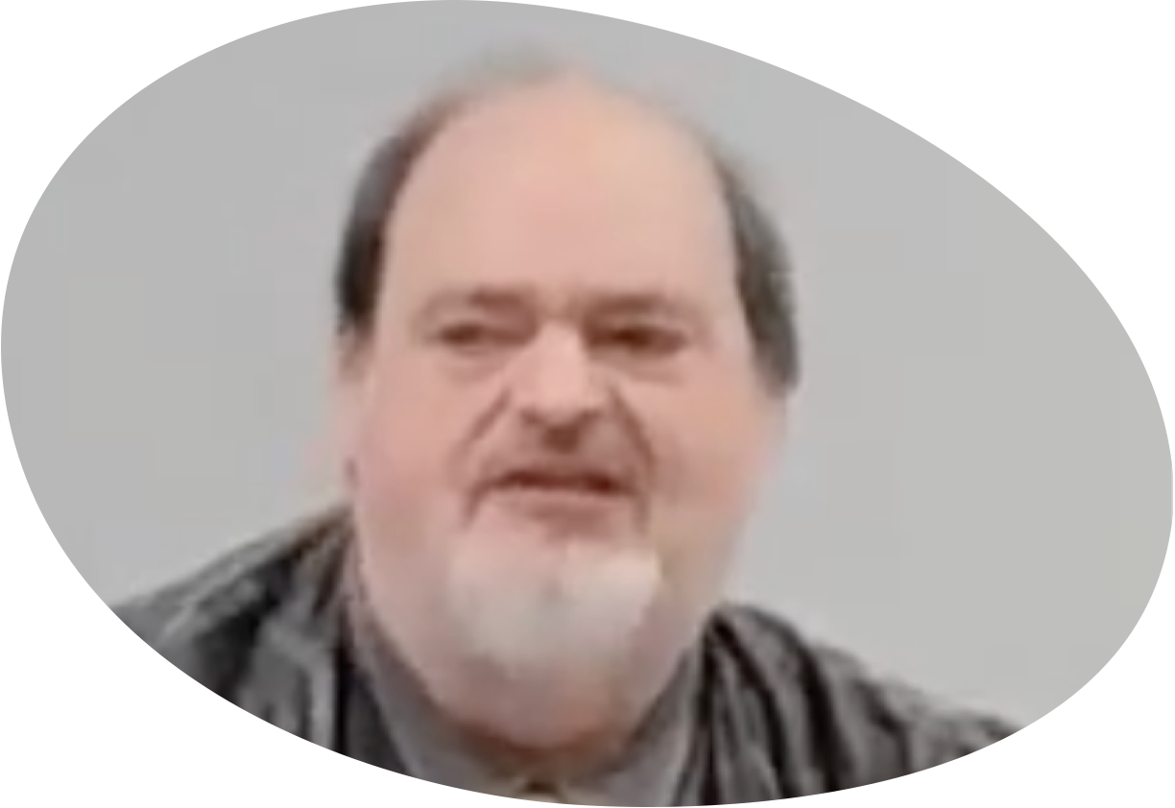
“Church of Christ MEETING @ 100 CORNERSTONE, Alexander AR. 72002”
TODAY’S LESSON
Sunday evening lesson live stream 4:00 PM ^{CDT} February 22, 2026
https://www.youtube.com/user/donmcclain11/live / WWW.ALEXANDERCHURCHOFCHRIST.COM

Slide 2
THE SIMPLICITY OF THE GOSPEL OF CHRIST
2 CORINTHIANS 1:12-14

Slide 3
Colossians 4:2-6
² Continue earnestly in prayer, being vigilant in it with thanksgiving; ³ meanwhile praying also for us, that God would open to us a door for the word, to speak the mystery of Christ, for which I am also in chains, ⁴ that I may make it manifest, as I ought to speak.

Slide 4
Colossians 4:2-6
² Continue earnestly in prayer, being vigilant in it with thanksgiving; ³ meanwhile praying also for us, that God would open to us a door for the word, to speak the mystery of Christ, for which I am also in chains, ⁴ that I may make it manifest, as I ought to speak.
5 Walk in wisdom toward those outside, redeeming the time. 6 Let your speech always be with grace, seasoned with salt, that you may know how you ought to answer each one.

Slide 5
Colossians 4:2-6
Three Steps of Evangelism
In Scriptural Order
Pray earnestly! Acts 6:4 priority of prayer
Live wisely! 1 Corinthians 13:13; 1 Peter 3:15
Speak wisely! 1 Peter 3:15; Ephesians 4:15

Slide 6
Pray for Evangelism
Pray for boldness Acts 4:23-31
Pray for wisdom James 1:5
Pray for workers Matthew 9:37-38
Pray for opportunities 2 Thessalonians 3:1
Pray for deliverance from wicked men 2 Thess. 3:2
Pray for the lost Romans 10:1

Slide 7
Walk In Wisdom for Evangelism
We are saved to be conformed to the image of Christ Romans 8:29
Reflect His glory 2 Cor. 3:18
Don’t give the enemy any ammunition Titus 2:8
The apostles worked signs to direct people to the word of Christ Acts 3; 1 Corinthians 13:8-13
Today (and then) we live by faith, hope (1 Peter 3:15), and love Acts 2:46-47

Slide 8
Speak With Grace for Evangelism
We are messengers, servants 1 Cor. 3:6-7
Don’t put self in the way; put faith in the word
Win a soul, not an argument 2 Timothy 2:24-26
Jesus let others talk as much as He did John 4
Listen, show love, and keep it simple 2 Cor. 1:12-14

Slide 9
1 Corinthians 15:1-6a
¹ Moreover, brethren, I declare to you the gospel which I preached to you, which also you received and in which you stand, ² by which also you are saved, if you hold fast that word which I preached to you—unless you believed in vain.
³ For I delivered to you first of all that which I also received: that Christ died for our sins according to the Scriptures, ⁴ and that He was buried, and that He rose again the third day according to the Scriptures, ⁵ and that He was seen by Cephas, then by the twelve. ⁶ After that He was seen by over five hundred brethren at once,

Slide 10
Jesus Is Lord
Essential facts of the gospel of Christ by which we are saved 1 Corinthians 15:1-6a
The gospel is the power that came when the Holy Spirit fell on the apostles Romans 1:16; Acts 1:8; 2:1-4
The main message is that Jesus is LORD! World history is changed forever Ac. 2:14-36; John 12:31; Hebrews 5:8-9
Jesus has ALL authority Matthew 28:18
All false doctrines and philosophies of men deny the absolute authority of Jesus Christ

Slide 11
Jesus Has All Authority
Jesus defined the greatest faith He witnessed was a centurion’s understanding that the authority of Christ is within the word of Christ Matthew 8:5-13

Slide 12
Matthew 8:5-13
⁵ Now when Jesus had entered Capernaum, a centurion came to Him, pleading with Him, ⁶ saying, “Lord, my servant is lying at home paralyzed, dreadfully tormented.”
⁷ And Jesus said to him, “I will come and heal him.”
⁸ The centurion answered and said, “Lord, I am not worthy that You should come under my roof. But only speak a word, and my servant will be healed. ⁹ For I also am a man under authority, having soldiers under me. And I say to this one, ‘Go,’ and he goes; and to another, ‘Come,’ and he comes; and to my servant, ‘Do this,’ and he does it.”

Slide 13
Jesus Has All Authority
Jesus defined the greatest faith He witnessed was a centurion’s understanding that the authority of Christ is within the word of Christ Matthew 8:5-13
The Word of Christ is no more and no less than the New Testament scriptures John 16:12-13; 1 Cor. 2:13; 14:37; Ephesians 3:3-5; 2 Peter 1:12-15

Slide 14
John 16:12-13
¹² “I still have many things to say to you, but you cannot bear them now. ¹³ However, when He, the Spirit of truth, has come, He will guide you into all truth; for He will not speak on His own authority, but whatever He hears He will speak; and He will tell you things to come.”

Slide 15
1 Corinthians 2:13; 14:37; Ephesians 3:3-5
¹³ These things we also speak, not in words which man’s wisdom teaches but which the Holy Spirit teaches, comparing spiritual things with spiritual.
³⁷ If anyone thinks himself to be a prophet or spiritual, let him acknowledge that the things which I write to you are the commandments of the Lord.
³…by revelation He made known to me the mystery (as I have briefly written already, ⁴ by which, when you read, you may understand my knowledge in the mystery of Christ), ⁵ which in other ages was not made known to the sons of men, as it has now been revealed by the Spirit to His holy apostles and prophets

Slide 16
Jesus Is The Author of Eternal Salvation to All That Obey Him
Hebrews 5:8-9; Matt. 28:18 all authority
Preach the gospel to everyone Matt. 28:19; Mark 16:15; Luke 24:47
Teaching → (faith) → baptism → disciples → more teaching
Believe → baptized → saved Mark 16:16
Preach → Repentance → remission of sins in name of Christ Lk 24:47; Acts 2:38; Rom. 10:9

Slide 17
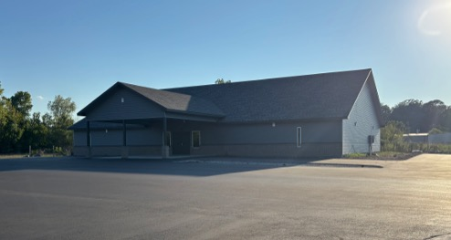

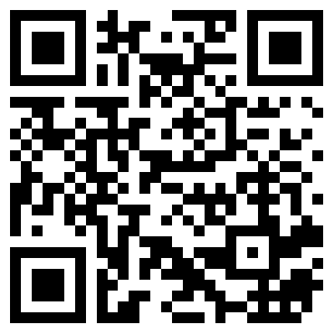
100 CORNERSTONE ALEXANDER AR, 72002
You Are Welcome At Any And All of Our Services!
Meeting Times:
Sunday A.M. Bible Study: 9:00
Sunday A.M. Assembly: 10:00
Sunday P.M. Assembly: 4:00
Wed. P.M. Bible Study: 7:00
ALEXANDERCHURCHOFCHRIST.COM

Slide 18
“Church of Christ MEETING @ 100 CORNERSTONE, Alexander AR. 72002”
TODAY’S LESSON
Sunday evening lesson live stream 4:00 PM ^{CDT} February 22, 2026
https://www.youtube.com/user/donmcclain11/live / WWW.ALEXANDERCHURCHOFCHRIST.COM

