Slide 1




1 Timothy 1:12–17
Psalm 51:1–17

Slide 2

The REALITY of The Sinners Guilt Before God
For all have sinned … Romans 3:23
There is not a just man on earth who does good And does not sin. Ecclesiastes 7:20
The Scripture has confined all under sin, that the promise by faith in Jesus Christ might be given to those who believe. Galatians 3:22
If we say that we have no sin, we deceive ourselves, and the truth is not in us. 1 John 1:8

Slide 3
The REALITY of The Sinners Guilt Before God
Objective guilt: represents the state of having violated God’s Law and being liable to punishment. (we may, or may not feel guilty)
Subjective guilt: the uncomfortable FEELING of regret, remorse, shame, and self-condemnation as a result of thinking we have done or thought something wrong, resulting in discouragement, anxiety, fear of punishment or rejection, and a sense of isolation.

Slide 4
The REALITY of The Sinners Guilt Before God
Guilt is not merely a subjective feeling; it is an objective condition. It is the legal and moral liability that rests upon every person who has violated God’s holy law.
Human courts may fail to convict, and conscience may be seared, but the divine verdict stands.

Slide 5
The REALITY of The Sinners Guilt Before God
God’s holiness and justice make guilt an objective reality that cannot be erased by time, self-esteem, or human rationalization.
The value of this reality is that it tells the truth.

Slide 6
Both Spiritual & Earthly Consequences of Sin
Violating just one of God’s laws makes us guilty before God (Jam 2:10; Gal 3:10; Rom 3:19)
The Bible tells us that all sin separates us from God (Isa. 59:1-2).
The Bible also tells us that if we believe in, and by faith obey Jesus, we will be forgiven of our sins (John 8:24; Acts 2:38; 22:16; 1 John 1:8-10)
Even when one’s sins are forgiven there are still earthly consequences (2 Sam 12:13; Ps 51:3)

Slide 7
Both Spiritual & Earthly Consequences of Sin
While God and man may forgive us, forgiving ourselves may be much more difficult.
David wrote, "For I acknowledge my transgressions, And my sin is always before me" (Ps. 51:3).
While God forgave David (2 Sam. 12:13), his sin continued to follow him.
Paul is another great example of how our guilty past can positively effect us today & moving forward (1 Ti 1:12-17)

Slide 8
1 Timothy 1:12–17 (NKJV)
¹² And I thank Christ Jesus our Lord who has enabled me, because He counted me faithful, putting me into the ministry, ¹³ although I was formerly a blasphemer, a persecutor, and an insolent man; but I obtained mercy because I did it ignorantly in unbelief. ¹⁴ And the grace of our Lord was exceedingly abundant, with faith and love which are in Christ Jesus.

Slide 9
1 Timothy 1:12–17 (NKJV)
¹⁵ This is a faithful saying and worthy of all acceptance, that Christ Jesus came into the world to save sinners, of whom I am chief. ¹⁶ However, for this reason I obtained mercy, that in me first Jesus Christ might show all longsuffering, as a pattern to those who are going to believe on Him for everlasting life. ¹⁷ Now to the King eternal, immortal, invisible, to God who alone is wise, be honor and glory forever and ever. Amen.

Slide 10

Destructive ResponseS To Guilt …
Denial of Guilt:
Defy Guilt Until it Goes Away
(Dr Wayne W. Dyer - Erroneous Zone, 90-91)
“Do something which you know is bound to result in feelings of guilt….Take a week to be alone if you have always wanted to do so, despite the guilt-engendering protestation from other members of your family. These kinds of behavior will help you to tackle that…guilt.”

Slide 11
Destructive ResponseS To Guilt …
Denial of Guilt:
Defy Guilt Until it Goes Away
“Hardened by the deceitfulness of sin” (Hebrews 3:13)
leads to the “searing of the conscience”
(I Tim 4:2).
Those who suppress the truth in their conscience will be given over to their desires.
(Rom 1:18-20).

Slide 12
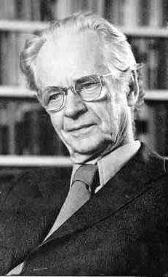
Destructive ResponseS To Guilt …
Denial of Guilt:
Redefine sin as not being sin …
B.F. Skinner (Harvard professor, founder of behaviorist psychology)
- “Guilt is a myth because man is simply a product of evolution—controlled exclusively by his environment.”
B.F. Skinner

Slide 13
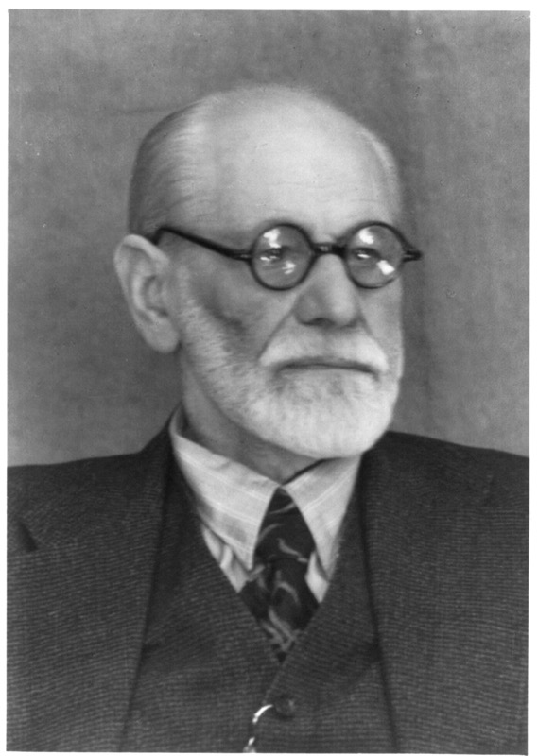
Destructive ResponseS To Guilt …
Denial of Guilt:
By Blaming Others …
Freud believed that all guilt came from authoritarian sources, i.e. religion, parents, government, etc.
Adam & Eve – Gen. 3:12,13
King Saul – 1 Sam 15:15,20,21
Ahab – 1 Kings 18:17,18
Sigmund Freud

Slide 14
Destructive ResponseS To Guilt …
Remove the reality of sin, personal guilt and the human conscience & You remove the FELT need for a Savior, for repentance and redemption.

Slide 15
Psalm 51:1–17 (NKJV)
¹ Have mercy upon me, O God, According to Your lovingkindness; According to the multitude of Your tender mercies, Blot out my transgressions. ² Wash me thoroughly from my iniquity, And cleanse me from my sin. ³ For I acknowledge my transgressions, And my sin is always before me. ⁴ Against You, You only, have I sinned, And done this evil in Your sight— That You may be found just when You speak, And blameless when You judge. ⁵ Behold, I was brought forth in iniquity, And in sin my mother conceived me.

Slide 16
Psalm 51:1–17 (NKJV)
⁶ Behold, You desire truth in the inward parts, And in the hidden part You will make me to know wisdom. ⁷ Purge me with hyssop, and I shall be clean; Wash me, and I shall be whiter than snow. ⁸ Make me hear joy and gladness, That the bones You have broken may rejoice. ⁹ Hide Your face from my sins, And blot out all my iniquities. ¹⁰ Create in me a clean heart, O God, And renew a steadfast spirit within me. ¹¹ Do not cast me away from Your presence, And do not take Your Holy Spirit from me.

Slide 17
Psalm 51:1–17 (NKJV)
¹² Restore to me the joy of Your salvation, And uphold me by Your generous Spirit. ¹³ Then I will teach transgressors Your ways, And sinners shall be converted to You. ¹⁴ Deliver me from the guilt of bloodshed, O God, The God of my salvation, And my tongue shall sing aloud of Your righteousness. ¹⁵ O Lord, open my lips, And my mouth shall show forth Your praise. ¹⁶ For You do not desire sacrifice, or else I would give it; You do not delight in burnt offering. ¹⁷ The sacrifices of God are a broken spirit, A broken and a contrite heart— These, O God, You will not despise.

Slide 18
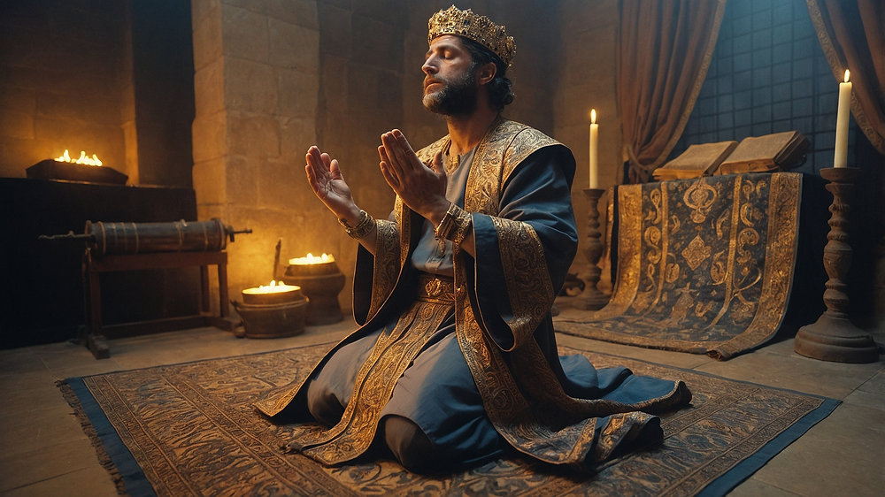
The Correct Response To Our Guilt …
Acknowledgment -
Acknowledge our TOTAL dependance upon the mercy of God (Ps 51:1-3)
Acknowledge our guilt - take responsibility & REPENT (Ps 51:4-6)
Acknowledge our NEED for God’s forgiveness, cleansing, & renewal (Ps. 51:7-17; Eze 18:21-32; Lk 13:3; Acts 17:30)
Psalm 51:1–17

Slide 19
The Correct Response To Our Guilt …
Complete Devotion -
God will not accept the “double minded” (James 1:8; Mat 6:24)
Our guilt SHOULD motivate us to whole hearted devotion as God demands? (Matt 16:24–25; Gal 2:20; 5:24; Phili 3:7-11)
ANY area of our life not completely devoted to God leaves an avenue for Satan to attack! (Eph 4:27; 1 Pet 5:8–9)
Psalm 51:1–17

Slide 20
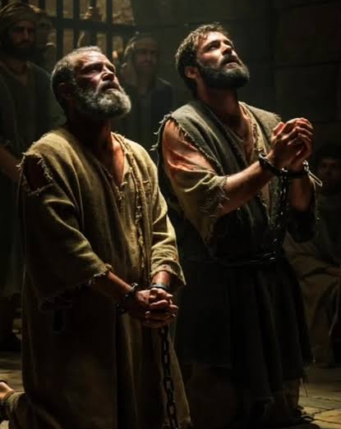
The Correct Response To Our Guilt …
Fruit of Repentance -
Part of repentance includes restitution (Luke 3:8–14; 19:8; Matt 5:23–24).
Restitution is not always possible, but godly sorrow & a devoted life is (Acts 19:18–19; 26:20; Eph 4:28).
If we make godly changes in our lives, others can't help but see it (Matt. 5:13-16; 2 Cor 7:9–11; 1 Pet. 4:3-5; Eph. 2:1-10)

Slide 21
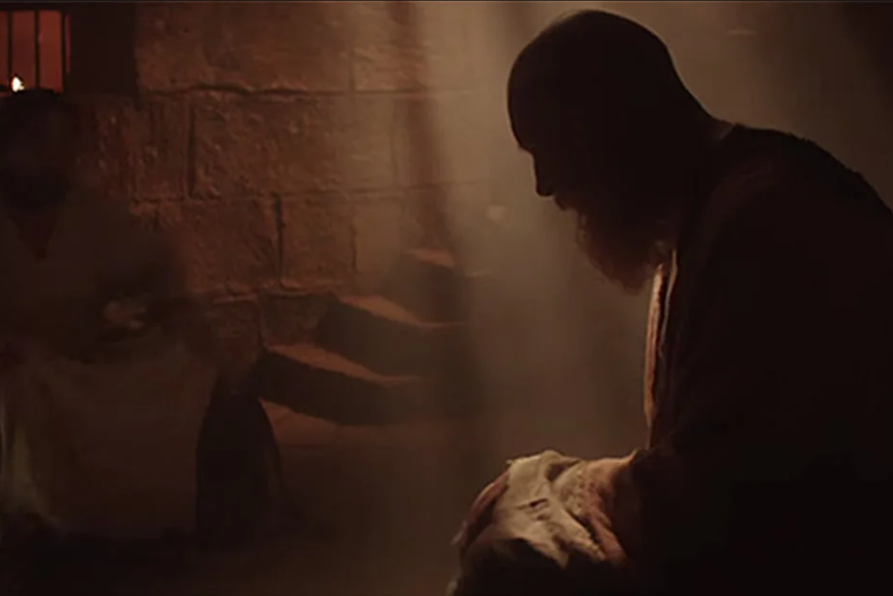
The Correct Response To Our Guilt …
Accept God’s Forgiveness -
Forgiving ourselves is NOT EASY! Even if we don't feel forgiven, we can know we are (1 Jn. 3:20-21).
Paul never forgot his sin (1 Tim. 1:13), yet his hope was firm because he TRUSTED God’s forgiveness (2 Tim. 4:8)
When we obey the gospel by faith - we are FORGIVEN! (Mark 16:16; Acts 2:38; 22:16; 1 John 1:9,10)

Slide 22
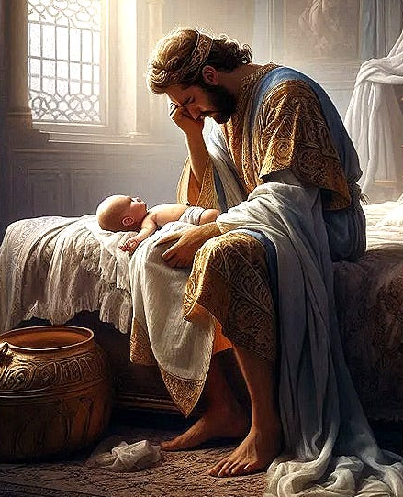
The Correct Response To Our Guilt …
Accept Consequences -
The consequence of David’s sin: “…the sword shall never depart from your house … ” (2 Sam 12:10), even after David said, "I have sinned against the Lord" (2 Sam. 12:13).
Nathan also told David that the son of Bathsheba would die (2 Sam 12:14,15; 15-23)

Slide 23

The Correct Response To Our Guilt …
Accept Consequences -
In days & years to follow David witnessed:
the death of the child of his sin,
the rape of Tamar by Amnon,
the murder of Amnon by Absalom,
the usurpation of his throne by Absalom,
and the death of Absalom.

Slide 24
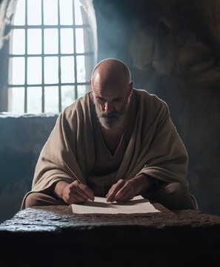
The Correct Response To Our Guilt …
Accept Consequences -
Paul was told he would suffer much for the “name of Jesus” (Acts 9:16)
Paul speaks of these sufferings in 2 Cor 11:23-27.
Paul pleaded with God to remove his thorn in the flesh, but the Lord’s response was, “my grace is sufficient for you.” (2 Cor 12:7-10).

Slide 25

The Correct Response To Our Guilt …
Use Guilt Positively -
Guilt can motivate us to live humbly toward God and those we have sinned against (Matt 5:3; James. 4:8-10).
Guilt should help us to be merciful towards those who have sinned against us (Matt 6:14,15; Mark 11:25–26; Col. 3:12–13)

Slide 26
The Correct Response To Our Guilt …
Use Guilt Positively -
Should keep us from further sin by reminding us of the pain we've caused God, others, and ourselves. (1 Cor 15:10; 1 Tim 1:14-17; Col. 3:5; Rom 6:3-22)
Should motivate us to give ourselves wholly to God’s service (1 Cor 15:10)

Slide 27
The Correct Response To Our Guilt …
Use Guilt Positively -
1 Corinthians 15:10 (NKJV)
¹⁰ But by the grace of God I am what I am, and His grace toward me was not in vain; but I labored more abundantly than they all, yet not I, but the grace of God which was with me.

Slide 28
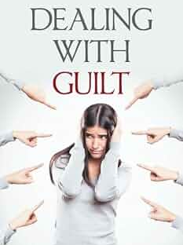
The Correct Response To Our Guilt …
Acknowledge Guilt!
Complete Devotion To God!
Bear Fruit of Repentance!
Accept God’s Forgiveness!
Accept Consequences!
Use Guilt Positively!

Slide 29
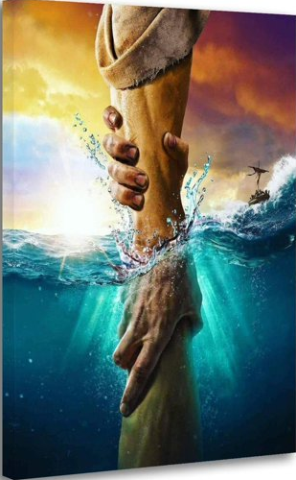
The Correct Response To Our Guilt …
Obey the gospel
(Acts 2:38; 22:16; Col 2:12,13)
Repent, confess & pray
(Acts 8:22; 1 Jn 1:9,10)
LIVE your life FULLY for JESUS
(Matt. 16:24-26; Gal. 2:19–21)

Slide 30



100 CORNERSTONE ALEXANDER AR, 72002
You Are Welcome At Any And All of Our Services!
Meeting Times:
Sunday A.M. Bible Study: 9:00
Sunday A.M. Assembly: 10:00
Sunday P.M. Assembly: 4:00
Wed. P.M. Bible Study: 7:00
ALEXANDERCHURCHOFCHRIST.COM

Slide 32
Charts by Don McClain
Preached November 29, 2011 West 65th Street church of Christ
Preached August 23, 2026 Alexander church of Christ
/ 501-568-1062
Email – donmcclain@sbcglobal.net
www.alexanderchurchofchrist.com
1 Timothy 1:12–17
Psalm 51:1–17

Slide 33
Psalm 51:1–13 (NKJV)
¹ Have mercy upon me, O God, According to Your lovingkindness; According to the multitude of Your tender mercies, Blot out my transgressions. ² Wash me thoroughly from my iniquity, And cleanse me from my sin. ³ For I acknowledge my transgressions, And my sin is always before me. ⁴ Against You, You only, have I sinned, And done this evil in Your sight— That You may be found just when You speak, And blameless when You judge. ⁵ Behold, I was brought forth in iniquity, And in sin my mother conceived me. ⁶ Behold, You desire truth in the inward parts, And in the hidden part You will make me to know wisdom. ⁷ Purge me with hyssop, and I shall be clean; Wash me, and I shall be whiter than snow. ⁸ Make me hear joy and gladness, That the bones You have broken may rejoice. ⁹ Hide Your face from my sins, And blot out all my iniquities. ¹⁰ Create in me a clean heart, O God, And renew a steadfast spirit within me. ¹¹ Do not cast me away from Your presence, And do not take Your Holy Spirit from me. ¹² Restore to me the joy of Your salvation, And uphold me by Your generous Spirit. ¹³ Then I will teach transgressors Your ways, And sinners shall be converted to You.

