Slide 1


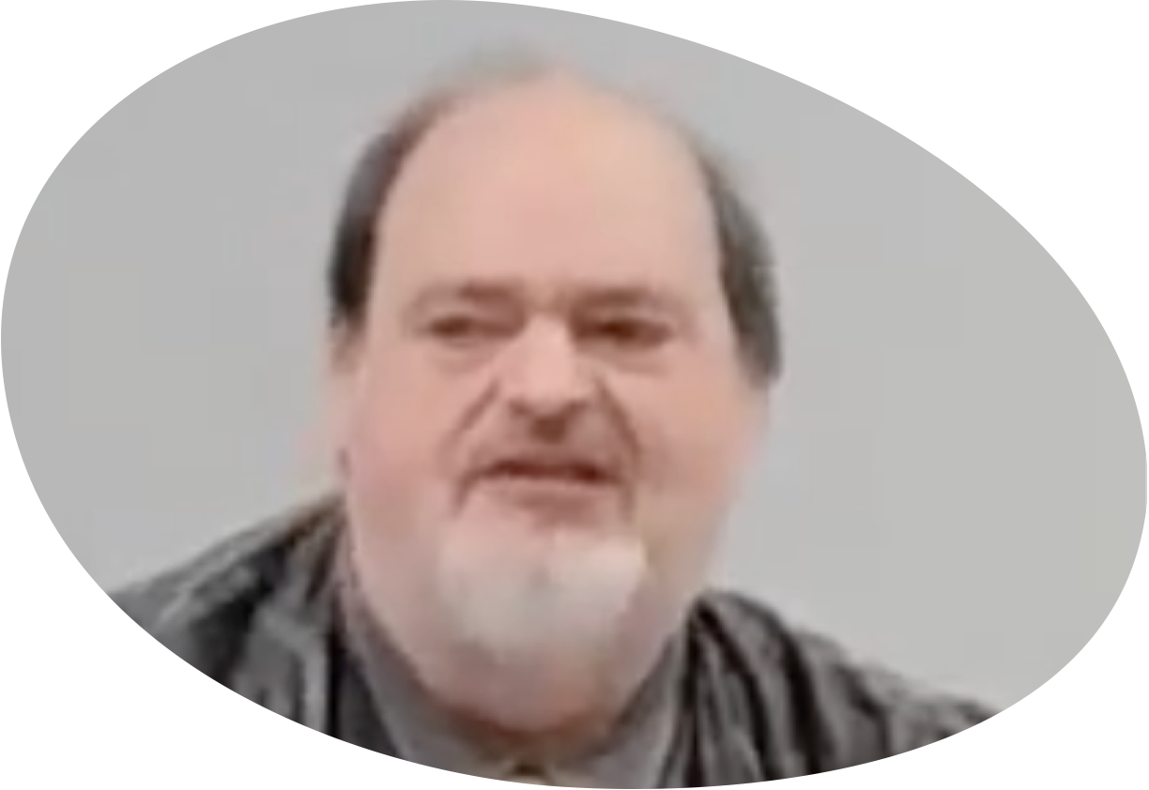
“Church of Christ MEETING @ 100 CORNERSTONE, Alexander AR. 72002”
TODAY’S LESSON
Sunday Morning Live Stream 10:00 AM ^{CT} March 1, 2026
https://www.youtube.com/user/donmcclain11/live / WWW.ALEXANDERCHURCHOFCHRIST.COM

Slide 2
HOW JESUS OVERCAME TEMPTATION
Part 5
THE WILL OF GOD
VS.
THE DEVICES OF SATAN

Slide 3
The Temptation of Pride
God’s will to fulfill our legitimate specific needs lawfully
Satan’s synthesis of sinful temptations always include pride as well as unlawful means to fulfill a legitimate need

Slide 4
The Temptation of Pride
God’s will to fulfill our legitimate specific needs lawfully
God is love 1 John 4:16
God created us to have fellowship with Him 1 John 1:3-4
This is true spiritual life and fulfillment of His will and purpose for us 1 John 5:13
Innocent, holy in Christ
True love, joy, and peace Galatians 5:22

Slide 5
The Will of God for Us
God created our spirits to inhabit physical bodies (male and female Gen. 2:18-25)
Physical needs fulfilled by physical blessings on earth:
Food, clothing, survival, security, companionship, rest, purpose:
Take care of the garden (2:15)
Rule the earth (1:29)
Populate the earth (1:29)

Slide 6
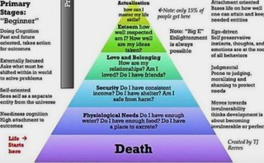

Slide 7
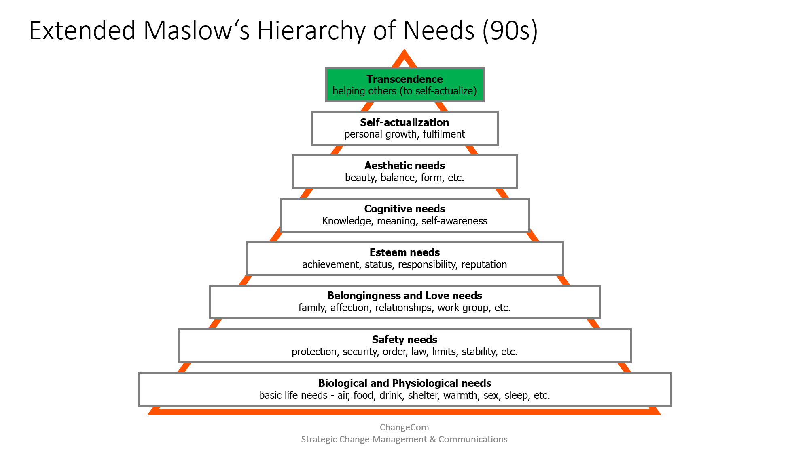
COLOSSIANS 2:9-10, 3
ECCLESIASTES 3:11b
ECCLESIASTES 3:1
ECCLESIASTES 3:11a
COLOSSIANS 1:9-12
1 CORINTHIANS 8:1c
PROVERBS 17:19
PROVERBS
6:30-35
PROVERBS
30:8b-9
PROVERBS
24:27

Slide 8
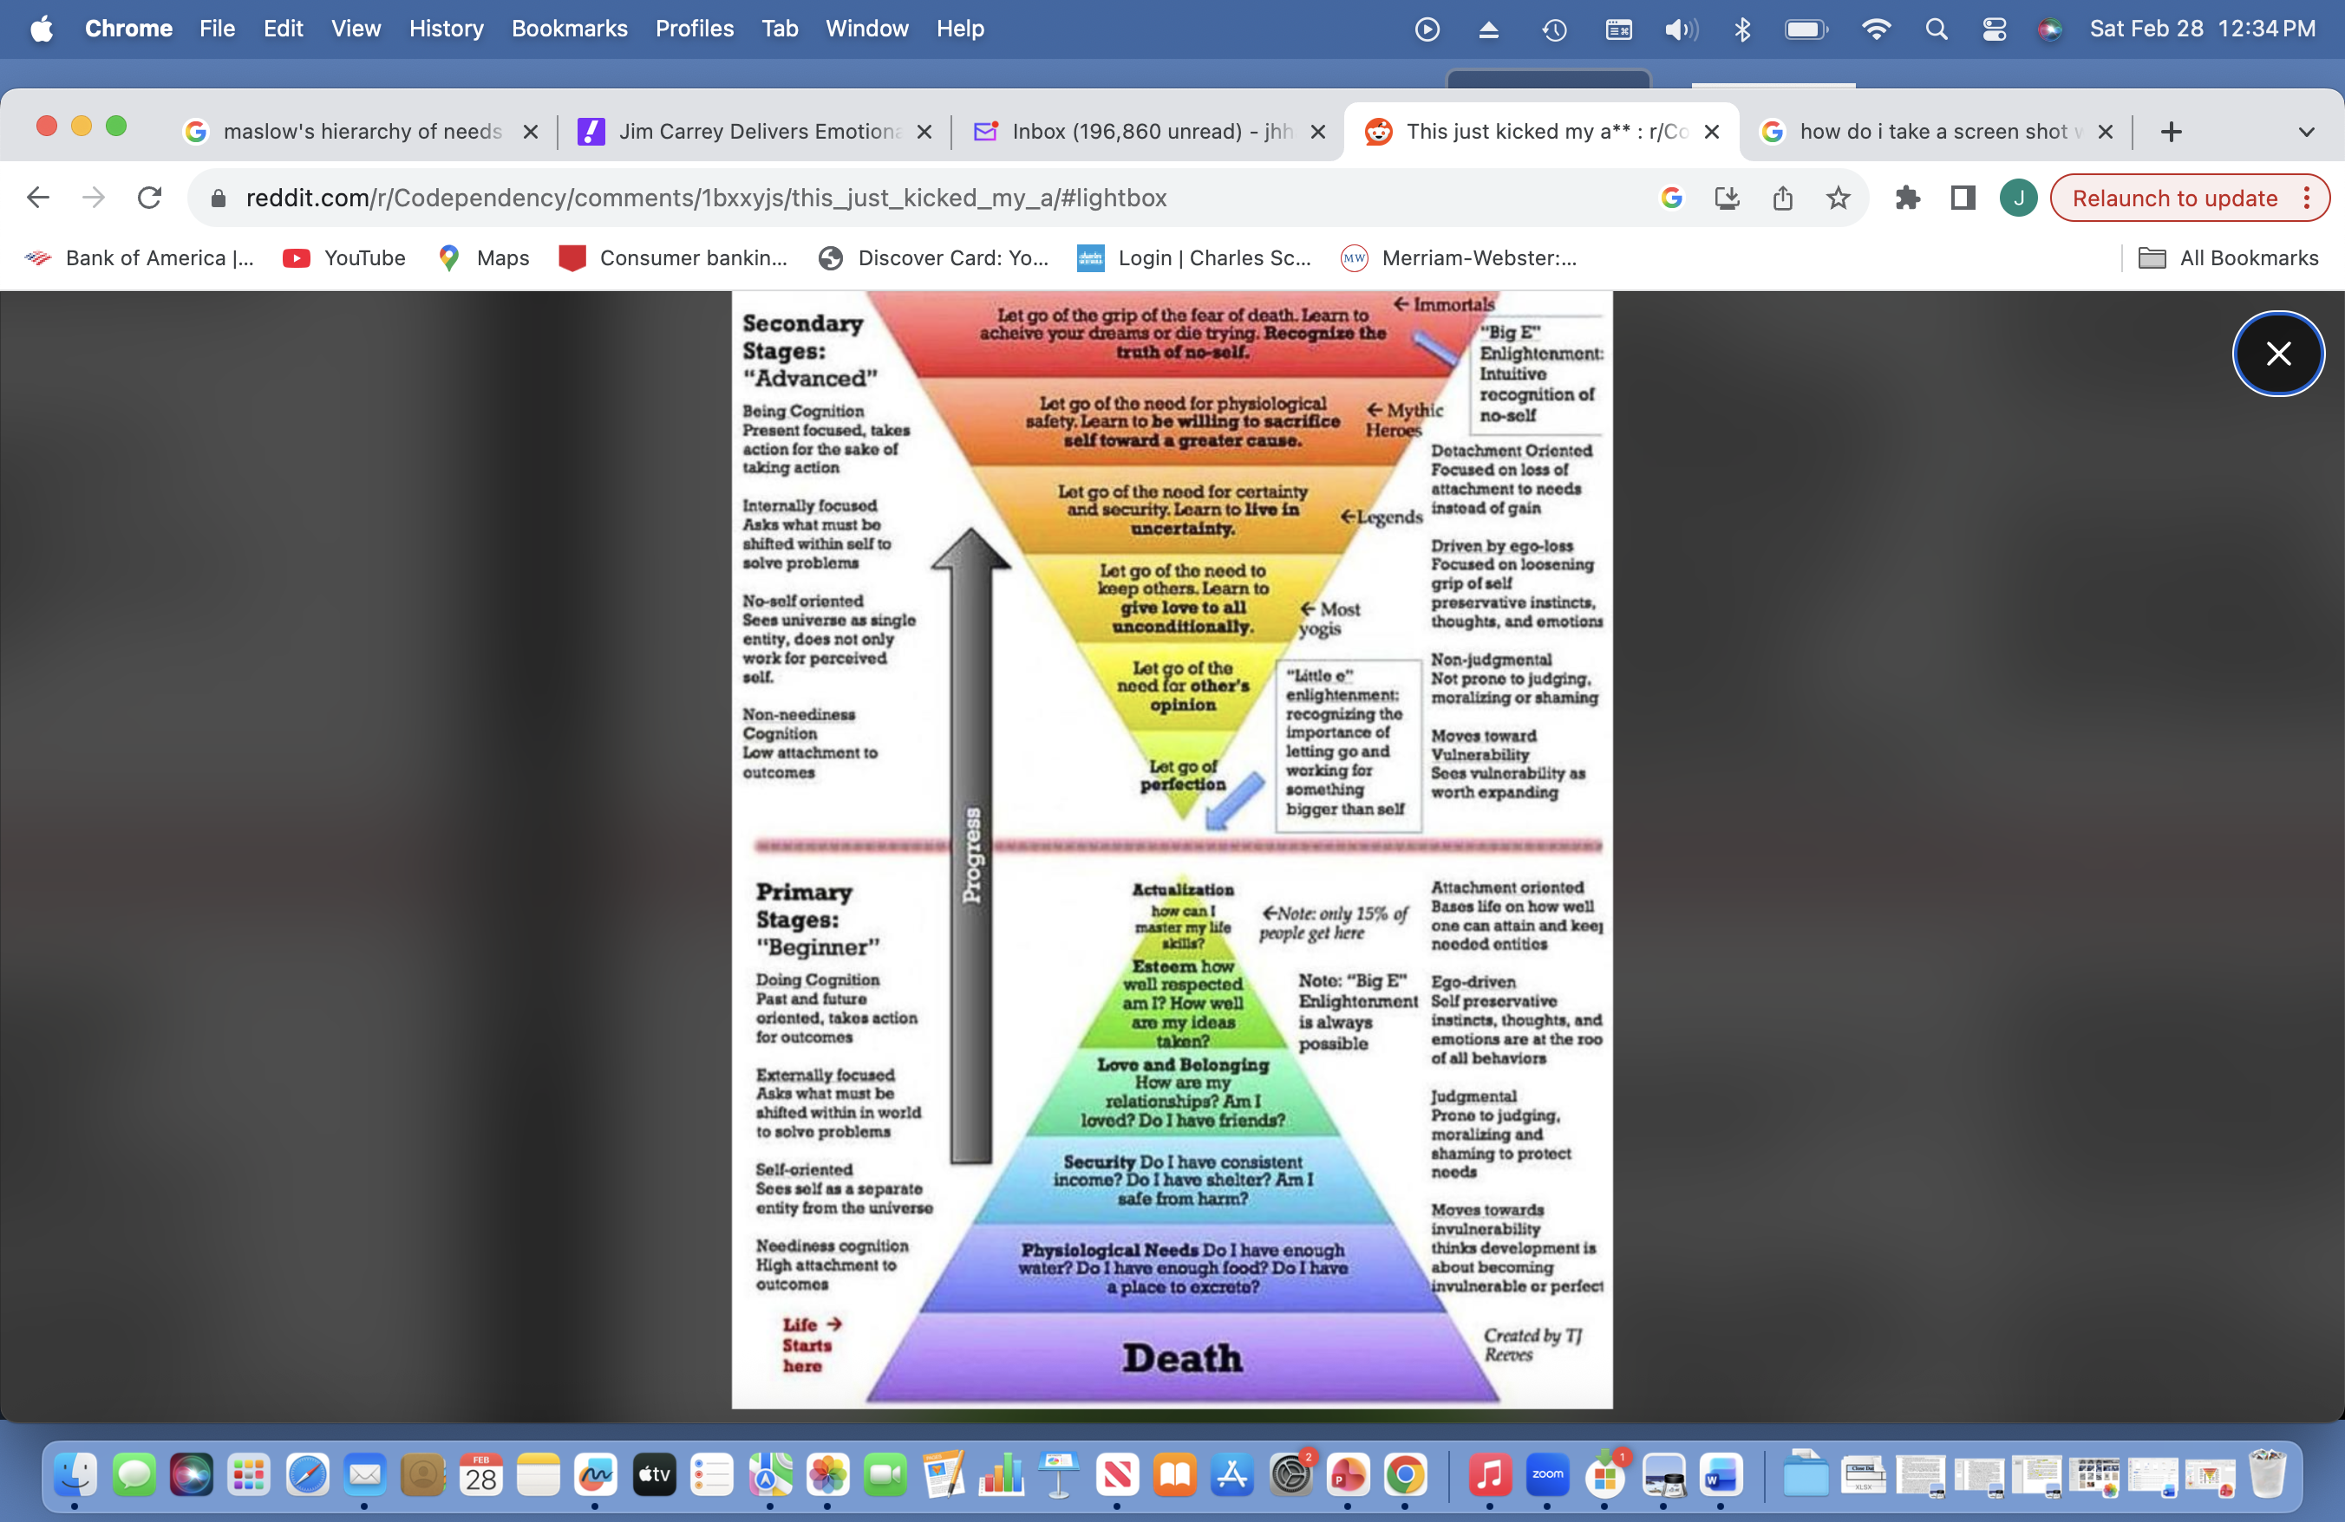

Slide 9
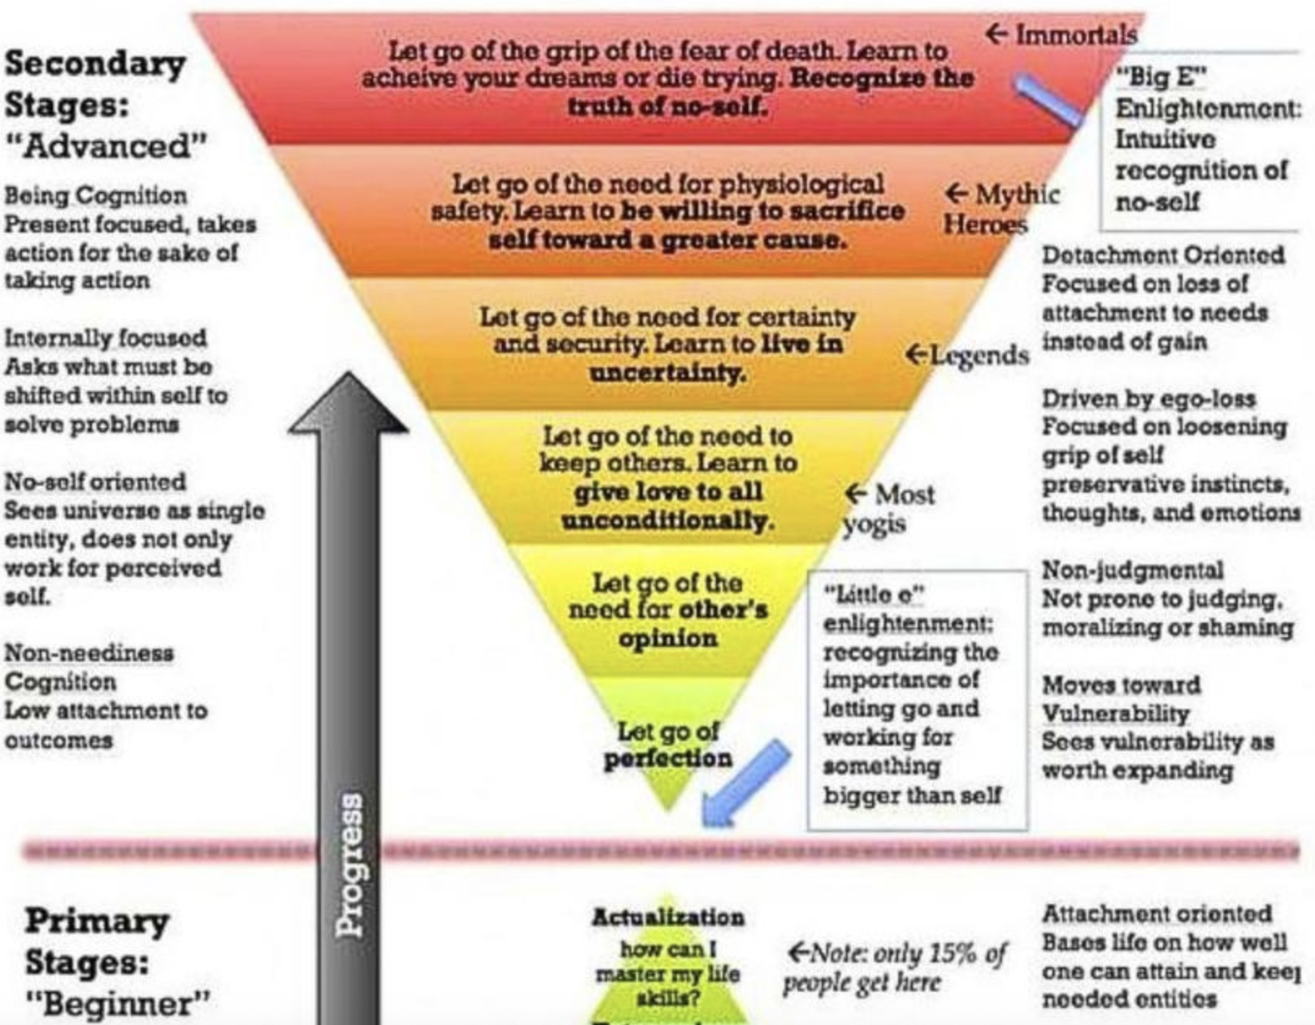

Slide 10
The Deceptive Devices of Satan
Doubt Genesis 3:1-5 Dogmatism Acts 8:1-3; 9
Deceit Genesis 3:4; John 8:44; Revelation 12:9
Dissatisfaction Colossians 3:5 Indolence Rev. 3:14-22
Distraction 2 Timothy 2:22; James 4:4
Division John 8:44; Galatians 5:20; Jm 3:14-16
Deference Galatians 1:10; 2:11-13
Delay Jm 4:13-17 good intentions don’t justify
Desperation 1 Samuel 13:8-10

Slide 11
Trusting The Will of God
God’s will is good Romans 12:1-2
Contentment→give thanks 1 Thess. 4:16-18
David served God’s purpose in his generation Acts 13:36
Mercy + Truth → Favor from God & men Proverbs 3:3-4
Bear good fruit: reproach, praise, sacrifices Micah 6:7-8; Hebrews 13:13-16
Trust & wait on the LORD, do good Psalm 37:1-11

Slide 12
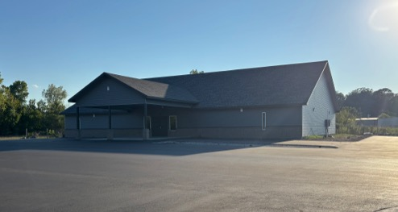

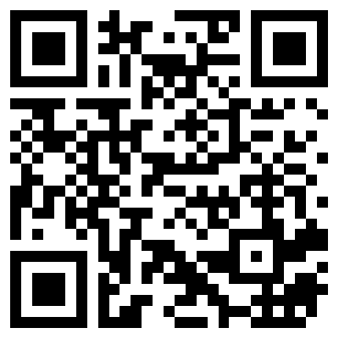
100 CORNERSTONE ALEXANDER AR, 72002
You Are Welcome At Any And All of Our Services!
Meeting Times:
Sunday A.M. Bible Study: 9:00
Sunday A.M. Assembly: 10:00
Sunday P.M. Assembly: 4:00
Wed. P.M. Bible Study: 7:00
ALEXANDERCHURCHOFCHRIST.COM

