Slide 2

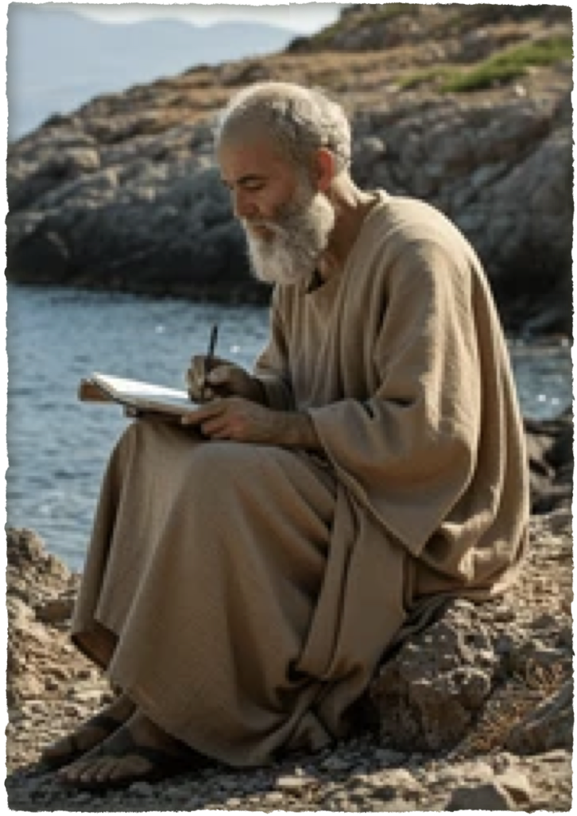

The author identifies himself simply as “the elder” (ho presbyteros), the same self-designation used in 2 John.
Early church tradition consistently attributed the letter to the Apostle John (the aged “beloved disciple”).
The vocabulary, style, and themes—especially the repeated emphasis on “truth” (alētheia), love expressed in deed, joy over spiritual children walking in the truth, and the language of testimony—align closely with 1 John and the Gospel of John.

Slide 3
Commonly dated ca. AD 85–95 (contemporary with 1 and 2 John).
Probably written while in Ephesus or the surrounding region of Asia Minor toward the end of the first century,
2nd John warns against supporting false teachers / 3rd John commends supporting those who teach the truth.
Another comparison - 2nd John condemned false teaching, or heresy, while 3rd John condemns a lack of love resulting in “schisms.”

Slide 4
Greeting and commendation of Gaius (vv. 1–8)
Condemnation of Diotrephes (vv. 9–10), with a transitional exhortation (v. 11)
Confirmation of Demetrius (v. 12)
Closing greetings and hope of a personal visit (vv. 13–15)

Slide 5

3 John 1–14 (NKJV)
¹ The Elder, To the beloved Gaius, whom I love in truth: ² Beloved, I pray that you may prosper in all things and be in health, just as your soul prospers. ³ For I rejoiced greatly when brethren came and testified of the truth that is in you, just as you walk in the truth. ⁴ I have no greater joy than to hear that my children walk in truth. ⁵ Beloved, you do faithfully whatever you do for the brethren and for strangers, ⁶ who have borne witness of your love before the church. If you send them forward on their journey in a manner worthy of God, you will do well,

Slide 6
3 John 1–14 (NKJV)
⁷ because they went forth for His name’s sake, taking nothing from the Gentiles. ⁸ We therefore ought to receive such, that we may become fellow workers for the truth. ⁹ I wrote to the church, but Diotrephes, who loves to have the preeminence among them, does not receive us. ¹⁰ Therefore, if I come, I will call to mind his deeds which he does, prating against us with malicious words. And not content with that, he himself does not receive the brethren, and forbids those who wish to, putting them out of the church.

Slide 7
3 John 1–14 (NKJV)
¹¹ Beloved, do not imitate what is evil, but what is good. He who does good is of God, but he who does evil has not seen God. ¹² Demetrius has a good testimony from all, and from the truth itself. And we also bear witness, and you know that our testimony is true. ¹³ I had many things to write, but I do not wish to write to you with pen and ink; ¹⁴ but I hope to see you shortly, and we shall speak face to face. Peace to you. Our friends greet you. Greet the friends by name.

Slide 8
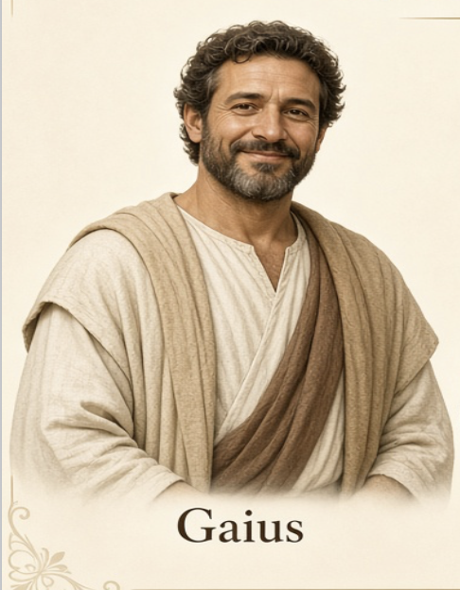

Gaius (Γάϊος, for Lat. Caius, a common Roman name), the name of three or four men in the N. T.
  A Macedonian, and fellow-traveller of Paul, who was seized by the populace at Ephesus (Acts 19:29), A.D. 54.
  A man of Derbe who accompanied Paul in his last journey to Jerusalem (Acts 20:4), A.D. 55.
  An inhabitant of Corinth with whom Paul lodged, and in whose house the church met (Rom. 16:23; 1 Cor. 1:14), A.D. 55. Perhaps one of the above.

Slide 9

Gaius (Γάϊος, for Lat. Caius, a common Roman name), the name of three or four men in the N. T.
  The Gaius of 3 John: A Christian (probably of Asia Minor) to whom John addressed his third epistle (3 John 1), A.D. cir. 92.
  There is no good reason for regarding him as identical with either of the foregoing.
  May have been a member of the congregation John had written to in 2 John Cf (3 Jn 9).

Slide 10
John prayed Gaius would prosper physically & spiritually (1-2)
  Had a good reputation (3a)
  Walked in the truth (3b)
  Gave John great joy (4)
  Was hospitable toward all (5-6a; cf. Matt. 10:10; Rom. 12:13; 1 Tim. 3:2, 5:10; Heb. 13:2).
  Was encouraged to continue supporting gospel preachers (6b-8)

Slide 11
Brethren told of the “truth in Him” (3b).
Seen by his actions (“walking”) (3c,4).
Could see his faithful work with brethren & strangers (5).
These strangers also attested to Gaius’ love (6).
Strangers accepted because they were acting “for the sake of the Name” (6,7).
On that basis, Gaius welcomed them as “fellow-workers for the truth” (8).

Slide 12
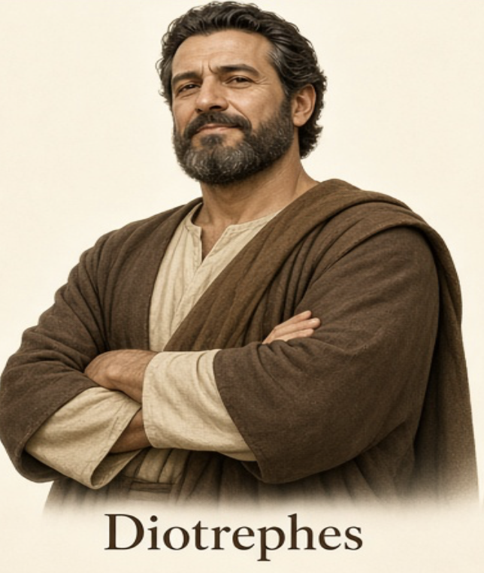
⁹ I wrote to the church, but Diotrephes, who loves to have the preeminence among them, does not receive us. - 3 John 9 (NKJV)
Self-promoter -- strove to be first (9a).
Insubordinate -- would not receive the [authority of] apostles (9b).
Slanderous -- slandered apostles (10a).
Vindictive -- did not receive certain brethren, casting those who did out of the church (10b).

Slide 13
⁹ I wrote to the church, but Diotrephes, who loves to have the preeminence among them, does not receive us. - 3 John 9 (NKJV)
Diotrephes stands as the negative counterpart to Gaius: where Gaius advances the truth through open-handed love, Diotrephes damages it through self-centered control.

Slide 14
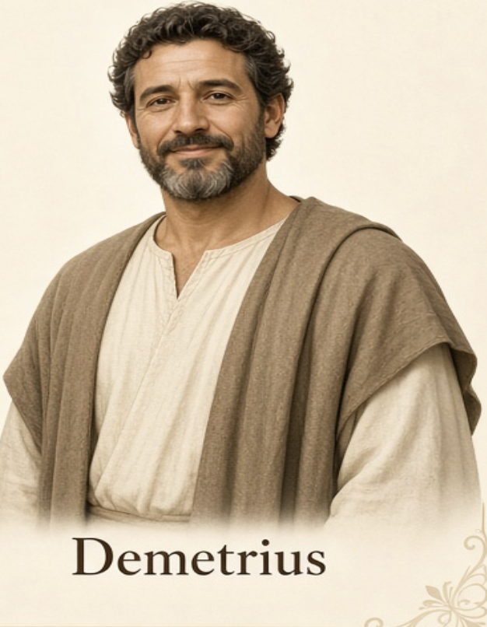
3 John 11 (NKJV)
¹¹ Beloved, do not imitate what is evil, but what is good. He who does good is of God, but he who does evil has not seen God.

Slide 15
¹² Demetrius has a good testimony from all, and from the truth itself. And we also bear witness, and you know that our testimony is true. (3 John 12 (NKJV)
Demetrius was offered as a pattern for Gaius, because he had a good report… (12)
  From all the brethren
  From the truth itself
  From John and the apostles

Slide 16
Gaius | Diotrephes | Demetrius
Had & held to truth | Rejected truth | Good report from the brethren
Accepted brethren in truth | Refused those who came with the truth. | Good report from the truth itself
Did a faithful work towards all | Cast supporters of truth out of the church | Good report from the apostles
Aided & assisted those acting in the Name | Slandered the apostles & those who spoke the truth | An example worthy of following

Slide 17

Christians Are Not Always What They Should Be…
  We may have to serve in the face of opposition from other brethren
  Will we allow this to affect our service?
  Will we allow this to affect our salvation?

Slide 18
The importance of our influence & example …
  We are to follow what is good so we can influence for good (Mat 5:13-16; Phili 2:14-16
  What example are we setting in the local church? Who are we imitating? - 1 Cor 11:1; Eph 5:1; Heb 12:1,2; 1 Pet 2:21-26

Slide 19
The "Spirit Of Diotrephes” is TOO often allowed to Reign
  Members allowed Diotrephes to dominate - would not take a stand for the truth for fear.
  Diotrephes was successful because there was a certain climate of complacency & cowardice within the local church. (Rev 21:8)

Slide 20
The Importance of Supporting Gospel Preachers:
  A Testimony To Our Faithfulness our love for God & the lost - vs5,6
  We Obey God... vs 8a; cf. Gal 6:6; 1 Cori 9:11
  We are Fellow Workers For The Truth… vs 8; Phili 1:3-5; 4:15-16; 2 John 10-11; Mat 10:40-42

Slide 21
We are either benefitting the kingdom & the truth or damaging its effectiveness by our words & deeds!
Are we more like Gaius & Demetrius, or more like Diotrephes?

Slide 22
3 John 11 (NKJV)
¹¹ Beloved, do not imitate what is evil, but what is good. He who does good is of God, but he who does evil has not seen God.

Slide 24
Charts by Don McClain
Preached April 10, 2016 West 65th Street church of Christ
Preached October 24, 2026 - Alexander church of Christt
501-568-1062
Email – donmcclain@sbcglobal.net
Prepared using Keynote - More Keynote, PPT & Audio Sermons:
www.alexanderchurchofchrist.com

Slide 25

Hebrews 13:1–9 (NKJV)
¹ Let brotherly love continue. ² Do not forget to entertain strangers, for by so doing some have unwittingly entertained angels. ³ Remember the prisoners as if chained with them—those who are mistreated—since you yourselves are in the body also. ⁴ Marriage is honorable among all, and the bed undefiled; but fornicators and adulterers God will judge. ⁵ Let your conduct be without covetousness; be content with such things as you have. For He Himself has said, “I will never leave you nor forsake you.”

Slide 26
Hebrews 13:1–9 (NKJV)
⁶ So we may boldly say: “The Lord is my helper; I will not fear. What can man do to me?” ⁷ Remember those who rule over you, who have spoken the word of God to you, whose faith follow, considering the outcome of their conduct. ⁸ Jesus Christ is the same yesterday, today, and forever. ⁹ Do not be carried about with various and strange doctrines. For it is good that the heart be established by grace, not with foods which have not profited those who have been occupied with them.

