Slide 1

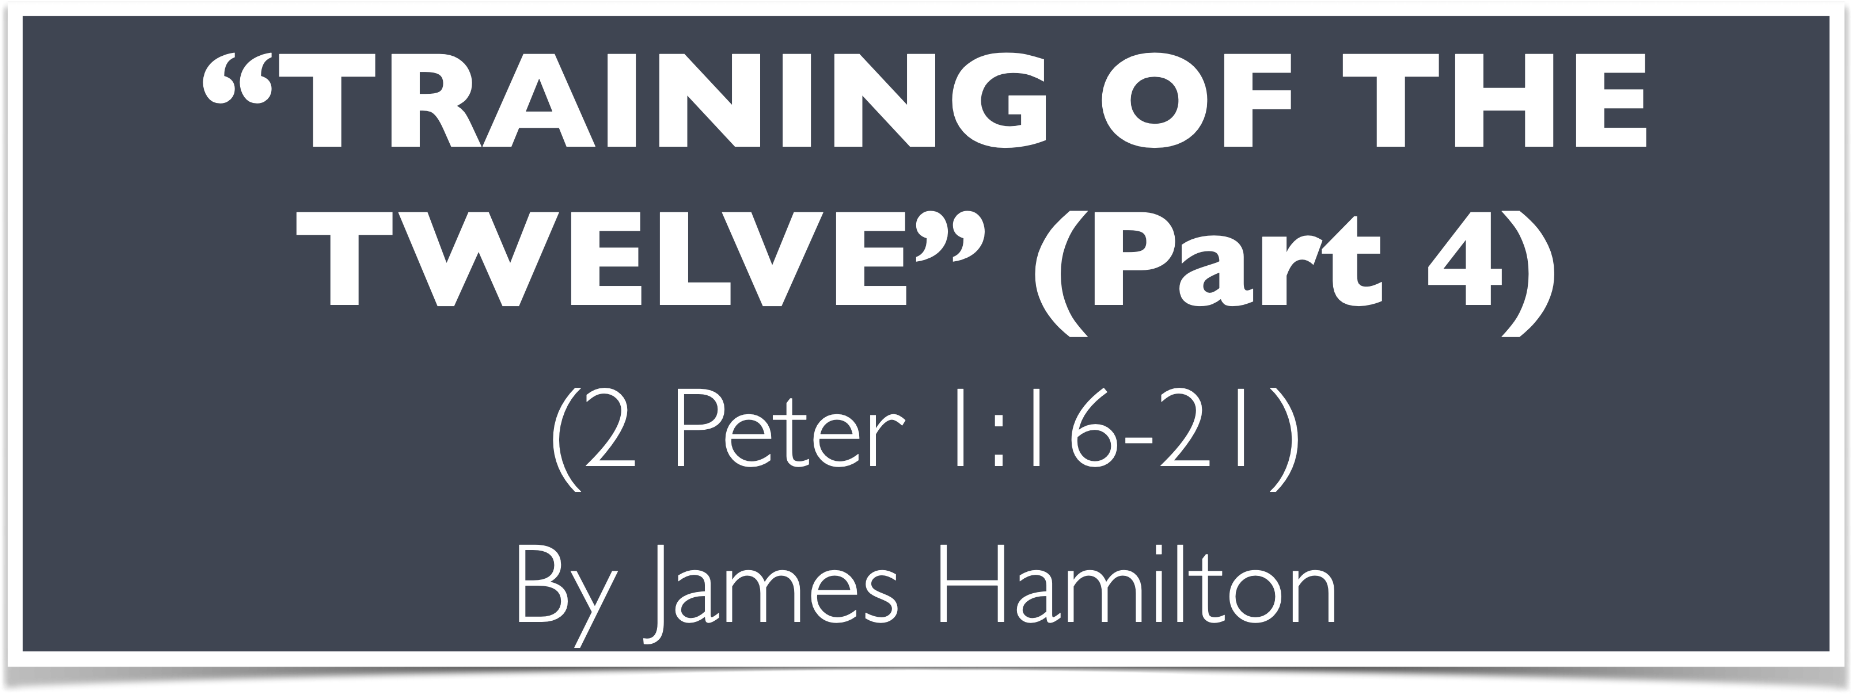

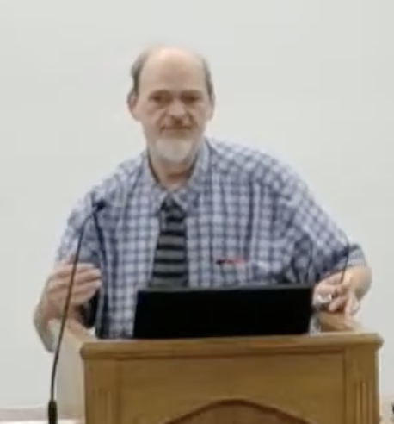
“Church of Christ MEETING @ 100 CORNERSTONE, Alexander AR. 72002”
TODAY’S LESSON
Sunday evening lesson live stream 4:00 PM ^{CDT} August 9, 2026
https://www.youtube.com/user/donmcclain11/live / WWW.ALEXANDERCHURCHOFCHRIST.COM

Slide 2
INSTRUCTIONS FOR THE KINGDOM OF HEAVEN
Part 4
MATTHEW 17

Slide 3
The Training of the Twelve
Peter’s privilege (to witness the Transfiguration of Christ) 17:1-13
  Transfiguration 17:1-3
  Peter’s rash suggestion 17:4
  God’s response 17:5-9
  Disciples’ question about scribes’ doctrine about Elijah 17:10-13

Slide 4
The Training of the Twelve
Disciples’ failure to cast out demon 17:14-23
  Disciples’ public failure 17:14-16
  Jesus’ success 17:17-18
  Private explanation for failure 17:19-21
  Jesus foretells His sacrifice 17:22-23
Peter’s rash answer concerning the temple tax 17:24-27

Slide 5
Lessons from Matt. 17:1-27
You need to remember your goal 17:2,9; 1 Peter 1:3-4
God gave Jesus a reminder/guarantee, and He gives us a reminder/guarantee 17:2-3; Luke 9:29-31; Eph. 1:13-14; 2 Cor. 1:22; 5:5
Jesus was present before Moses and Elijah, and Jesus is present after Moses and Elijah departed 17:3,8; 28:18
So were the disciples 17:1; Galatians 3:8; Ephesians 3:8-11

Slide 6
Lessons from Matt. 17:1-27
We must listen to Jesus! 17:5; 28:18; 8:8-10
Elijah (1 Kings 17:1-2 Kings 2:11) typified John 17:10-13; Malachi 4:5-6; 3:1-7

Slide 7
Malachi 3:1-7
“Behold, I send My messenger, and he will prepare the way before Me. And the Lord, whom you seek, will suddenly come to His temple, even the Messenger of the covenant, in whom you delight. Behold, He is coming,” says the LORD of hosts. “But who can endure the day of His coming? And who can stand when He appears? For He is like a refiner's fire and like launderer's soap. He will sit as a refiner and a purifier of silver; He will purify the sons of Levi, and purge them as gold and silver, that they may offer to the LORD an offering in righteousness. Then the offering of Judah and Jerusalem will be pleasant to the LORD, as in the days of old, as in former years.

Slide 8
Malachi 3:1-7
“And I will come near you for judgment; I will be a swift witness against sorcerers, against adulterers, against perjurers, against those who exploit wage earners and widows and orphans, and against those who turn away an alien—because they do not fear Me,” says the LORD of hosts. “For I am the LORD, I do not change; therefore you are not consumed, O sons of Jacob. Yet from the days of your fathers you have gone away from My ordinances and have not kept them. Return to Me, and I will return to you,” says the LORD of hosts. “But you said, ‘In what way shall we return?’”

Slide 9
Lessons from Matt. 17:1-27
We must listen to Jesus! 17:5; 28:18; 8:8-10
Elijah (1 Kings 17:1-2 Kings 2:11) typified John 17:10-13; Malachi 4:5-6; 3:1-7
Elisha (2 Kings 2:9-13:21) foreshadowed Jesus Malachi 3:1a; Isaiah 40:3; Mal. 3:1b/ John 1:14; 2:19; Mal. 3:1c/Deuteronomy 18:18-22/Acts 3:18-23; Mal. 3:2a/Mark 9:3; Mal. 3:2b-3a/Acts 2:36-41; Mal. 3:3b-4/1 Peter 1:6-9; John 4:23-24; Acts 4:42-47; Mal. 3:5/ Matt. 25:31-46; Revelation 21:8; 22:15; Mal.3:6/Heb. 13:8; Mal. 3:7; 4:5-6/Luke 3:10-14

Slide 10
Lessons from Matt. 17:1-27
Failure produces disputes v.14-21; Mark 9:14; Numbers 13-16; 1 Cor. 6:7; Heb. 12:12-17
Unbelief in God leads to failure v.19-20; 1 Cor. 1:26-31
Selfless prayer and fasting empower us spiritually v.19-21; Luke 9:28; Ephesians 6:10-20; Matt. 18:1-5
Let Jesus speak for Himself v.24-26; Rev. 22:18-19; Acts 20:26-27; 1 Peter 4:11
Don’t be a stumblingblock v.27-28; 18:6-11

Slide 11



100 CORNERSTONE ALEXANDER AR, 72002
You Are Welcome At Any And All of Our Services!
Meeting Times:
Sunday A.M. Bible Study: 9:00
Sunday A.M. Assembly: 10:00
Sunday P.M. Assembly: 4:00
Wed. P.M. Bible Study: 7:00
ALEXANDERCHURCHOFCHRIST.COM

