Slide 1




Matthew 14:22-33; Mark 6:45–52; John 6:14–21

Slide 2


Jesus Feeds 5,000 (Mat. 14:13-21; Mark 6:31–44; Luke 9:11–17; John 6:1–13).
With five loaves of barley and the two small fish (Matthew 14:19; Mark 6:38; Luke 9:16; John 6:9)
Many said this is “the Prophet who is to come into the world.” (John 6:14)
Jesus perceived that they were about to come and take Him by force to make Him king, He departed again to the mountain by Himself alone (John 6:15)

Slide 3
Matthew 14:22–33 (NKJV)
²² Immediately Jesus made His disciples get into the boat and go before Him to the other side, while He sent the multitudes away. ²³ And when He had sent the multitudes away, He went up on the mountain by Himself to pray. Now when evening came, He was alone there. ²⁴ But the boat was now in the middle of the sea, tossed by the waves, for the wind was contrary. ²⁵ Now in the fourth watch of the night Jesus went to them, walking on the sea. ²⁶ And when the disciples saw Him walking on the sea, they were troubled, saying, “It is a ghost!” And they cried out for fear. ²⁷ But immediately Jesus spoke to them, saying, “Be of good cheer! It is I; do not be afraid.”

Slide 4
Matthew 14:22–33 (NKJV)
²⁸ And Peter answered Him and said, “Lord, if it is You, command me to come to You on the water.” ²⁹ So He said, “Come.” And when Peter had come down out of the boat, he walked on the water to go to Jesus. ³⁰ But when he saw that the wind was boisterous, he was afraid; and beginning to sink he cried out, saying, “Lord, save me!” ³¹ And immediately Jesus stretched out His hand and caught him, and said to him, “O you of little faith, why did you doubt?” ³² And when they got into the boat, the wind ceased. ³³ Then those who were in the boat came and worshiped Him, saying, “Truly You are the Son of God.”

Slide 5
Matthew 14:29 (NKJV)
²⁹ So He said, "Come." And when Peter had come down out of the boat, he walked on the water to go to Jesus.
Literally – NO – (the command was to Peter and NOT TO US!)
BUT WE CAN accomplish ANYTHING Jesus COMMANDS us to do!

Slide 6
Matthew 14:22-33

Slide 7
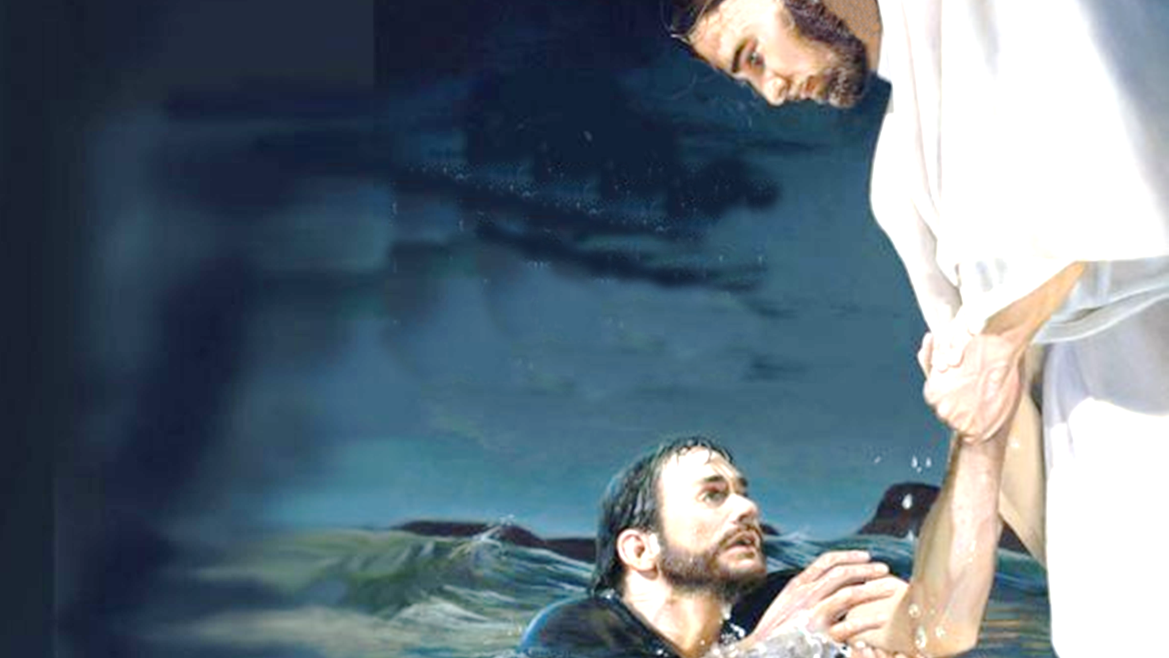

Matthew 14:22-33
Did he lack FAITH in Jesus’s power? (28)
Did he lack interest & effort? (28)
Did he act presumptuously? (28,29)
Were the instructions of the Lord “IMPOSSIBLE”? (29)

Slide 8
Matthew 14:22-33
Because He Took His Eyes Off Jesus (30)
Matthew 14:30 (NKJV)
³⁰ But when he saw that the wind was boisterous, he was afraid; and beginning to sink he cried out, saying, “Lord, save me!”

Slide 9
Matthew 14:22-33
Because He Took His Eyes Off Jesus (30)
He was distracted by the storm – he began to notice what was going on around him instead of focusing on Jesus . . .
Distraction is a tool often used by Satan . . .

Slide 10

Because We Take Our Eyes Off Jesus (Heb. 12:1,2)
Hebrews 12:1–2 (NKJV)
¹ Therefore we also, since we are surrounded by so great a cloud of witnesses, let us lay aside every weight, and the sin which so easily ensnares us, and let us run with endurance the race that is set before us, ² looking unto Jesus, the author and finisher of our faith, who for the joy that was set before Him endured the cross, despising the shame, and has sat down at the right hand of the throne of God.

Slide 11
Because We Take Our Eyes Off Jesus (Heb. 12:1,2)
We can easily be distracted by:
Allowing material, unnecessary, and sinful things to consume our time and efforts (Mat 13:22; Heb. 12:1).
Being anxious, or overly concerned for our material needs (Mat 6:19-33)
The physical, financial, or relational hardships we face (Mt 13:20-21; 2 Cor. 12:7-10; Heb. 12:3-11)

Slide 12
Because We Take Our Eyes Off Jesus (Heb. 12:1,2)
We can easily be distracted by:
Temptations (Gen 3:1-6)
Problems (Num. 13:28-33)
Our Past (Phili 3:13,14)
Our Work / Our Burdens (Eph 4:28; 2 Cor 5:4; Gal 6:2; Heb 10:35-39)
Relationships (1 Cor. 15:33)
Our feelings (Prov. 14:12)

Slide 13
Because We Take Our Eyes Off Jesus (Heb. 12:1,2)
The need to keep our focus:
On our Lord, Jesus Christ (1 Pet 2:21; Heb 2:9-18; 12:1-3)
On the words of Christ (Lk. 21:33; Mat 28:18,19; Jam 1:25; Jn. 12:48)
On blessings (Eph 1:3; Phili 4:4-13)
On God’s promises (1 Cor. 10:1-13; 2 Cor 4:16-18; 2 Tim. 2:10; 4:6-8).

Slide 14
Matthew 14:22-33
Fear Overpowered Peter’s Faith (30)
Matthew 14:30 (NKJV)
³⁰ But when he saw that the wind was boisterous, he was afraid; and beginning to sink he cried out, saying, “Lord, save me!”

Slide 15
Matthew 14:22-33
Fear Overpowered Peter’s Faith (30)
What seemed so sure to Peter “INSIDE” the boat became a frightening experience “OUTSIDE” the boat!
When buffeted by the gale he began to doubt then panicked!
Fear gripped Peter again (Mat 26:33,69-75; Gal. 2:11,12)

Slide 16
Our Faith Can Be Overpowered By Fear (John 12:42)
We need to seek to increase our faith (Luke 17:5; Heb. 13:5,6; Rom. 10:17).
Fear is the result of doubt “O you of little faith, why did you doubt?” (Mat 14:31; Jam. 1:6-8).
There is really only one thing we should be afraid of (Mat. 10:28).
Fear can destroy our faith, but faith can destroy our fears (Rev. 2:10; 21:8).

Slide 17
Our FEAR Can Be Overpowered By FAITH (2 Tim 1:7–12)
2 Timothy 1:7–12 (NKJV)
⁷ For God has not given us a spirit of fear, but of power and of love and of a sound mind. ⁸ Therefore do not be ashamed of the testimony of our Lord, nor of me His prisoner, …¹⁰ but has now been revealed by the appearing of our Savior Jesus Christ, who has abolished death and brought life and immortality to light through the gospel, ¹¹ to which I was appointed a preacher, an apostle, and a teacher of the Gentiles. ¹² For this reason I also suffer these things; nevertheless I am not ashamed, for I know whom I have believed and am persuaded that He is able to keep what I have committed to Him until that Day.

Slide 18
Matthew 14:22-33
He Was Distracted By The Storm And Took His Eyes Off Jesus (30)
He Doubted What He Could Do With The Lord and Feared (30)
When His Faith Sank, He sank (30)

Slide 19
Matthew 14:22-33
Had the faith to get out of the boat (29)
Walked on the water (29)
Began to sink and cried out “Lord save me!” (30)
Jesus SAVED HIM! (32)

Slide 20

A loosening of morals
A growing disinterest in worship and associating w/ other Christians
Backsliding into practices you confessed were wrong

Slide 21
Unsinkable faith requires a committed, focussed, and loyal mind! (Mat 6:22,23).
We can do what the Lord commands us to do! (Deut 30:11–14; Phili. 4:13; 1 John 5:3; 1 Cor. 10:13).

Slide 22
Matthew 14:22-33
We can easily find ourselves sinking . . . and we need to know the Lord is there for us! (Acts 2:21; Rom 10:13)
WHY DROWN????? (Acts 2:38; 22:16; 1 John 1:7-9)

Slide 24

Matthew 14:22-33
Charts by Don McClain
Preached January 9, 2011 West 65th Street church of Christ
Preached April 4, 2026 Alexander church of Christ
501-568-1062
Prepared using PPT 2010 –
Email – donmcclain@sbcglobal.net
More PPT & Audio Sermons:
www.alexanderchurchofchrist.com

Slide 25
Hebrews 12:1–3 (NKJV)
¹ Therefore we also, since we are surrounded by so great a cloud of witnesses, let us lay aside every weight, and the sin which so easily ensnares us, and let us run with endurance the race that is set before us, ² looking unto Jesus, the author and finisher of our faith, who for the joy that was set before Him endured the cross, despising the shame, and has sat down at the right hand of the throne of God. ³ For consider Him who endured such hostility from sinners against Himself, lest you become weary and discouraged in your souls.

