Slide 1


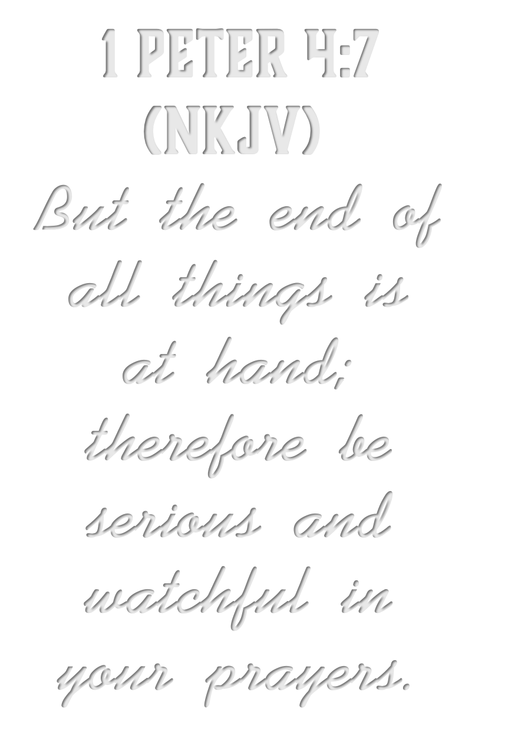





Slide 2




Slide 3

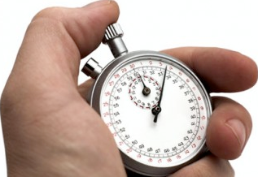
Sporting Events
Deadlines
Special Days
Opportunities
Our Lives
This World

Slide 4
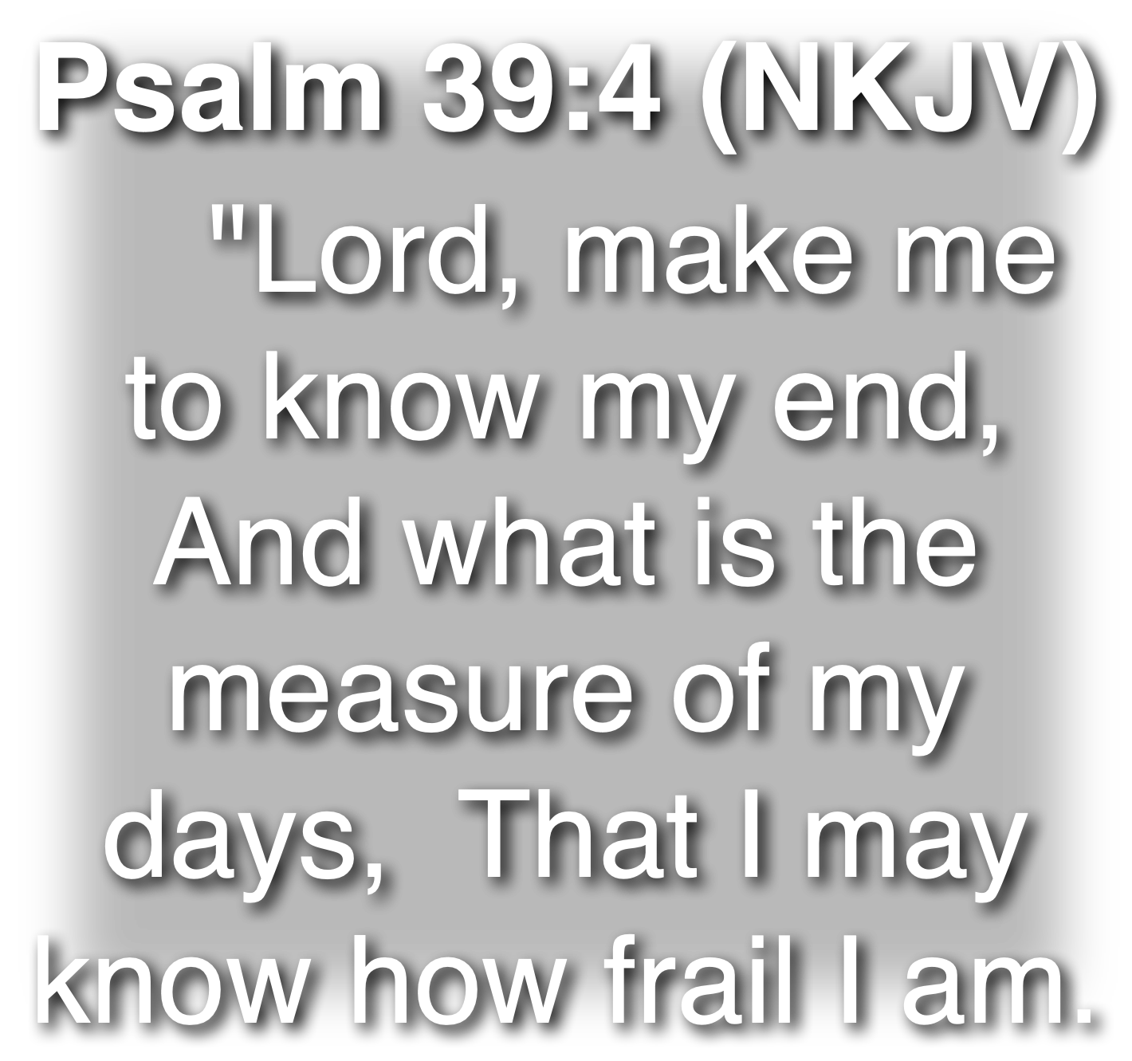

Slide 5
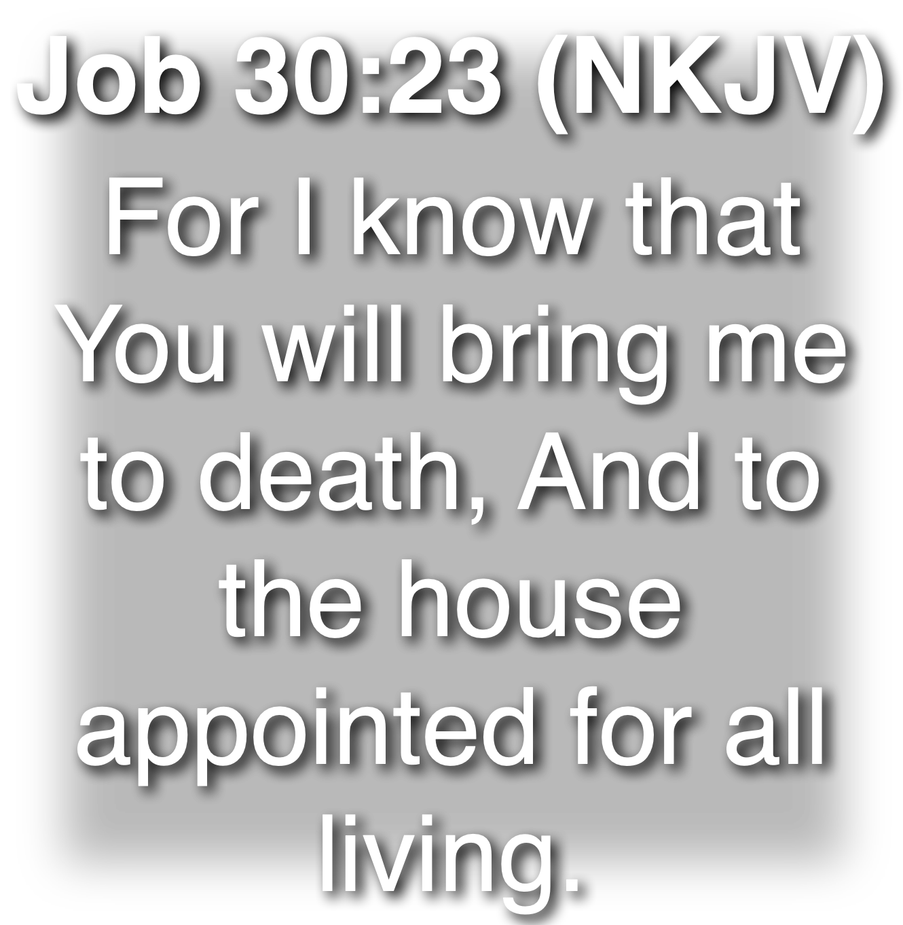

Slide 6
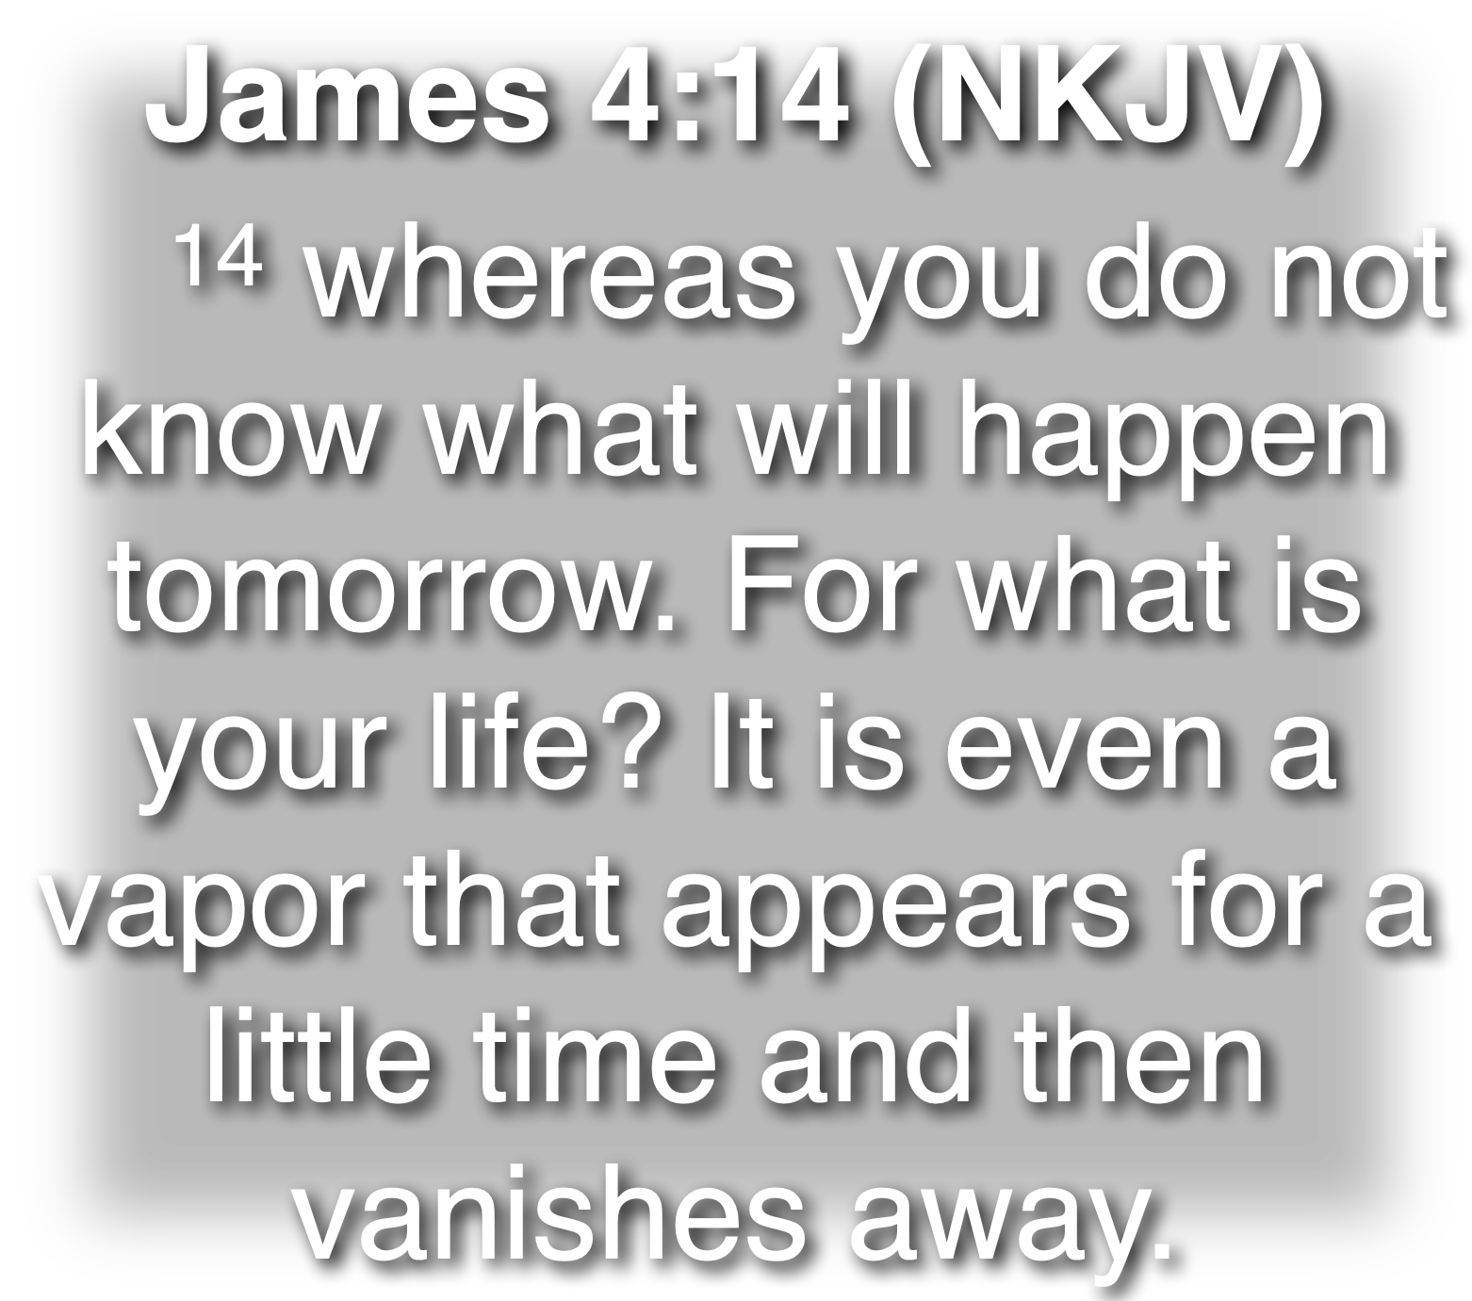

Slide 7
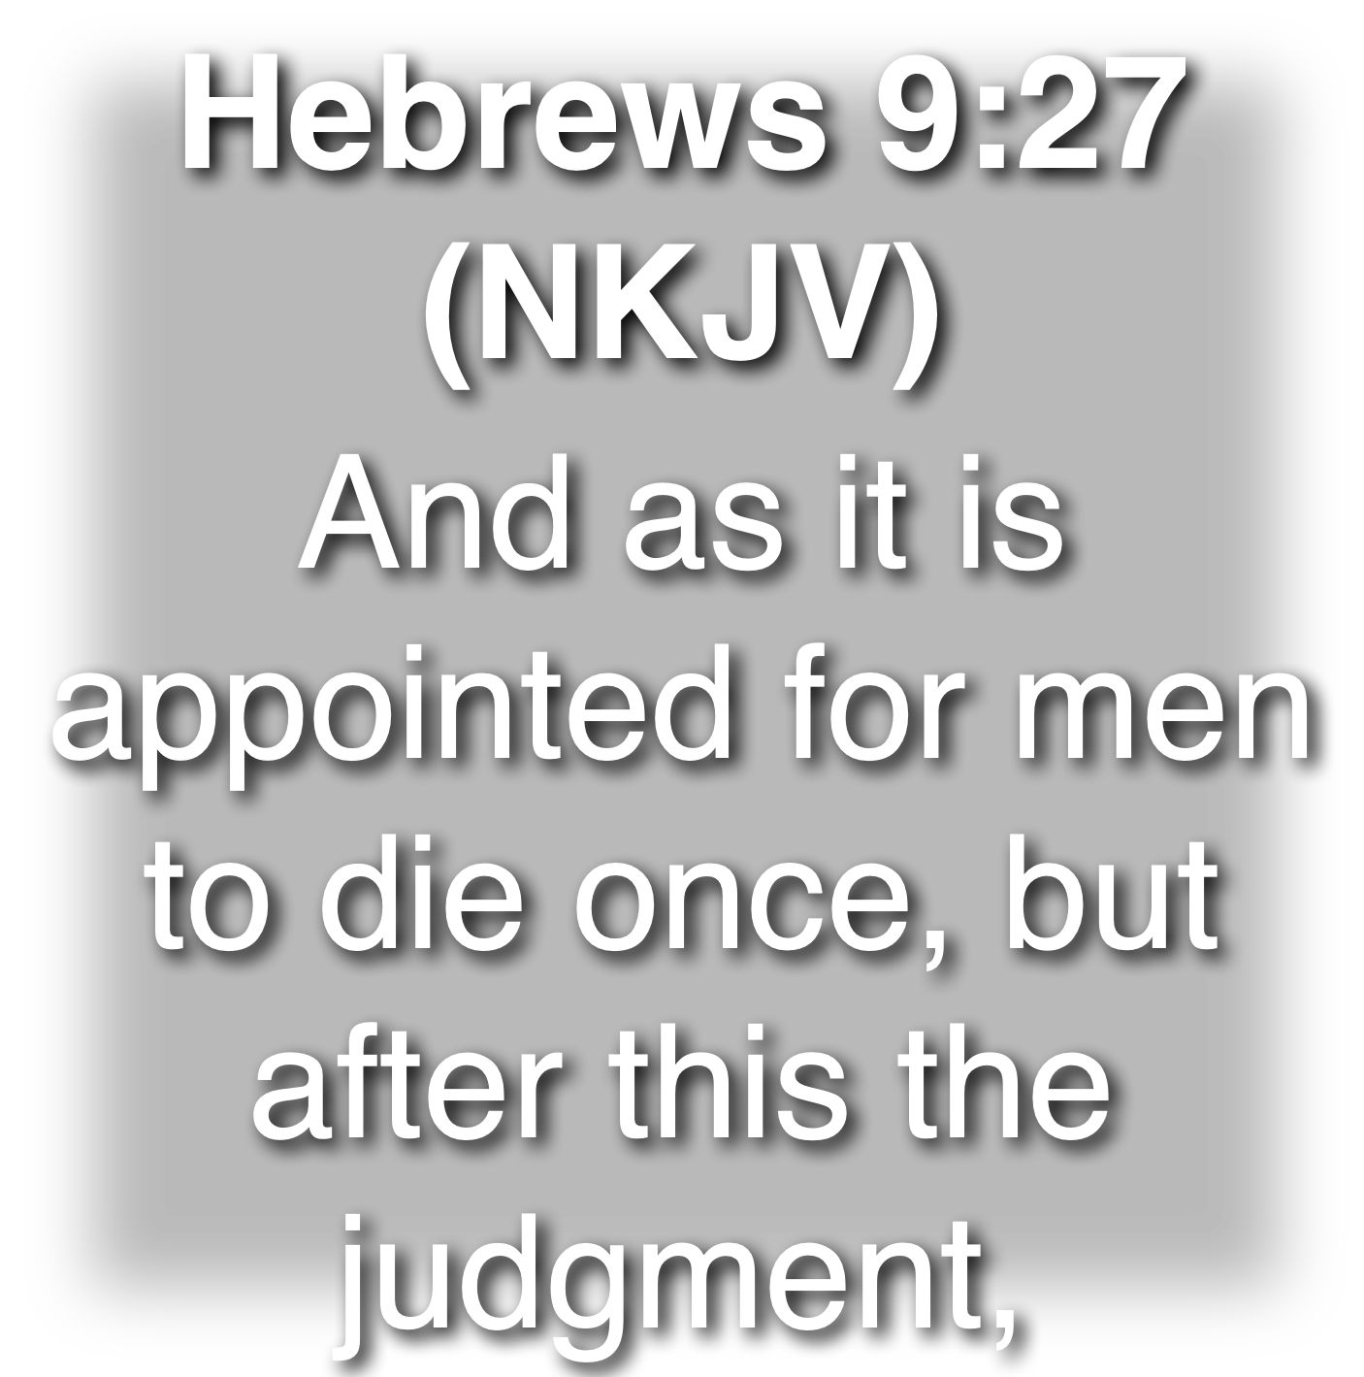

Slide 8
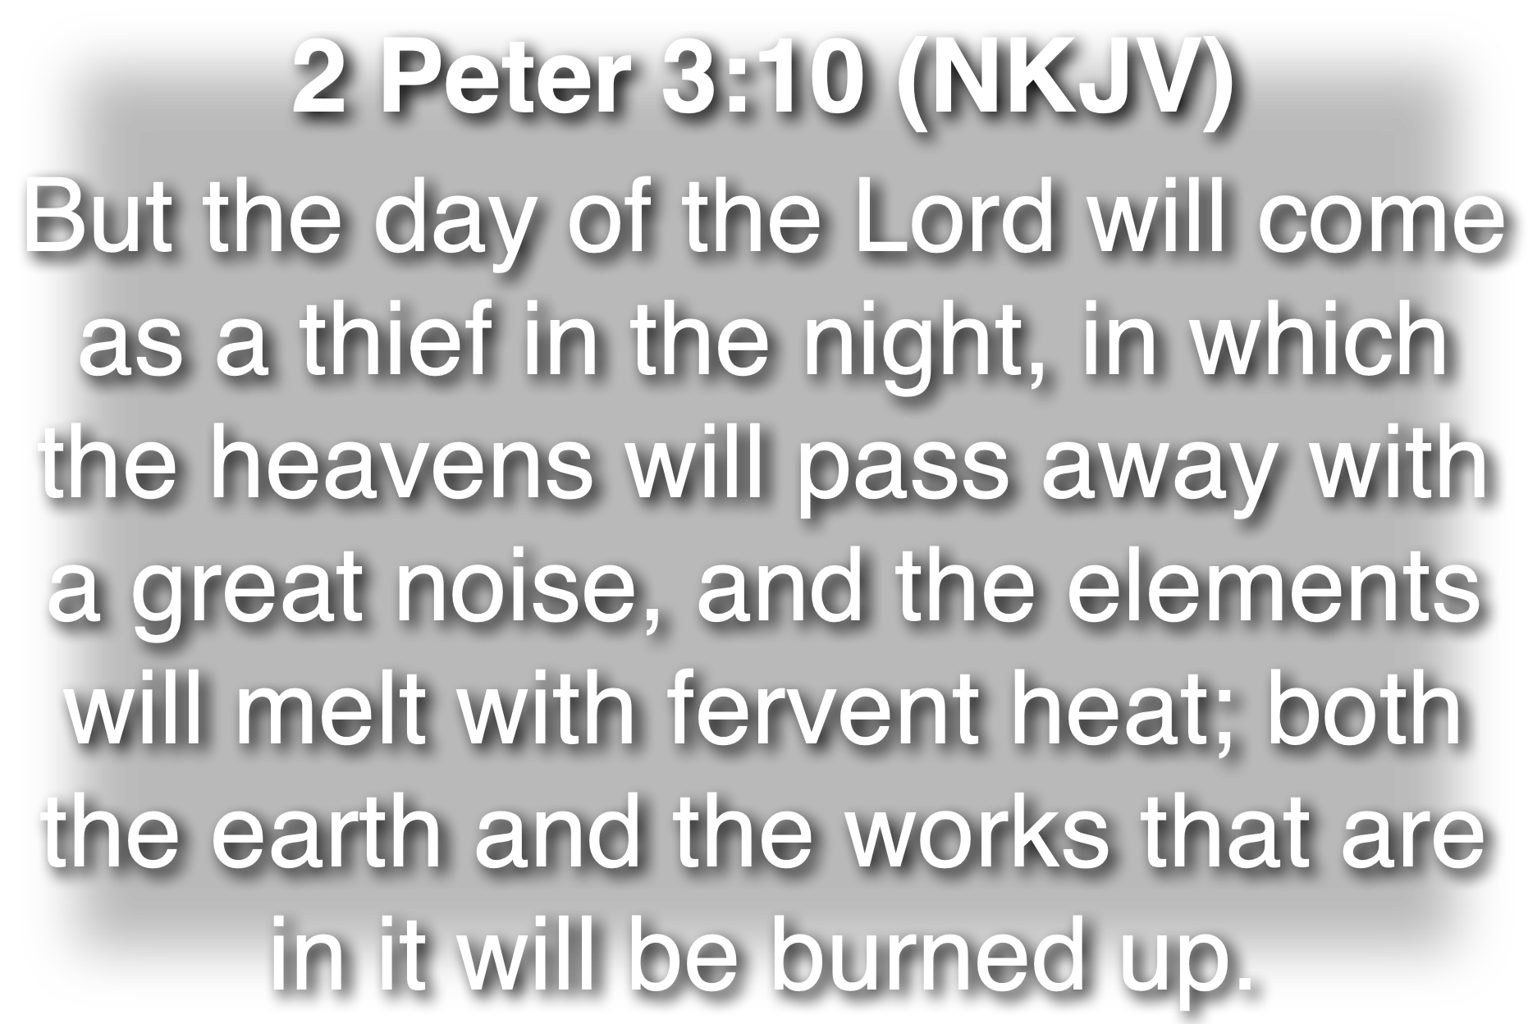

Slide 9
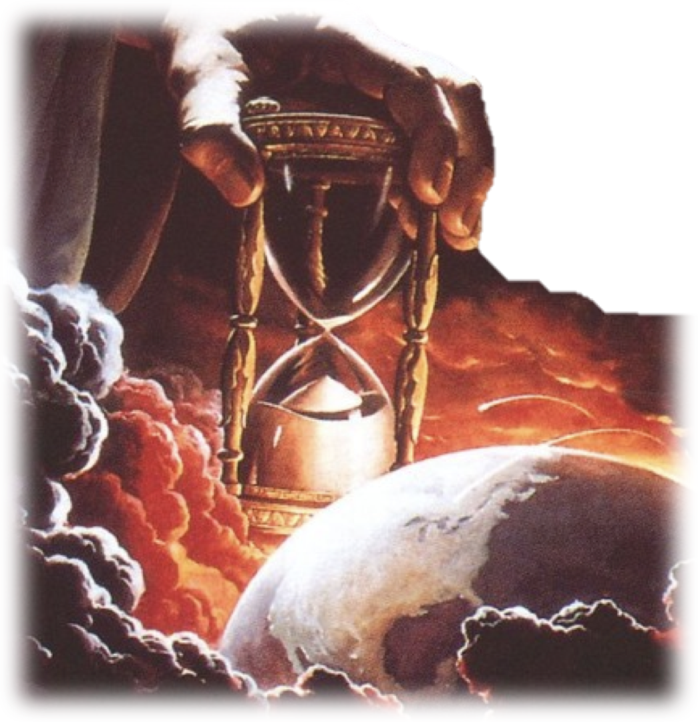
1 Peter 4:7 (NKJV)
But the end of all things is at hand; therefore be serious and watchful in your prayers.
(cf. Romans 13:11-14)

Slide 10
1 Peter 4:1–11 (NKJV)
¹ Therefore, since Christ suffered for us in the flesh, arm yourselves also with the same mind, for he who has suffered in the flesh has ceased from sin, ² that he no longer should live the rest of his time in the flesh for the lusts of men, but for the will of God. ³ For we have spent enough of our past lifetime in doing the will of the Gentiles—when we walked in lewdness, lusts, drunkenness, revelries, drinking parties, and abominable idolatries.

Slide 11
1 Peter 4:1–11 (NKJV)
⁴ In regard to these, they think it strange that you do not run with them in the same flood of dissipation, speaking evil of you. ⁵ They will give an account to Him who is ready to judge the living and the dead. ⁶ For this reason the gospel was preached also to those who are dead, that they might be judged according to men in the flesh, but live according to God in the spirit. ⁷ But the end of all things is at hand; therefore be serious and watchful in your prayers.

Slide 12
1 Peter 4:1–11 (NKJV)
⁸ And above all things have fervent love for one another, for “love will cover a multitude of sins.” ⁹ Be hospitable to one another without grumbling. ¹⁰ As each one has received a gift, minister it to one another, as good stewards of the manifold grace of God. ¹¹ If anyone speaks, let him speak as the oracles of God. If anyone ministers, let him do it as with the ability which God supplies, that in all things God may be glorified through Jesus Christ, to whom belong the glory and the dominion forever and ever. Amen.

Slide 13


Think Spiritually
1 Peter 4:1 (NKJV)
¹ Therefore, since Christ suffered for us in the flesh, arm yourselves also with the same mind, for he who has suffered in the flesh has ceased from sin,
The example of Jesus -
  Because of His mindset, He suffered abuse & death due to His faithfulness to the will of His Father (2:21-25; 3:18-22; Phili 2:5-10; Heb 12:1-3)
  Our minds must have the same bent!

Slide 14
Think Spiritually
1 Peter 4:1 (NKJV)
¹ Therefore, since Christ suffered for us in the flesh, arm yourselves also with the same mind, for he who has suffered in the flesh has ceased from sin,
“Arm yourself with the same mind”
  ”ARM” - a military term -
  We are at war, and it is a war that begins in the mind - (2:11; Eph. 6:10-18; 2 Cor. 10:3-5)

Slide 15
Think Spiritually
1 Peter 4:1 (NKJV)
¹ Therefore, since Christ suffered for us in the flesh, arm yourselves also with the same mind, for he who has suffered in the flesh has ceased from sin,
Victory always begins in the MIND (Rom 12:1,2)
  Initial resolve - Josh 24:15
  Prioritization - Mat 6:33
  Commitment - 2 Cor 8:5
  Determination - 2 Pet 1:5-10
  Persistence - 1 Cor 15:58

Slide 16
Live Acceptably
Ceasing To Walk In Sin (Rom 6:1-23)
  The Christian repents – i.e. turns from his sins (Isaiah 1:16; Eph 4:25-27; 5:15,16; 1 John 2:6;3:1,7,9,21,22)
  The Christian is ashamed of his sinful past! (Rom 6:21)
1 Peter 4:2 (NKJV)
² that he no longer should live the rest of his time in the flesh for the lusts of men, but for the will of God.

Slide 17
Live Acceptably
Ceasing To Walk In Sin (Rom 6:1-23)
  We are not to live for our own selfish desires or for the will of other men
  We are to live “for the will of God - to please God (Rom 12:2; 1 John 2:17)
1 Peter 4:2 (NKJV)
² that he no longer should live the rest of his time in the flesh for the lusts of men, but for the will of God.

Slide 18
Live Acceptably
Ceasing To Walk In Sin (Rom 6:1-23)
  LEWDNESS -  () absence of restraint, indecency, shameless conduct.
  LUST -  () evil desires that are inconsistent with the will of God.
1 Peter 4:3 (NKJV)
³ For we have spent enough of our past lifetime in doing the will of the Gentiles--when we walked in lewdness, lusts, drunkenness, revelries, drinking parties, and abominable idolatries.

Slide 19
Live Acceptably
Ceasing To Walk In Sin (Rom 6:1-23)
  DRUNKENNESS -  οἰνοφλυγία - intoxicated, inebriated, drunk with wine.
  REVELRIES - □□ (□) (Vines) the concomitant and consequence of drunkenness.
1 Peter 4:3 (NKJV)
³ For we have spent enough of our past lifetime in doing the will of the Gentiles--when we walked in lewdness, lusts, drunkenness, revelries, drinking parties, and abominable idolatries.

Slide 20
Live Acceptably
Ceasing To Walk In Sin (Rom 6:1-23)
  DRINKING PARTIES -  () - Lit. a drinking, (Vines) gathering at which wine was served, drinking party - (BDAG)
  ABOMINABLE IDOLATRIES
1 Peter 4:3 (NKJV)
³ For we have spent enough of our past lifetime in doing the will of the Gentiles--when we walked in lewdness, lusts, drunkenness, revelries, drinking parties, and abominable idolatries.

Slide 21
Live Acceptably
There is a noticeable change in the Christian’s life (Mat. 5:13-16; Phili 2:15,16).
  So much so that the ungodly speak evil of the righteous (1 Pet. 2:12; Jde 1:10 )
  Such treatment is to be expected (Mat. 5:10,11; John 15:19; 1 John 3:12)
1 Peter 4:4 (NKJV)
⁴ In regard to these, they think it strange that you do not run with them in the same flood of dissipation, speaking evil of you.

Slide 22
Live Acceptably
They will be judged by God (2 Thes 1:6-10; Rom 14:10-12)
1 Peter 4:5,6 (NKJV)
⁵ They will give an account to Him who is ready to judge the living and the dead.

Slide 23
Live Acceptably
1 Peter 4:5,6 (NKJV)
⁶ For this reason the gospel was preached also to those who are dead, that they might be judged according to men in the flesh, but live according to God in the spirit.
They will be judged by God (2 Thes 1:6-10; Rom 14:10-12)
  Since everyone will face the judgment, preach the gospel (2 Cor. 5:9-11)
  Those who believe & obey the gospel face a different fate than those who reject it (1 Pet 4:6, 12-19)

Slide 24
Act Soberly
1 Peter 4:7 (NKJV)
⁷ But the end of all things is at hand; therefore be serious and watchful in your prayers.
Take Life Seriously -
  To be clear-minded and self-controlled - lit., “be sober”; cf. 1 Peter 1:13; 5:8)
“And Sober Minded For The Sake of Your Prayers” - ESV
  Prayer without sober living is ineffective - but God hears the righteous (Eph 6:18; 1 John 5:15,16)

Slide 25
Love Fervently
The Priority & Nature of love - (Col. 3:12-14; 1 Pet. 1:22; 1 Cor. 13:1-8; 1 Thes. 4:10)
  Love is a choice, desire & commitment to actively seek the well being of its object (John 3:16; John 15:13; 1 John 5:3; 3:17; Rom 5:8)
  True love flows from God!
1 Peter 4:8 (NKJV)
⁸ And above all things have fervent love for one another, for "love will cover a multitude of sins."

Slide 26
Love Fervently
Will cover a multitude of sins (Prov. 10:12)
  Active love is not restricted to the righteous (Mt 5:43-48; Luke 6:27,35)
  Love never turns a blind eye to sin, but actively does whatever is necessary to help sinners overcome their sin (Ja 5:20)
1 Peter 4:8 (NKJV)
⁸ And above all things have fervent love for one another, for "love will cover a multitude of sins."

Slide 27
Love Fervently
Love provides the needs of others gladly (Heb 13:2)
  Individually, good is to be done towards all men (Gal. 6:10; Mat 5:45)
  Provides for brethren “without complaining” (Gal. 6:10; Rom 12:13)
1 Peter 4:9 (NKJV)
⁹ Be hospitable to one another without grumbling.

Slide 28
Serve Faithfully
1 Peter 4:10 (NKJV)
¹⁰ As each one has received a gift, minister it to one another, as good stewards of the manifold grace of God.
Using The Abilities We Have Been Given (Rom 12:6-8)
  Serving one another (Mat. 25:44, 2 Cor. 9:1, Heb. 6:10; Phili. 2:1-5)
  As good stewards (1 Cor. 4:1, Mat. 25:14-30)

Slide 29
Serve Faithfully
1 Peter 4:11 (NKJV)
¹¹ If anyone speaks, let him speak as the oracles of God. If anyone ministers, let him do it as with the ability which God supplies, that in all things God may be glorified through Jesus Christ, to whom belong the glory and the dominion forever and ever. Amen.
Using The Abilities We Have Been Given (Rom 12:6-8)
  Speaking God’s word (Acts 8:1-4; 2 Tim 4:2)
  Giving the glory to God through Jesus (1 Cor. 6:20; 10:31; 2 Cor. 9:13; Eph. 3:21)

Slide 30
Romans 13:11-14 (NKJV)
¹¹ And do this, knowing the time, that now it is high time to awake out of sleep; for now our salvation is nearer than when we first believed. ¹² The night is far spent, the day is at hand. Therefore let us cast off the works of darkness, and let us put on the armor of light. ¹³ Let us walk properly, as in the day, not in revelry and drunkenness, not in lewdness and lust, not in strife and envy. ¹⁴ But put on the Lord Jesus Christ, and make no provision for the flesh, to fulfill its lusts.

Slide 31
2 Peter 3:10-14 (NKJV)
¹² looking for and hastening the coming of the day of God, because of which the heavens will be dissolved, being on fire, and the elements will melt with fervent heat? ¹³ Nevertheless we, according to His promise, look for new heavens and a new earth in which righteousness dwells. ¹⁴ Therefore, beloved, looking forward to these things, be diligent to be found by Him in peace, without spot and blameless;

Slide 32
How much time do you have????
The day will come when "every one of us shall give account of himself to God"
(Romans 14:12).

Slide 33
Are You:
Thinking Spiritually?
Living Acceptably?
Acting Soberly?
Loving Fervently?
Serving Faithfully?

Slide 34
How will you live out the rest of your time? (4:2)
Have you obeyed the gospel? (4:17)
What if time ran out today?

Slide 35
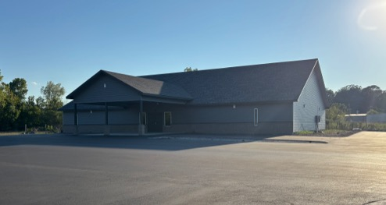

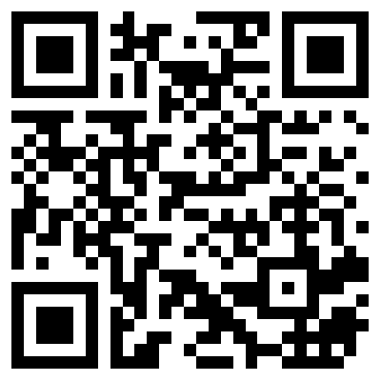
100 CORNERSTONE ALEXANDER AR, 72002
You Are Welcome At Any And All of Our Services!
Meeting Times:
Sunday A.M. Bible Study: 9:00
Sunday A.M. Assembly: 10:00
Sunday P.M. Assembly: 4:00
Wed. P.M. Bible Study: 7:00
ALEXANDERCHURCHOFCHRIST.COM

Slide 37
Charts by Don McClain
Preached November 4, 2012 West 65th Street church of Christ
Preached May 31, 2026 Alexander church of Christ/ / 100 Cornerstone Alexander AR 72002 / 501-568-1062
Prepared using Keynote
Email – donmcclain@sbcglobal.net / Our Website: WWW.BRYANTCHURCHOFCHRIST.COM

Slide 38
Romans 13:11-14 (NKJV)
¹¹ And do this, knowing the time, that now it is high time to awake out of sleep; for now our salvation is nearer than when we first believed. ¹² The night is far spent, the day is at hand. Therefore let us cast off the works of darkness, and let us put on the armor of light. ¹³ Let us walk properly, as in the day, not in revelry and drunkenness, not in lewdness and lust, not in strife and envy. ¹⁴ But put on the Lord Jesus Christ, and make no provision for the flesh, to fulfill its lusts.

