Slide 1
“Where Can I Flee From Your Presence?”
Jonah 1 – Series from Jonah Lesson #1

Slide 2
God Examines Us All
Before we begin to look at Jonah I believe it is imperative to understand something about God – The word “search” in Psalm 139:1 means that God is checking to see if we are pure, and after judging us determines if we are worthy after examining our inner man and intentions → The reality of this chapter and all throughout Psalms is that it is foolishness to reject God’s word, because ultimately God’s plans are accomplished (Isa. 55:11)
Paul speaks of the same thing essentially in 2 Corinthians 13:5 – Paul says we need to prove or test ourselves and determine from a close examination of ourselves as to whether or not we are truly in the faith and living Godly
In 2 Kings 19:8-13 a letter is sent by the Assyrian King to Judah telling them not to trust Hezekiah and he takes this letter before God and asks for deliverance… and God’s response in 2 Kings 19:27 explains that He knows the whereabouts and thoughts of all men despite being in Heaven, and David recognizes this by acknowledging that wherever he travels, whatever he thinks, sees, knows, hears… God knows
Verses 8-10 – David reveals that God is aware of man’s whereabouts despite even our best efforts to hide from Him (Jeremiah 23:23-24;32:17; Amos 9:1-4)
Knowing this, man is expected to follow the creator’s authorized words or laws (Psalm 119:73 & Rom. 9:20-21)

Slide 3
Psalm 139:1-10
Jonah was not dealing with just a god of the mountains or a god of the plains. Jehovah is THE God. No one can physically hide from Him (leave His presence) and no one can refuse to obey Him without consequence (Jer. 16:17; 23:23,24; Prov. 15:3; Heb 4:13
How does that thought make you feel? → God knows
When we act in ways that are sinful or shameful, God is aware
God knows if we love Him, hate Him or if we simply do not care either way
For the wicked that is the most terrifying of thoughts… But for the faithful, there is comfort in the omniscience of God
God knows what His faithful children go through, and He cares. The faithful simply do not want to hide from God. In fact, they look forward to the day when they will be with Him
A small child at times puts their hands over their face thinking you can’t see them, and many people think they can hide themselves from God in the exact same sense
In the book of Jonah, Jonah and all of us will come to find out that you can’t hide from God

Slide 4
How Far Would You Go To Hide From God?
Jonah → Hebrew for “Dove”
The story of Jonah is more of a history of a prophet than it is a book of prophecy although there is much foreshadowing surrounding Jesus being in the grave just as Jonah was in the belly of the fish (Matt. 12:40 & Matt. 16:4)
This book is not so much about God message from the prophet as God’s message to the prophet… He is mentioned in 2 Kings 14:25 where the text is speaking of Jeroboam II
Jonah was probably a contemporary with Hosea and Amos; or possibly he preceded them. He may have been the very oldest of all the prophets whose writings we possess
He prophesied during the reign of Jeroboam II (~793-753 B.C.)
He was from Gath Hepher (4 miles NE of what was later Nazareth in Galilee)
This is important because in Jesus’ day the Jews and their leaders recognized Jonah as a great prophet, and his origin contradicts the Pharisees’ assertion in John 7:52 that “no prophet came from Galilee”

Slide 5
How Far Would You Go To Hide From God?
During the reign of Jeroboam II (~793-753 B.C.) Israel and Judah were able to expand their borders, because of a period of decline in Assyria. It was probably during this period, the period during which Assyria was suffering a decline, that Jonah was commissioned to go to Nineveh. Sometimes called the “missionary prophet” – one sent, not to preach doom to Assyria, but repentance
Nineveh was the capital of Assyria
The Assyrians were noted for their cruelty, especially to prisoners (supposedly the gate to their city was covered with victories over enemies and carrying slaves off from their victories and running them over with chariots)
As a zealous patriot, Jonah wanted God to punish or destroy them; not forgive them
Jonah’s rejection of God’s mission is at the heart of this book
Now, Assyria was evil and in Jonah 1:1-2, God tells us that He has seen it. God is judge of all the earth (Gen 18:25) and he’s aware of Nineveh’s evil ways
One inscription from an Assyrian king said, “Many of the captives…I took alive; from some I cut off their hands to the wrists, from others I cut off their noses, ears and fingers; I put out the eyes of many of the soldiers. I burned their young men, women and children to death.” In another inscription, he wrote: “I flayed the nobles as many as rebelled; and spread their skins out on the piles.”

Slide 6
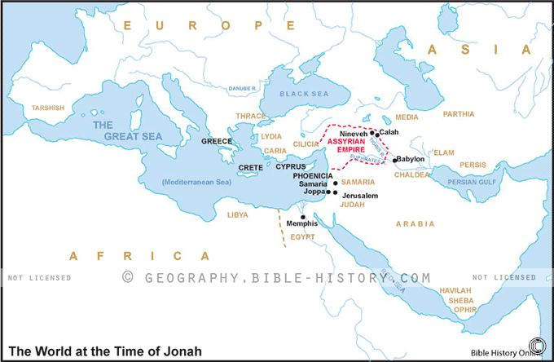
He REALLY Didn’t Want Nineveh To Repent

Slide 7
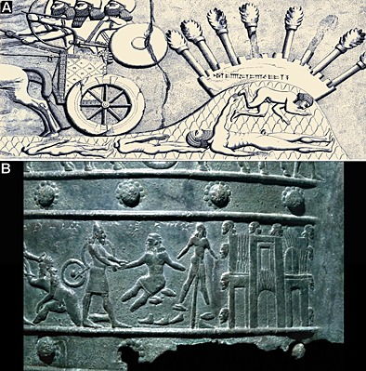
Israel Hated Assyria
A relief found in Sargon's (721–705 BC) Khorsbad palace, showing decapitated corpses run over by Assyrian war chariots (carvings or panels depicting cruel treatment of captives)
A relief found in the Balawat city gates showing Assyrian soldiers amputating the hands and feet of enemies and impaling them, as well as severed heads hung on the city gates

Slide 8
God’s Timing
From everything we know about the Assyrians: Cruel, pagans, gentiles
Why in the world did God pick this time to send Jonah?
History paints a picture for us that might help make it make sense for us…
Assyria had been defeated by Damascus and had lost most Syria at this point and had suffered another major defeat to another people called the Urartu
Plague and brutal civil wars were taking place around 750 BC in the kingdom… and I believe the people of Nineveh were in state of mind that was ready to receive the word of God as it would’ve been a means of hope
I think the people of Assyria knew their complete and utter destruction was coming if something didn’t change
God picks Jonah to be the man of the hour and commands him to go to Nineveh, but Jonah goes the opposite direction
Jonah was bitter in his mind and had no concern for the eternal souls of his enemies
Jonah was a man of deep convictions, and just like Jonah I believe many today allow those convictions to get the better of them… allowing a personal conviction to supersede what God has said to do is the very peak of arrogant foolishness in mankind (2 Thes. 2:1-4)

Slide 9
Jonah Flees
Verse 3 – Instead of going Northeast to Nineveh, he heads Southwest towards the coastal city of Joppa located on the Mediterranean
Now… at this point we are not told exactly why he Jonah ran from God.
Was Jonah afraid of the violent people of Nineveh? Did Jonah deem the people of Nineveh unworthy of God’s forgiveness? Why did Jonah ignore God’s command?
I know at this point we could easily speculate as to whether or not Jonah truly believed God was confined to just one region and that he could really escape, he probably was just trying to escape the responsibility, but ask yourself… if someone living on your borders were as cruel as the Assyrians how likely would you be to go out and do the job God has given us to do… to preach repentance? (2 Peter 3:9 – God was exercising patience with Nineveh)... you know, whether people like it or not, people will learn God is Creator and we all owe our allegiance to him, and everyone will learn it now in this life or in the life after this (Rom. 1:18-32)
As you go throughout this story you’ll see later the people of Nineveh do repent… but…

Slide 10
Jonah Flees
“When God saw their deeds, that they turned from their wicked way, then God relented concerning the calamity which He had declared He would bring upon them. And He did not do it.” (Jon. 3:10)
This shows the principle that “God is opposed to the proud, but gives grace to the humble” (1 Pet 5:5)
Because of their humility, that generation knew God’s grace and was spared from destruction
Unfortunately, the following generations of Assyrians returned to their evil practices and destroyed the northern kingdom of Israel in 722 B.C. And two decades later they attacked the southern kingdom of Judah during King Hezekiah’s reign (~701 BC)
What this lesson about the Assyrians reveals is that the humility and faith of one generation is merely the humility and faith of one generation – sadly one generation can’t force another generation to do right… and Assyria was destroyed around 622 BC
But, God is going to react to Jonah’s rebellion just as he reacted to Assyria’s rebellion

Slide 11
Jonah Flew The Coop
True to the meaning of his name, “Dove”, Jonah flies out of there as quick as he can
As parents when you tell your kid to do something, most of us if not all of us expect it to be done. We almost expect to read that God said to Jonah “go”, and then read “so Jonah went”... but rather if you ever want to jump on a boat going the opposite direction of God, there’s always room for one more passenger… when we want to go the opposite direction Satam is more than kind enough to provide the transportation
Verses 4-17: The storm!
Storms were typical in the Mediterranean, but even the pagans on the ship knew something just wasn’t right
They’re begging their gods for deliverance and throwing stuff overboard
Where is Jonah during this entire ordeal? – Verses 5 & 6 → The captain of the ship finds him snoozing away and unbothered
Notice that Jonah was really the only one guilty on board of rebelling against God in the moment yet everyone is danger… sin is not a victimless crime as we try to convince ourselves that it is – Neglect can cost the souls of your kids, grandkids, family, etc. (2 Tim, 4:2 – Even when it is not comfortable to do so, preach God’s word)

Slide 12
Jonah Flew The Coop
Verses 4-17:
6 & 7 – The irony and tragedy behind what the captain says to Jonah… pray to your God
A heathen sailor rebuking a prophet of God and calling on him to pray!
The crew on the ship cast lots, which was something similar to dice/rocks or perhaps drawing straws, in order to determine whose fault it was that the storm was coming, and it falls on Jonah (casting lots was normal – Joshua 18:10; 1 Chron. 25:8; Luke 23:34; & Acts 1:26)
9-12 – The interrogation and solution
The sailors immediately begin questioning Jonah – He tells them that he fears Jehovah God, but it makes you wonder how much he fears God… because he doesn’t hit his knees in repentance. Some commentators suggest this was a step towards repentance when he admits who he is, but look at his solution – essentially he says, “Kill me”
Throw me overboard and God will calm the seas
It is ironic in this 1st chapter that even pagan worshippers can understand something that Jonah and we tend to forget… it is foolish to disobey God… these men even wanted to know what God would have them do! And even Jonah recognizes God as the God of land and sea, yet here he is in a boat on the sea

Slide 13
The Tempest of Life
Verses 13-17
Sometimes in life we may be told things that we may not want to hear, such as the truth… Jonah was hit with truth that he didn’t like, that God wants Nineveh to repent
The Bible shows all sorts of situations where people did things out of the hardness of their heart, or they refused to do something out of the hardness of their hearts
Matt. 19:8 – Men throwing their wives out for any reason and leaving them destitute and not wanting to do right led God to allowing a certificate of divorce to be issued under 1 circumstance… and every time a divorce happens, at least 1 person has hardened their heart to behaving Godly
Exodus – All throughout this book we find God through Moses and Aaron telling Pharaoh what he must do, and Pharaoh hardened his heart… and what do we mean by that? That Pharaoh was told to do something he didn’t like and he ignored the demands of God and God used his arrogance to show His power (Romans 9:14-18)
Hebrews 3:8 – This references back to Psalm 95 and the people complaining to God in the wilderness. Don’t forget what happened to those who heard the voice of the Lord but did harden their hearts. They saw the works of God for forty years. Psalm 95 is a call to worship and God says, don’t ignore it & don’t test me

Slide 14
The Tempest of Life
Verses 13-17
Verse 13 & 14 – God makes a believer out of these sailors… they try to avoid having to grant the request of Jonah; They had no intentions of murdering him
Ultimately they realize it must be done and they pray to God that his blood be not upon them… which I find so interesting because the Jews in the days of Jesus were the same ones who said “let His blood be upon us”
Verse 15 & 16 – It went against their inclinations to worship God, they knew paganism… but after it is all said and done they knew one thing: God is in charge!
I truly believe these men took what had happened and what they had seen and realized just how helpless and puny they really were in comparison to the power of God… and they made vows to worship God
Verse 17 – Some speculate as to whether the men who threw Jonah overboard saw this great fish, but we know this… Jonah was to spend the next 3 days of his life in the depths of the ocean & Jesus refers to this event in Matthew 12:40 when rebuking the Pharisees… but we figure out why Jesus spoke of this incident in chapter 2

Slide 15
Lessons Learned From Jonah 1
You can’t hide from God – Psalms 139 → Jonah tried… Adam and Eve tried… and if we ignore what God requires of us, we’ll be judged for it John 12:48; Prov. 1:24-33
God has compassion for all the people of the earth – 2 Peter 3:9
Jehovah looked down upon Nineveh and observed the wickedness of these people (Jon. 1:2). Since sin is the transgression of divine law (1 Jn. 3:4; cf. Rom. 4:15), the Ninevites were obviously subject to such even though they weren’t under the Mosaic Law
We MUST be more compassionate towards others – Col. 3:12
Ephesians 4:31-32 – Let all bitterness and wrath and anger and clamor and slander be put away from you, along with all malice. Be kind to one another, tenderhearted, forgiving one another, as God in Christ forgave you
God’s way prevails one way or another; remember something though… God is longsuffering, he is not FOREVERsuffering – Colossians 1:16-17 (He created all things, and all things are before Him)
1 Peter 3:20 – who formerly were disobedient, when once the Divine longsuffering waited in the days of Noah, while the ark was being prepared, in which a few, that is, eight souls, were saved through water
Proverbs 19:21 – Many are the plans in the mind of a man, but it is the purpose of the Lord that will stand.

Slide 16
Conclusion
The book of Jonah is of value to PREACHERS… 1) Never prejudge an audience & 2) Don't try to avoid the responsibility God has placed on you
The book of Jonah is of value to ALL CHRISTIANS… 1) Don't have a selfish, narrow-minded, sectarian spirit & 2) Be concerned for all the wicked, whoever and wherever they are
The book of Jonah is of value to SINNERS… 1) God loves you & 2) Destruction is coming...
But He sent Christ and the apostles to reveal His will and save you
Today He has His preachers and teachers to warn you
Salvation is available wherever there is true repentance and obedience!
Finally, may the example of Nineveh's repentance remind us of what Jesus said:
"The men of Nineveh will rise up in the judgment with this generation and condemn it, because they repented at the preaching of Jonah; and indeed a greater than Jonah is here." (Mt 12:41)
Nineveh repented at the preaching of Jonah; have we repented at the preaching of One (Jesus) Who is much greater?

Slide 17
Invitation
Where is it that you believe you can hide from God? To who exactly are you going to turn when the question of eternity is presented?
Peter answers this question – in life, when you have a true understanding of where it is you are trying to go, there’s nothing that can keep you from deviating from that path. People left Jesus all the time, and he asks a question after all these people who have been following him for a free meal are told, no more free food… he says, “I am the manna that has come down from heaven… (and he then says to the disciples) do you also want to go away? (John 6:66,67)
But Simon Peter answered Him, “Lord, to whom shall we go? You have the words of eternal life (6:68)
Maybe you’ve been running from God. You can’t run far enough – let me ask you this? Who knows your disappointments? Who hears each time you cry? And who hears your call for comfort?

Slide 18
Invitation?
Why would you want to flee? Who do you turn to?
Suffering is a guarantee → James 1:2; 1 Peter 4:15-19
Turning to Jesus ensures things working together for good for us spiritually, and perhaps physically → Romans 8:28
Jesus doesn’t sympathise with us, he empathises with us because he’s been in our shoes and felt what we feel → Hebrews 4:15
Who was Jonah, and who are we to not offer the truth to others, even our enemies? Romans 13:7,8; Acts 20:24-38)… we owe it to others to at the very least offer them the gospel; don’t owe men in the sense that you held the truth back from them. Pay that obligation to man what is owed them, which is the opportunity to hear the truth
And the fact of the matter is this, the more that obey God allows two things to happen 1) all of heaven to rejoice and 2) Allows us as their brothers and sisters in Christ to not sorrow as those with no hope
-We can turn to God, and others can turn to God and feel comforted knowing this life is but a speck in eternity. Think of the biggest number you can possibly think, and even then you haven’t even begun to touch eternity

Slide 19
Philippians 2:10,11
“that at the name of Jesus every knee should bow, of those in heaven, and of those on earth, and of those under the earth, and that every tongue should confess that Jesus Christ is Lord, to the glory of God the Father”
If you’re not in Christ, there is no other name under heaven by which we all must be saved – He is THE way, THE truth, and THE life… will you be baptized into the body of Christ and submit to his will for us all… whether you do it in this life, or in the next, make no mistake about it, you will submit one way or another

Slide 20
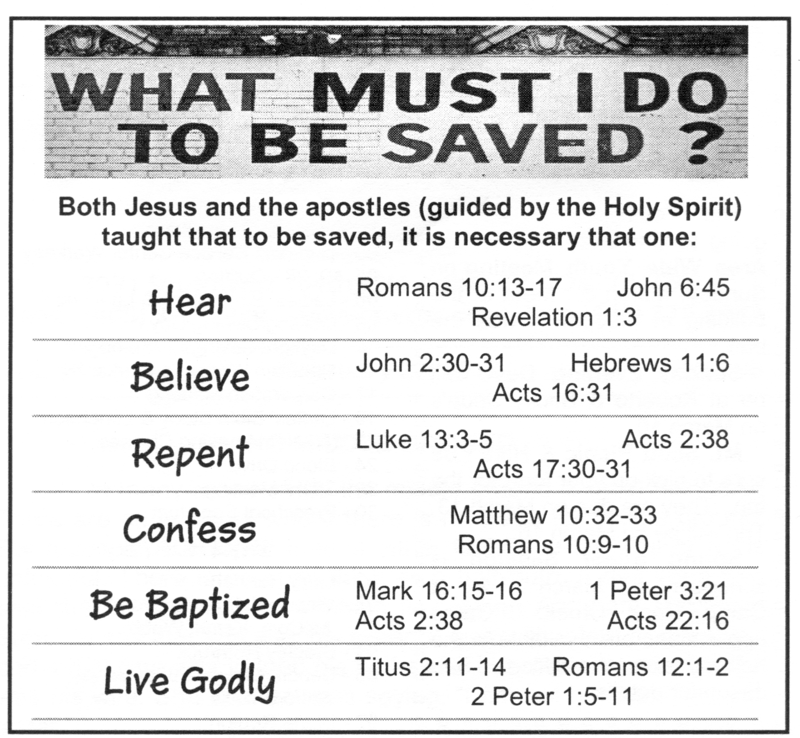
Invitation

Slide 21
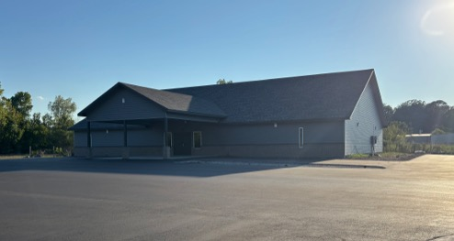

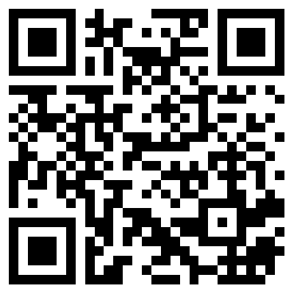
100 CORNERSTONE ALEXANDER AR, 72002
You Are Welcome At Any And All of Our Services!
Meeting Times:
Sunday A.M. Bible Study: 9:00
Sunday A.M. Assembly: 10:00
Sunday P.M. Assembly: 4:00
Wed. P.M. Bible Study: 7:00
ALEXANDERCHURCHOFCHRIST.COM

