Slide 1

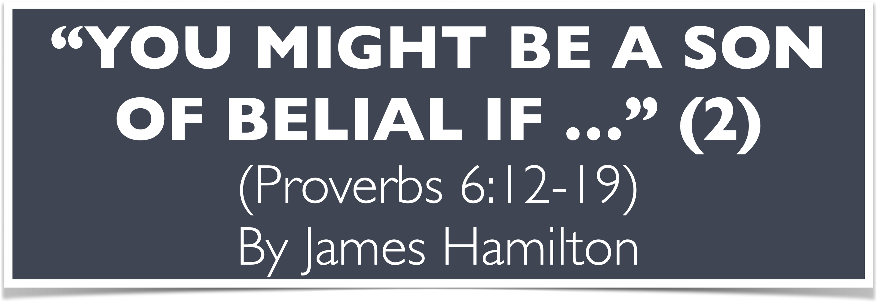

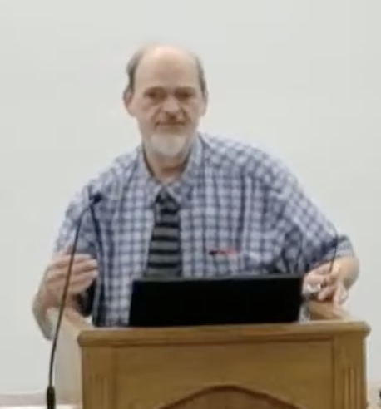
“Church of Christ MEETING @ 100 CORNERSTONE, Alexander AR. 72002”
TODAY’S LESSON
Sunday Morning Stream
10:00 AM ^{CT} October 25, 2026
https://www.youtube.com/user/donmcclain11/live / WWW.ALEXANDERCHURCHOFCHRIST.COM

Slide 2
YOU JUST MIGHT BE A SON OF BELIAL IF…
PROVERBS 6:12-19

Slide 3
You Are a Child of Belial If You…
Try to impose the Law of Moses upon Gentile Christians 2 Cor. 6:14-7:1; 11:12-15
Want to kill the Son of God John 8:24-59
Try to encourage others to practice idolatry Deuteronomy 13:13 (first time in scripture) Colossians 3:5
Plan not to lend to someone in need because you won’t see that money ever again Deut. 15:9; Matt. 5:42; Proverbs 19:17

Slide 4
Other Passages in the Original Hebrew
Deuteronomy 15:9 wicked heart
2 Sam. 22:5; Psalm 18:4 ungodly men
Job 34:18 Thou art wicked
Psalm 41:8 evil disease
Psalm 101:3 no wicked thing before my eyes
Proverbs 6:12 a naughty person
Prov. 16:27 an ungodly man
Prov. 19:28 an ungodly witness 1 Kings 21:10-13
Nahum 1:11,15 a wicked counsellor…the wicked shall no more pass through thee

Slide 5
1 Samuel 2:12-17
12 Now the sons of Eli were corrupt; they did not know the Lord. 13 And the priests’ custom with the people was that when any man offered a sacrifice, the priest’s servant would come with a three-pronged fleshhook in his hand while the meat was boiling. 14 Then he would thrust it into the pan, or kettle, or caldron, or pot; and the priest would take for himself all that the fleshhook brought up. So they did in Shiloh to all the Israelites who came there.

Slide 6
King James Version Passages
Deut. 13:13 encouraging idolatry
Judges 19:22; 20:13 sexual abusers of others
1 Samuel 1:15-16 drunkenness
1 Sam. 2:12-17 Eli’s sons: selfishness, forced false worship, fornication

Slide 7
1 Samuel 2:12-17
15 Also, before they burned the fat, the priest’s servant would come and say to the man who sacrificed, “Give meat for roasting to the priest, for he will not take boiled meat from you, but raw.” 16 And if the man said to him, “They should really burn the fat first; then you may take as much as your heart desires,” he would then answer him, “No, but you must give it now; and if not, I will take it by force.” 17 Therefore the sin of the young men was very great before the Lord, for men abhorred the offering of the Lord.

Slide 8
King James Version Passages
Deut. 13:13 encouraging idolatry
Judges 19:22; 20:13 sexual abusers of others
1 Samuel 1:15-16 drunkenness
1 Sam. 2:12 Eli’s sons: selfishness, adultery
1 Sam. 10:27 insult the king Job 34:18; Acts 23:5
1 Sam. 25:17,25 selfish Nabal Matt. 5:42
1 Sam. 30:22 David’s men not sharing Matthew 20:1-16; 1 Sam. 22:2

Slide 9
1 Samuel 30:18-25
18 So David recovered all that the Amalekites had carried away, and David rescued his two wives. 19 And nothing of theirs was lacking, either small or great, sons or daughters, spoil or anything which they had taken from them; David recovered all. 20 Then David took all the flocks and herds they had driven before those other livestock, and said, “This is David’s spoil.”

Slide 10
1 Samuel 30:18-25
21 Now David came to the two hundred men who had been so weary that they could not follow David, whom they also had made to stay at the Brook Besor. So they went out to meet David and to meet the people who were with him. And when David came near the people, he greeted them.” 22 Then all the wicked and worthless men of those who went with David answered and said, “Because they did not go with us, we will not give them any of the spoil that we have recovered, except for every man’s wife and children, that they may lead them away and depart.”

Slide 11
1 Samuel 30:18-25
23 But David said, “My brethren, you shall not do so with what the Lord has given us, who has preserved us and delivered into our hand the troop that came against us. 24 For who will heed you in this matter? But as his part is who goes down to the battle, so shall his part be who stays by the supplies; they shall share alike.” 25 So it was, from that day forward; he made it a statute and an ordinance for Israel to this day.

Slide 12
King James Version Passages
2 Sam. 16:7 resentful Shemei cursed David
2 Sam. 20:1 rebel Sheba
2 Sam. 23:6 those of rebellion
1 Kings 21:9-14 false witnesses Prov. 19:28

Slide 13
1 Kings 21:9-14
Jezebel…wrote in the letters, saying, “Proclaim a fast, and seat Naboth with high honor among the people; ¹⁰ and seat two men, scoundrels, before him to bear witness against him, saying, ‘You have blasphemed God and the king.’ Then take him out, and stone him, that he may die.” ¹¹ So the men of his city, the elders and nobles who were inhabitants of his city, did as Jezebel had sent to them, as it was written in the letters which she had sent to them.

Slide 14
1 Kings 21:9-14
12 They proclaimed a fast, and seated Naboth with high honor among the people. 13 And two men, scoundrels, came in and sat before him; and the scoundrels witnessed against him, against Naboth, in the presence of the people, saying, “Naboth has blasphemed God and the king!” Then they took him outside the city and stoned him with stones, so that he died. 14 Then they sent to Jezebel, saying, “Naboth has been stoned and is dead.”

Slide 15
King James Version Passages
2 Sam. 16:7 resentful Shemei cursed David
2 Sam. 20:1 rebel Sheba
2 Sam. 23:6 those of rebellion
1 Kings 21:9-14 false witnesses Prov. 19:28

Slide 16
King James Version Passages
2 Sam. 16:7 resentful Shemei cursed David
2 Sam. 20:1 rebel Sheba
2 Sam. 23:6 those of rebellion
1 Kings 21:9-14 false witnesses Prov. 19:28
2 Chronicles 13:7 worthless rebels

Slide 17
King James Version Passages
2 Sam. 16:7 resentful Shemei cursed David
2 Sam. 20:1 rebel Sheba
2 Sam. 23:6 those of rebellion
1 Kings 21:9-14 false witnesses Prov. 19:28
2 Chronicles 13:7 worthless rebels
2 Corinthians 6:15 what accord has Christ with Belial?

Slide 18
If You Are a Child of Belial Then You…
Should realize there is hope for you!
Good news! Jesus died for you, He arose from the dead, and He is the author of eternal salvation to all that obey Him Hebrews 5:7-9; 1 Corinthians 15:1-4
Believe in Jesus Romans 10:9 confess He is Lord
Repent of living for self; commit to obey Him Acts 2:38 be baptized in His name for the remission of your sins and live in Him

Slide 19
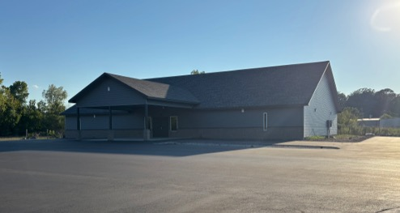

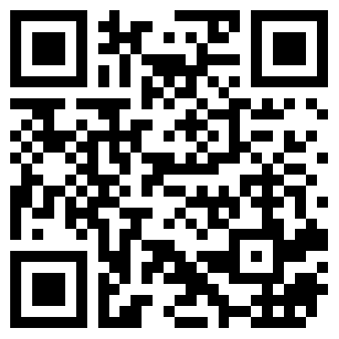
100 CORNERSTONE ALEXANDER AR, 72002
You Are Welcome At Any And All of Our Services!
Meeting Times:
Sunday A.M. Bible Study: 9:00
Sunday A.M. Assembly: 10:00
Sunday P.M. Assembly: 4:00
Wed. P.M. Bible Study: 7:00
ALEXANDERCHURCHOFCHRIST.COM

Slide 20
“Church of Christ MEETING @ 100 CORNERSTONE, Alexander AR. 72002”
TODAY’S LESSON
Sunday Morning Stream
10:00 AM ^{CT} October 25, 2026
https://www.youtube.com/user/donmcclain11/live / WWW.ALEXANDERCHURCHOFCHRIST.COM

