Slide 1
James 3:5 (NKJV)
“ Even so the tongue is a little member and boasts great things. See how great a forest a little fire kindles! ”
“The Power of Our Tongue” James 3:1-12

Slide 2
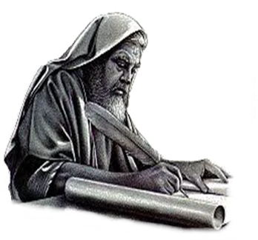
“The Power of Our Tongue”
“ Even so the tongue is a little member and boasts great things. See how great a forest a little fire kindles! ”James 3:5
Enduring trials through faith - 1:1-12
Overcoming temptation to do evil through faith - 1:13-16
Overcoming anger through faith - 1:17-19
Being doers of the word by faith - 1:20-27
The sin of favoritism / prejudice - 2:1-13
The faith that does not save and the ONLY kind of faith that does - 2:14-26
The power of the tongue and our need to control it - 3:1-12
Notes:
The practice of showing partiality to the rich discriminates against the poor and is evil (2:1–4). It is also strange, as the rich rather than the poor exploit Christians and slander that name (vv. 5–7). Worst of all, it is sin, for God’s Law calls on everyone to love a neighbor as yourself. Breaking that Law is the same as indulging in the more “serious” sins, for law is like a balloon: Stick a pin in one part and the whole thing breaks (vv. 8–11). We are to speak and act as those who are freed by the law of love from the law of rules. We will be evaluated on this basis: He who has received mercy must show himself merciful (vv. 12–13).0

Slide 3
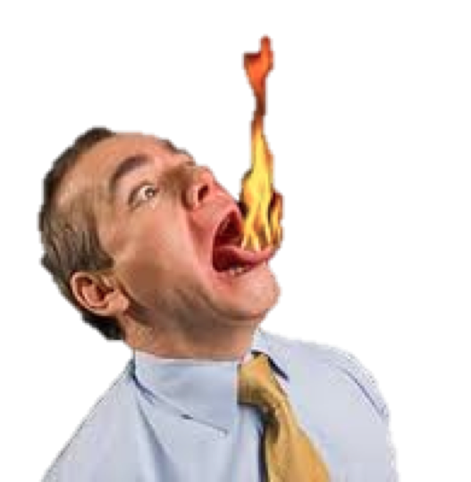
“The Power of Our Tongue”
“ Even so the tongue is a little member and boasts great things. See how great a forest a little fire kindles! ”James 3:5
It is such a small member, yet we should NEVER underestimate the role it plays, either for good or evil, in one’s ability to effect the lives of others.
The greater part of what James says is given to describe the evils the tongue is capable of doing, and will do, unless proper control is exercised.
Evidently James saw a greater need to warn against the misuse of the tongue than to extol its potential for good.
Notes:
The practice of showing partiality to the rich discriminates against the poor and is evil (2:1–4). It is also strange, as the rich rather than the poor exploit Christians and slander that name (vv. 5–7). Worst of all, it is sin, for God’s Law calls on everyone to love a neighbor as yourself. Breaking that Law is the same as indulging in the more “serious” sins, for law is like a balloon: Stick a pin in one part and the whole thing breaks (vv. 8–11). We are to speak and act as those who are freed by the law of love from the law of rules. We will be evaluated on this basis: He who has received mercy must show himself merciful (vv. 12–13).0

Slide 4
“The Power of Our Tongue”
James 3:1-12 (NKJV)
¹ My brethren, let not many of you become teachers, knowing that we shall receive a stricter judgment. ² For we all stumble in many things. If anyone does not stumble in word, he is a perfect man, able also to bridle the whole body. ³ Indeed, we put bits in horses' mouths that they may obey us, and we turn their whole body.

Slide 5
“The Power of Our Tongue”
James 3:1-12 (NKJV)
⁴ Look also at ships: although they are so large and are driven by fierce winds, they are turned by a very small rudder wherever the pilot desires. ⁵ Even so the tongue is a little member and boasts great things. See how great a forest a little fire kindles! ⁶ And the tongue is a fire, a world of iniquity. The tongue is so set among our members that it defiles the whole body, and sets on fire the course of nature; and it is set on fire by hell.

Slide 6
“The Power of Our Tongue”
James 3:1-12 (NKJV)
⁷ For every kind of beast and bird, of reptile and creature of the sea, is tamed and has been tamed by mankind. ⁸ But no man can tame the tongue. It is an unruly evil, full of deadly poison. ⁹ With it we bless our God and Father, and with it we curse men, who have been made in the similitude of God.

Slide 7
“The Power of Our Tongue”
James 3:1-12 (NKJV)
¹⁰ Out of the same mouth proceed blessing and cursing. My brethren, these things ought not to be so. ¹¹ Does a spring send forth fresh water and bitter from the same opening? ¹² Can a fig tree, my brethren, bear olives, or a grapevine bear figs? Thus no spring yields both salt water and fresh.

Slide 8
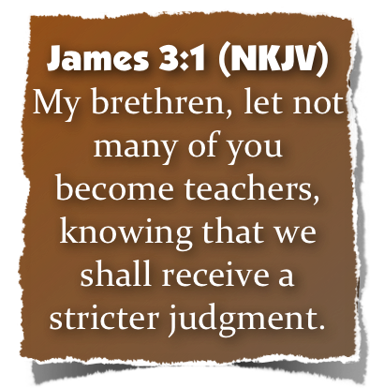
“The Power of Our Tongue”
A Warning To Teachers
Not everyone should teach. - 3:1-2 (As important as teaching the truth is, since it involves the use of the tongue, it can lead to sin.)
It was characteristic of Jewish Christians to want to become teachers. - Rom 2:17-20; 1 Timothy 1:7;
Some wanted to teach for the wrong reasons. -Matthew 23:5-7; Acts 20:33; 2 Pet 2:1-22
Notes:
The practice of showing partiality to the rich discriminates against the poor and is evil (2:1–4). It is also strange, as the rich rather than the poor exploit Christians and slander that name (vv. 5–7). Worst of all, it is sin, for God’s Law calls on everyone to love a neighbor as yourself. Breaking that Law is the same as indulging in the more “serious” sins, for law is like a balloon: Stick a pin in one part and the whole thing breaks (vv. 8–11). We are to speak and act as those who are freed by the law of love from the law of rules. We will be evaluated on this basis: He who has received mercy must show himself merciful (vv. 12–13).0

Slide 9
“The Power of Our Tongue”
A Warning To Teachers
Not everyone is qualified to teach. - Romans 12:4-7; 2 Timothy 2:2
All should strive to become qualified to teach. -1 Peter 3:15; Hebrews 5:12
The Lord placed within the church the function of teachers - Acts 13:1; Eph. 4:11
It is the function or work of teaching that James speaks of here - cf. 1 Cor. 12:28; Rom. 12:3-7
Notes:
The practice of showing partiality to the rich discriminates against the poor and is evil (2:1–4). It is also strange, as the rich rather than the poor exploit Christians and slander that name (vv. 5–7). Worst of all, it is sin, for God’s Law calls on everyone to love a neighbor as yourself. Breaking that Law is the same as indulging in the more “serious” sins, for law is like a balloon: Stick a pin in one part and the whole thing breaks (vv. 8–11). We are to speak and act as those who are freed by the law of love from the law of rules. We will be evaluated on this basis: He who has received mercy must show himself merciful (vv. 12–13).0

Slide 10
“The Power of Our Tongue”
A Warning To Teachers
No one should become a teacher without realizing what an awesome responsibility it is to be a teacher of the word of God. - (Precious souls are involved). Acts 20:30
Greater responsibility demands greater accountability - Luke 12:48
All who become teachers must do so "knowing that as such we shall incur a stricter judgment" (vs. 1).
Notes:
The practice of showing partiality to the rich discriminates against the poor and is evil (2:1–4). It is also strange, as the rich rather than the poor exploit Christians and slander that name (vv. 5–7). Worst of all, it is sin, for God’s Law calls on everyone to love a neighbor as yourself. Breaking that Law is the same as indulging in the more “serious” sins, for law is like a balloon: Stick a pin in one part and the whole thing breaks (vv. 8–11). We are to speak and act as those who are freed by the law of love from the law of rules. We will be evaluated on this basis: He who has received mercy must show himself merciful (vv. 12–13).0

Slide 11
“The Power of Our Tongue”
A Warning To Teachers
Needs to realize the great responsibility!
Must exercise caution and restraint in what he says!
Must be genuine in motive!
Must be properly prepared!
This is a HUGE problem in the religious world today!!! Far too many - "Desiring to be teachers of the law; understanding neither what they say, nor whereof they affirm.” 1 Timothy 1:7
Notes:
The practice of showing partiality to the rich discriminates against the poor and is evil (2:1–4). It is also strange, as the rich rather than the poor exploit Christians and slander that name (vv. 5–7). Worst of all, it is sin, for God’s Law calls on everyone to love a neighbor as yourself. Breaking that Law is the same as indulging in the more “serious” sins, for law is like a balloon: Stick a pin in one part and the whole thing breaks (vv. 8–11). We are to speak and act as those who are freed by the law of love from the law of rules. We will be evaluated on this basis: He who has received mercy must show himself merciful (vv. 12–13).0

Slide 12
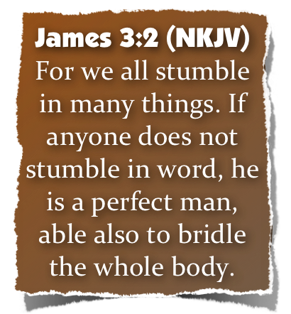
“The Power of Our Tongue”
A Warning To Teachers
We all sin - (even teachers) - He is not stating sin as a necessity, or as unavoidable - Rom 6:11-12; 1 Corinthians 15:34; 1 John 2:1; 3:8
The tongue is the hardest member of the body to control. - 3:2
A man who controls his tongue is “perfect.” - ibid (“Perfect in the sense in which James immediately explains himself; that he is able to keep every other member of the body in subjection” (Barnes).
Notes:
The practice of showing partiality to the rich discriminates against the poor and is evil (2:1–4). It is also strange, as the rich rather than the poor exploit Christians and slander that name (vv. 5–7). Worst of all, it is sin, for God’s Law calls on everyone to love a neighbor as yourself. Breaking that Law is the same as indulging in the more “serious” sins, for law is like a balloon: Stick a pin in one part and the whole thing breaks (vv. 8–11). We are to speak and act as those who are freed by the law of love from the law of rules. We will be evaluated on this basis: He who has received mercy must show himself merciful (vv. 12–13).0

Slide 13
“The Power of Our Tongue”
A Warning To Teachers
This does not excuse the misuse of the tongue. - Mat 12:36-37; Jam 1:26
It does show we can control the bodily passions and avoid sin.
If we can control the tongue we can control the whole body. - 3:2
We can control the tongue. - 1:26
Therefore, we can control the whole body. - cf. 1 Cor. 10:13
Notes:
The practice of showing partiality to the rich discriminates against the poor and is evil (2:1–4). It is also strange, as the rich rather than the poor exploit Christians and slander that name (vv. 5–7). Worst of all, it is sin, for God’s Law calls on everyone to love a neighbor as yourself. Breaking that Law is the same as indulging in the more “serious” sins, for law is like a balloon: Stick a pin in one part and the whole thing breaks (vv. 8–11). We are to speak and act as those who are freed by the law of love from the law of rules. We will be evaluated on this basis: He who has received mercy must show himself merciful (vv. 12–13).0

Slide 14
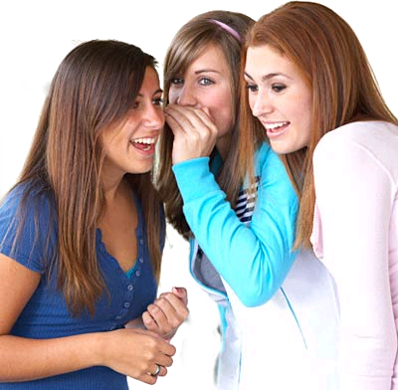
“The Power of Our Tongue”
The Tongue Is Small But Powerful - 3:3-5
The tongue is like:
A small bit that turns a large horse. - 3:3
A small rudder that turns a large ship. - 3:4
A small fire that ignites an inferno. - 3:5
Notes:
The practice of showing partiality to the rich discriminates against the poor and is evil (2:1–4). It is also strange, as the rich rather than the poor exploit Christians and slander that name (vv. 5–7). Worst of all, it is sin, for God’s Law calls on everyone to love a neighbor as yourself. Breaking that Law is the same as indulging in the more “serious” sins, for law is like a balloon: Stick a pin in one part and the whole thing breaks (vv. 8–11). We are to speak and act as those who are freed by the law of love from the law of rules. We will be evaluated on this basis: He who has received mercy must show himself merciful (vv. 12–13).0

Slide 15
“The Power of Our Tongue”
The Tongue Is Small But Powerful - 3:3-5
Even so the tongue has great power:
Proverbs 10:11 (NKJV)
The mouth of the righteous is a well of life, But violence covers the mouth of the wicked.
Notes:
The practice of showing partiality to the rich discriminates against the poor and is evil (2:1–4). It is also strange, as the rich rather than the poor exploit Christians and slander that name (vv. 5–7). Worst of all, it is sin, for God’s Law calls on everyone to love a neighbor as yourself. Breaking that Law is the same as indulging in the more “serious” sins, for law is like a balloon: Stick a pin in one part and the whole thing breaks (vv. 8–11). We are to speak and act as those who are freed by the law of love from the law of rules. We will be evaluated on this basis: He who has received mercy must show himself merciful (vv. 12–13).0

Slide 16
“The Power of Our Tongue”
The Tongue Is Small But Powerful - 3:3-5
Even so the tongue has great power:
To do great good - Mark 16:15-16; Eph 4:29; Prov 25:11
But FAR too often it is used to do great harm - Prov 26:20; Eph 4:25; 5:4
Notes:
The practice of showing partiality to the rich discriminates against the poor and is evil (2:1–4). It is also strange, as the rich rather than the poor exploit Christians and slander that name (vv. 5–7). Worst of all, it is sin, for God’s Law calls on everyone to love a neighbor as yourself. Breaking that Law is the same as indulging in the more “serious” sins, for law is like a balloon: Stick a pin in one part and the whole thing breaks (vv. 8–11). We are to speak and act as those who are freed by the law of love from the law of rules. We will be evaluated on this basis: He who has received mercy must show himself merciful (vv. 12–13).0

Slide 17
“The Power of Our Tongue”
The Tongue Is Small But Powerful - 3:3-5
Destroy neighbor - (Prov. 11:9)
Reveal secrets - (Prov. 11:13; 20:19)
Sows strife - (Prov. 16:28)
Separates friends - (Prov. 16:28; 17:9)
Destroy a church - (Gal. 5:15)
Notes:
The practice of showing partiality to the rich discriminates against the poor and is evil (2:1–4). It is also strange, as the rich rather than the poor exploit Christians and slander that name (vv. 5–7). Worst of all, it is sin, for God’s Law calls on everyone to love a neighbor as yourself. Breaking that Law is the same as indulging in the more “serious” sins, for law is like a balloon: Stick a pin in one part and the whole thing breaks (vv. 8–11). We are to speak and act as those who are freed by the law of love from the law of rules. We will be evaluated on this basis: He who has received mercy must show himself merciful (vv. 12–13).0

Slide 18
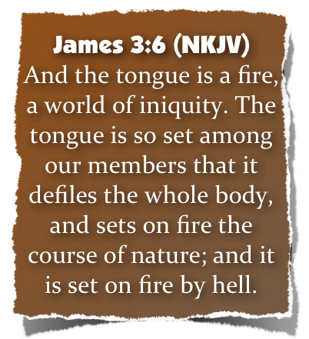
“The Power of Our Tongue”
The Tongue Is Untamable - 3:6-8
The tongue has incredible power to harm - 3:6:
“World of iniquity” - The tongue utters and leads to all the evil in the world. - e.g., Prov 26:21
Defiles (stains) the whole body. - Matthew 12:34-35
“Sets on fire the course (wheel) of nature” - inflames the whole round of one’s life
“Is set on fire of hell” - the source of the deadly fire is hell itself (lit., “Gehenna,”)
Notes:
The practice of showing partiality to the rich discriminates against the poor and is evil (2:1–4). It is also strange, as the rich rather than the poor exploit Christians and slander that name (vv. 5–7). Worst of all, it is sin, for God’s Law calls on everyone to love a neighbor as yourself. Breaking that Law is the same as indulging in the more “serious” sins, for law is like a balloon: Stick a pin in one part and the whole thing breaks (vv. 8–11). We are to speak and act as those who are freed by the law of love from the law of rules. We will be evaluated on this basis: He who has received mercy must show himself merciful (vv. 12–13).0

Slide 19
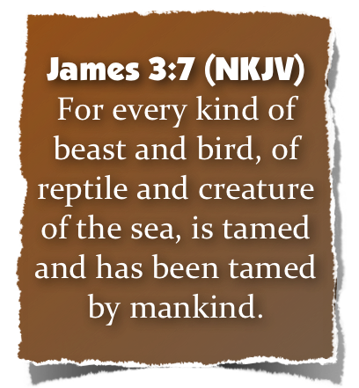
“The Power of Our Tongue”
The Tongue Is Untamable - 3:6-8
An untamable beast must be caged
Generally speaking, man is able to tame beasts (A tamed beast needs no restraints - dogs, cats, horses, etc). -3:7; cf. Gen 1:27-28; 9:22
There are beast that cannot be domesticated - they must be kept in a cage! (why do they put lions, tigers, poisonous reptiles, etc. in cages?)
Notes:
The practice of showing partiality to the rich discriminates against the poor and is evil (2:1–4). It is also strange, as the rich rather than the poor exploit Christians and slander that name (vv. 5–7). Worst of all, it is sin, for God’s Law calls on everyone to love a neighbor as yourself. Breaking that Law is the same as indulging in the more “serious” sins, for law is like a balloon: Stick a pin in one part and the whole thing breaks (vv. 8–11). We are to speak and act as those who are freed by the law of love from the law of rules. We will be evaluated on this basis: He who has received mercy must show himself merciful (vv. 12–13).0

Slide 20
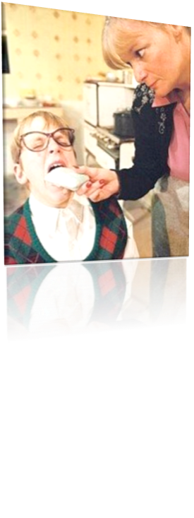
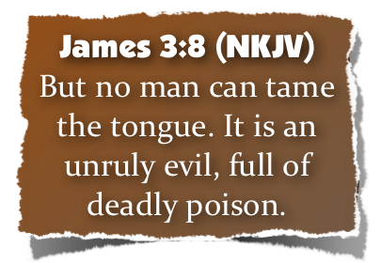
“The Power of Our Tongue”
The Tongue Is Untamable - 3:6-8
An untamable beast must be caged
The tongue, being untamable, must be restrained. - 3:8; Proverbs 10:19As an untamable beast is kept caged - God has given us pearly white bars to cage the tongue, - (Clench the teeth, close the lips, and restrain the tongue) - Ps 141:3
The unrestrained tongue can do more harm than a room full of rattle snakes! - Ps 140:3
Notes:
The practice of showing partiality to the rich discriminates against the poor and is evil (2:1–4). It is also strange, as the rich rather than the poor exploit Christians and slander that name (vv. 5–7). Worst of all, it is sin, for God’s Law calls on everyone to love a neighbor as yourself. Breaking that Law is the same as indulging in the more “serious” sins, for law is like a balloon: Stick a pin in one part and the whole thing breaks (vv. 8–11). We are to speak and act as those who are freed by the law of love from the law of rules. We will be evaluated on this basis: He who has received mercy must show himself merciful (vv. 12–13).0

Slide 21
“The Power of Our Tongue”
The Tongue Is Untamable - 3:6-8
An untamable beast must be caged
Psa. 34:13 "Keep your tongue from evil, And your lips from speaking deceit“
Ep 4:29 “Let no corrupt word proceed out of your mouth, but what is good for necessary edification, that it may impart grace to the hearers.”
Co 4:6 “Let your speech always be with grace, seasoned with salt, that you may know how you ought to answer each one.”
Notes:
The practice of showing partiality to the rich discriminates against the poor and is evil (2:1–4). It is also strange, as the rich rather than the poor exploit Christians and slander that name (vv. 5–7). Worst of all, it is sin, for God’s Law calls on everyone to love a neighbor as yourself. Breaking that Law is the same as indulging in the more “serious” sins, for law is like a balloon: Stick a pin in one part and the whole thing breaks (vv. 8–11). We are to speak and act as those who are freed by the law of love from the law of rules. We will be evaluated on this basis: He who has received mercy must show himself merciful (vv. 12–13).0

Slide 22
“The Power of Our Tongue”
The Tongue Is Untamable - 3:6-8
The Lying Tongue
The Flattering Tongue
The Proud Tongue
The Overused Tongue
The Swift Tongue
The Backbiting Tongue
The Tale bearing (Gossiping) Tongue
The Cursing Tongue
The Filthy Tongue
The Complaining Tongue
The Silent Tongue

Slide 23
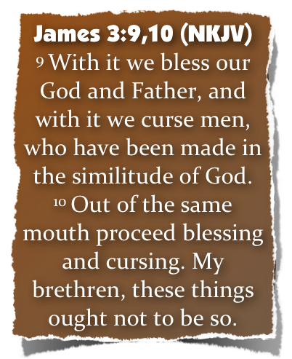
“The Power of Our Tongue”
Foolish Inconsistencies Regarding The Tongue - (9-12)
Should one and the same tongue:
Bless (praise, thank) God - cf. Psalm 145:21; 1 Cor. 10:16
And curse (petition God to destroy) men who are made in God’s likeness? - 3:9-10; cf. Gen 1:27; 1 John 4:20; Rom 12:14
Notes:
The practice of showing partiality to the rich discriminates against the poor and is evil (2:1–4). It is also strange, as the rich rather than the poor exploit Christians and slander that name (vv. 5–7). Worst of all, it is sin, for God’s Law calls on everyone to love a neighbor as yourself. Breaking that Law is the same as indulging in the more “serious” sins, for law is like a balloon: Stick a pin in one part and the whole thing breaks (vv. 8–11). We are to speak and act as those who are freed by the law of love from the law of rules. We will be evaluated on this basis: He who has received mercy must show himself merciful (vv. 12–13).0

Slide 24
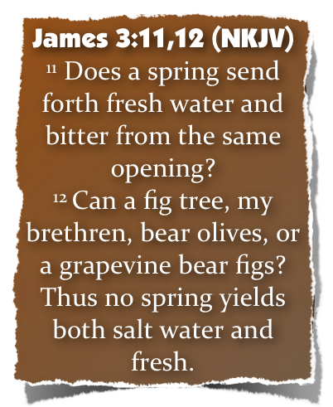
“The Power of Our Tongue”
Foolish Inconsistencies Regarding The Tongue - (9-12)
Does The same spring send out fresh and salty water - 3:11
Does A fig tree produce olives. - 3:12;
Then how can a good heart send out wholesome words and evil, hurtful, destructive words?
Notes:
The practice of showing partiality to the rich discriminates against the poor and is evil (2:1–4). It is also strange, as the rich rather than the poor exploit Christians and slander that name (vv. 5–7). Worst of all, it is sin, for God’s Law calls on everyone to love a neighbor as yourself. Breaking that Law is the same as indulging in the more “serious” sins, for law is like a balloon: Stick a pin in one part and the whole thing breaks (vv. 8–11). We are to speak and act as those who are freed by the law of love from the law of rules. We will be evaluated on this basis: He who has received mercy must show himself merciful (vv. 12–13).0

Slide 25
“The Power of Our Tongue”
Foolish Inconsistencies Regarding The Tongue - (9-12)
Matthew 12:33–37 (NKJV)
³³ “Either make the tree good and its fruit good, or else make the tree bad and its fruit bad; for a tree is known by its fruit. ³⁴ Brood of vipers! How can you, being evil, speak good things? For out of the abundance of the heart the mouth speaks.
Notes:
The practice of showing partiality to the rich discriminates against the poor and is evil (2:1–4). It is also strange, as the rich rather than the poor exploit Christians and slander that name (vv. 5–7). Worst of all, it is sin, for God’s Law calls on everyone to love a neighbor as yourself. Breaking that Law is the same as indulging in the more “serious” sins, for law is like a balloon: Stick a pin in one part and the whole thing breaks (vv. 8–11). We are to speak and act as those who are freed by the law of love from the law of rules. We will be evaluated on this basis: He who has received mercy must show himself merciful (vv. 12–13).0

Slide 26
“The Power of Our Tongue”
Foolish Inconsistencies Regarding The Tongue - (9-12)
Matthew 12:33–37 (NKJV)
³⁵ A good man out of the good treasure of his heart brings forth good things, and an evil man out of the evil treasure brings forth evil things.
Notes:
The practice of showing partiality to the rich discriminates against the poor and is evil (2:1–4). It is also strange, as the rich rather than the poor exploit Christians and slander that name (vv. 5–7). Worst of all, it is sin, for God’s Law calls on everyone to love a neighbor as yourself. Breaking that Law is the same as indulging in the more “serious” sins, for law is like a balloon: Stick a pin in one part and the whole thing breaks (vv. 8–11). We are to speak and act as those who are freed by the law of love from the law of rules. We will be evaluated on this basis: He who has received mercy must show himself merciful (vv. 12–13).0

Slide 27
“The Power of Our Tongue”
Foolish Inconsistencies Regarding The Tongue - (9-12)
Matthew 12:33–37 (NKJV)
³⁶ But I say to you that for every idle word men may speak, they will give account of it in the day of judgment. ³⁷ For by your words you will be justified, and by your words you will be condemned.”
Notes:
The practice of showing partiality to the rich discriminates against the poor and is evil (2:1–4). It is also strange, as the rich rather than the poor exploit Christians and slander that name (vv. 5–7). Worst of all, it is sin, for God’s Law calls on everyone to love a neighbor as yourself. Breaking that Law is the same as indulging in the more “serious” sins, for law is like a balloon: Stick a pin in one part and the whole thing breaks (vv. 8–11). We are to speak and act as those who are freed by the law of love from the law of rules. We will be evaluated on this basis: He who has received mercy must show himself merciful (vv. 12–13).0

Slide 28
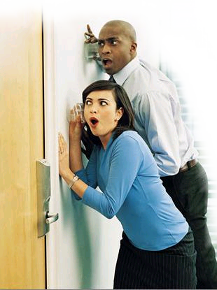
“The Power of Our Tongue”
How Can We Restrain The Tongue?
Acknowledge the need - Psalm 39:1; Prov 10:19; 29:11
Careful what your say to & about others - Jam 1:19; Prov 11:13
Genuine love - 1 Cor 13:4-8
Purify Your Mind - Mat 23:25-26; 12:33; Rom 12:1-2
Notes:
The practice of showing partiality to the rich discriminates against the poor and is evil (2:1–4). It is also strange, as the rich rather than the poor exploit Christians and slander that name (vv. 5–7). Worst of all, it is sin, for God’s Law calls on everyone to love a neighbor as yourself. Breaking that Law is the same as indulging in the more “serious” sins, for law is like a balloon: Stick a pin in one part and the whole thing breaks (vv. 8–11). We are to speak and act as those who are freed by the law of love from the law of rules. We will be evaluated on this basis: He who has received mercy must show himself merciful (vv. 12–13).0

Slide 29
“The Power of Our Tongue”
Tremendous Power For Both Good & Evil – (But Most Often Is The Cause of Big Problems) – James 3:1-6
Is Never Fully Tamed - James 3:7-8
Reflects What Is In The Heart – James 3:9-12
Notes:
The practice of showing partiality to the rich discriminates against the poor and is evil (2:1–4). It is also strange, as the rich rather than the poor exploit Christians and slander that name (vv. 5–7). Worst of all, it is sin, for God’s Law calls on everyone to love a neighbor as yourself. Breaking that Law is the same as indulging in the more “serious” sins, for law is like a balloon: Stick a pin in one part and the whole thing breaks (vv. 8–11). We are to speak and act as those who are freed by the law of love from the law of rules. We will be evaluated on this basis: He who has received mercy must show himself merciful (vv. 12–13).0

Slide 30
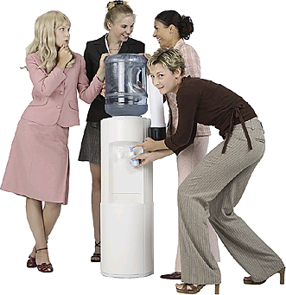
“Be Careful Little Mouth What You Say . . .”
James 3:1-12
Matthew 12:33-37
Notes:
O Be Careful, Little Eyes
Listen to sample & buy CD »
O be careful little eyes what you see
O be careful little eyes what you see
There's a Father up above
And He's looking down in love
So, be careful little eyes what you see
O be careful little ears what you hear
O be careful little ears what you hear
There's a Father up above
And He's looking down in love
So, be careful little ears what you hear
O be careful little hands what you do
O be careful little hands what you do
There's a Father up above
And He's looking down in love
So, be careful little hands what you do
O be careful little feet where you go
O be careful little feet where you go
There's a Father up above
And He's looking down in love
So, be careful little feet where you go
O be careful little mouth what you say
O be careful little mouth what you say
There's a Father up above
And He's looking down in love
So, be careful little mouth what you say

Slide 32
Charts by Don McClain
Prepared May 19,20, 2012
Preached May 20, 2012
West 65th Street church of Christ
P.O. Box 190062
Little Rock AR 72219
501-568-1062
Prepared using PPT 2010
Email – donmcclain@sbcglobal.net
More PPT & Audio Sermons:
http://w65stchurchofchrist.org/donmaccla/2010SermonPage.html
Note – Many of the transition effects used in this presentation may be lost using PPT 2007 Viewer
http://www.microsoft.com/downloads/details.aspx?FamilyID=cb9bf144-1076-4615-9951-294eeb832823&displaylang=en

Slide 33
Proverbs 10:13–21 (NKJV)
¹³ Wisdom is found on the lips of him who has understanding, But a rod is for the back of him who is devoid of understanding. ¹⁴ Wise people store up knowledge, But the mouth of the foolish is near destruction. ¹⁵ The rich man’s wealth is his strong city; The destruction of the poor is their poverty. ¹⁶ The labor of the righteous leads to life, The wages of the wicked to sin.

Slide 34
Proverbs 10:13–21 (NKJV)
¹⁷ He who keeps instruction is in the way of life, But he who refuses correction goes astray. ¹⁸ Whoever hides hatred has lying lips,
And whoever spreads slander is a fool.
¹⁹ In the multitude of words sin is not lacking, But he who restrains his lips is wise.
²⁰ The tongue of the righteous is choice silver; The heart of the wicked is worth little.
²¹ The lips of the righteous feed many,
But fools die for lack of wisdom.

