Slide 1
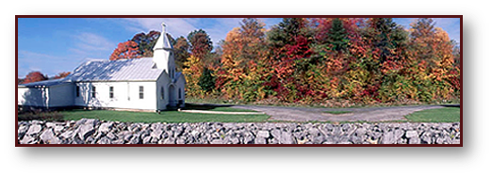
Why I Am A Member of the Church of Christ

Slide 2
Why I Am A Member of the Church of Christ
I am a member of the church of Christ, (i.e. the body of Christ), because the Lord added me to it when I obeyed the gospel! - Acts 2:37-47
Why am I a member of this local church and why do I fellowship some who identify themselves as members of the church of Christ? - Rom. 16:16

Slide 3
Why I Am A Member of the Church of Christ
Defining “The Church of Christ”
3

Slide 4
Why I Am A Member of the Church of Christ
Defining “The Church of Christ”
“I will build MY CHURCH” Matt. 16:18
“There is ONE BODY” Eph. 4:4
“He is also head of the BODY, the CHURCH” Col. 1:18; Eph. 1:22-23

Slide 5
Why I Am A Member of the Church of Christ

Slide 6
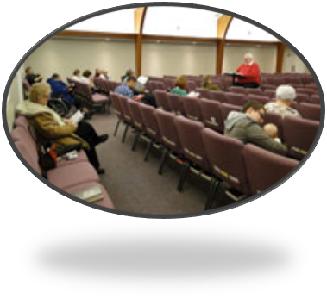
Why I Am A Member of the Church of Christ
Defining “The Church of Christ”
Who agree to join together in fellowship (Acts 9:26).
Who worship in a common assembly – (1 Cor. 11:18)
Who work out of a common treasury – (1 Cor.16:1-3)
Who submit to a common oversight – (Acts 14:23; 20:28)

Slide 7
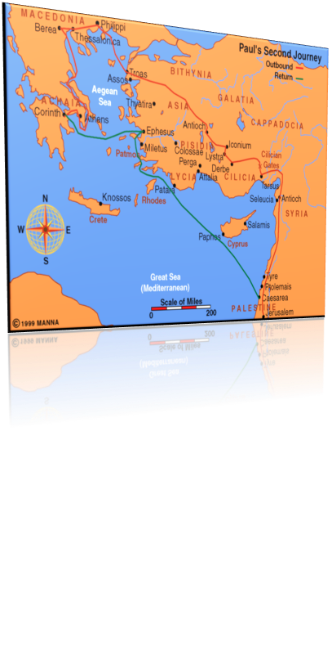
Why I Am A Member of the Church of Christ
Defining “The Church of Christ”
“the church of God which is at Corinth” - (1 Cor. 1:2)
“the church of the Thessalonians in God” - (1 Thess. 1:1).
“the churches of Galatia” - (1 Cor. 16:1).
“the churches of the saints” - (1 Cor. 14:33).
“the churches of Christ” - (Rom. 16:16).
“the churches” - (Acts 8:3; 15:41, etc., etc.).

Slide 8
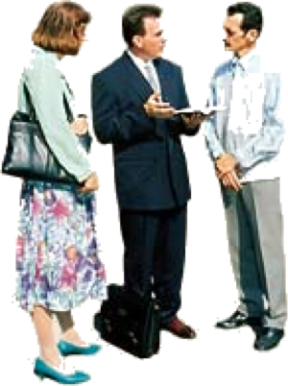
Why I Am A Member of the Church of Christ
“Anti” Denominational
Jesus Prayed For Unity – John 17:20-23
Paul Pleaded For Unity – 1 Cor. 1:10
The Church belonging to Christ Submits To Christ – Ephe 5:23,24; 4:1-6; 1 Cor 4:17

Slide 9
Why I Am A Member of the Church of Christ
“Anti” Denominational

Slide 10
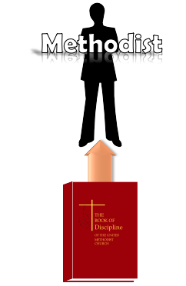
Why I Am A Member of the Church of Christ
“Anti” Denominational

Slide 11
Why I Am A Member of the Church of Christ
The Standard It Follows
Human Denominations Do Not Use “JUST” The Bible – (Confessions, Disciplines, Rules of Faith, Party Statements, etc.)
The Lord’s Church Uses ONLY The Bible As Its Guide In Faith, Teaching, Work, Worship & Organization. (2 Tim 3:16,17; 1 Pet 4:16; Col 3:17)

Slide 12
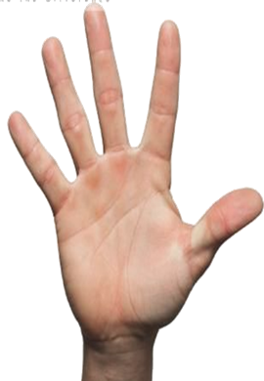
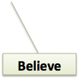
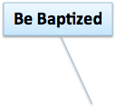
Why I Am A Member of the Church of Christ
The Message Preached
What A Person Must Do In Order To Be Saved In The Words of Inspired Men – (1 Peter 4:11)
The Alien Sinner - (Rom 10:17; John 8:24; Romans 10:9,10; Luke 13:3,5; Acts 17:30; Mark 16:15,16; Acts 2:38; 10:47; 22:16; Ro 6:3-6; 1 Pet 3:21)
The Christian – (Col. 1:23; Rev 2:10; Acts 8:18-24; 1 John 1:9)

Slide 13
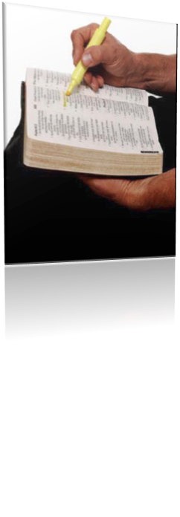
Why I Am A Member of the Church of Christ
The Message Preached
The Need To Live In Love & Purity – (Mark 12:29-31; Col. 3:1-14; 2 Cor 6:14-7:1; Ephe 5:1-18; 1 Pet 1:13-18)
The Need For Positive Divine Authority For Everything Believed, Taught & Practiced - (Mat 21:25; 1 Pet 4:11; Col. 3:17)
The Plea For Unity Upon What The Bible Says – (1 Cor 1:10; John 17:20-22; Ephe 4:1-6)
13

Slide 14
Why I Am A Member of the Church of Christ
The Organization Is Found In NT
Part of the structure through their writings - Eph 2:20
Ephesians 4:11 (NKJV) 11 And He Himself gave some to be apostles, some prophets, some evangelists, and some pastors and teachers,
Apostles,
Prophets,
Evangelists,
Pastors
Teachers,

Slide 15
Why I Am A Member of the Church of Christ
The Organization Is Found In NT
Elders / Pastors / Bishops - (Acts 14:23; 20:17,28; 1 Pet. 5:1-5; 1 Tim 3:1-7; Titus 1:5-9)
Deacons – (Phili 1:1; 1 Tim 3:8-13)
Saints – (Phili 1:1; 1 Cor 1:2; 2 Cor. 1:1; Eph 1:1; Col 1:1)
Philippians 1:1 (NKJV) Paul and Timothy, bondservants of Jesus Christ, To all the saints in Christ Jesus who are in Philippi, with the bishops and deacons:

Slide 16
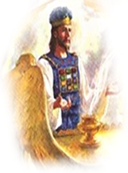
Why I Am A Member of the Church of Christ
The Organization Is Found In NT
Pastors (bishops; elders), over each local church
(1 Peter 5:1,2; Acts 14:23; Titus 1:5)
Speaks through the apostles in the New Testament
Jesus
(The Head)
Elders
Elders
Elders
Elders
Russellville
65 Conway
28th PB
65th LR
16

Slide 17
Why I Am A Member of the Church of Christ
The Worship Is Scriptural
Studying God’s Word - (Acts 20:7; Col 4:16)
Singing – (Eph 5:19; Col. 3:16)
Praying – (Acts 4:23-31; Eph 6:18)
Giving – (1 Cor 16:1,2)
Observing The Lord’s Supper– (Acts 20:7; 1 Cor 11:23-26)

Slide 18
The Work Is Authorized
Evangelism - (Acts 13:1-3)
Edification of the church -(Eph 4:11-16)
Benevolence to needy saints - (Ro 15:25-26)
Nothing else - (Col. 3:17)

Slide 19
Why I Am A Member of the Church of Christ
Have you been added to Christ’s church – Act 2:47?
Are you serving Christ in a scriptural local church? – Acts 9:26-28
Anti-Denominational -
The Standard –
The Message preached –
The organization is according to the NT pattern
The Worship Is Scriptural –
The Work Is Authorized -

Slide 21
Romans 16:16-20,25-27 (NKJV)
16 Greet one another with a holy kiss. The churches of Christ greet you. 17 Now I urge you, brethren, note those who cause divisions and offenses, contrary to the doctrine which you learned, and avoid them. 18 For those who are such do not serve our Lord Jesus Christ, but their own belly, and by smooth words and flattering speech deceive the hearts of the simple.
21

Slide 22
Romans 16:16-20,25-27 (NKJV) 19 For your obedience has become known to all. Therefore I am glad on your behalf; but I want you to be wise in what is good, and simple concerning evil. 20 And the God of peace will crush Satan under your feet shortly. The grace of our Lord Jesus Christ be with you. Amen.
22

Slide 23
Romans 16:16-20,25-27 (NKJV)
25 Now to Him who is able to establish you according to my gospel and the preaching of Jesus Christ, according to the revelation of the mystery kept secret since the world began 26 but now has been made manifest, and by the prophetic Scriptures has been made known to all nations, according to the commandment of the everlasting God, for obedience to the faith-- 27 to God, alone wise, be glory through Jesus Christ forever. Amen.
23

