Slide 1
That You May
”The Nobleman’s Son Healed”
(John 4:43-54)

Slide 2
“The Nobleman’s Son Healed”
John 20:30-31 (NKJV) ³⁰ And truly Jesus did many other signs in the presence of His disciples, which are not written in this book; ³¹ but these are written that you may believe that Jesus is the Christ, the Son of God, and that believing you may have life in His name.

Slide 3
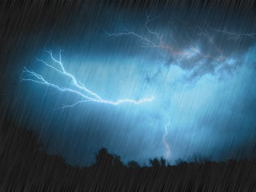
John 4:43-54 (NKJV)
⁴³ Now after the two days He departed from there and went to Galilee. ⁴⁴ For Jesus Himself testified that a prophet has no honor in his own country. ⁴⁵ So when He came to Galilee, the Galileans received Him, having seen all the things He did in Jerusalem at the feast; for they also had gone to the feast. ⁴⁶ So Jesus came again to Cana of Galilee where He had made the water wine. And there was a certain nobleman whose son was sick at Capernaum.

Slide 4
John 4:43-54 (NKJV)
⁴⁷ When he heard that Jesus had come out of Judea into Galilee, he went to Him and implored Him to come down and heal his son, for he was at the point of death. ⁴⁸ Then Jesus said to him, "Unless you people see signs and wonders, you will by no means believe." ⁴⁹ The nobleman said to Him, "Sir, come down before my child dies!" ⁵⁰ Jesus said to him, "Go your way; your son lives." So the man believed the word that Jesus spoke to him, and he went his way.

Slide 5
John 4:43-54 (NKJV)
⁵¹ And as he was now going down, his servants met him and told him, saying, "Your son lives!" ⁵² Then he inquired of them the hour when he got better. And they said to him, "Yesterday at the seventh hour the fever left him." ⁵³ So the father knew that it was at the same hour in which Jesus said to him, "Your son lives." And he himself believed, and his whole household. ⁵⁴ This again is the second sign Jesus did when He had come out of Judea into Galilee.

Slide 6
“The Nobleman’s Son Healed”
Jesus turned water into wine (John 2:1-12)
Jesus cleansed the temple, (John 2:13-22).
Preformed miracles in Jerusalem during Passover Week (John 2:23)
Talked with Nicodemus (John 3:1-15).
John the Baptist declares he must decrease (John 3:22-36).
Traveling through Samaria, Jesus encounters an immoral woman (John 4:1-26).
Jesus teaches His disciples (John 4:27-38)
Many Samaritans believe in Him (John 4:39-42)

Slide 7
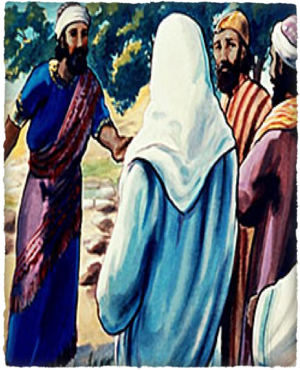
“The Nobleman’s Son Healed”
After His two-day ministry in Samaria, Jesus and His disciples continued north into Galilee. - (cf. Mat 4:4:12ff; Mark 1:14ff; Luke 4:14ff)
Jesus performed many miracles in Galilee during this time - (Mat 4:23-25)
John 4:43 (NKJV)
⁴³ Now after the two days He departed from there and went to Galilee.

Slide 8
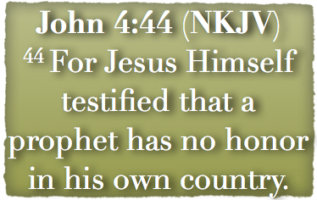
“The Nobleman’s Son Healed”
A prophet has no honor in his own country. (cf. Matt. 13:57; Mark 6:4).
Is His “own country” Judea or Nazareth?
Mike Willis: “Judea . . . seat of Jewish worship & government. Jerusalem, in the sense intended here.”

Slide 9
“The Nobleman’s Son Healed”
A prophet has no honor in his own country. (cf. Matt. 13:57; Mark 6:4).
Is His “own country” Judea or Nazareth?
Barnes, JFB, Adam Clarke: “Jesus went to Galilee, but not to Nazareth, . . .”

Slide 10
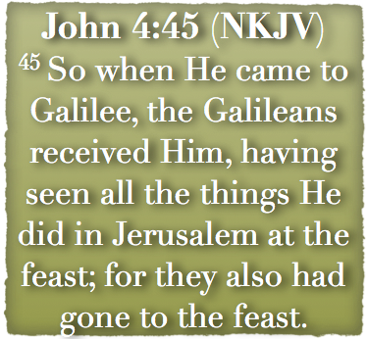
“The Nobleman’s Son Healed”
They had been impressed by His clearing the temple at the Passover feast (2:13-22) and His miracles (2:23).
Those in Judea generally rejected Jesus, but the Galileans were more ready to accept Him even though they witnessed the same events.

Slide 11
“The Nobleman’s Son Healed”
Location of first miracle recorded by John - (2:1-12)
The first miracle was associated with a wedding and is a time of festivity and joy, the second miracle is associated with sickness and is a time of anxiety and sorrow.

Slide 12
“The Nobleman’s Son Healed”
“Nobleman” - An officer of the king's court: for this is the meaning of the original word, which the Vulgate translates regulus, a little king.
This officer probably belonged to Herod Antipas, who was then tetrarch of Galilee.

Slide 13
“The Nobleman’s Son Healed”
Some people say this story is just another version of the healing of the Centurion’s servant (Matthew 8:5-13; Luke 7:2-10).
Although there are some similarities there are more differences.

Slide 14
“The Nobleman’s Son Healed”
The Centurion’s slave suffered from a paralysis; - the Nobleman’s son was ill with a fever.
The Centurion was a Roman officer - The Nobleman of Herod’s court.
The Centurion is in Capernaum; - the Nobleman travels 25 miles to Cana.

Slide 15
“The Nobleman’s Son Healed”
The Centurion urges Jesus not to come, but only to speak the word; - the Nobleman urges Jesus to come.
The Centurion has Jewish elders to plead his case; - the Nobleman pleads with Jesus personally.

Slide 16
“The Nobleman’s Son Healed”
It was a crisis in this man’s life (the sickness of his son) that lead him to travel 25 miles to find Jesus.
When the nobleman finds Jesus, he pleads with him to return immediately with him to Capernaum and to heal his son who is about to die.

Slide 17
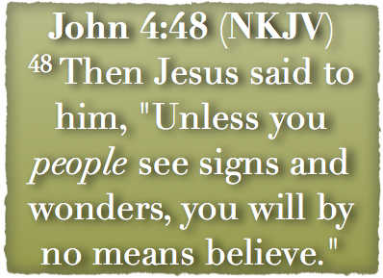
“The Nobleman’s Son Healed”
On the surface the response of Jesus is surprising.
Would this nobleman sought out Jesus had his son not been ill?
Jesus is speaking to more than just the nobleman. Jesus is rebuking the attitude of the crowd who had followed.

Slide 18
“The Nobleman’s Son Healed”
The people were more interested in the spectacular than what the signs pointed to.
Each miracle had a purpose (John 20:30,31; Heb 2:4)
Many sought Jesus just for the miracles - (Mark 8:11;,12; Mat 16:1-4; Luke 11:29; 1 Cor. 1:22)

Slide 19
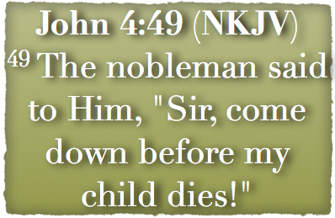
“The Nobleman’s Son Healed”
The nobleman is expressing a limited faith.
He thinks that Jesus can only help as long as the boy is alive.
It was also limited in that the nobleman thought that Jesus had to be present with the boy to heal him.

Slide 20
“The Nobleman’s Son Healed”
The words of Jesus are not intended to turn him away but to turn him to Jesus in faith.
The Nobleman believed Jesus to the point that he simply “went his way” towards home.

Slide 21
“The Nobleman’s Son Healed”
John 4:51-52 (NKJV) ⁵¹ And as he was now going down, his servants met him and told him, saying, "Your son lives!" ⁵² Then he inquired of them the hour when he got better. And they said to him, "Yesterday at the seventh hour the fever left him."

Slide 22
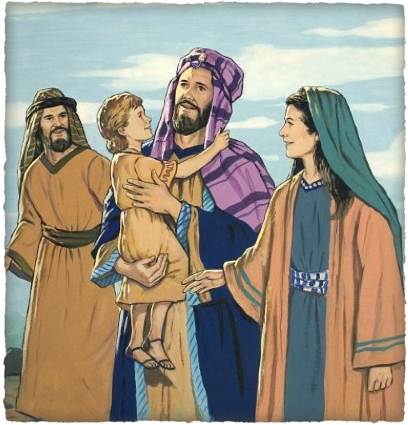
“The Nobleman’s Son Healed”
John 4:53-54 (NKJV) ⁵³ So the father knew that it was at the same hour in which Jesus said to him, "Your son lives." And he himself believed, and his whole household. ⁵⁴ This again is the second sign Jesus did when He had come out of Judea into Galilee.

Slide 23
“The Nobleman’s Son Healed”
John 20:30-31 (NKJV) ³⁰ And truly Jesus did many other signs in the presence of His disciples, which are not written in this book; ³¹ but these are written that you may believe that Jesus is the Christ, the Son of God, and that believing you may have life in His name.

Slide 24
“The Gift of God, ‘Living Water’”
Charts by Don McClain
Prepared & preached January 19, 2013
West 65th Street church of Christ
P.O. Box 190062
Little Rock AR 72219
501-568-1062
Prepared using Keynote
Email – donmcclain@sbcglobal.net
More Keynote, PPT & Audio Sermons:
http://w65stchurchofchrist.org/coc/sermons/
Note – Many of the transition effects used in this presentation will be lost using PPT 2007 Viewer
http://www.microsoft.com/downloads/details.aspx?FamilyID=cb9bf144-1076-4615-9951-294eeb832823&displaylang=en

Slide 25
Matthew 4:23-25 (NKJV)
²³ And Jesus went about all Galilee, teaching in their synagogues, preaching the gospel of the kingdom, and healing all kinds of sickness and all kinds of disease among the people.

Slide 26
Matthew 4:23-25 (NKJV)
²⁴ Then His fame went throughout all Syria; and they brought to Him all sick people who were afflicted with various diseases and torments, and those who were demon-possessed, epileptics, and paralytics; and He healed them. ²⁵ Great multitudes followed Him--from Galilee, and from Decapolis, Jerusalem, Judea, and beyond the Jordan.

