Slide 1
That You May
“True Disciples & The Truth”
(John 8:31-59)”

Slide 2
“True Disciples & The Truth”
John 20:30-31 (NKJV) ³⁰ And truly Jesus did many other signs in the presence of His disciples, which are not written in this book; ³¹ but these are written that you may believe that Jesus is the Christ, the Son of God, and that believing you may have life in His name.

Slide 3
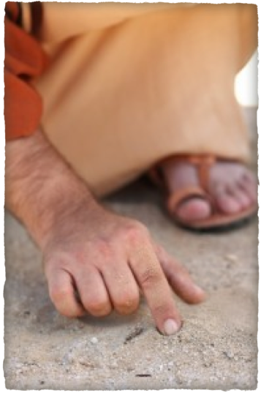
“True Disciples & The Truth”
Woman taken in adultery, vv. 1-11.
Jesus declares himself the light of the world, v. 12.
The Pharisees cavil, v. 13.
Jesus answers, and shows his authority, vv. 14-20.
He convicts them of sin, vv. 21-24.
They question him; he answers, foretelling his death, vv. 25-29.
Many believe on him, v. 30-32.

Slide 4
“True Disciples & The Truth”
In spite of widespread unbelief and official rejection, the ministry of Jesus did bring many to faith (cf. 7:31).
Yet this faith would need to be tested and refined - (31,32)

Slide 5
John 8:31–36 (NKJV)
³¹ Then Jesus said to those Jews who believed Him, “If you abide in My word, you are My disciples indeed. ³² And you shall know the truth, and the truth shall make you free.”

Slide 6
John 8:31–36 (NKJV)
³³ They answered Him, “We are Abraham’s descendants, and have never been in bondage to anyone. How can You say, ‘You will be made free’?” ³⁴ Jesus answered them, “Most assuredly, I say to you, whoever commits sin is a slave of sin.

Slide 7
John 8:31–36 (NKJV)
³⁵ And a slave does not abide in the house forever, but a son abides forever. ³⁶ Therefore if the Son makes you free, you shall be free indeed.

Slide 8
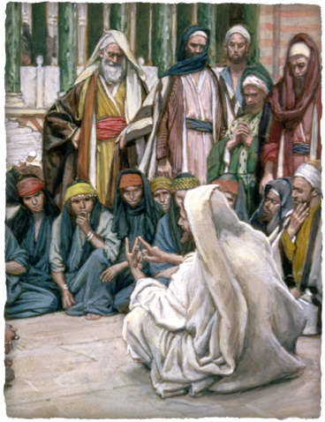
“True Disciples & The Truth”
Abiding in Jesus’ word - The real test of true discipleship - 31; 6:66–71; 15:4–9; Mat. 24:13. Ac. 13:43; 14:22; 26:22; Ro. 2:7; 11:22; Col. 1:23; 1 Ti. 2:15; 4:16; 2 Ti. 3:14; He. 3:14; 4:11; 8:9; 10:38,39; Ja. 1:25; 1 Jno. 2:19, 24
Their knowledge of Him was incomplete & their faith untested - Would they still be disciples when they understood what it cost? - Luke 9:23-26, 57-62; 18:18-23
John 8:31 (NKJV)
³¹ Then Jesus said to those Jews who believed Him, “If you abide in My word, you are My disciples indeed.

Slide 9
“True Disciples & The Truth”
Abiding in Jesus’ words, being a true disciple, [learner], of Jesus, places one in contact with the source of ALL TRUTH - Jesus - 1:14,17; 6:45; 7:17; 14:6; 15:1-10; 16:13.
This knowledge of “THE TRUTH shall make you free” from the bondage of sin - Is. 61:1; Ro. 6:14–18,22; 8:2,15; Ga. 5:1,13; 2 Ti. 2:25, 26. Ja. 1:25.
This freedom is found only when we listen to Jesus’ words & put them into practice - Jam 1:21,22;
John 8:32 (NKJV)
³² And you shall know the truth, and the truth shall make you free.”

Slide 10
“True Disciples & The Truth”
Their response indicate they had not grasped Christ’s message.
Even though they were currently under Rome’s control - They insisted that as Abraham’s descendants they were free men.
How could Jesus free them when they were not slaves? They had no sense of their bondage to sin.
John 8:33 (NKJV)
³³ They answered Him, “We are Abraham’s descendants, and have never been in bondage to anyone. How can You say, ‘You will be made free’?”

Slide 11
“True Disciples & The Truth”
More oppressive than any kind physical slavery is the spiritual slavery that comes from being a sinner! - Rom 7:5-8:3
Sin is personified as a cruel master. Paul used the same illustration (Rom. 6:15–23; Rom. 7; Gal 3:10-14) - (Compare 1 Jn 1:5-10; 3:4-9).
The Son makes free - Rom 8; Gal 3:26-4:7
John 8:34–36 (NKJV)
³⁴ Jesus answered them, “Most assuredly, I say to you, whoever commits sin is a slave of sin. . . . ³⁶ Therefore if the Son makes you free, you shall be free indeed.

Slide 12
“True Disciples & The Truth”
Jesus is the true Son and seed of Abraham (Gal. 3:16).
He remains in the house and is over it (Heb. 3:6).
People can become truly free by becoming sons of God by faith in Christ, the Son (Rom 8; Gal 3:26-4:7)
John 8:34–36 (NKJV)
³⁴ Jesus answered them, “Most assuredly, I say to you, whoever commits sin is a slave of sin. . . . ³⁶ Therefore if the Son makes you free, you shall be free indeed.

Slide 13
“True Disciples & The Truth”
John 20:30-31 (NKJV) ³⁰ And truly Jesus did many other signs in the presence of His disciples, which are not written in this book; ³¹ but these are written that you may believe that Jesus is the Christ, the Son of God, and that believing you may have life in His name.

Slide 15
“True Disciples & The Truth”
Charts by Don McClain
Prepared June 15, July 13 / Preached July 13, 2014
West 65th Street church of Christ
P.O. Box 190062
Little Rock AR 72219
501-568-1062
Prepared using Keynote
Email – donmcclain@sbcglobal.net
More Keynote, PPT & Audio Sermons:
http://w65stchurchofchrist.org/coc/sermons/
Note – Many of the transition effects used in this presentation will be lost using PPT 2007 Viewer
http://www.microsoft.com/downloads/details.aspx?FamilyID=cb9bf144-1076-4615-9951-294eeb832823&displaylang=en

Slide 16
John 15:1–8 (NKJV)
¹ “I am the true vine, and My Father is the vinedresser. ² Every branch in Me that does not bear fruit He takes away; and every branch that bears fruit He prunes, that it may bear more fruit. ³ You are already clean because of the word which I have spoken to you.

Slide 17
John 15:1–8 (NKJV)
⁴ Abide in Me, and I in you. As the branch cannot bear fruit of itself, unless it abides in the vine, neither can you, unless you abide in Me. ⁵ “I am the vine, you are the branches. He who abides in Me, and I in him, bears much fruit; for without Me you can do nothing.

Slide 18
John 15:1–8 (NKJV)
⁶ If anyone does not abide in Me, he is cast out as a branch and is withered; and they gather them and throw them into the fire, and they are burned.

Slide 19
John 15:1–8 (NKJV)
⁷ If you abide in Me, and My words abide in you, you will ask what you desire, and it shall be done for you. ⁸ By this My Father is glorified, that you bear much fruit; so you will be My disciples.

