Slide 1
That You May
“He Who Believes In Jesus Shall Live” - [John 11:1-57]

Slide 3
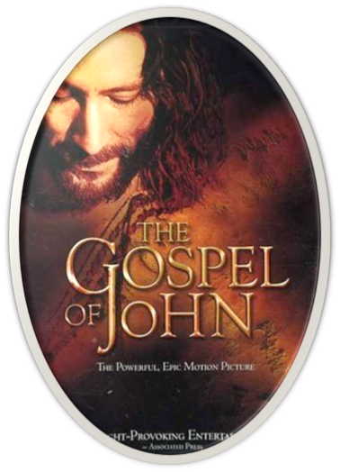
“I AM The Resurrection & The Life”
John 20:30-31 (NKJV) ³⁰ And truly Jesus did many other signs in the presence of His disciples, which are not written in this book; ³¹ but these are written that you may believe that Jesus is the Christ, the Son of God, and that believing you may have life in His name.

Slide 4
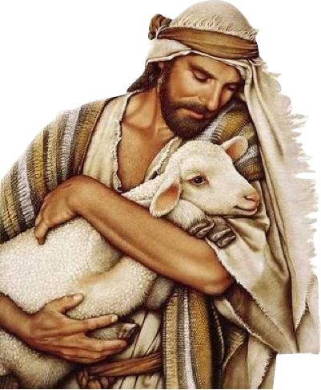
“I AM The Resurrection & The Life”
Our Lord’s three great declarations of chapter 10?
I AM the Door. Have you “entered in” by faith so that you are saved? al 3:26,27
I AM the Good Shepherd. Are you hearing His voice and following Him?
I AM the Son of God. Do you believe that? Have you given yourself to Him and received eternal life?

Slide 5
“I AM The Resurrection & The Life”
The turning of water into wine (2:1-11)
Healing of the nobleman’s son (4:43-54)
Healing of the impotent man (5:1-15)
Feeding of the multitude (6:1-14)
Walking on the water (6:16-21)
Healing of the blind man (9:1-41)
Raising of Lazarus (11:1-45).

Slide 6
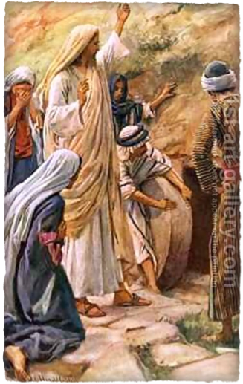
“I AM The Resurrection & The Life”
Only record of this great miracle -
Climactic miracle - Jesus’ public evidence of His great claim, “I am the Resurrection and the Life.” - (11:25)
Not the only person restored to physical life by Jesus:
Widow's son at Nain (Lk 7:11-17),
Jairus' daughter (Matthew 9:18-26; Mark 5:21-43; Luke 8:40-56),
Lazarus (John 11:1-44).

Slide 7
“I AM The Resurrection & The Life”
Death is the great horror which sin has produced (1 Cor. 15:20-22).
Physical death is the divine object lesson of what sin does in the spiritual realm. (Rom 5:12; Jam 1:15)
As physical death separates people, - spiritual death is the separation of people from God and the loss of life which is in God (Is 59:1,2).
Spiritual life restored in Jesus! (11:25-26; 3:36; 14:6; 1 Jn 5:10-12; )

Slide 8
“I AM The Resurrection & The Life”
Lazarus is mentioned in the New Testament only in this chapter and in chapter 12.
Bethany is about two miles (11:18) east of Jerusalem on the south-east slope of Olivet
Mary and Martha (Luke 10:38–42). This Mary was the same one who later (see John 12:1–10) poured perfume on the Lord and wiped His feet with her hair. (Mat. 26:6, 7. Mar. 14:3)
John 11:1 (NKJV)
¹ Now a certain man was sick, Lazarus of Bethany, the town of Mary and her sister Martha.

Slide 9
“I AM The Resurrection & The Life”
The sisters send a message to Jesus of Lazarus’ illness - undoubtedly they were wanting Him to come to Bethany. (11:2,3, 21, 32)
Jesus did not go immediately ( v. 6). His delay was not from lack of love (cf. v. 5), or fear of the Jews, (cf. v. 8-10), but that “the Son of God may be glorified” - (11:4-5; cf 9:3).
Jesus plainly informs His disciples of Lazarus’ death - despite the danger, they all depart - (11:11-16)
John 11:1 (NKJV)
¹ Now a certain man was sick, Lazarus of Bethany, the town of Mary and her sister Martha.

Slide 10
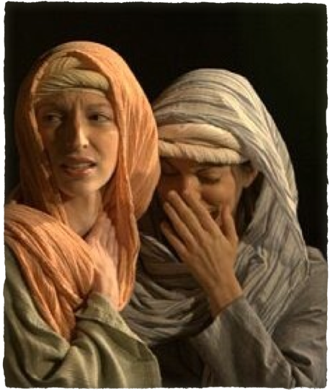
“I AM The Resurrection & The Life”
Lazarus had been in the tomb 4 days - (11:17)
Bethany’s proximity to Jerusalem explains why there was such a large gathering of Jews - (11:1811:18,19)
Martha rushes to meet the Lord - notice her faith, (11:21) No criticism of Jesus seems to be implied - her brother was dead before the messengers got to Jesus. (v. 6 & 17)
John 11:17–19 (NKJV)
¹⁷ . . .already been in the tomb four days. . . . ¹⁹ And many of the Jews had joined the women around Martha and Mary, to comfort them concerning their brother

Slide 11
“I AM The Resurrection & The Life”
Your brother will rise again. Since the word “again” - This promise sets the stage for Jesus’ conversation with Martha.
She confident in Lazarus’ raising up in the final resurrection at the last day. (11:24)
I am the Resurrection and the Life. This is the fifth of Jesus’ great “I am” revelations.
John 11:17–19 (NKJV)
¹⁷ . . .already been in the tomb four days. . . . ¹⁹ And many of the Jews had joined the women around Martha and Mary, to comfort them concerning their brother

Slide 12
“I AM The Resurrection & The Life”
John 11:25–26 (NKJV)
²⁵ Jesus said to her, “I am the resurrection and the life. He who believes in Me, though he may die, he shall live. ²⁶ And whoever lives and believes in Me shall never die. Do you believe this?”
John 11:17–19 (NKJV)
¹⁷ . . .already been in the tomb four days. . . . ¹⁹ And many of the Jews had joined the women around Martha and Mary, to comfort them concerning their brother

Slide 13
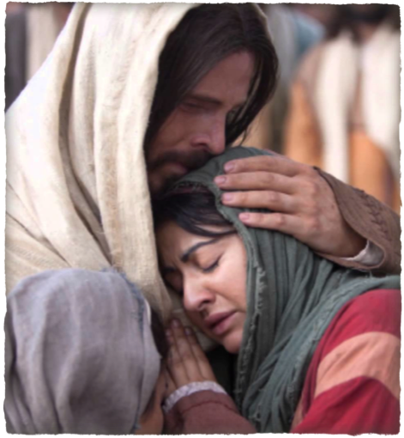
“I AM The Resurrection & The Life”
Martha gave a great confession of faith in Christ. (11:27)
Martha informs Mary of Jesus’ presence & desire to speak with her - (11:28-31)
Jesus comforts Mary - note His commission - (11:32-37)
Jesus raises Lazarus - (11:38-44)
John 11:27 (NKJV)
²⁷ She said to Him, “Yes, Lord, I believe that You are the Christ, the Son of God, who is to come into the world.”

Slide 14
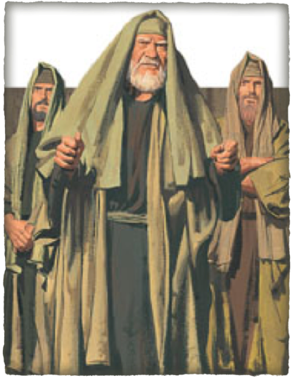
“I AM The Resurrection & The Life”
For many of the Jews, this miracle was clear proof of Jesus’ claim. - 11:45-47
But others were only hardened and reported what had happened.
This miraculous sign was so significant that the chief priests & the Pharisees to call an emergency session of the Sanhedrin - 47-53

Slide 15
“I AM The Resurrection & The Life”
John 20:30-31 (NKJV) ³⁰ And truly Jesus did many other signs in the presence of His disciples, which are not written in this book; ³¹ but these are written that you may believe that Jesus is the Christ, the Son of God, and that believing you may have life in His name.

Slide 17
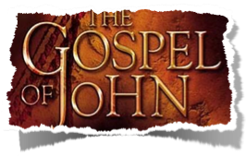
“I AM The Resurrection & The Life”
Charts by Don McClain
Prepared August 31 / Preached August 31, 2014
West 65th Street church of Christ
P.O. Box 190062
Little Rock AR 72219
501-568-1062
Prepared using Keynote
Email – donmcclain@sbcglobal.net
More Keynote, PPT & Audio Sermons:
http://w65stchurchofchrist.org/coc/sermons/
Note – Many of the transition effects used in this presentation will be lost using PPT 2007 Viewer
http://www.microsoft.com/downloads/details.aspx?FamilyID=cb9bf144-1076-4615-9951-294eeb832823&displaylang=en

