Slide 1
That You May
“A Lesson of Humility & Service”
[Jesus’ Private Words To Apostles Before His Death]
John 13:1-18

Slide 2
“A Lesson of Humility & Service”
John 20:30-31 (NKJV) ³⁰ And truly Jesus did many other signs in the presence of His disciples, which are not written in this book; ³¹ but these are written that you may believe that Jesus is the Christ, the Son of God, and that believing you may have life in His name.

Slide 3
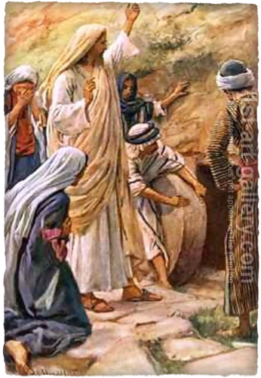
“A Lesson of Humility & Service”
With the story of the raising of Lazarus from the dead, John has set the stage for the final days of Christ’s ministry on earth . . .
The anointing (12:1–8)
Plot to kill Lazarus (12:9-11)
The triumphal entry (12:12–19).
The fruitful grain of wheat (12:20–26).
Jesus speaks of His death (12:27-36)
Jewish national unbelief & Jesus’ response (12:37–50).

Slide 4
John 13:1–18 (NKJV)
¹ Now before the Feast of the Passover, when Jesus knew that His hour had come that He should depart from this world to the Father, having loved His own who were in the world, He loved them to the end. ² And supper being ended, the devil having already put it into the heart of Judas Iscariot, Simon’s son, to betray Him,

Slide 5
John 13:1–18 (NKJV)
³ Jesus, knowing that the Father had given all things into His hands, and that He had come from God and was going to God, ⁴ rose from supper and laid aside His garments, took a towel and girded Himself. ⁵ After that, He poured water into a basin and began to wash the disciples’ feet, and to wipe them with the towel with which He was girded.

Slide 6
John 13:1–18 (NKJV)
⁶ Then He came to Simon Peter. And Peter said to Him, “Lord, are You washing my feet?” ⁷ Jesus answered and said to him, “What I am doing you do not understand now, but you will know after this.” ⁸ Peter said to Him, “You shall never wash my feet!” Jesus answered him, “If I do not wash you, you have no part with Me.” ⁹ Simon Peter said to Him, “Lord, not my feet only, but also my hands and my head!”

Slide 7
John 13:1–18 (NKJV)
¹⁰ Jesus said to him, “He who is bathed needs only to wash his feet, but is completely clean; and you are clean, but not all of you.” ¹¹ For He knew who would betray Him; therefore He said, “You are not all clean.” ¹² So when He had washed their feet, taken His garments, and sat down again, He said to them, “Do you know what I have done to you? ¹³ You call Me Teacher and Lord, and you say well, for so I am.

Slide 8
John 13:1–18 (NKJV)
¹⁴ If I then, your Lord and Teacher, have washed your feet, you also ought to wash one another’s feet. ¹⁵ For I have given you an example, that you should do as I have done to you. ¹⁶ Most assuredly, I say to you, a servant is not greater than his master; nor is he who is sent greater than he who sent him. ¹⁷ If you know these things, blessed are you if you do them.

Slide 9
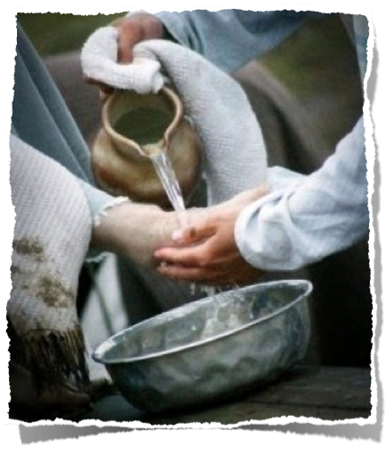
“A Lesson of Humility & Service”
Chapters 13–17 concentrate on His teachings on that fateful night in which He was arrested.
John’s Gospel reports more of the content of Jesus’ instructions to His disciples than the others.
Before these instructions, Jesus teaches them the most important lesson as He washes His disciples’ feet -

Slide 10
“A Lesson of Humility & Service”
Jesus knew that His hour had come to die in obedience to the Father’s will & that His glorification would follow His obedience - Heb 2:9ff; 5:8,9; 12:1,2- ch. 7:6, 30; 8:20; 12:23; 17:1; 18:4
Jesus’ love for His disciples was constant & to the “uttermost”
¹ Now before the Feast of the Passover, when Jesus knew that His hour had come that He should depart from this world to the Father, having loved His own who were in the world, He loved them to the end.

Slide 11
“A Lesson of Humility & Service”
Other translations, “being prepared,” “being served,” or, “going on”; for that it was not “ended” is plain from Jn 13:26.
“Put into the heart of Judas” … referring to the agreement already made with the chief priests (Lu 22:3–6). - Jesus had predicted this (6:70–71). Later Satan enters Judas -(13:27).
John 13:2–3 (NKJV)
² And supper being ended, the devil having already put it into the heart of Judas Iscariot, Simon’s son, to betray Him,

Slide 12
“A Lesson of Humility & Service”
Jesus knew (cf. vv. 1, 18) His sovereign authority, His origin, and coming destiny; yet He voluntarily took the place of a slave, washing the feet of His disciples. - (cf. Phil. 2:5–8).
His action contrasts sharply with their self-seeking (cf. Matt. 20:20–24; Mark 9:33–34; Luke 22:24–30)
John 13:2–3 (NKJV)
³ Jesus, knowing that the Father had given all things into His hands, and that He had come from God and was going to God,

Slide 13
“A Lesson of Humility & Service”
Left heaven – John 6:51;
Relinquished the glory He had in heaven – John 17:5
Became a man! – Phili 2:5-8; Heb 2:10-18; 4:14-16
Became POOR! – 2 Cor. 8:9; Mat 4:2; 8:20; Jn 4:6
Suffered at the hands of cruel men & crucified! – Isa 53; Mat 26:47-27:50; 1 Pt 2:23,24
John 13:2–3 (NKJV)
³ Jesus, knowing that the Father had given all things into His hands, and that He had come from God and was going to God,

Slide 14
“A Lesson of Humility & Service”
Done with awareness of His imminent death (v. 2)
Done with awareness of his exalted position (v. 3)
Girded self with towel – dressed like a servant (v. 4)
Act of a servant (v. 5)
Peter objects - Jesus explains - Peter submits - (v. 6-10)

Slide 15
“A Lesson of Humility & Service”
The true teacher SERVES - 12,13; Mat 20:26-28; 1 Tim 3:1-10; Acts 20:28-31; 1 Pet 5
We are to follow the EXAMPLE of Jesus - 14,15 - (12:26; Lk 9:23-26; 57-62; 1 Pet 2:21; 4:1-3; Phili 2:1-10; 1 Jn 2:6)
Not to follow the example of Jesus is to exalt oneself above Him and to live in pride. 16,17

Slide 16
“A Lesson of Humility & Service”
The true teacher SERVES - 12,13; Mat 20:26-28
We are to follow the EXAMPLE of our Lord & Teacher - 14,15 - (12:26; Lk 9:23-26; 57-62; 1 Pet 2:21; 4:1-3; Phili 2:1-10; 1 Jn 2:6)
Not to follow the example of Jesus is to exalt oneself above Him and to live in pride. 16,17
John 13:16–17 (NKJV)
¹⁶ Most assuredly, I say to you, a servant is not greater than his master; nor is he who is sent greater than he who sent him. ¹⁷ If you know these things, blessed are you if you do them.

Slide 17
“A Lesson of Humility & Service”
John 20:30-31 (NKJV) ³⁰ And truly Jesus did many other signs in the presence of His disciples, which are not written in this book; ³¹ but these are written that you may believe that Jesus is the Christ, the Son of God, and that believing you may have life in His name.

Slide 19
“A Lesson of Humility & Service”
Charts by Don McClain
Prepared & Preached October 12, 2014
West 65th Street church of Christ
P.O. Box 190062
Little Rock AR 72219
501-568-1062
Prepared using Keynote
Email – donmcclain@sbcglobal.net
More Keynote, PPT & Audio Sermons:
http://w65stchurchofchrist.org/coc/sermons/
Note – Many of the transition effects used in this presentation will be lost using PPT 2007 Viewer
http://www.microsoft.com/downloads/details.aspx?FamilyID=cb9bf144-1076-4615-9951-294eeb832823&displaylang=en

Slide 20
Romans 12:9–18 (NKJV)
⁹ Let love be without hypocrisy. Abhor what is evil. Cling to what is good. ¹⁰ Be kindly affectionate to one another with brotherly love, in honor giving preference to one another; ¹¹ not lagging in diligence, fervent in spirit, serving the Lord;

Slide 21
Romans 12:9–18 (NKJV)
¹² rejoicing in hope, patient in tribulation, continuing steadfastly in prayer; ¹³ distributing to the needs of the saints, given to hospitality. ¹⁴ Bless those who persecute you; bless and do not curse. ¹⁵ Rejoice with those who rejoice, and weep with those who weep.

Slide 22
Romans 12:9–18 (NKJV)
¹⁶ Be of the same mind toward one another. Do not set your mind on high things, but associate with the humble. Do not be wise in your own opinion. ¹⁷ Repay no one evil for evil. Have regard for good things in the sight of all men. ¹⁸ If it is possible, as much as depends on you, live peaceably with all men.

