Slide 1
That You May
“The Work of The Holy Spirit” - John 16:5-15

Slide 2
“The Holy Spirit & His Work”
John 20:30-31 (NKJV) ³⁰ And truly Jesus did many other signs in the presence of His disciples, which are not written in this book; ³¹ but these are written that you may believe that Jesus is the Christ, the Son of God, and that believing you may have life in His name.

Slide 3
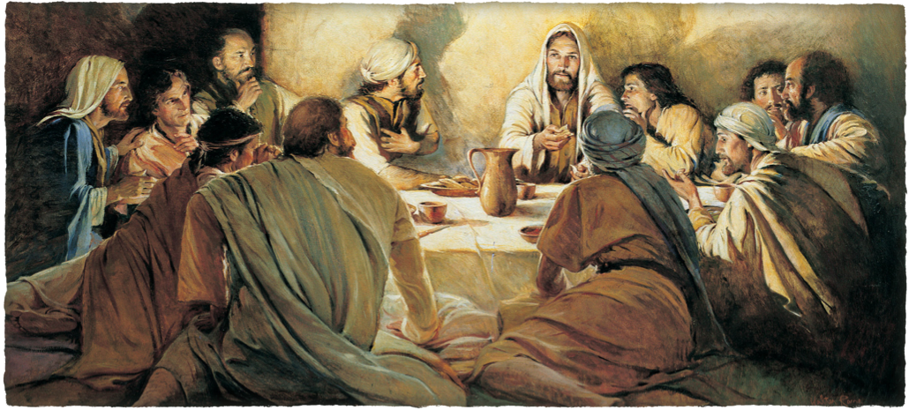
“The Holy Spirit & His Work”
Chapters 13–17 concentrate on His teachings on that fateful night in which He was arrested.
He washes their feet - 13:1-20 - then gives them troubling news . . .

Slide 4
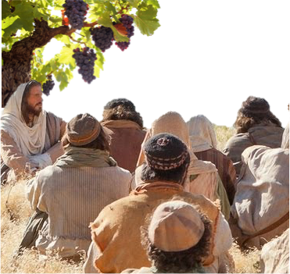
“The Holy Spirit & His Work”
True Disciples Abide In The Vine, (Jesus) - 15:1-10
The need of love - 15:9-17
The world will hate them - 15:18-27
Jesus told thee things so when they happen they will believe - 16:1-4

Slide 5
John 16:5–15 (NKJV)
⁵ “But now I go away to Him who sent Me, and none of you asks Me, ‘Where are You going?’ ⁶ But because I have said these things to you, sorrow has filled your heart. ⁷ Nevertheless I tell you the truth. It is to your advantage that I go away; for if I do not go away, the Helper will not come to you; but if I depart, I will send Him to you.

Slide 6
John 16:5–15 (NKJV)
⁸ And when He has come, He will convict the world of sin, and of righteousness, and of judgment: ⁹ of sin, because they do not believe in Me; ¹⁰ of righteousness, because I go to My Father and you see Me no more; ¹¹ of judgment, because the ruler of this world is judged.

Slide 7
John 16:5–15 (NKJV)
¹² “I still have many things to say to you, but you cannot bear them now. ¹³ However, when He, the Spirit of truth, has come, He will guide you into all truth; for He will not speak on His own authority, but whatever He hears He will speak; and He will tell you things to come.

Slide 8
John 16:5–15 (NKJV)
¹⁴ He will glorify Me, for He will take of what is Mine and declare it to you. ¹⁵ All things that the Father has are Mine. Therefore I said that He will take of Mine and declare it to you.

Slide 9
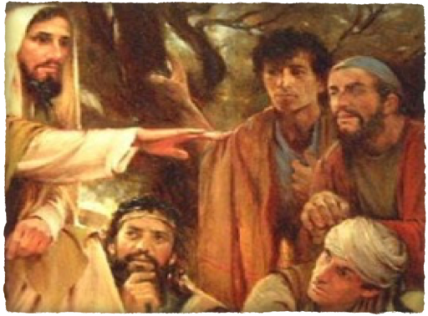
“The Holy Spirit & His Work”
“None of you asks Me, ‘Where are You going?’” - cf. 13:36; 14:4-6
Seems their focus was on their coming personal loss - “sorrow had filled their hearts - (16:6)
The essentiality of His death was hard for them to understand - He must leave so the Spirit could come - 14:16,17,26; 15:26
⁷ Nevertheless I tell you the truth. It is to your advantage that I go away; for if I do not go away, the Helper will not come to you; but if I depart, I will send Him to you.

Slide 10
“The Holy Spirit & His Work”
The rise of mysticism and emotionalism has played a large role in attributing to the Holy Spirit things that we can be certain should not be.
Objective testimony, i.e., the scriptures, rather than subjective speculation, sensationalism & mysticism!
⁸ And when He has come, He will convict the world of sin, and of righteousness, and of judgment

Slide 11
“The Holy Spirit & His Work”
The Holy Spirit Will Not Guide …
Men To Teach Conflicting Doctrines
Men To Teach Doctrines Contrary To The Word Of God
Men To Perform Acts Contrary To, Or Different From, The Word Of God
⁸ And when He has come, He will convict the world of sin, and of righteousness, and of judgment

Slide 12
“The Holy Spirit & His Work”
The Holy Spirit Has Revealed ALL The Truth About Himself That We Can Know!
(Cf. John 14:26; 15:26; 16:12-13; Romans 8:2; 2 Timothy 3:16; 2 Peter 1:3; Jude 3; 1 Cor 4:6; Eph 3:3-5)
¹³ “… when He, the Spirit of truth, has come, He will guide you into all truth; for He will not speak on His own authority, but whatever He hears He will speak; … “

Slide 13
“The Holy Spirit & His Work”
The Word “SPIRIT”?
THE HUMAN SPIRIT – “The body without spirit is dead” - (James 2:26)
ATTITUDE - 1) Bondage/Adoption (Rom. 8:15) - 2) Stupor / Slumber (Rom 11:8) - 3) antichrist (1John 4:3) - 4) truth (1 John 4:6) - 5) Meekness (Gal 6:1) - 6) Wisdom (Exo 28:3)
¹³ “… when He, the Spirit of truth, has come, He will guide you into all truth; for He will not speak on His own authority, but whatever He hears He will speak; … “

Slide 14
“The Holy Spirit & His Work”
The Word “SPIRIT”?
THE HOLY SPIRIT - (John 14:26)
1) Empowered - (Acts 2:1-4,17,33)
2) Revealed – (Eph. 3:3-5)
3) Confirmed - (Heb. 2:4)
¹³ “… when He, the Spirit of truth, has come, He will guide you into all truth; for He will not speak on His own authority, but whatever He hears He will speak; … “

Slide 15
“The Holy Spirit & His Work”
A divine “PERSON” - (An Individual With Conscious Existence)
Can Be Lied To (Acts 5:4)
Can Be Grieved (Eph 4:30)
Can Be Resisted (Acts 7:51)
Forbids (Acts 16:6)
Speaks (1 Tim 4:1)
Searches (1 Cor. 2:10)
Judges (Acts 15:28)
Teaches (John 14:26)
A “Person” -- With “Life, Thought, Volition, Action, Influence”
Is Divine, Is God (Acts 5:1-4)
¹³ “… when He, the Spirit of truth, has come, He will guide you into all truth; for He will not speak on His own authority, but whatever He hears He will speak; … “

Slide 16
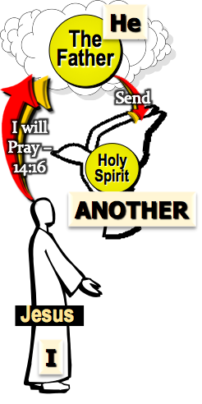
“The Holy Spirit & His Work”
The Holy Spirit Distinct From The Father & Son
John 14:16 (NKJV) ¹⁶ And I will pray the Father, and He will give you another Helper, that He may abide with you forever--

Slide 17
“The Holy Spirit & His Work”
The Holy Spirit Distinct From The Father & Son
John 14:26 (NKJV)
²⁶ But the Helper, the Holy Spirit, whom the Father will send in My name, He will teach you all things, and bring to your remembrance all things that I said to you.

Slide 18
“The Holy Spirit & His Work”
The Holy Spirit Distinct From The Father & Son
John 16:7-15 (NKJV)
⁷ Nevertheless I tell you the truth. It is to your advantage that I go away; for if I do not go away, the Helper will not come to you; but if I depart, I will send Him to you. ⁸ And when He has come, He will convict the world of sin, and of righteousness, and of judgment: ⁹ of sin, because they do not believe in Me;

Slide 19
“The Holy Spirit & His Work”
The Holy Spirit Distinct From The Father & Son
John 16:7-15 (NKJV)
¹⁰ of righteousness, because I go to My Father and you see Me no more; ¹¹ of judgment, because the ruler of this world is judged. ¹² I still have many things to say to you, but you cannot bear them now. ¹³ However, when He, the Spirit of truth, has come, He will guide you into all truth; . . . .

Slide 20
“The Holy Spirit & His Work”
The Holy Spirit Distinct From The Father & Son
John 16:7-15 (NKJV)
. . . for He will not speak on His own authority, but whatever He hears He will speak; and He will tell you things to come. ¹⁴ He will glorify Me, for He will take of what is Mine and declare it to you. ¹⁵ All things that the Father has are Mine. Therefore I said that He will take of Mine and declare it to you.

Slide 21
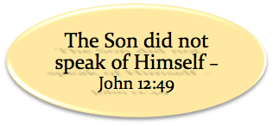
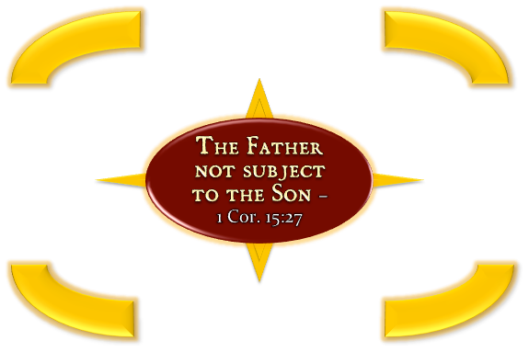
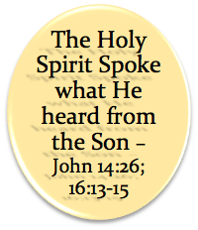
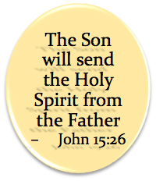
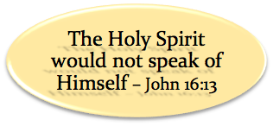
“The Holy Spirit & His Work”
The Holy Spirit Distinct From The Father & Son

Slide 22
John 16:7-11 (NKJV)
⁷ Nevertheless I tell you the truth. It is to your advantage that I go away; for if I do not go away, the Helper will not come to you; but if I depart, I will send Him to you. ⁸ And when He has come, He will convict the world of sin, and of righteousness, and of judgment: ⁹ of sin, because they do not believe in Me; ¹⁰ of righteousness, because I go to My Father and you see Me no more; ¹¹ of judgment, because the ruler of this world is judged.

Slide 23
“The Holy Spirit & His Work”
John 20:30-31 (NKJV) ³⁰ And truly Jesus did many other signs in the presence of His disciples, which are not written in this book; ³¹ but these are written that you may believe that Jesus is the Christ, the Son of God, and that believing you may have life in His name.

Slide 25
“The Holy Spirit & His Work”
Charts by Don McClain
Prepared & Preached - November 30, 2014
West 65th Street church of Christ
P.O. Box 190062
Little Rock AR 72219
501-568-1062
Prepared using Keynote
Email – donmcclain@sbcglobal.net
More Keynote, PPT & Audio Sermons:
http://w65stchurchofchrist.org/coc/sermons/
Note – Many of the transition effects used in this presentation will be lost using PPT 2007 Viewer
http://www.microsoft.com/downloads/details.aspx?FamilyID=cb9bf144-1076-4615-9951-294eeb832823&displaylang=en

Slide 26
Acts 2:29–39 (NKJV)
²⁹ “Men and brethren, let me speak freely to you of the patriarch David, that he is both dead and buried, and his tomb is with us to this day. ³⁰ Therefore, being a prophet, and knowing that God had sworn with an oath to him that of the fruit of his body, according to the flesh, He would raise up the Christ to sit on his throne,

Slide 27
Acts 2:29–39 (NKJV)
³¹ he, foreseeing this, spoke concerning the resurrection of the Christ, that His soul was not left in Hades, nor did His flesh see corruption. ³² This Jesus God has raised up, of which we are all witnesses. ³³ Therefore being exalted to the right hand of God, and having received from the Father the promise of the Holy Spirit, He poured out this which you now see and hear.

Slide 28
Acts 2:29–39 (NKJV)
³⁴ “For David did not ascend into the heavens, but he says himself: ‘The Lord said to my Lord, “Sit at My right hand, ³⁵ Till I make Your enemies Your footstool.” ’ ³⁶ “Therefore let all the house of Israel know assuredly that God has made this Jesus, whom you crucified, both Lord and Christ.”

Slide 29
Acts 2:29–39 (NKJV)
³⁷ Now when they heard this, they were cut to the heart, and said to Peter and the rest of the apostles, “Men and brethren, what shall we do?” ³⁸ Then Peter said to them, “Repent, and let every one of you be baptized in the name of Jesus Christ for the remission of sins; and you shall receive the gift of the Holy Spirit. ³⁹ For the promise is to you and to your children, and to all who are afar off, as many as the Lord our God will call.”

