Slide 1
Heaven
What is There?
What is Not There?

Slide 2
What is Heaven ?
In the NKJV, the word “heaven” is used 532 times in 502 different verses
3 levels of the heavens; Third Heaven is spoken of specifically in (2 Cor. 12), and we know that the first two heavens are to pass away (2 Peter 3:10)
Heaven is the place where either all of us here will or will not be when this life comes to an end

Slide 3
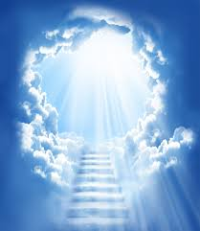
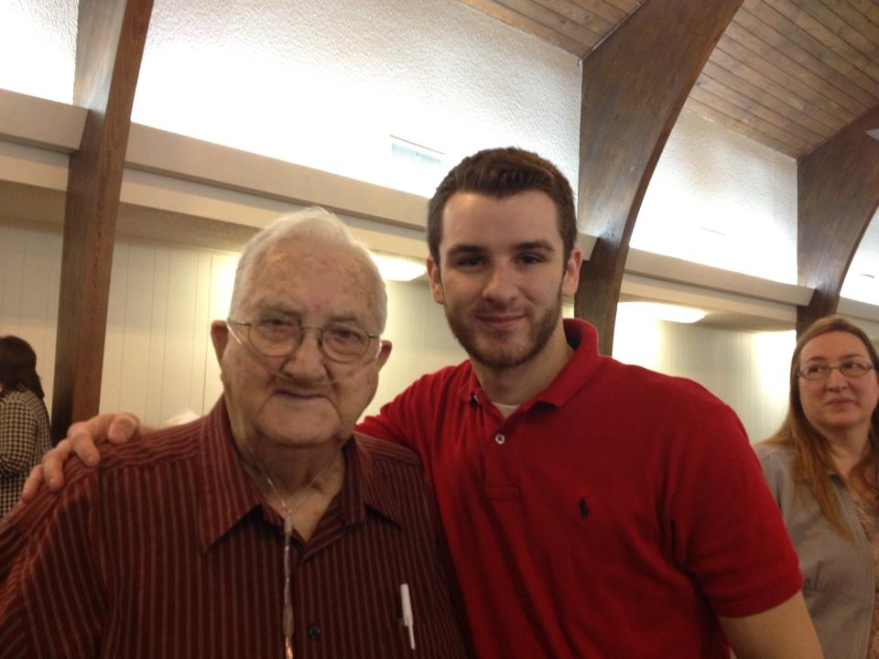
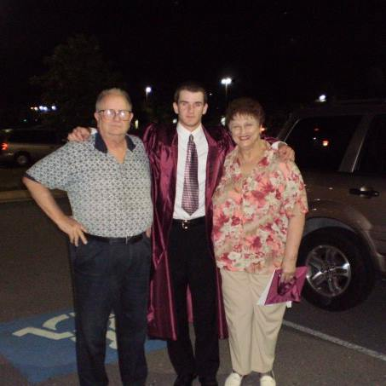
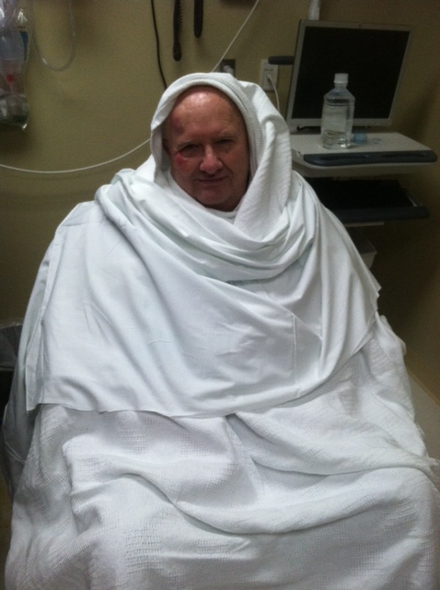
What is There?
God the Father (Eccl. 5:2; Mark 14:62; Acts 7:55)
God the Son
“a cloud of witnesses” (Heb. 12:1)
Endless Day (Rev. 21:25)
Our Mansion, Robe, and
Crown that God has prepared
For us (John 14:2;Rev. 6:11;
2 Tim. 4:7-8)

Slide 4
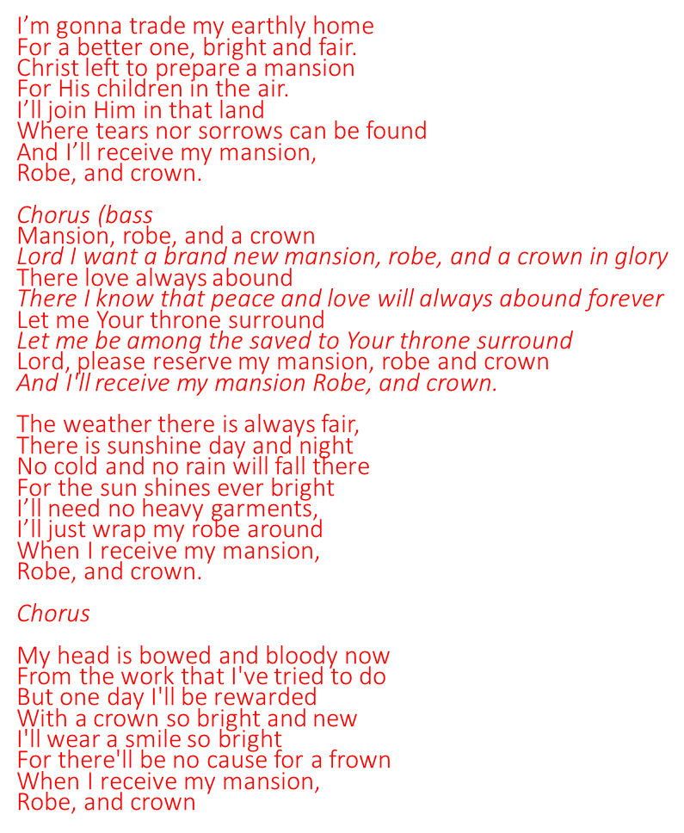
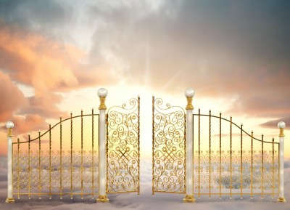

Slide 5
What is Not There?
No Sorrows
No Night
No Sun or Moon
“Nothing that defiles, or causes an abomination or a lie” – (Rev. 21:27)
No More Death – (Rev. 22:1 – The pure river of water of life)
No More Tears nor Crying
Nothing Old, all things are made new

Slide 6
The Swiftness of Life
Time is not on our side, so just like Joshua did, we have to determine who it is we are to follow – (James 4:14; Psalms 39:4,5) “….that I may know how frail I am”
Our lives measured up to the Greatness of God – (Isaiah 40)
Know your place and prepare now – (Proverbs 20:29)….Young men, it won’t be long before we are the old men with the gray hair. (Eccl 12)….The days are coming when the things you could do years ago, you will no longer be able to do. But the thing you can do is remember God!

Slide 7
Things to Consider
1 of 2 things will happen to all of us, either we will grow old and leave this earth (Heb. 9:27), or Christ will return while we are still alive (Rev. 1:7)
One of the greatest fears to me, is having eternity to think about what went wrong while being in torment
The road to Heaven is not a road that is heavily traveled – (Matt. 7:13-22)
We are one day closer to heaven or hell than we were yesterday
There is NO comparison between heaven and hell
The Death of a Christian is better than the day of his/her birth (Eccl. 7:1)
When Christ returns, this world and all of its elements will be burned up (2 Peter 3:10)
If you miss Heaven, you have missed it ALL!

Slide 8
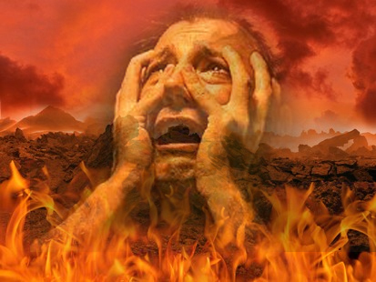
Hell “Gnashing of teeth” – (Luke 13:28) “Tormented day and night forever and ever” – (rev. 20:10)

Slide 9
Heaven 1 John 5:4 & 1 Corinthians 5:57 “Death where is your sting? O Death where is your victory?

