Slide 2
God has joined a number of things together - Thus they are divinely joined.
We have no right or divine authority to put asunder or to separate ANY of these things!
Matthew 19:6
Therefore what God has joined together, let not man separate.”

Slide 3
God has joined a number of things together - Thus they are divinely joined.
We have no right or divine authority to put asunder or to separate ANY of these things!
Let us consider several things God has joined together, which we dare not separate.

Slide 4
Genesis 2:24
Mark 10:5-9
Ephesians 5:31
Matthew 19:5–6 (NKJV)
⁵ and said, ‘For this reason a man shall leave his father and mother and be joined to his wife, and the two shall become one flesh’? ⁶ So then, they are no longer two but one flesh. Therefore what God has joined together, let not man separate.”

Slide 5
God is the author of marriage between a man and a woman - Gen.2:18-24.
Scriptural marriage is a sacred & holy union - Heb.13:4; 1Cor.7:2,9,28.
Scriptural marriage is to be one man & one woman for life - Mt.19:3-6; Ro 7:1-3; 1 Cor.7:10,11a; Cf. 7:5,39; Ro 7:1-3
Only one exception to the rule - Mt.19:3-9; 1Cor.7:5,10,11. Emphasize Mt.19:6.

Slide 6
Malachi 2:15–16 (NKJV)
¹⁵ But did He not make them one, . . . “Therefore take heed to your spirit, And let none deal treacherously with the wife of his youth. ¹⁶ “For the Lord God of Israel says That He hates divorce, . . .”

Slide 7
1 Corinthians 7:10–11 (NKJV)
¹⁰ Now to the married I command, yet not I but the Lord: A wife is not to depart from her husband. ¹¹ But even if she does depart, let her remain unmarried or be reconciled to her husband. And a husband is not to divorce his wife.

Slide 8
Mat 16:18; Acts 2:47
Eph 1:22,23; 5:23-30
Col 1:18,24
Acts 9:1–5 (NKJV)
¹ Then Saul, still breathing threats and murder against the disciples of the Lord, . . . “Saul, Saul, why are you persecuting Me?” ⁵ And he said, “Who are You, Lord?” Then the Lord said, “I am Jesus, whom you are persecuting. …”

Slide 9
Hebrews 1:1,2; 2:3;
Hebrews 10:29-31
Luke 6:46; John 6:63
John 12:48 (NKJV)
⁴⁸ He who rejects Me, and does not receive My words, has that which judges him—the word that I have spoken will judge him in the last day.

Slide 10
James 2:14-26
Philippians 2:12
1 Thessalonians 1:3
Wherefore, that we are justified by faith, only, is a most wholesome doctrine and very full of comfort - The Book of Discipline of the United Methodist Church, 1972 Edition, p. 55.

Slide 11
James 2:14-26
Philippians 2:12
1 Thessalonians 1:3
James 2:24 (NKJV)
²⁴ You see then that a man is justified by works, and not by faith only.

Slide 12
God has separated salvation from the Law of Moses & meritorious works - Rom 3:23-8:13; 11:6; Gal 3:10; 5:1-4; Eph 2:8,9; Tit 3:3-5
But God has ALWAYS required BOTH faith & obedience in order to be justified before Him & receive His blessings - Heb 11:6,30; Jos 6; Rom 4:12-25; 10:13-17; 2 The 1:7-9

Slide 13
James 1:25
Romans 8:2
Galatians 6:2
Titus 2:11–12 (NKJV)
¹¹ For the grace of God that brings salvation has appeared to all men, ¹² teaching us that, denying ungodliness and worldly lusts, we should live soberly, righteously, and godly in the present age,

Slide 14
John 15:10-14
1 John 2:3-5; 5:2,3
Galatians 5:6
John 14:23–24 (NKJV)
²³ Jesus answered and said to him, “If anyone loves Me, he will keep My word; and My Father will love him, and We will come to him and make Our home with him. ²⁴ He who does not love Me does not keep My words; and the word which you hear is not Mine but the Father’s who sent Me.

Slide 15
Acts 2:38; 22:16
Rom 6:3-6; Gal 3:26,27
Col 2:12-13; 1 Peter 3:21
Mark 16:16 (NKJV)
¹⁶ He who believes and is baptized will be saved; but he who does not believe will be condemned.

Slide 16
Page 1665, 1667
Mark 16:16. “Only faith, not baptism, is essential for salvation, as the omission of baptism from the last clause shows.”
1 Peter 3:21. “Baptism doth also now save us” does not mean that water baptism is essential to salvation.”
Acts 2:38. “For several reasons be baptized should not be joined with for the remission of sins."

Slide 17
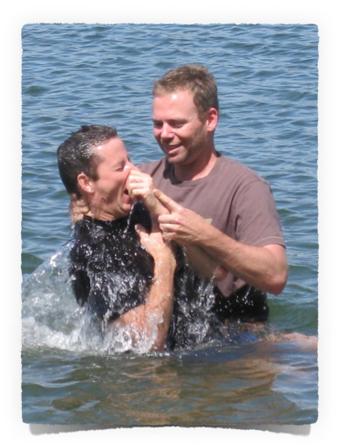
A command of Jesus - Mat 28:18,19; Acts 2:38-41; 10:47,48;
For (unto) remission of sins - Acts 2:38; 22:16; Col 2:12,13
Into Jesus Christ - Rom. 6:3-6; Gal 3:26,27; 1 Cor 12:13
Saves us - Mark 16:16; 1 Peter 3:21
Exemplified - Acts 8;9;16;18;19;22

Slide 18
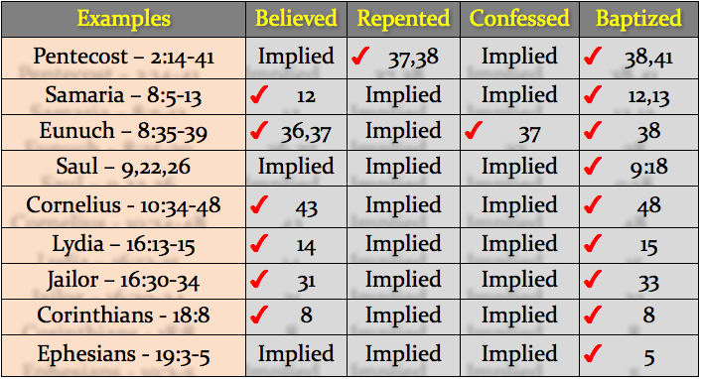

Slide 19
Leviticus 10:1-3
Psalm 51:17; Isaiah 57:15
Hebrews 12:28
John 4:24 (NKJV)
²⁴ God is Spirit, and those who worship Him must worship in spirit and truth.”

Slide 20
Revelation 2:10
Colossians 1:23
1 Corinthians 15:58
Hebrews 3:12–14 (NKJV)
¹² Beware, brethren, lest there be in any of you an evil heart of unbelief in departing from the living God; … ¹⁴ For we have become partakers of Christ if we hold the beginning of our confidence steadfast to the end,

Slide 21
Revelation 21:8
Matthew 25:31-46
2 Thessalonians 1:7-9
Hebrews 3:18–19 (NKJV)
¹⁸ And to whom did He swear that they would not enter His rest, but to those who did not obey? ¹⁹ So we see that they could not enter in because of unbelief.

Slide 22
God has joined a number of things together - Thus they are divinely joined.
We have no right or divine authority to put asunder or to separate ANY of these things!
Matthew 19:6
Therefore what God has joined together, let not man separate.”

Slide 23
Scripturally Married Husband & Wife
Christ & His Church & His Teaching
Faith & Works of Obedience
Grace & Law of Christ / Spirit
Love & Obedience To God / Christ
Scriptural Baptism & Salvation
Spirit & Truth In Worship & Service
Faithfulness & Eternal Life
Unbelief (Disobedience) & Condemnation

Slide 25
Charts by Don McClain
Prepared November 20-22, 2014
Preached - November 23, 2014
West 65th Street church of Christ
P.O. Box 190062
Little Rock AR 72219
501-568-1062
Prepared using Keynote
Email – donmcclain@sbcglobal.net
More Keynote, PPT & Audio Sermons:
http://w65stchurchofchrist.org/coc/sermons/
Note – Many of the transition effects used in this presentation will be lost using PPT 2007 Viewer
http://www.microsoft.com/downloads/details.aspx?FamilyID=cb9bf144-1076-4615-9951-294eeb832823&displaylang=en

Slide 26
Mark 10:1–12 (NKJV)
¹ Then He arose from there and came to the region of Judea by the other side of the Jordan. And multitudes gathered to Him again, and as He was accustomed, He taught them again. ² The Pharisees came and asked Him, “Is it lawful for a man to divorce his wife?” testing Him.

Slide 27
Mark 10:1–12 (NKJV)
³ And He answered and said to them, “What did Moses command you?” ⁴ They said, “Moses permitted a man to write a certificate of divorce, and to dismiss her.” ⁵ And Jesus answered and said to them, “Because of the hardness of your heart he wrote you this precept.

Slide 28
Mark 10:1–12 (NKJV)
⁶ But from the beginning of the creation, God ‘made them male and female.’ ⁷ ‘For this reason a man shall leave his father and mother and be joined to his wife, ⁸ and the two shall become one flesh’; so then they are no longer two, but one flesh. ⁹ Therefore what God has joined together, let not man separate.”

Slide 29
Mark 10:1–12 (NKJV)
¹⁰ In the house His disciples also asked Him again about the same matter. ¹¹ So He said to them, “Whoever divorces his wife and marries another commits adultery against her. ¹² And if a woman divorces her husband and marries another, she commits adultery.”

