Slide 2
Who Wants - Needs - Seeks -
Peace?

Slide 3
Peace?
The world CAN BE a place of worry, anxiety, Stress, fear and terror . . .

Slide 4
Severe weather -Work overload -Unexpected expenses - Material loss - Anxieties concerning future provisions . . .
Peace?

Slide 5
Peace?
Rejection - Emotional Scars - Mistreatment - Sickness – Death - Loss of a loved one . . .

Slide 6
Sin / Repeatedly sub-coming to temptation / Absence of inner peace, i.e., spiritual insecurity . . .
Peace?

Slide 7
Peace?
WE ALL WANT IT -
BUT - Most are searching for it in all the wrong places and all the wrong ways.

Slide 8
Philippians 4:6–13 (NKJV)
⁶ Be anxious for nothing, but in everything by prayer and supplication, with thanksgiving, let your requests be made known to God; ⁷ and the peace of God, which surpasses all understanding, will guard your hearts and minds through Christ Jesus.

Slide 9
Philippians 4:6–13 (NKJV)
⁸ Finally, brethren, whatever things are true, whatever things are noble, whatever things are just, whatever things are pure, whatever things are lovely, whatever things are of good report, if there is any virtue and if there is anything praiseworthy—meditate on these things.

Slide 10
Philippians 4:6–13 (NKJV)
⁹ The things which you learned and received and heard and saw in me, these do, and the God of peace will be with you. ¹⁰ But I rejoiced in the Lord greatly that now at last your care for me has flourished again; though you surely did care, but you lacked opportunity.

Slide 11
Philippians 4:6–13 (NKJV)
¹¹ Not that I speak in regard to need, for I have learned in whatever state I am, to be content: ¹² I know how to be abased, and I know how to abound.

Slide 12
Philippians 4:6–13 (NKJV)
Everywhere and in all things I have learned both to be full and to be hungry, both to abound and to suffer need. ¹³ I can do all things through Christ who strengthens me.

Slide 14
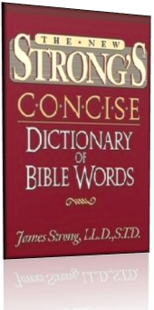
1515. εἰρήνη ĕirēnē, i-ray´-nay; prob. from a prim. verb εἴρω ĕirō (to join); peace (lit. or fig.); by impl. prosperity:—one, peace, quietness, rest, + set at one again.
Strong, J. (2009). A Concise Dictionary of the Words in the Greek Testament and The Hebrew Bible. Bellingham, WA: Logos Bible Software.

Slide 15
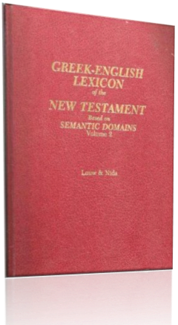
1645 εἰρήνη (eirēnē), ης (ēs), ἡ (hē): n.fem.; 1. LN 22.42 peace, harmony, tranquility; in certain contexts seen in the OT concept of the Shalom, i.e., welfare, health (Mt 10:34; Mk 5:34; Jn 14:27; 16:33; 20:19, 21; Ro 1:7; 5:1; 15:33; Gal 5:22; Eph 2:14; Php 4:7, 9; Col 3:15; Ro 10:15 v.r.); 2. LN 25.248 freedom from worry (Gal 5:22), for another interp, see prior
Louw, J. P., & Nida, E. A. (1996). Greek-English lexicon of the New Testament: based on semantic domains. New York: United Bible Societies.

Slide 16
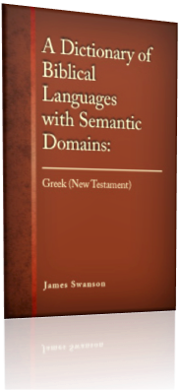
22.42 εἰρήνηª, ης f: a set of favorable circumstances involving peace and tranquility—‘peace, tranquility.’ . . . The meaning of ‘peace’ or ‘tranquility’ may be expressed in some languages in a negative form, for example, ‘to be without trouble’ or ‘to have no worries’ or ‘to sit down in one’s heart.’
Swanson, J. (1997). Dictionary of Biblical Languages with Semantic Domains: Greek (New Testament). Oak Harbor: Logos Research Systems, Inc.

Slide 17
a state of concord, peace, harmony - between governments - harmony in personal relationships peace, harmony - good order, 1 Cor 14:33
a state of well-being, peace - welfare, health - synonymous w. messianic salvation
A Greek-English Lexicon of the New Testament and Other Early Christian Literature. - BDAG

Slide 18
It describes (a) harmonious relationships between men, (b) between nations, (c) friendliness, (d) freedom from molestation, (e) order, in the State, in the churches, (f) the harmonized relationships between God and man, accomplished through the gospel, (g) the sense of rest and contentment consequent thereon,
Vine's Expository Dictionary of Old Testament and New Testament Words.

Slide 19
“5. according to a conception distinctly peculiar to Christianity, the tranquil state of a soul assured of its salvation through Christ, and so fearing nothing from God and content with its earthly lot, of whatsoerer sort that is”
Greek-English Lexicon of the New Testament.

Slide 20
Peace?
“The deep tranquility of a soul resting wholly upon God – the antithesis to the solicitude engendered by the world and worldliness.”
(Ellicott, 102,103)

Slide 21
Peace?
John 14:27 (NKJV)
Peace I leave with you, My peace I give to you; not as the world gives do I give to you. Let not your heart be troubled, neither let it be afraid.

Slide 22
Peace?
God’s Peace
Circumstances good or bad
God is in control
As long as we hold fast to the truth
Based on eternal, spiritual & obtainable promises
World’s Peace
As long as circumstances are good
As long as we are in control
As long as we keep quiet & don’t ruffle feathers
Based on things temporary.

Slide 23
Peace?
John 16:33 (NKJV)
These things I have spoken to you, that in Me you may have peace. In the world you will have tribulation; but be of good cheer, I have overcome the world."

Slide 24
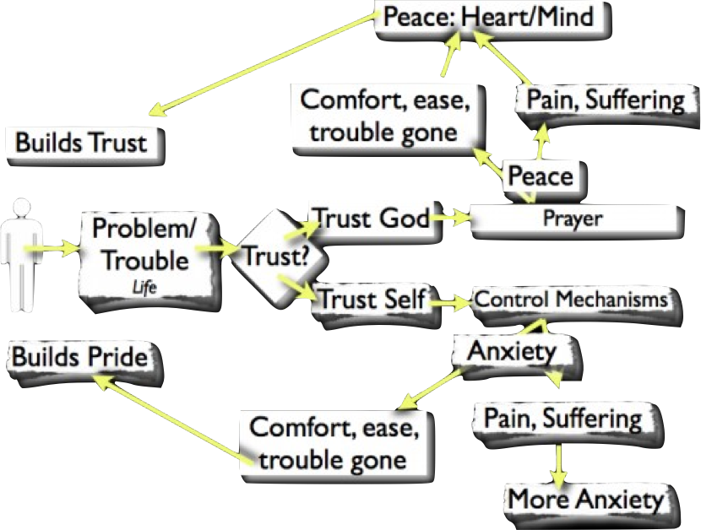

Slide 25
Peace Exemplified
Jesus before High Priest & Pilate - (John 18,19)
Steven on trial - (Acts 7)
James put to death, Herod plans to kill Peter - Peter sleeps – (Acts 12:1-12 - vs 6)
Paul preparing for death - (2 Tim 1:12; 4:6-8)

Slide 26
How Can I Have Peace?
Peace with God is based upon what God has done for us – (Eph. 2:1-14; Tit 2:11-3:8; Heb 13:20,21)
Conditioned upon our adherence to God’s revealed will! – (Phili 4:9; Col 3:15; compare Pr 3:17).

Slide 27
How Can I Have Peace?
Comes From Jesus - Jn 14:27; Isa 9:6-7; Jn 16:33
Preached Through Him - remission of sins - Acts 10:36-43
With God – Rom 5:1-11; Ep. 2:12,13
With Others – Eph. 2:14-16
With Self – Phili 4:7; Col 3:15

Slide 28
How Can I Have Peace?
Right Thinking - Phili 4:8; Isa 26:3; 2 Pet 3:16-18
Right Doing - Phili 4:9; Psa 119:165; Isa 48:18; Jn 14:23;
Philip. 4:9 (NKJV)
The things which you learned and received and heard and saw in me, these do, and the God of peace will be with you.

Slide 29
How Can I Have Peace?
Right Thinking - Phili 4:8; Isa 26:3; 2 Pet 3:16-18
Right Doing - Phili 4:9; Psa 119:165; Isa 48:18; Jn 14:23;
Right Attitude - (learning contentment, trusting, loving, depending on God’s provisions - SPIRITUAL or CARNAL) Phili 4:10-13; Mark 12:29-31

Slide 30
How Can I Have Peace?
With God
Hear Him, Believe Him, & Obey Him – Acts 2:38; 1 Pet 3:21
1st - be reconciled to God - then "pursue" peace with others - 1 Pe 3:8-12
Walk in the Spirit - Rom. 8:1; Gal. 5:16
With Others
With Self

Slide 31
How Can I Have Peace?
Trust in God - Live for Him, not yourself!
Do not live in the past - Do not waste time worrying about what you cannot change.
Do not indulge in self pity.

Slide 32
How Can I Have Peace?
Seek to eliminate suspicion and resentment.
Cultivate, love, joy, compassion, good humor, and loyalty.
Be realistic in your expectations of others as well as your expectations of yourself.

Slide 33
How Can I Have Peace?
Slow down - live simply - live within your means -
Value the things we should - truly put God first & watch everything else fall into place . . .

Slide 34
Will Enable you to:
Get beyond the regrets of the past
Manage the anxiety of the present
Overcome the fear of the future

Slide 35
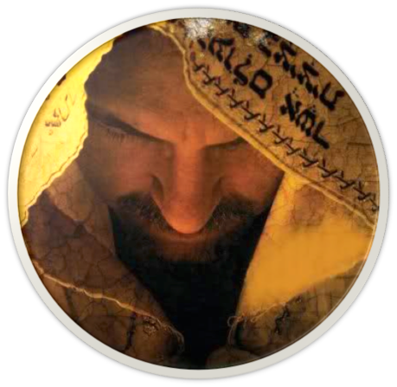
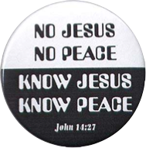
Peace?
KNOW Jesus
KNOW Peace!
No Jesus
No Peace –
Acts 2:38
Gal 3:26,27

Slide 37
Charts by Don McClain
Prepared October 10,11, 2014 - Preached October 12, 2014
West 65th Street church of Christ/ P.O. Box 190062 / Little Rock AR 72219
501-568-1062
Prepared using Keynote
Email – donmcclain@sbcglobal.net
More PPT & Audio Sermons:
http://w65stchurchofchrist.org/coc/sermons/
Note – Many of the transition effects used in this presentation may be lost using PPT 2007 Viewer
http://www.microsoft.com/downloads/details.aspx?FamilyID=cb9bf144-1076-4615-9951-294eeb832823&displaylang=en

Slide 38
Isaiah 26:1–9 (NKJV)
¹ In that day this song will be sung in the land of Judah: “We have a strong city; God will appoint salvation for walls and bulwarks. ² Open the gates, That the righteous nation which keeps the truth may enter in.

Slide 39
Isaiah 26:1–9 (NKJV)
³ You will keep him in perfect peace, Whose mind is stayed on You, Because he trusts in You. ⁴ Trust in the Lord forever, For in Yah, the Lord, is everlasting strength.

Slide 40
Isaiah 26:1–9 (NKJV)
⁵ For He brings down those who dwell on high, The lofty city; He lays it low, He lays it low to the ground, He brings it down to the dust. ⁶ The foot shall tread it down— The feet of the poor And the steps of the needy.”

Slide 41
Isaiah 26:1–9 (NKJV)
⁷ The way of the just is uprightness; O Most Upright, You weigh the path of the just. ⁸ Yes, in the way of Your judgments, O Lord, we have waited for You; The desire of our soul is for Your name And for the remembrance of You.

Slide 42
Isaiah 26:1–9 (NKJV)
⁹ With my soul I have desired You in the night, Yes, by my spirit within me I will seek You early; For when Your judgments are in the earth, The inhabitants of the world will learn righteousness.

