Slide 1
Providence
in theFaith / Life
of
Todays Christian

Slide 2
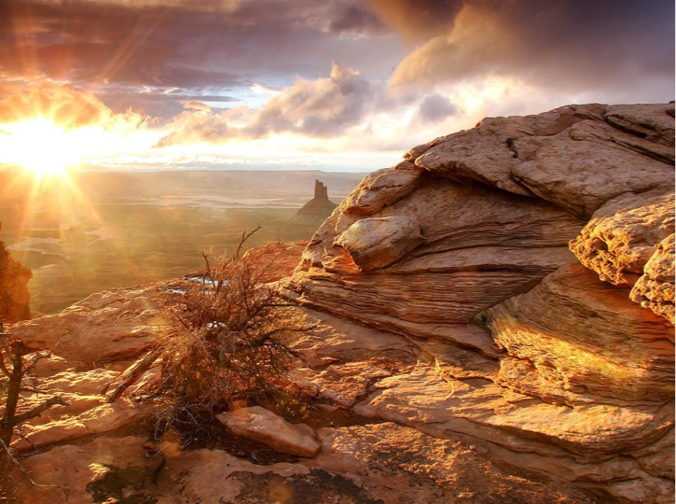
Notes:
Believing in divine providence helps one to cope with the vicissitudes of life.
Problems are a part of life and how one handles these problems is related to his view of God.
Life has no meaning or purpose when God is removed from one’s world view.

Slide 3
Notes:
Believing in divine providence helps one to cope with the vicissitudes of life.
Problems are a part of life and how one handles these problems is related to his view of God.
Life has no meaning or purpose when God is removed from one’s world view.

Slide 4
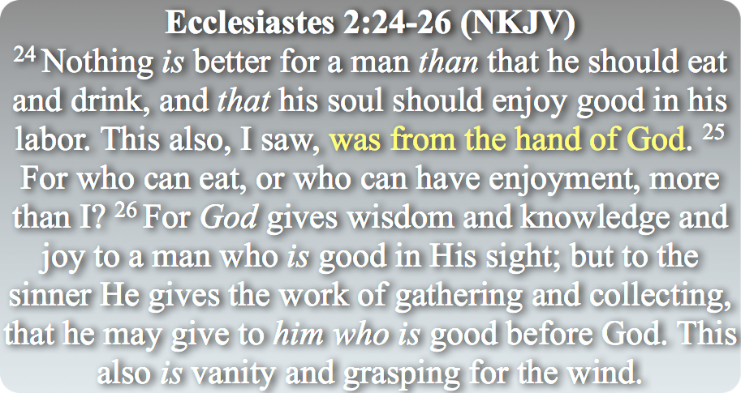
Notes:
Believing in divine providence helps one to cope with the vicissitudes of life.
Problems are a part of life and how one handles these problems is related to his view of God.
Life has no meaning or purpose when God is removed from one’s world view.

Slide 5
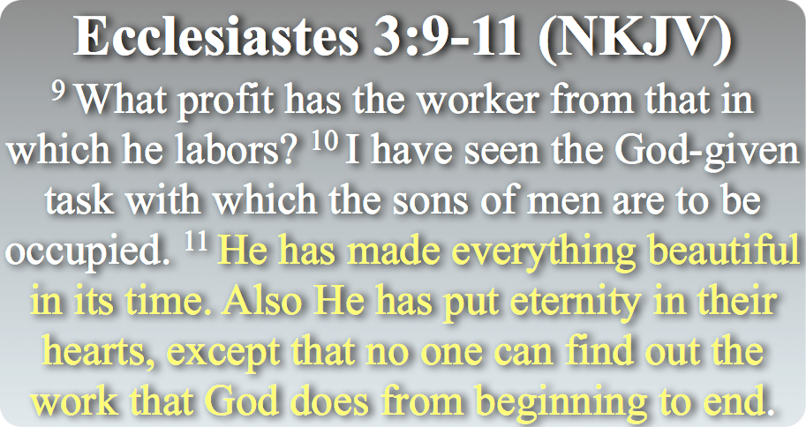
Notes:
Believing in divine providence helps one to cope with the vicissitudes of life.
Problems are a part of life and how one handles these problems is related to his view of God.
Life has no meaning or purpose when God is removed from one’s world view.

Slide 6
Incorrect Views
Charismatics - If God is not working miraculously, He is not working.
Deism - God “wound up” the world and let it be.
Calvinism - God has predetermined everything that happens in this world and it cannot be changed.
Open Theism - God’s purposes are wholly subject to human action.

Slide 7
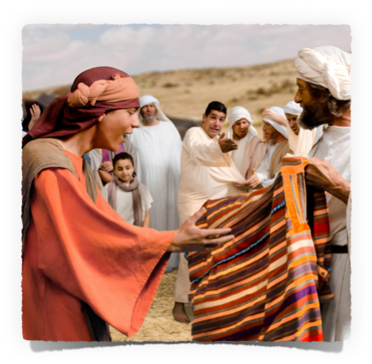
What Is Providence?
The term “providence,” is derived from the Latin word, providentia , but conceptually comes from the Greek term pronoia , suggesting foresight or making provision beforehand, is traditionally utilized to describe actions taken by Almighty God within the universe.

Slide 8
What Is Providence?
This work is done invisibly and undetectably. (Phile 1:15)
The manipulation of nature and circumstances that God’s will & purpose be accomplished.
(Pharaoh, Exo. 9:16; Rom. 9:17)
(Cyrus , Isa. 44:24-28; Ezra 1:1-4)
(Nations, Ps 66:7; Dan 2:21; 4:25, 35)

Slide 9
What Is Providence?
The word itself never appears in Holy Scripture in reference to God, (Acts 24:1), but the concept is found Throughout the Bible.

Slide 10
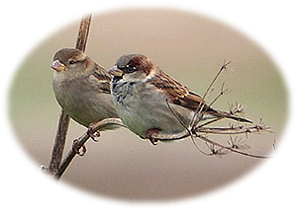
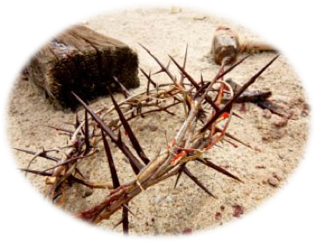
What Is Providence?
Important to distinguish between God's ordinary general providence and special providential interventions from time to time.
General
Special
Acts 17:28; Mat 5:45
Gal 4:4; Jam 5:17,18

Slide 11
Genesis 3:15 | Genesis 22:8,14 | Genesis 50:19-21 | Esther 4:14
¹⁵ And I will put enmity Between you and the woman, And between your seed and her Seed; He shall bruise your head, And you shall bruise His heel." | ⁸ And Abraham said, "My son, God will provide for Himself the lamb for a burnt offering." So the two of them went together. . . ¹⁴ And Abraham called the name of the place, The-LORD-Will-Provide; | ¹⁹ Joseph said to them, "Do not be afraid, for am I in the place of God? ²⁰ But as for you, you meant evil against me; but God meant it for good, in order to bring it about as it is this day, to save many people alive. | ¹⁴ For if you remain completely silent at this time, relief and deliverance will arise for the Jews from another place, but you and your father's house will perish. Yet who knows whether you have come to the kingdom for such a time as this?"
Notes:
Believing in divine providence helps one to cope with the vicissitudes of life.
Problems are a part of life and how one handles these problems is related to his view of God.
Life has no meaning or purpose when God is removed from one’s world view.

Slide 12
Acts 2:22-28 (NKJV)
²² "Men of Israel, hear these words: Jesus of Nazareth, a Man attested by God to you by miracles, wonders, and signs which God did through Him in your midst, as you yourselves also know-- ²³ Him, being delivered by the determined purpose and foreknowledge of God, you have taken by lawless hands, have crucified, and put to death; ²⁴ whom God raised up, having loosed the pains of death, because it was not possible that He should be held by it.
Notes:
Believing in divine providence helps one to cope with the vicissitudes of life.
Problems are a part of life and how one handles these problems is related to his view of God.
Life has no meaning or purpose when God is removed from one’s world view.

Slide 13
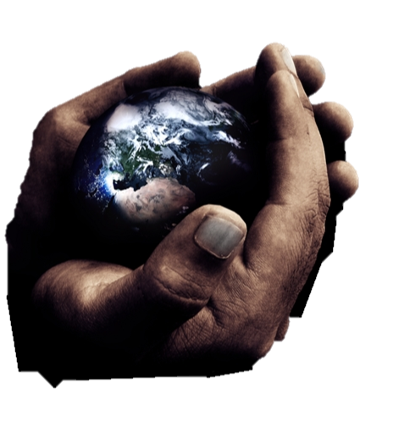
God Is In Control
God is the divine creator of our universe and He has the power to control His creation (Gen. 1:1; Ps. 148:5; Rev. 4:11).
God continues to oversee and sustain His universe today. He now “upholds all things by the word of His power” (Col. 1:17; Heb. 1:3; John 5:17).

Slide 14
God Is In Control
All mankind is subject to all laws of nature, righteous & unrighteous - (Mat 5:45)
Man will suffer consequences upon violation of natural law. (Gen 3:17-19; Eccl. 9:11)
Our view of God determines our reaction to negative events (Jam 1:2-5; 1 Pet. 1:5-6).

Slide 15
God Is In Control
God has the power, ability & will to allow mankind the freedom of choice in his daily life, but we are not free to choose the consequences - (Acts 5:4; Deut 30:15-20)
God can use man’s choices, good or bad, to accomplish his purpose. (Gen 45:4-8; 50:19-21)

Slide 16
God Is In Control
God can directly alter the course of human events, if He wills, in answer to the prayers of His children (James 5:13-18; 1 Pet. 3:12; 2 Cor 12:7-10; Mat 26:39,42; 1 John 5:14; 1 Pet 5:7).
We should trust God - which will enable us to endure regardless of circumstances - (Phili 4:4-13; Rom 8:18-39)

Slide 17
Romans 8:17-39
These brethren were being persecuted – (17,18,36)
Those who suffer with Him will be glorified together with Him (17)
God’s promises are the basis of our HOPE – (18-25)
The Holy Spirit intercedes for us – (26,27)

Slide 18
Romans 8:17-39
Due to God’s faithfulness Christians have assurance that their perseverance through trials will result in glorification - Rom 8:17,18,25,28
There is no external force that can separate the faithful Christian from God! – Rom 8:35-39; John 10:27-29
Compares the present suffering with the “glory which shall be reveled in us” - (18)

Slide 19
Romans 8:17-39
Romans 8:28 (NKJV)
²⁸ And we know that all things work together for good to those who love God, to those who are the called according to His purpose.

Slide 20
Spiritually Minded
2 Corinthians 4:16-18 (NKJV)
¹⁶ Therefore we do not lose heart. Even though our outward man is perishing, yet the inward man is being renewed day by day.

Slide 21
Spiritually Minded
2 Corinthians 4:16-18 (NKJV)
¹⁷ For our light affliction, which is but for a moment, is working for us a far more exceeding and eternal weight of glory,

Slide 22
Spiritually Minded
2 Corinthians 4:16-18 (NKJV)
¹⁸ while we do not look at the things which are seen, but at the things which are not seen. For the things which are seen are temporary, but the things which are not seen are eternal.

Slide 23
God did not create the universe and let it go - nor does God micromanage every little thing.
Both the Father & Son are still working

Slide 24
We live in a wicked world, a fallen world - a hard place for godly people to live.
One day - all wrongs will be made right! - 2 Thes 1:7-9
Those who endure and are through faith victorious will be granted eternal life - 1 Cor 15:58; 1 Peter 1:1-9

Slide 25
Trust & obey God - Acts 2:38; Rev 2:10
Keep our focus on the spiritual rather than the temporal.
In All Times We Must Put Our Problems In Perspective

Slide 26
His Eye Is On The Sparrow
“Why Should I feel discouraged?”
“Why should my heart be lonely?”
“Let not your heart be troubled”

Slide 27
Charts by Don McClain
Prepared March 7,8, 2014 Preached March 9, 2014
West 65th Street church of Christ
P.O. Box 190062
Little Rock AR 72219
501-568-1062
Prepared using Keynote
Email – donmcclain@sbcglobal.net
More Keynote, PPT & Audio Sermons:
http://w65stchurchofchrist.org/coc/sermons/
Note – Many of the transition effects used in this presentation will be lost using PPT 2007 Viewer
http://www.microsoft.com/downloads/details.aspx?FamilyID=cb9bf144-1076-4615-9951-294eeb832823&displaylang=en

Slide 28
Genesis 50:15-21 (NKJV)
¹⁵ When Joseph's brothers saw that their father was dead, they said, "Perhaps Joseph will hate us, and may actually repay us for all the evil which we did to him." ¹⁶ So they sent messengers to Joseph, saying, "Before your father died he commanded, saying,

Slide 29
Genesis 50:15-21 (NKJV)
¹⁷ 'Thus you shall say to Joseph: "I beg you, please forgive the trespass of your brothers and their sin; for they did evil to you." ' Now, please, forgive the trespass of the servants of the God of your father." And Joseph wept when they spoke to him. ¹⁸ Then his brothers also went and fell down before his face, and they said, "Behold, we are your servants."

Slide 30
Genesis 50:15-21 (NKJV)
¹⁹ Joseph said to them, "Do not be afraid, for am I in the place of God? ²⁰ But as for you, you meant evil against me; but God meant it for good, in order to bring it about as it is this day, to save many people alive. ²¹ Now therefore, do not be afraid; I will provide for you and your little ones." And he comforted them and spoke kindly to them.

