Slide 1
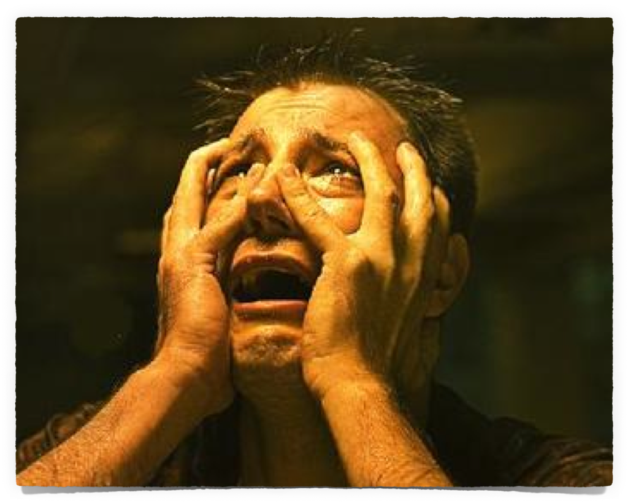
Does God’s Word Scare You?

Slide 2
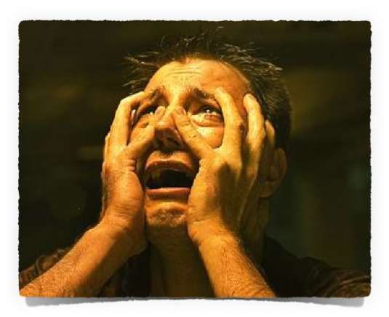
Does God’s Word Scare You?
Your Attitude Towards God & His Word?
Warnings Are Necessary & Ought To Be Appreciated!
Many believe & heed God & the warnings He has given us in His word!
Many more ignore God & His warnings

Slide 3
Does God’s Word Scare You?
Your Attitude Towards God & His Word?
Isaiah 66:1–2 (NKJV)
¹ Thus says the Lord: “Heaven is My throne, And earth is My footstool. Where is the house that you will build Me? And where is the place of My rest? ² For all those things My hand has made, And all those things exist,” Says the Lord. “But on this one will I look: On him who is poor and of a contrite spirit, And who trembles at My word.
trembles at My word

Slide 4
Does God’s Word Scare You?
Your Attitude Towards God & His Word?
Psalm 119:118–120 (NKJV)
¹¹⁸ You reject all those who stray from Your statutes, For their deceit is falsehood. ¹¹⁹ You put away all the wicked of the earth like dross; Therefore I love Your testimonies. ¹²⁰ My flesh trembles for fear of You, And I am afraid of Your judgments.

Slide 5
Does God’s Word Scare You?
Your Attitude Towards God & His Word?
Philippians 2:12 (NKJV)
¹² Therefore, my beloved, as you have always obeyed, not as in my presence only, but now much more in my absence, work out your own salvation with fear and trembling;

Slide 6
Does God’s Word Scare You?
Your Attitude Towards God & His Word?
Hebrews 12:28–29 (NKJV)
²⁸ Therefore, since we are receiving a kingdom which cannot be shaken, let us have grace, by which we may serve God acceptably with reverence and godly fear. ²⁹ For our God is a consuming fire.

Slide 7
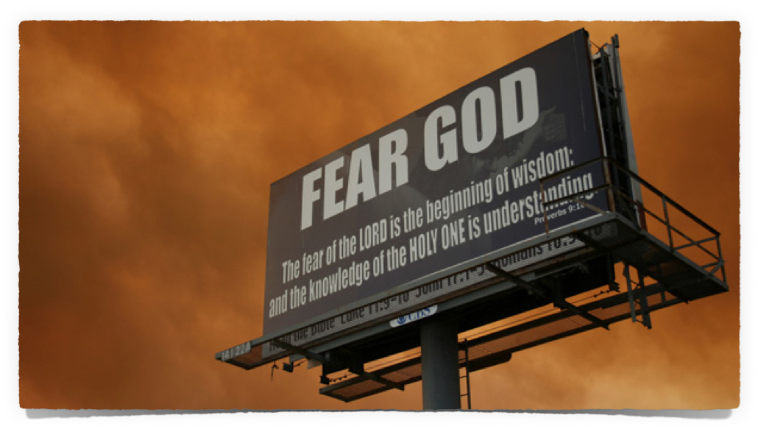
Does God’s Word Scare You?
Your Attitude Towards God & His Word?
Proverbs 1:7 (NKJV)
⁷ The fear of the Lord is the beginning of knowledge, But fools despise wisdom and instruction.
Proverbs 9:10

Slide 8
Does God’s Word Scare You?
Your Attitude Towards God & His Word?
Job 28:28 (NKJV)
²⁸ And to man He said, ‘Behold, the fear of the Lord, that is wisdom, And to depart from evil is understanding.’ ”
Proverbs 9:10

Slide 9
Does God’s Word Scare You?
Your Attitude Towards God & His Word?
Psalm 111:10 (NKJV)
¹⁰ The fear of the Lord is the beginning of wisdom; A good understanding have all those who do His commandments. His praise endures forever.
Proverbs 9:10

Slide 10
Does God’s Word Scare You?
Your Attitude Towards God & His Word?
Psalm 112:1 (NKJV)
¹ Praise the Lord! Blessed is the man who fears the Lord, Who delights greatly in His commandments.
Proverbs 9:10

Slide 11
Does God’s Word Scare You?
Judgment Is Coming
Ecclesiastes 12:13–14 (NKJV)
¹³ Let us hear the conclusion of the whole matter: Fear God and keep His commandments, For this is man’s all. ¹⁴ For God will bring every work into judgment, Including every secret thing, Whether good or evil.

Slide 12
Does God’s Word Scare You?
Judgment Is Coming
Hebrews 4:13 (NKJV)
¹³ And there is no creature hidden from His sight, but all things are naked and open to the eyes of Him to whom we must give account.

Slide 13
Does God’s Word Scare You?
Judgment Is Coming
Matthew 25:31–46 (NKJV)
³¹ “When the Son of Man comes in His glory, and all the holy angels with Him, then He will sit on the throne of His glory. ³² All the nations will be gathered before Him, and He will separate them one from another, as a shepherd divides his sheep from the goats. ³³ And He will set the sheep on His right hand, but the goats on the left.

Slide 14
Does God’s Word Scare You?
Judgment Is Coming
Matthew 25:31–46 (NKJV)
³⁴ Then the King will say to those on His right hand, ‘Come, you blessed of My Father, inherit the kingdom prepared for you from the foundation of the world: ³⁵ for I was hungry and you gave Me food; I was thirsty and you gave Me drink; I was a stranger and you took Me in; ³⁶ I was naked and you clothed Me; I was sick and you visited Me; I was in prison and you came to Me.’

Slide 15
Does God’s Word Scare You?
Judgment Is Coming
Matthew 25:31–46 (NKJV)
. . . ⁴¹ “Then He will also say to those on the left hand, ‘Depart from Me, you cursed, into the everlasting fire prepared for the devil and his angels: ⁴² for I was hungry and you gave Me no food; I was thirsty and you gave Me no drink; ⁴³ I was a stranger and you did not take Me in, naked and you did not clothe Me, sick and in prison and you did not visit Me.’ . . .

Slide 16
Does God’s Word Scare You?
Judgment Is Coming
Matthew 25:31–46 (NKJV)
. . . ⁴⁵ Then He will answer them, saying, ‘Assuredly, I say to you, inasmuch as you did not do it to one of the least of these, you did not do it to Me.’ ⁴⁶ And these will go away into everlasting punishment, but the righteous into eternal life.”

Slide 17
Does God’s Word Scare You?
Judgment Is Coming
Romans 2:5-11 (NKJV)
⁵ But in accordance with your hardness and your impenitent heart you are treasuring up for yourself wrath in the day of wrath and revelation of the righteous judgment of God, ⁶ who "will render to each one according to his deeds": ⁷ eternal life to those who by patient continuance in doing good seek for glory, honor, and immortality;

Slide 18
Does God’s Word Scare You?
Judgment Is Coming
Romans 2:5-11 (NKJV)
⁸ but to those who are self-seeking and do not obey the truth, but obey unrighteousness--indignation and wrath, ⁹ tribulation and anguish, on every soul of man who does evil, of the Jew first and also of the Greek; ¹⁰ but glory, honor, and peace to everyone who works what is good, to the Jew first and also to the Greek. ¹¹ For there is no partiality with God.

Slide 19
Does God’s Word Scare You?
Judgment Is Coming
2 Corinthians 5:9-11 (NKJV)
⁹ Therefore we make it our aim, whether present or absent, to be well pleasing to Him. ¹⁰ For we must all appear before the judgment seat of Christ, that each one may receive the things done in the body, according to what he has done, whether good or bad. ¹¹ Knowing, therefore, the terror of the Lord, we persuade men; but we are well known to God, and I also trust are well known in your consciences.

Slide 20
Does God’s Word Scare You?
Judgment Is Coming
Revelation 21:6–8 (NKJV)
⁶ And He said to me, “It is done! I am the Alpha and the Omega, the Beginning and the End. I will give of the fountain of the water of life freely to him who thirsts. ⁷ He who overcomes shall inherit all things, and I will be his God and he shall be My son. ⁸ But the cowardly, unbelieving, abominable, murderers, sexually immoral, sorcerers, idolaters, and all liars shall have their part in the lake which burns with fire and brimstone, which is the second death.”

Slide 21
Does God’s Word Scare You?
MANY Have Nothing To Fear
Every Faithful Believer
Trusting – (Rom 4:19-21)
Obedient– (Heb 5:8,9)
Loving – (1 John 4:7-11,17)
Diligent – (2 Pet. 1:5-10)
Persevering – (Rom 5:1-5; 2 Pet. 1:3-9)

Slide 22
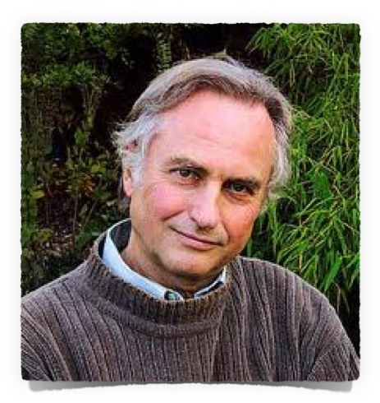
Does God’s Word Scare You?
MANY Have Everything To Fear
The Professed Unbeliever
The Atheist – (Psalm 14:1)
The Skeptic – (2 Pet. 3:1-15)
The Idolater & Immoral – (1 Cor. 6:9-11; Rev. 21:8)
The Moral Unbeliever – (Acts 10; John 8:24; Rom 3:23; 6:23)

Slide 23
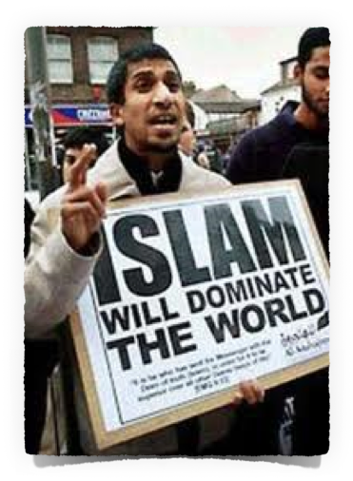
Does God’s Word Scare You?
MANY Have Everything To Fear
The Religious Unbeliever
The idolater – Hindu, Buddhist, Etc. – (Heb. 11:6)
Muslim, Jew, J.W.’s; Mormons - Etc. – (John 3:16-18; 8:24; 12:48; 14:6; Rom 2:16)
The Moralist – (Eph. 2:8,9; Rom. 2:16; 3:23; 6:23)

Slide 24
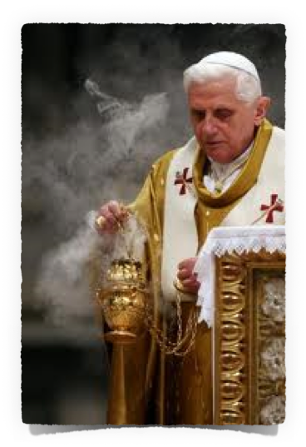
Does God’s Word Scare You?
MANY Have Everything To Fear
The Religious Unbeliever
Those who preach false doctrine – (2 Cor. 11:13-15; 2 Pet. 2:1-3,17)
Those who follow the doctrines & commandments of men - (Mat 15:7-9; 2 Jon 9)
All who do not know God and obey NOT the gospel – (2 Thes 1:7-9; Rom. 6:16,17; Acts 17:11)

Slide 25
Does God’s Word Scare You?
MANY Have Everything To Fear
Every Erring Believer
Judgment begins with the house of God – (1 Pet 4:17; 2 Cor 5:10)
Those who return to the world – (2 Pet 2:20-22; 2 Tim 4:10; Jam 4:4)
Those who do not walk in the light & turn from the truth – (1 John 1:5-10; James 5:19:20)
The self righteous – (Luke 18:9-14)

Slide 26
Does God’s Word Scare You?
MANY Have Everything To Fear
Every Erring Believer
Innovators – (2 John 9)
Cold formalism – (Amos 8:5; Mal. 1:8; John 4:24)
Those who harbor hatred – (Gal. 5:19-21; 1 John 4:7-21)
Those who are lukewarm – (Rev 3:14ff; Matt. 25:31-46; Heb 10:24,25)

Slide 27
Does God’s Word Scare You?
MANY Have Everything To Fear
Acts 17:30-31 (NKJV)
³⁰ Truly, these times of ignorance God overlooked, but now commands all men everywhere to repent, ³¹ because He has appointed a day on which He will judge the world in righteousness by the Man whom He has ordained. He has given assurance of this to all by raising Him from the dead."

Slide 28
Does God’s Word Scare You?
Passages To Take Very Seriously
Matthew 7:13,14; Luke 13:20-27
Mat 5:28,30
Mat 12:33-37
James 4:17
2 Thes 2:10-12
Matthew 7:21-23

Slide 29
Does God’s Word Scare You?

Slide 30
Does God’s Word Scare You?
You Can Have Nothing To Fear
You Can Be Saved – Mark 16:16; Acts 2:38
You Can Serve The Lord Acceptably – John 4:24; James 1:26,27
You Can Be Ready For THAT DAY– 2 Cor 15:58; 2 Peter 3:13,14
You CAN Hear the Words “Come, you blessed of My Father” – Mat 25:34

Slide 31
Does God’s Word Scare You?
You Can Have Nothing To Fear
1 John 4:18 (NKJV)
¹⁸ There is no fear in love; but perfect love casts out fear, because fear involves torment. But he who fears has not been made perfect in love.

Slide 33
Does God’s Word Scare You?
Charts by Don McClain
Prepared August 22,23 / Preached August 24, 2014
West 65th Street church of Christ
P.O. Box 190062
Little Rock AR 72219
501-568-1062
Prepared using Keynote
Email – donmcclain@sbcglobal.net
More Keynote, PPT & Audio Sermons:
http://w65stchurchofchrist.org/coc/sermons/
Note – Many of the transition effects used in this presentation will be lost using PPT 2007 Viewer
http://www.microsoft.com/downloads/details.aspx?FamilyID=cb9bf144-1076-4615-9951-294eeb832823&displaylang=en

Slide 34
2 Peter 3:9–14 (NKJV)
⁹ The Lord is not slack concerning His promise, as some count slackness, but is longsuffering toward us, not willing that any should perish but that all should come to repentance.

Slide 35
2 Peter 3:9–14 (NKJV)
¹⁰ But the day of the Lord will come as a thief in the night, in which the heavens will pass away with a great noise, and the elements will melt with fervent heat; both the earth and the works that are in it will be burned up.

Slide 36
2 Peter 3:9–14 (NKJV)
¹¹ Therefore, since all these things will be dissolved, what manner of persons ought you to be in holy conduct and godliness, ¹² looking for and hastening the coming of the day of God, because of which the heavens will be dissolved, being on fire, and the elements will melt with fervent heat?

Slide 37
2 Peter 3:9–14 (NKJV)
¹³ Nevertheless we, according to His promise, look for new heavens and a new earth in which righteousness dwells. ¹⁴ Therefore, beloved, looking forward to these things, be diligent to be found by Him in peace, without spot and blameless;

