Slide 1
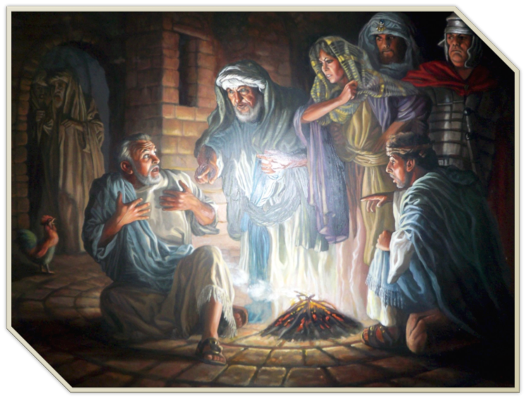
Are We Setting Ourselves Up
"I do not know this Man of whom you speak!” - Mark 14:71
Mark 14:27-31, 53,54, 66-72

Slide 2
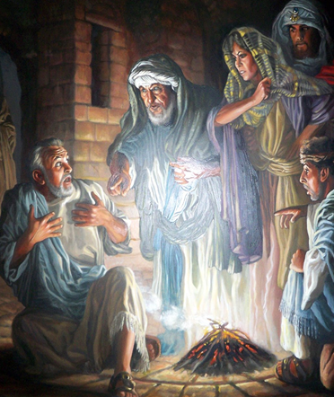
Are We Setting Ourselves Up
Every sin we commit is a result of our failure to implement the wisdom & strength of God, which He provides us through His word - Ps 119:9-11; Ep 6:10-18; 2 Pet 1:5-11; 1 Jn 3:9
After Peter is told he will deny Jesus three times, he assures Jesus he would never do that - then he denies Jesus three times.

Slide 3
Mark 14:27–31 (NKJV)
²⁷ Then Jesus said to them, “All of you will be made to stumble because of Me this night, for it is written: ‘I will strike the Shepherd, And the sheep will be scattered.’ ²⁸ “But after I have been raised, I will go before you to Galilee.”

Slide 4
Mark 14:27–31 (NKJV)
²⁹ Peter said to Him, “Even if all are made to stumble, yet I will not be.” ³⁰ Jesus said to him, “Assuredly, I say to you that today, even this night, before the rooster crows twice, you will deny Me three times.” ³¹ But he spoke more vehemently, “If I have to die with You, I will not deny You!” And they all said likewise.

Slide 5
Mark 14:53–54 (NKJV)
⁵³ And they led Jesus away to the high priest; and with him were assembled all the chief priests, the elders, and the scribes. ⁵⁴ But Peter followed Him at a distance, right into the courtyard of the high priest. And he sat with the servants and warmed himself at the fire.

Slide 6
Mark 14:66–72 (NKJV)
⁶⁶ Now as Peter was below in the courtyard, one of the servant girls of the high priest came. ⁶⁷ And when she saw Peter warming himself, she looked at him and said, “You also were with Jesus of Nazareth.”

Slide 7
Mark 14:66–72 (NKJV)
⁶⁸ But he denied it, saying, “I neither know nor understand what you are saying.” And he went out on the porch, and a rooster crowed. ⁶⁹ And the servant girl saw him again, and began to say to those who stood by, “This is one of them.”

Slide 8
Mark 14:66–72 (NKJV)
⁷⁰ But he denied it again. And a little later those who stood by said to Peter again, “Surely you are one of them; for you are a Galilean, and your speech shows it.” ⁷¹ Then he began to curse and swear, “I do not know this Man of whom you speak!”

Slide 9
Mark 14:66–72 (NKJV)
⁷² A second time the rooster crowed. Then Peter called to mind the word that Jesus had said to him, “Before the rooster crows twice, you will deny Me three times.” And when he thought about it, he wept.

Slide 10
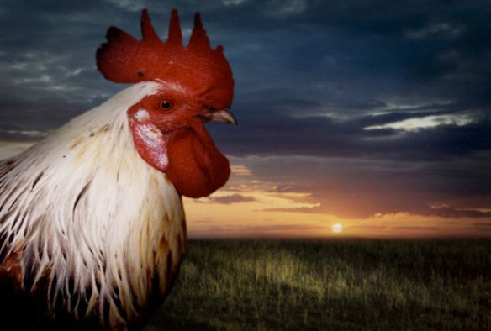
Are We Setting Ourselves Up
Peter - Close to Jesus:
At transfiguration - (Mat. 17:1)
Raising daughter of Jarius - (Lk 8:51)
Asked about destr. of Jerusalem - (Mk. 13:3)
In Garden - (Mat. 26:37-40; Mk. 5:37)

Slide 11
Are We Setting Ourselves Up
Peter - Close to Jesus:
Jesus healed mother-in-law - (Mat 8:14)
Walked on the water - (Mat. 14:28)
Confessed Jesus as being the Christ - (Mat. 16:13ff)
Asked “To whom shall we go” - (Jn 6:68)

Slide 12
Are We Setting Ourselves Up

Slide 13
Are We Setting Ourselves Up
Peter - quick to follow - John 1:35-42; Mt 4:18-22
Impulsive - Quick to Speak & act - Mt 15:15; 16:13-18; 17:4; Jn 13:8-9
Rebuked Jesus for speaking of His death - Mat 16:21-23
Misunderstanding -

Slide 14
Are We Setting Ourselves Up
Initially refuses to allow Jesus to wash his feet - (Jn 13:6-9)
Over Confident - Told he would deny Jesus - which he denied - “Even if all are made to stumble, yet I will not be.” - (Mark 14:29-31; - cf. Mat 26:31-35; Lk 22:33, 34; Jn 13:6-38)
Misunderstanding -
Pride -

Slide 15
Are We Setting Ourselves Up
In Garden / Asleep - (Mt. 26:36-46)
Attacks Malchus / rebuked by Jesus - (Jn 18:10-12; Mat 6:51-54)
Followed at a distance - (Mat 26:56-58)
Warms himself by the fire - (Mark 14:54; Mat 26:58)
Misunderstanding -
Pride -
Neglect –
Presumptuous -
Cowardice –
Worldliness –

Slide 16
Are We Setting Ourselves Up
⁶⁷ “You also were with Jesus of Nazareth.” ⁶⁸ But he denied it, saying, “I neither know nor understand what you are saying.”
⁶⁹ . . .“This is one of them.” ⁷⁰ But he denied it again.
⁷⁰ . . . “Surely you are one of them; for you are a Galilean, and your speech shows it.” ⁷¹ Then he began to curse and swear, “I do not know this Man of whom you speak!”

Slide 17
Are We Setting Ourselves Up
Misunderstanding - Mat 16:21-23; Hos 4:6; 2 Pt 3:16-18
Pride - Mark 14:29,31; Prov 16:18; 18:12; 1 Cor. 10:12
Neglect – Mark 14:37-38; John 9:4; 1 Thes. 5:6
Presumptuous - Mark 14:47; 2 Chro 13:1-14; 15:2,13
Cowardice – Mark 14:54; 8:38; Rev 21:8
Worldliness – Mark 14:54; Prov. 6:27-29; Ja 4:4

Slide 18
Are We Setting Ourselves Up
Denial – Mark 14:66-71; Mat 10:32,33; 2 Tim 2:12; Tit 1:16
Stubborn unbelief - Jn 20:30,31; 8:24; Heb 11:6
Cowardice - Rev 21:8; John 12:42,43; Mat 10:28
Teaching / following the wrong Jesus - 2 Cor 11:3,4; Gal 1:6-9; Mat 7:21-23
Not obeying the REAL Jesus - Luke 6:46; Heb 5:8,9; 2 Thes 1:8

Slide 19
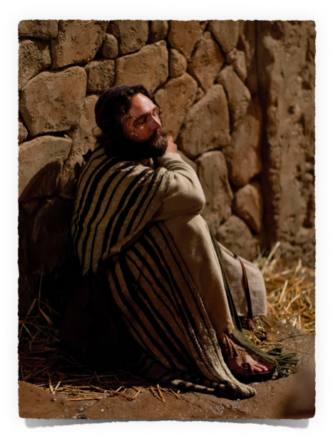
Are We Setting Ourselves Up
Peter’s Return To The Lord
Jesus prophesied Peter’s Denial – Mark 14:30
Jesus prayed that Peter’s faith would not fail - Luke 22:32
Jesus said, “when you have returned to Me, strengthen your brethren ." Luke 22:32; John 21:15

Slide 20
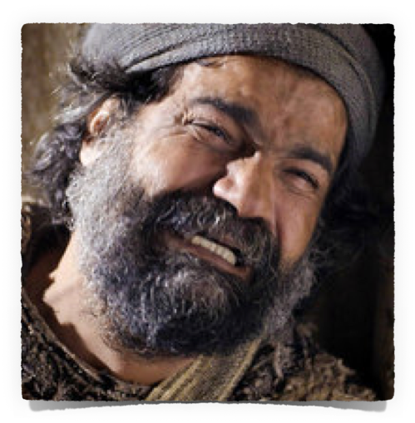
Are We Setting Ourselves Up
Peter’s Return To The Lord
When the Cock Crew…
Luke 22:60–62 (NKJV)
⁶⁰ But Peter said, “Man, I do not know what you are saying!” Immediately, while he was still speaking, the rooster crowed. ⁶¹ And the Lord turned and looked at Peter. Then Peter remembered the word of the Lord, how He had said to him, “Before the rooster crows, you will deny Me three times.” ⁶² So Peter went out and wept bitterly.

Slide 21
Are We Setting Ourselves Up
Peter’s Return To The Lord
When the Cock Crew…
A Moral Coward Remembered - Mat 26:75; Luke 12:4, 5 (cf. 2 Peter 1:5)
A Sorrowful Man Wept Bitter Tears - Mat 26:75; 2 Cor 7:10
An Erring Disciple Returned to God - Luke 22:31; Mk 14:72

Slide 22
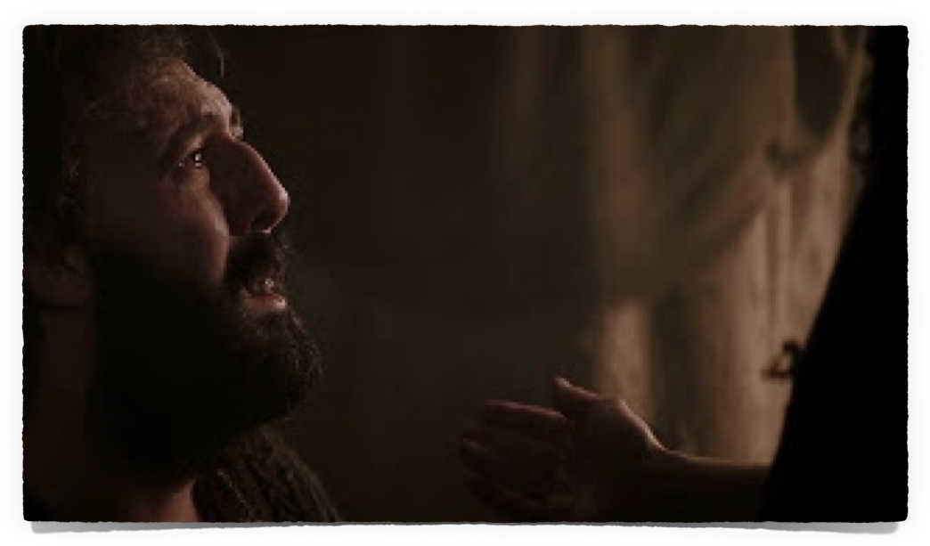
Are We Setting Ourselves Up
Peter’s Return To The Lord
His Restoration / Usefulness
Preached on Pentecost - Converted 3,000 + (Acts 2)
Preached to Cornelius (Acts 10)
Participated in Discussion at Jerusalem (Acts 15)
Served as an Elder (1 Pet. 5:1-4)
Wrote 1 Peter (Living Holy)
Wrote 2 Peter (Danger of Departing)

Slide 23
Are We Setting Ourselves Up
Peter’s Return To The Lord
His Restoration / Usefulness
Before
After
Pride
(Mt. 26:31-33)
Indifference
(Mt. 26:36-46)
Coward
(Mt. 26:58)
distracted By World
(Mk. 14:54)
Humility
(1 Pet 5:5-6)
Diligence
(2 Pet. 1:5, 10)
Bold
(Acts 4:19; 5:29)
Focused on Heaven
(2 Pet 3:13-14)

Slide 24
Are We Setting Ourselves Up
Lessons & Applications
Take Heed / Watch & Pray
If you are now a child of God carefully following in your masters footsteps
Grow In Knowledge
Be Humble
Be Diligent
Walk by faith
Courageous
Spiritual Minded

Slide 25
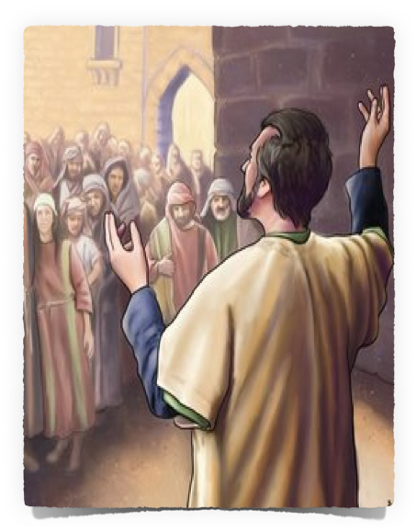
Are We Setting Ourselves Up
Lessons & Applications
Invitation
Your response, after becoming aware of your sin, is what matters MOST!
If you have traveled the road of a backslider . . . You can come home! Acts 8:22; 1 John 1:9.10
You can be a valuable & an effective servant of the Lord - you can confess Him daily - you can lead many to Christ – 1 Pet 3:14,15; 4:16

Slide 26
Are We Setting Ourselves Up
Lessons & Applications
Acts 2:36–38 (NKJV)
36 “Therefore let all the house of Israel know assuredly that God has made this Jesus, whom you crucified, both Lord and Christ.” 37 Now when they heard this, they were cut to the heart, and said to Peter and the rest of the apostles, “Men and brethren, what shall we do?” 38 Then Peter said to them, “Repent, and let every one of you be baptized in the name of Jesus Christ for the remission of sins; and you shall receive the gift of the Holy Spirit.
Invitation

Slide 28
Are We Setting Ourselves Up
Mark 14:27-31, 53,54, 66-72
Charts by Don McClain
Prepared October 30 - November 1, 2014
Preached - November 2, 2014
West 65th Street church of Christ
P.O. Box 190062
Little Rock AR 72219
501-568-1062
Prepared using Keynote
Email – donmcclain@sbcglobal.net
More Keynote, PPT & Audio Sermons:
http://w65stchurchofchrist.org/coc/sermons/
Note – Many of the transition effects used in this presentation will be lost using PPT 2007 Viewer
http://www.microsoft.com/downloads/details.aspx?FamilyID=cb9bf144-1076-4615-9951-294eeb832823&displaylang=en

Slide 29
Luke 22:24–34 (NKJV)
²⁴ Now there was also a dispute among them, as to which of them should be considered the greatest. ²⁵ And He said to them, “The kings of the Gentiles exercise lordship over them, and those who exercise authority over them are called ‘benefactors.’

Slide 30
Luke 22:24–34 (NKJV)
²⁶ But not so among you; on the contrary, he who is greatest among you, let him be as the younger, and he who governs as he who serves. ²⁷ For who is greater, he who sits at the table, or he who serves? Is it not he who sits at the table? Yet I am among you as the One who serves.

Slide 31
Luke 22:24–34 (NKJV)
²⁸ “But you are those who have continued with Me in My trials. ²⁹ And I bestow upon you a kingdom, just as My Father bestowed one upon Me, ³⁰ that you may eat and drink at My table in My kingdom, and sit on thrones judging the twelve tribes of Israel.”

Slide 32
Luke 22:24–34 (NKJV)
³¹ And the Lord said, “Simon, Simon! Indeed, Satan has asked for you, that he may sift you as wheat. ³² But I have prayed for you, that your faith should not fail; and when you have returned to Me, strengthen your brethren.”

Slide 33
Luke 22:24–34 (NKJV)
³³ But he said to Him, “Lord, I am ready to go with You, both to prison and to death.” ³⁴ Then He said, “I tell you, Peter, the rooster shall not crow this day before you will deny three times that you know Me.”

