Slide 1
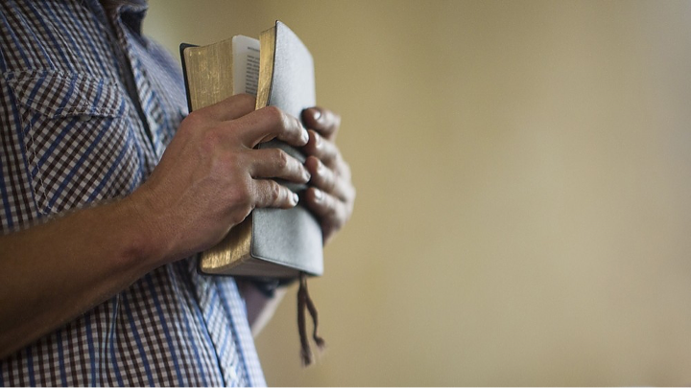
Is The Church of CHRIST A Biblical Church?
What’s
Wrong/Right
With The
Church of Christ?

Slide 2
Is The Church of CHRIST A Biblical Church?
There have been many questions & objections raised regarding the “church of Christ”
“Questions a church of Christ preacher cannot answer” - So says David Martin of the so-called “Rock Solid Baptist Church”
“Is the church of Christ denomination a cult” - Freedom Quest Ministries - http://www.chocd.org
Regardless of the answers given, (even if the answers are Biblically sound), many refuse to listen, or even objectively consider their legitimacy. - [Stephen answered the Sanhedrin but not as they deemed “satisfactorily” (Acts 7:54-60)] -

Slide 3
Is The Church of CHRIST A Biblical Church?
Answer: This is a difficult question to answer due to the phrase "Church of Christ" being such a broad description. There are many churches who refer to themselves as the "Church of Christ." Even within the most widespread "Church of Christ" denomination, there can be significant differences between the churches. There is no doubt that many in the Church of Christ denomination are genuine believers in Christ who desire to truly worship, follow, and obey Him. At the same time, there are others in the Church of Christ, and some Church of Christ churches, that are borderline cult-like in their preferences, practices, and doctrines. We are by no means disparaging the entire Church of Christ denomination or every church that refers to itself as the "Church of Christ." The purpose of this article is to express some concerns and answer some questions about the Church of Christ that we have observed and experienced.
http://www.gotquestions.org/Church-of-Christ.html

Slide 4
Is The Church of CHRIST A Biblical Church?
A Biblical Understanding of The Church Jesus Built
All Christians Everywhere
“I will build MY CHURCH” - Matt. 16:18
“The Lord added to THE CHURCH daily” - Acts 2:47
“there is ONE BODY” - Eph. 4:4
“He is also head of the BODY, the CHURCH” - Col. 1:18; Eph. 1:22-23
“He is the Savior of THE BODY” - Eph 5:23,24

Slide 5
Is The Church of CHRIST A Biblical Church?
A Biblical Understanding of The Church Jesus Built
Description
Passage
Jesus
Relationship
“the church”
(Acts 8:3, etc.)
The One Who Calls
The Called Out
“the church of God”
(Acts 20:28)
Paid The Price
Purchased of God
“the body of Christ”
(1 Cor. 12:27)
Headship
Members
“the kingdom of God”
(Rom. 14:17)
Kingship
Citizens
“the family of God”
(1 Tim. 3:15)
Son
Children
“the temple of God”
(1 Cor. 3:16)
High Priest
Serve / Worship
“the church of the firstborn”
(Heb. 12:23)
Heir
Fellow Heirs

Slide 6
Is The Church of CHRIST A Biblical Church?
A Biblical Understanding of The Church Jesus Built
Christians In A Specific Area
Christians - who continue steadfastly in the apostles doctrine … (Acts 2:36-47)
Agree to join together in fellowship - (Acts 9:26).
Worship in a common assembly – (1 Cor. 11:18)
Work out of a common treasury – (1 Cor.16:1-3)
Submit to a common oversight – (Acts 14:23; 20:28)

Slide 7
Is The Church of CHRIST A Biblical Church?
A Biblical Understanding of The Church Jesus Built
Christians In A Specific Area
“the church of God which is at Corinth” - (1 Cor. 1:2)
“the church of the Thessalonians in God” - (1 Thess. 1:1).
“the churches of Galatia” - (1 Cor. 16:1).
“the churches of the saints” - (1 Cor. 14:33).
“the churches of Christ” - (Rom. 16:16).
“the churches” - (Acts 8:3; 15:41, etc., etc.).
“The Seven churches of Asia” - (Rev 2,3)

Slide 8
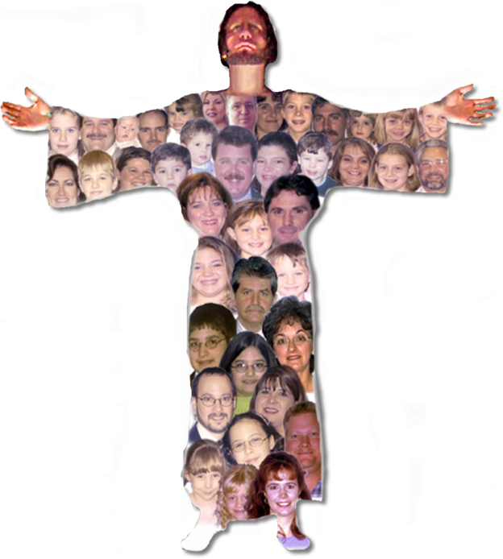
In relation to God’s calling: “saints” (1 Cor. 1:1-2)
In relation to the gospel: “believers” (1 Thess. 1:7)
In relation to Christ: “Christians” (Acts 11:26)
In relation to the Father: “children of God” - (1 Jn. 3:1)
In relation to Christ’s teaching: “disciples” - (Acts 6:7)
In relation to one another: “brethren” (1 Cor. 1:10)
Notes:
A.D. 30 – The Lord’s church – Acts 2:47

Slide 9
Is The Church of CHRIST A Biblical Church?
Merriam-Webster
4 : a religious organization uniting local congregations in a single legal and administrative body
http://library.christchurch.org.nz/FamilyHistory/Glossary
“A group of religious congregations united under a common faith and name and organized under a single administrative and legal hierarchy, e.g., Anglicans, Presbyterians, Catholics etc.”

Slide 10
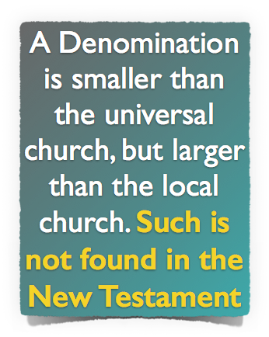
Is The Church of CHRIST A Biblical Church?
A Biblical Understanding of The Church Jesus Built

Slide 11
Roman Catholic Church
Greek Orthodox Church
Lutheran Church
Church of England
Presbyterian Church
Baptist Church
1739 Methodist Church
1830 Mormon Church
Seventh Day Adventists
Jehovah’s Witnesses
Church of God
Nazarene Church
Christian Church
Assemblies of God
Notes:
A.D. 30 – The Lord’s church – Acts 2:47

Slide 12
Bound together by distinct beliefs
Bound together by distinct beliefs
Earthly Headquarters
Earthly Headquarters
Baptist (1608)
Divided By Distinction In Belief
Presbyterian (1560)
Bound together by distinct beliefs
Bound together by distinct beliefs
Earthly Headquarters
Earthly Headquarters
Methodist (1740)
Pentecostal (1898)
Notes:
Divided By Distinction In Belief

Slide 13
Is The Church of CHRIST A Biblical Church?
Unscriptural Concepts
“We're all going to heaven, just by different routes.” (Mat. 7:13,14; John 10:9; 14:1-6; Acts 4:12; 2 John 1:9)
You must not challenge or oppose somebody else’s church (faith). (2 Tim 4:2-4; Tit 1:10-2:1; Prov. 27:5; Mat 15:7-9)
All denominations (belief systems) are OK. They are “parts” or “units” of the one church and the one faith (John 15:1-8; 1 Cor. 1:10-13; 4:17). (Different Kinds???)

Slide 14
Is The Church of CHRIST A Biblical Church?
John 17:20–21 (NKJV)
²⁰ “I do not pray for these alone, but also for those who will believe in Me through their word; ²¹ that they all may be one, as You, Father, are in Me, and I in You; that they also may be one in Us, that the world may believe that You sent Me.

Slide 15
Is The Church of CHRIST A Biblical Church?
1 Corinthians 1:10–13 (NKJV)
¹⁰ Now I plead with you, brethren, by the name of our Lord Jesus Christ, that you all speak the same thing, and that there be no divisions among you, but that you be perfectly joined together in the same mind and in the same judgment.

Slide 16
Is The Church of CHRIST A Biblical Church?
1 Corinthians 1:10–13 (NKJV)
¹¹ For it has been declared to me concerning you, my brethren, by those of Chloe’s household, that there are contentions among you. ¹² Now I say this, that each of you says, “I am of Paul,” or “I am of Apollos,” or “I am of Cephas,” or “I am of Christ.” ¹³ Is Christ divided? Was Paul crucified for you? Or were you baptized in the name of Paul?

Slide 17
Is The Church of CHRIST A Biblical Church?
Ephesians 4:3–6 (NKJV)
³ endeavoring to keep the unity of the Spirit in the bond of peace. ⁴ There is one body and one Spirit, just as you were called in one hope of your calling; ⁵ one Lord, one faith, one baptism; ⁶ one God and Father of all, who is above all, and through all, and in you all.

Slide 18
Corn
Apple
Acorn

Slide 19
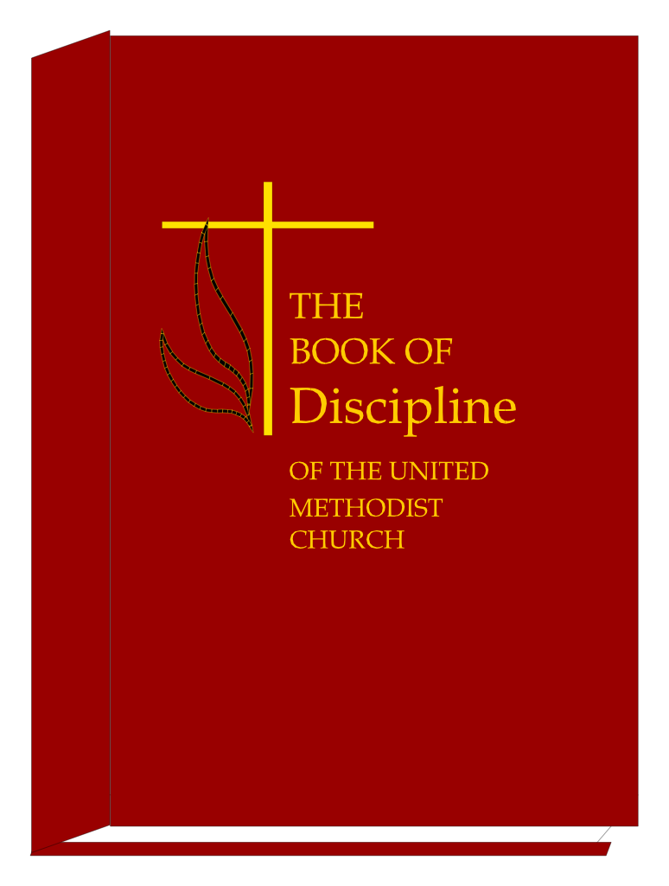
Methodist
Christian
Mennonite
Nazarene

Slide 20
And the disciples were first called Presbyterians in Antioch.
And the disciples were first called Methodists in Antioch.
. . . And the disciples were first called Christians in Antioch. Acts 11:26 (NKJV)
Notes:
The Bible Doesn’t Teach Me to Wear One Name and You to Wear Another

Slide 21
Ask Jesus to come into your heart . . . Say the sinners prayer!
There is ABSOLUTELY NOTHING you can do to be saved!
Believe, repent, confess, and be baptized into Christ – Mark 16:16; Acts 2:38; Rom. 10:9; Rom. 6:3-6; Col. 2:11-13
Notes:
The Bible Doesn’t Teach Me to Be Saved One Way And You Another

Slide 22
“I don’t think it makes any difference what CHURCH you join!”
“You have to be a member of “MY” denomination in order to go to heaven!!”
. . . The Lord added daily to the church those who were being saved – Acts 2:47
Notes:
The Bible Doesn’t Teach Me to Be A Member of One KIND of Church And You Another!!

Slide 23
The one body is an organism, not an organization. (Col. 1:18-24)
Unity is NOT maintained by bringing all Christians into a “visible body of Christ”. (2 Peter 5:1,2)
Unity is maintained as Christians remain faithful to the revealed TRUTH of God (Eph. 4:1-6).

Slide 24
When all men will lay down their creeds, disciplines, manuals, confessions of faith, catechisms, think-so's, maybe's, and subjective feelings, and with an unprejudiced and receptive heart turn to the Word of God, then, and ONLY then, will unity result.
We must be committed to being nothing, calling ourselves nothing, obeying nothing, and saying nothing except that which is authorized by the Word of God.
Don McClain
W. 65 St church of Christ - May, 28, 2006

Slide 25
Don McClain

Slide 26
Is The Church of CHRIST A Biblical Church?
A Biblical Understanding of The Church Jesus Built

Slide 27
Romans 16:16–20 (NKJV)
¹⁶ Greet one another with a holy kiss. The churches of Christ greet you. ¹⁷ Now I urge you, brethren, note those who cause divisions and offenses, contrary to the doctrine which you learned, and avoid them. ¹⁸ For those who are such do not serve our Lord Jesus Christ, but their own belly, and by smooth words and flattering speech deceive the hearts of the simple.

Slide 28
Romans 16:16–20 (NKJV)
¹⁹ For your obedience has become known to all. Therefore I am glad on your behalf; but I want you to be wise in what is good, and simple concerning evil. ²⁰ And the God of peace will crush Satan under your feet shortly. The grace of our Lord Jesus Christ be with you. Amen.

