Slide 1
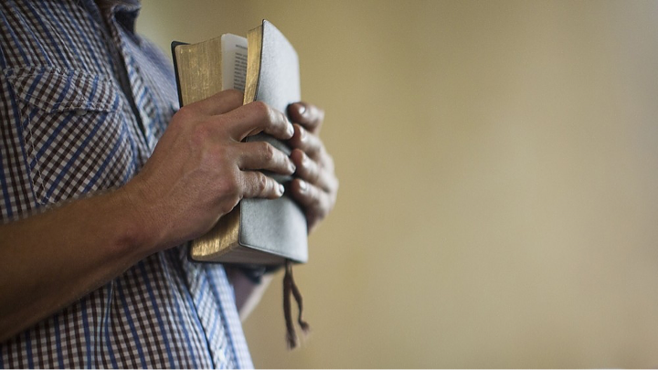
Is The Church of CHRIST A Biblical Church?
Seeking To Establish Scriptural Permission For All We Believe, Teach & Practice

Slide 2
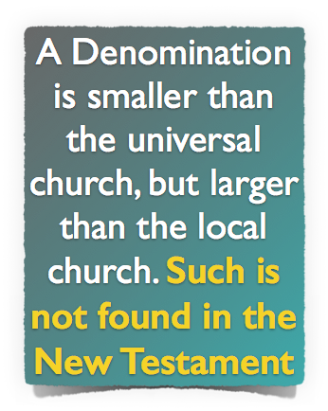
Is The Church of CHRIST A Biblical Church?
A Biblical Understanding of The Church Jesus Built

Slide 3
Is The Church of CHRIST A Biblical Church?
The church of Christ Submits To Christ!
Therefore, just as the church is subject to Christ,… Eph 5:24
“I don’t think it makes any difference what CHURCH you join!”
“You have to be a member of “MY” denomination in order to go to heaven!!”
. . . The Lord added daily to the church those who were being saved – Acts 2:47
Notes:
The Bible Doesn’t Teach Me to Be A Member of One KIND of Church And You Another!!

Slide 4
Is The Church of CHRIST A Biblical Church?
The church of Christ Submits To Christ!
Therefore, just as the church is subject to Christ,… Eph 5:24
Methodist
Christian
Mennonite
Nazarene

Slide 5
Is The Church of CHRIST A Biblical Church?
The church of Christ Submits To Christ!
Therefore, just as the church is subject to Christ,… Eph 5:24
Ask Jesus to come into your heart . . . Say the sinners prayer!
There is ABSOLUTELY NOTHING you can do to be saved!
Believe, repent, confess, and be baptized into Christ – Mark 16:16; Acts 2:38; Rom. 10:9; Rom. 6:3-6; Col. 2:11-13
Notes:
The Bible Doesn’t Teach Me to Be Saved One Way And You Another

Slide 6
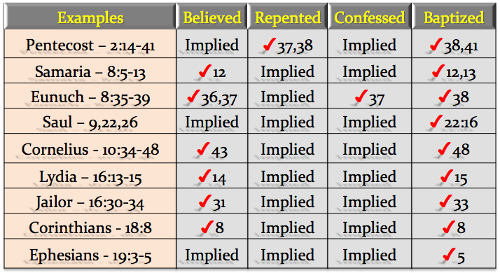
Is The Church of CHRIST A Biblical Church?
The church of Christ Are Those In Christ!
For as many of you as were baptized into Christ have put on Christ. - Gal 3:27
“The idea that a person could receive Christ as Savior and not be baptized was completely foreign to the early church.”

Slide 7
Is The Church of CHRIST A Biblical Church?
One “minor” issue is the Church of Christ policy of not allowing musical instruments in their church services. While we entirely agree that a church is well within the freedom God gives to not use musical instruments in worship, the problem is that some within the Church of Christ are fanatically against musical instruments. Some are fanatical to the point of declaring any church that uses musical instruments as not being a true, biblical, or godly church. Such dogmatism on a clearly non-essential issue is often the mark of a cult, not the mark of a good biblical church.
http://www.gotquestions.org/Church-of-Christ.html

Slide 8
Is The Church of CHRIST A Biblical Church?
The Principle of Submission
Seeking Permission For All We Believe, Teach & Practice
Walking By Faith …
2 Corinthians 5:7
Hebrews 1:1
James 2:14-26

Slide 9
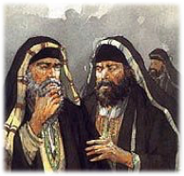
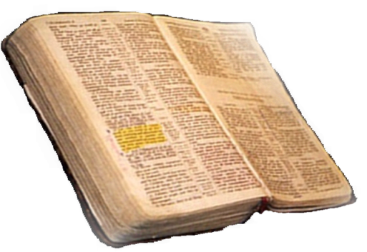
Is The Church of CHRIST A Biblical Church?
The Principle of Submission
Seeking Permission For All We Believe, Teach & Practice
Matthew 21:25-26
Only Two Possible Sources
From Heaven
Mt. 21:23-27
1 John 4:4-6
Gal. 1:6-9
Col. 2:6-10
2 Thess. 2:15
From Men
Mt. 15:1-9
1 Cor. 4:6
Gal. 1:10-17
Col. 2:8
2 Thess. 2:2-4
From Heaven or Men?

Slide 10
Is The Church of CHRIST A Biblical Church?
The Principle of Submission
Seeking Permission For All We Believe, Teach & Practice
Who Gave You Permission?
Your Parents (Mt. 10:21, 34-37)
Your Conscience (Acts 23:1; 24:16; 26:9-11)
The Majority (Mt. 7:13-14; 1 John 5:19)
Religious Leaders (2 Cor. 11:13-15; 2 Pet. 2:1-3)
Human Creeds & Traditions (Mt. 15:1-9; Col. 2:8, 18-23; 2 Thes 2:15)
Personal Desire (Pr. 14:12; 16:25; Jer. 10:23)
Emotions & Feelings (Pr. 28:26; Jer. 17:9)
The Good End (Rom. 3:8)
The Word of God?? - (Rom. 10:17; 1 Thes 2:13)

Slide 11
Is The Church of CHRIST A Biblical Church?
The Principle of Submission
Seeking Permission For All We Believe, Teach & Practice
Who Gave You Permission?
2 Timothy 3:16,17 (NKJV)
¹⁶ All Scripture is given by inspiration of God, and is profitable for doctrine, for reproof, for correction, for instruction in righteousness, ¹⁷ that the man of God may be complete, thoroughly equipped for every good work.
The Bible Is Enough
2 Timothy 3:15-17

Slide 12
Is The Church of CHRIST A Biblical Church?
The Principle of Submission
Seeking Permission For All We Believe, Teach & Practice
The Inspired Pattern - (2 Tim. 1:13; 3:16-17; 2 Pet. 1:20-21)
The Complete Pattern - (Jn. 14:26; 16:13; 1 Cor. 2:10-13; 2 Tim. 3:16-17; 2 Pet. 1:3)
The Final Pattern - (Gal 1:6-9; 1 Pet. 1:24-25; Jude 3)
The Understandable Pattern - (Eph. 3:3-5; 5:17; 2 Tim. 3:15)
The Unalterable Pattern - (Gal. 1:6-10; 2 Jn. 9-11; Rev. 22:18-19)
The Saving Pattern - (Rom. 1:16-17; Jas. 1:21-25; 1 Pet. 1:22-25)
The Uniting Pattern (John 17:10,21)
Is There A Pattern To Follow?
2 Timothy 3:15-17

Slide 13
Is The Church of CHRIST A Biblical Church?
The Principle of Submission
Seeking Permission For All We Believe, Teach & Practice
The totality of information revealed regarding any act of righteousness forms the pattern for that act!
Is There A Pattern To Follow?
Ps 119:160
2 Timothy 1:13;
2 Peter 1:3
2 Timothy 3:15-17

Slide 14
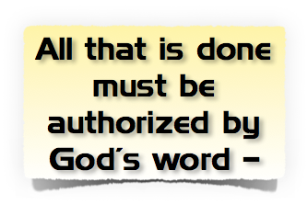
Is The Church of CHRIST A Biblical Church?
The Principle of Submission
Seeking Permission For All We Believe, Teach & Practice
Most religious divisions arise, not from what the Bible says, but out of what the Bible does not say.
Two extreme positions regarding the silence of scriptures:
Silence is permissive and that we are free to do whatever we desire if God has not specifically condemned it.
Silence is prohibitive and that we are to do only what God has commanded.

Slide 15
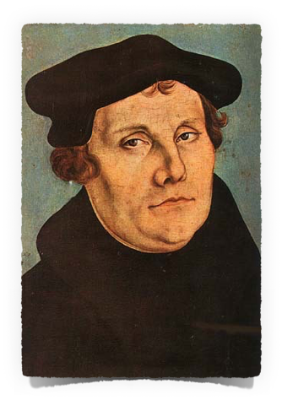
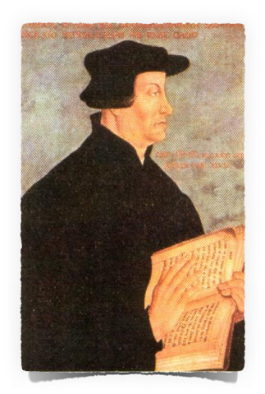
Is The Church of CHRIST A Biblical Church?
The Principle of Submission
Seeking Permission For All We Believe, Teach & Practice
Does God’s Silence Grant Permission?
“Whatever is not against scripture is for scripture, and scripture for it”
“What the Bible does not command we may not do,”
Martin Luther
1483-1546
Ulrich Zwingli – 1484-1531
[Handbook of Denominations, pg. 132]

Slide 16
Is The Church of CHRIST A Biblical Church?
The Principle of Submission
Seeking Permission For All We Believe, Teach & Practice
Does God’s Silence Grant Permission?
1 Peter 4:11 (NKJV)
¹¹ If anyone speaks, let him speak as the oracles of God. If anyone ministers, let him do it as with the ability which God supplies, that in all things God may be glorified through Jesus Christ, to whom belong the glory and the dominion forever and ever. Amen.

Slide 17
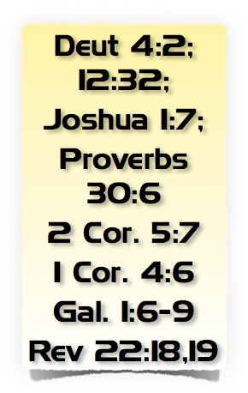
Is The Church of CHRIST A Biblical Church?
The Principle of Submission
Seeking Permission For All We Believe, Teach & Practice
God’s Silence To Be Respected!
Cain – (Gen. 4:7) – Heb 11:4
Nadab and Abihu – (Lev. 10:1,2)
Moses – (Num 20:8-24)
King Saul – (1 Sam. 13 & 15)
David’s ox cart – (1 Chr. 13:7-12; 15:2)
Jeroboam – (1 Kings 12:25-33)
Uzziah – (2 Chr. 26:16-23)

Slide 18
Is The Church of CHRIST A Biblical Church?
The Principle of Submission
Seeking Permission For All We Believe, Teach & Practice
No Such Command - Acts 15:6-24
James appealed to direct statements. vs. 14-19
Paul referenced how God exemplified His will. v. 12
Peter argued by the implications of what God did. vs. 7-11
Faith not based on God’s silence: “to whom we gave no such commandment.” v. 24

Slide 19
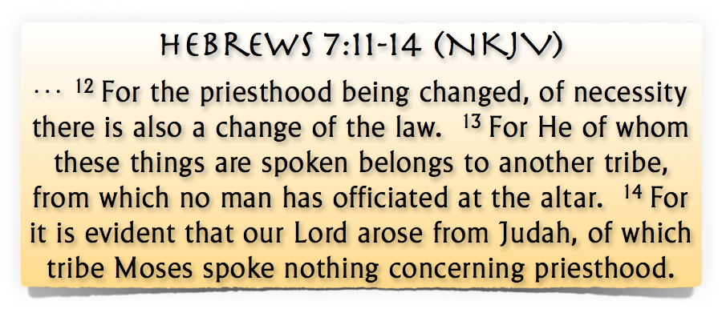
Is The Church of CHRIST A Biblical Church?
The Principle of Submission
Seeking Permission For All We Believe, Teach & Practice
Of which Moses Spoke Nothing

Slide 20
Is The Church of CHRIST A Biblical Church?
The Principle of Submission
Seeking Permission For All We Believe, Teach & Practice
God’s Silence To Be Respected!
We cannot know the mind of God except through revelation
1 Cor 2:10, 11,14
Eph 3:3-5
Isaiah 55:8,9
God has revealed everything that He wants from us –
2 Pet 1:3;
2 Tim 3:16,17
Jude 3
Faith comes by hearing
ROMANS 10:17
Walking by faith means walking by what God has said
2 Cor. 5:7; 1 Cor. 4:6; Gal. 1:6-9

Slide 21
Is The Church of CHRIST A Biblical Church?
The Principle of Submission
Seeking Permission For All We Believe, Teach & Practice
Things That Cannot Be Done By Faith
Sprinkling in place of immersion -
Baptizing / sprinkling babies
Saying the sinners prayer for salvation -
Asking Jesus to come into your heart and save you -
Teaching salvation by faith alone - i.e., at the point of faith before & without being baptized -

Slide 22
Is The Church of CHRIST A Biblical Church?
The Principle of Submission
Seeking Permission For All We Believe, Teach & Practice
Things That Cannot Be Done By Faith
Peanut butter on the bread –
Piano / Orchestras / rock bands -
Pagan holiday observances –
Political / secular speeches-
Fund raising campaigns -
Social programs –
Recreational activities –
Entertainment centers . . . . Etc.

Slide 23
Is The Church of CHRIST A Biblical Church?
The Principle of Submission
Seeking Permission For All We Believe, Teach & Practice
Believe
Repent
3
2
4
Confess
1
Luke 8:11; Rom. 10:17
John 8:24; Heb 11:6
Luke 13:3,5; Acts 17:30
Mat. 10:32,33; Rom 10:9
Acts 2:38; 1 Pet 3:21
Hear
5
Be Baptized

Slide 24
Don McClain

Slide 25
Is The Church of CHRIST A Biblical Church?
The church of Christ Are Those In Christ!

Slide 26
Acts 15:22–30 (NKJV)
²² Then it pleased the apostles and elders, with the whole church, to send chosen men of their own company to Antioch with Paul and Barnabas, namely, Judas who was also named Barsabas, and Silas, leading men among the brethren. ²³ They wrote this, letter by them: The apostles, the elders, and the brethren, To the brethren who are of the Gentiles in Antioch, Syria, and Cilicia: Greetings.

Slide 27
Acts 15:22–30 (NKJV)
²⁴ Since we have heard that some who went out from us have troubled you with words, unsettling your souls, saying, “You must be circumcised and keep the law”—to whom we gave no such commandment—²⁵ it seemed good to us, being assembled with one accord, to send chosen men to you with our beloved Barnabas and Paul,

Slide 28
Acts 15:22–30 (NKJV)
²⁶ men who have risked their lives for the name of our Lord Jesus Christ. ²⁷ We have therefore sent Judas and Silas, who will also report the same things by word of mouth. ²⁸ For it seemed good to the Holy Spirit, and to us, to lay upon you no greater burden than these necessary things:

Slide 29
Acts 15:22–30 (NKJV)
²⁹ that you abstain from things offered to idols, from blood, from things strangled, and from sexual immorality. If you keep yourselves from these, you will do well. Farewell. ³⁰ So when they were sent off, they came to Antioch; and when they had gathered the multitude together, they delivered the letter.

