Slide 1
Is The Church of CHRIST A Biblical Church?
“How To Establish The Faith
How God Instructs”

Slide 2
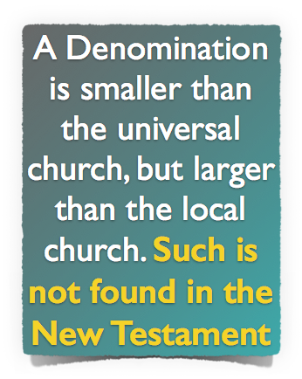
Is The Church of CHRIST A Biblical Church?
A Biblical Understanding of The Church Jesus Built

Slide 3
Is The Church of CHRIST A Biblical Church?
The church of Christ Submits To Christ!
Therefore, just as the church is subject to Christ,… Eph 5:24
“I don’t think it makes any difference what CHURCH you join!”
“You have to be a member of “MY” denomination in order to go to heaven!!”
. . . The Lord added daily to the church those who were being saved – Acts 2:47
Notes:
The Bible Doesn’t Teach Me to Be A Member of One KIND of Church And You Another!!

Slide 4
Is The Church of CHRIST A Biblical Church?
The church of Christ Submits To Christ!
Therefore, just as the church is subject to Christ,… Eph 5:24
Methodist
Christian
Mennonite
Nazarene

Slide 5
Is The Church of CHRIST A Biblical Church?
The church of Christ Submits To Christ!
Therefore, just as the church is subject to Christ,… Eph 5:24
Ask Jesus to come into your heart . . . Say the sinners prayer!
There is ABSOLUTELY NOTHING you can do to be saved!
Believe, repent, confess, and be baptized into Christ – Mark 16:16; Acts 2:38; Rom. 10:9; Rom. 6:3-6; Col. 2:11-13
Notes:
The Bible Doesn’t Teach Me to Be Saved One Way And You Another

Slide 6
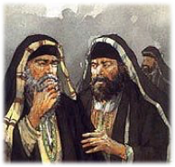
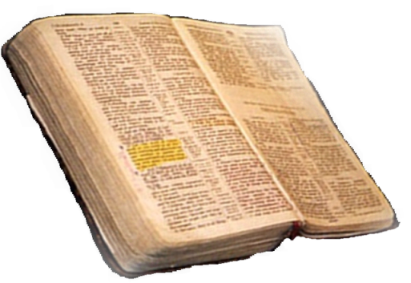
Is The Church of CHRIST A Biblical Church?
The Principle of Submission
“How To Establish Faith”
Matthew 21:25-26
Only Two Possible Sources
From Heaven
Mt. 21:23-27
1 John 4:4-6
Gal. 1:6-9
Col. 2:6-10
2 Thess. 2:15
From Men
Mt. 15:1-9
1 Cor. 4:6
Gal. 1:10-17
Col. 2:8
2 Thess. 2:2-4
From Heaven or Men?

Slide 7
Is The Church of CHRIST A Biblical Church?
The Principle of Submission
How To Establish Our Faith

Slide 8
Is The Church of CHRIST A Biblical Church?
The Principle of Submission
How To Establish Our Faith

Slide 9
Is The Church of CHRIST A Biblical Church?
The Principle of Submission
How To Establish Our Faith

Slide 10
Is The Church of CHRIST A Biblical Church?
The Principle of Submission
“How To Establish Faith”
The Comprehensive Nature of The New Testament Scriptures
Sufficiently Instructs - 2 Tim 3:16,17
Cannot Be Transgressed – 2 John 9
The totality of information revealed regarding any act of righteousness forms the pattern for that act – 2 Tim 1:13; 3:16,17; 2 Pet 1:3;
Understandable – Eph 3:3-5

Slide 11
Is The Church of CHRIST A Biblical Church?
The Principle of Submission
Seeking Permission For All We Believe, Teach & Practice
God’s Silence To Be Respected!
We cannot know the mind of God except through revelation
1 Cor 2:10, 11,14
Eph 3:3-5
Isaiah 55:8,9
God has revealed everything He wants us to know & do –
2 Pet 1:3;
2 Tim 3:16,17
Jude 3
Faith comes by hearing
ROMANS 10:17
Walking by faith means walking by what God has said
2 Cor. 5:7; 1 Cor. 4:6; Gal. 1:6-9

Slide 12
Is The Church of CHRIST A Biblical Church?
The Principle of Submission
“How To Establish Faith - How God Instructs”
How To Understand:
Direct Command or Statement. (Must Examine Context)
Approved Apostolic Example. (Observation of Approved Activity of first Century Christians).
Necessary Implication. (a logical and unavoidable conclusion drawn from statements or propositions).
God has used the basic laws of communication to reveal His will to us.

Slide 13
Is The Church of CHRIST A Biblical Church?
The Principle of Submission
“How To Establish Faith - How God Instructs”
Two Extremes
For a thing to be condemned it MUST BE SPECIFICALLY STATED
For a thing to be authorized it MUST BE SPECIFICALLY STATED

Slide 14
Is The Church of CHRIST A Biblical Church?
The Principle of Submission
“How To Establish Faith - How God Instructs”
Exclusive & Inclusive
Specific authority:
Precisely formulated or restricted. If a command is specific, the action is authorized, then the details are specified.
Generic authority:
General; opposite to specific. If a command is generic, an action is authorized without the details.

Slide 15
Is The Church of CHRIST A Biblical Church?
The Principle of Submission
“How To Establish Faith - How God Instructs”
Exclusive & Inclusive
Generic instruction includes all the essentials and the expedients to fulfill that instruction
Specific instruction, either stated or implied, takes precedence over generic instruction
Instruction, either specific or generic, can only be altered, modified, or limited by more specific instruction
God has used the basic laws of communication to reveal His will to us.

Slide 16
Exclusive & Inclusive
Heb 11:7 By faith Noah, being divinely warned of things not yet seen, moved with godly fear, prepared an ark for the saving of his household,
Specific authority:
Precisely formulated or restricted. If a command is specific, the action is authorized, then the details are specified.
Generic authority:
General; opposite to specific. If a command is generic, an action is authorized without the details.

Slide 17
Exclusive & Inclusive
Heb 11:7 By faith Noah, being divinely warned of things not yet seen, moved with godly fear, prepared an ark for the saving of his household,
²²Thus Noah did; according to all that God commanded him, so he did. . . . 7:5 ⁵And Noah did according to all that the Lord commanded him.
Specific authority:
Gopher wood (14)
Compartments (14)
450’ Long (15)
75’ Wide (15)
45’ Tall (15)
1 Window & Door (16)
3 Stories (16)
Generic & Specific:
Build an ark of gopher wood
Expedients
Tools & Size of material dependent upon specific need
Liberty:
Source and means of transporting materials

Slide 18
Exclusive & Inclusive
Heb 11:7 By faith Noah, being divinely warned of things not yet seen, moved with godly fear, prepared an ark for the saving of his household,
²²Thus Noah did; according to all that God commanded him, so he did. . . . 7:5 ⁵And Noah did according to all that the Lord commanded him.
Authorized
Excluded / Unauthorized
Another door
Different wood
Different size
Additional boats
Incidental
Tools
Scaffolds
Help
Build An Ark of Gopher Wood

Slide 19
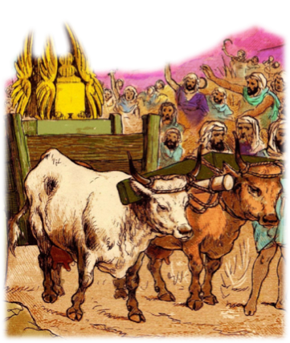
Exclusive & Inclusive
The method of moving the ark of the covenant was specified, thus excluding any other method
Consulted with every leader – (1 Chron 13:1) but forgot to consult God’s word (1 Chron 15:13)
The Ox Cart was unauthorized –NOT an expedient -
Was not specifically condemned – but was condemned because the method was specified!

Slide 20
Exclusive & Inclusive
The method of moving the ark of the covenant was specified, thus excluding any other method
When God specifies - we CANNOT substitute. (1 Chron 13:5-8)
David’s best attempt to serve God according to his own thinking dishonored God instead of honoring Him - (Lev 10:1-4; 1 Chron 15:2,13; Isa 55:6-9; Hos 14:9; Col. 3:17)

Slide 21
Exclusive & Inclusive
The method of moving the ark of the covenant was specified, thus excluding any other method
When God specifies - we CANNOT substitute. (1 Chron 13:5-8)
Nadab and Abihu – (Lev. 10:1,2)
Moses – (Num 20:8-24)
King Saul – (1 Sam. 13 & 15)
Jeroboam – (1 Kings 12:25-33)
Uzziah – (2 Chr. 26:16-23)

Slide 22
Exclusive & Inclusive
The method of moving the ark of the covenant was specified, thus excluding any other method
When God specifies - we CANNOT substitute. (1 Chron 13:5-8)
We must remember that any substitute for what God specifies is evil, regardless of intent (cf Num 20:8,11; Matt 7:21-23; 2 Jn 9,10; Dt 4:2; 12:32; Jos 1:7; Pro 30:6; Rev 22:18,19).

Slide 23
Exclusive & Inclusive
The Great Commission
Specified:
Make disciples
Baptizing them
Teach them to observe all things that I have commanded you
Excludes:
Making athletes / Professionals …
Sprinkling or pouring …
Teaching them –
chemistry? –
English? –
accounting? –
health?

Slide 24
Exclusive & Inclusive
The Great Commission
Specified:
Make disciples
Baptizing them
Teach them to observe all things that I have commanded you
Includes:
Method of going. Drive a car, boat, plane, walk, etc. Which nation –
River; Creek; Pond; Ocean; Tub; Baptistery
One on one; Public preaching; Written lesson plans; Illustrated lessons …

Slide 25
Exclusive & Inclusive
The Great Commission
Specified:
Obeying the Command to Assemble:-
A time – 1 Cor 11:33 - No specified pattern or limitation given to time of day.
A place – 1 Cor 11:20 - No specified pattern or limitation given to location:
Includes:
A Time: - anytime during specified day - Morning – Noon - Evening
A Place: in the temple. Acts 2:42\ - in a house. Rom 16:5 - by a river. Acts 16:13 - Home – Shade Tree –Rent – Buy -Building

Slide 26
Exclusive & Inclusive
Worship: When & Where?
Specified:
Activity only on first day of the Week -
Lord’ Supper. - Acts 20:7
Contribution - 1 Cor 16:1,2
Excludes:
- Any other day
- Thursday night observations?
- During midweek services?

Slide 27
Exclusive & Inclusive
Worship: When & Where?
Specified:
Music in our worship
The Participants –“one another”
The Kind of Songs – “Psalms and hymns and spiritual songs,”
The Instrument –“Singing Making melody in your heart to the Lord”
Excludes:
Solos & Choirs! Playing instrument!
- Patriotic songs, holiday jingles, secular songs -
Making melody on a piano!
Entertainment!

Slide 28
Exclusive & Inclusive
Worship: When & Where?
These change the type (nature, characteristic) of the music “specified.”
God Specified:
The Participants –
The Kind of Songs -
The Instrument to be Used -
Excludes:
Solos & Choirs! Playing instrument!
- Patriotic songs, holiday jingles, secular songs -
Making melody on a piano!
Entertainment!

Slide 29
Exclusive & Inclusive
Worship: When & Where?
Specified:
Music in our worship
The Participants –“one another”
The Kind of Songs – “Psalms and hymns and spiritual songs,”
The Instrument –“Singing Making melody in your heart to the Lord”
Includes:
Time or place Matt 26:30; Acts 16:25
# of songs OR Which P, H, or S S to sing
Song leader; Song Books
Parts
Pitch pipe
1 Cor 14:40

Slide 30
Exclusive & Inclusive
Worship: When & Where?
Includes:
Time or place Matt 26:30; Acts 16:25
# of songs OR Which P, H, or S S to sing
Song leader; Song Books
Parts
Pitch pipe
These are expedients / liberties / aides! -
Expedients do not change or alter the specific instructions given by God.
1 Cor 14:40

Slide 31
Is The Church of CHRIST A Biblical Church?
The Principle of Submission
“How To Establish Faith - How God Instructs”
Expediency in human wisdom involves the right of choice within the realm of those things included in what God has authorized –
When God specifies, then man has no choice but to obey or be in rebellion to God.
To go beyond or fall short of that which is specified is “EVIL” – Numbers 20:8-12

Slide 32
Is The Church of CHRIST A Biblical Church?
The Principle of Submission
“How To Establish Faith - How God Instructs”
If the Bible specifies a thing or action then we are not at liberty to alter or add to that thing or action.
If the Bible gives a command that is general in nature without specifying the particulars, then all things necessary in carrying out that command in an orderly fashion, which does not add to or alter the nature of said command, is authorized.

Slide 33
Is The Church of CHRIST A Biblical Church?
The Principle of Submission
“How To Establish Faith - How God Instructs”
The importance of establishing Divine authority for ALL we do!!
The NT is the ONLY source of Divine authority -
Must follow the inductive method of Bible study -
What is your attitude towards the need to establish authority for all that you do?
Do you desire to study the Word of God and follow it?
God has used the basic laws of communication to reveal His will to us.

Slide 34
Don McClain
W 65th St church of Christ / October 19, 2008

Slide 35
Is The Church of CHRIST A Biblical Church?
The church of Christ Submits To Christ!
“How To Establish Faith - How God Instructs”

Slide 36
Galatians 1:6–12 (NKJV)
⁶ I marvel that you are turning away so soon from Him who called you in the grace of Christ, to a different gospel, ⁷ which is not another; but there are some who trouble you and want to pervert the gospel of Christ. ⁸ But even if we, or an angel from heaven, preach any other gospel to you than what we have preached to you, let him be accursed.

Slide 37
Galatians 1:6–12 (NKJV)
⁹ As we have said before, so now I say again, if anyone preaches any other gospel to you than what you have received, let him be accursed. ¹⁰ For do I now persuade men, or God? Or do I seek to please men? For if I still pleased men, I would not be a bondservant of Christ.

Slide 38
Galatians 1:6–12 (NKJV)
¹¹ But I make known to you, brethren, that the gospel which was preached by me is not according to man. ¹² For I neither received it from man, nor was I taught it, but it came through the revelation of Jesus Christ.

