Slide 1
Is The Church of CHRIST A Biblical Church?
“How To Establish The Faith
Applications: (The Organization of The Local Church )

Slide 2
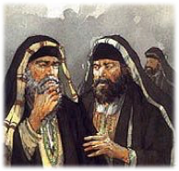
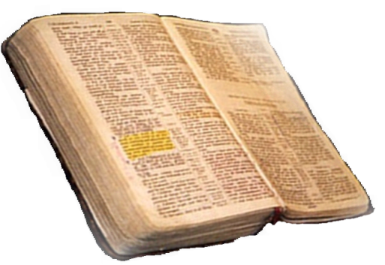
Is The Church of CHRIST A Biblical Church?
Therefore, just as the church is subject to Christ,… Eph 5:24
“How To Establish Faith”
Matthew 21:25-26
Only Two Possible Sources
From Heaven
Mt. 21:23-27
1 John 4:4-6
Gal. 1:6-9
Col. 2:6-10
2 Thess. 2:15
From Men
Mt. 15:1-9
1 Cor. 4:6
Gal. 1:10-17
Col. 2:8
2 Thess. 2:2-4
From Heaven or Men?

Slide 3
Is The Church of CHRIST A Biblical Church?
The Principle of Submission
Seeking Permission For All We Believe, Teach & Practice
God’s Silence To Be Respected!
We cannot know the mind of God except through revelation
1 Cor 2:10, 11,14
Eph 3:3-5
Isaiah 55:8,9
God has revealed everything He wants us to know & do –
2 Pet 1:3;
2 Tim 3:16,17
Jude 3
Faith comes by hearing
ROMANS 10:17
Walking by faith means walking by what God has said
2 Cor. 5:7; 1 Cor. 4:6; Gal. 1:6-9

Slide 4
Exclusive & Inclusive
Heb 11:7 By faith Noah, being divinely warned of things not yet seen, moved with godly fear, prepared an ark for the saving of his household,
²²Thus Noah did; according to all that God commanded him, so he did. . . . 7:5 ⁵And Noah did according to all that the Lord commanded him.
Authorized
Excluded / Unauthorized
Another door
Different wood
Different size
Additional boats
Incidental
Tools
Scaffolds
Help
Build An Ark of Gopher Wood

Slide 5
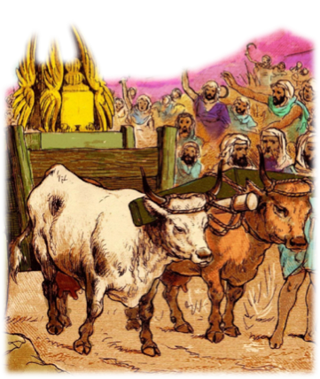
Is It Expedient?
Expediency in religion is a means or method of executing a divine command when the way to do it is not specified.

Slide 6
Is It Expedient?
UNAUTHORIZED Innovations under the guise of expediency, has caused Wholesale apostasies in the organization, work & worship of the church.

Slide 7
For A Thing To Be Expedient
It Must Be Lawful - Romans 3:7,8
It Can NOT Be An Addition To or subtraction from what God has specified – Deut 4:2; 2 Jo 9; Rev 22:18; Num 4:4-6
It Must Edify - 1 Cor 10:23,33; 14:26
It Must Not Cause My Brother To Violate His Conscience - Rom 14:13-23

Slide 8
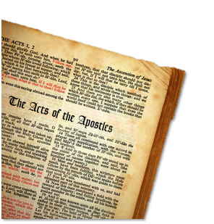
Is The Church of CHRIST A Biblical Church?
The N.T. Pattern For The Organization of A Local Church
The New Testament provides the divinely approved pattern.
Original apostasy began with changes in organization...
Organization reveals purpose...

Slide 9
Is The Church of CHRIST A Biblical Church?
The N.T. Pattern For The Organization of A Local Church
Compile all references to the subject including direct statements, approved actions, and necessary implications.

Slide 10
Is The Church of CHRIST A Biblical Church?
The N.T. Pattern For The Organization of A Local Church
Christ the head
Elders (bishops, pastors)
Deacons to serve
Evangelist, teachers & saints

Slide 11
Is The Church of CHRIST A Biblical Church?
Organization of the Church
Christ is the head of the universal church
This is the ONLY organization the universal church has!

Slide 12
Is The Church of CHRIST A Biblical Church?
Organization of the Church
Speaks through the apostles in the New Testament
Elders
Elders
Elders
Elders

Slide 13
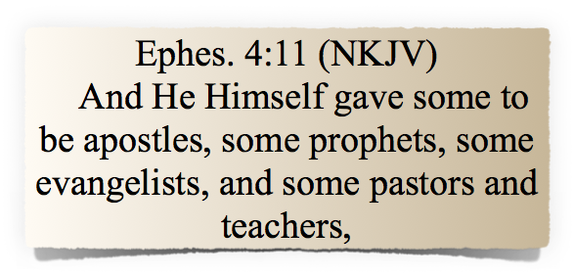
Is The Church of CHRIST A Biblical Church?
Organization of the Church
Ephesians 2:20
Laid the Foundation
apostles,
prophets,
evangelists,
pastors,
teachers

Slide 14
Is The Church of CHRIST A Biblical Church?
The N.T. Pattern For The Organization of A Local Church
Philippians 1:1 (NKJV)
¹ Paul and Timothy, bondservants of Jesus Christ, To all the saints in Christ Jesus who are in Philippi, with the bishops and deacons:

Slide 15
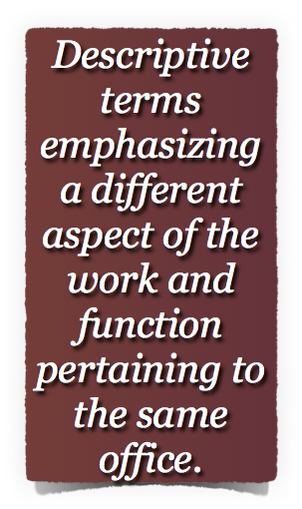
Is The Church of CHRIST A Biblical Church?
The N.T. Pattern For The Organization of A Local Church
The terms elder, bishop & pastor
1 Peter 5:1-2 (NKJV)
¹The elders (presbuteros), who are among you I exhort, I who am a fellow elder and a witness of the sufferings of Christ, and also a partaker of the glory that will be revealed: ²Shepherd (poimen), the flock of God which is among you, serving as overseers, (episkopos),

Slide 16
Is The Church of CHRIST A Biblical Church?
The N.T. Pattern For The Organization of A Local Church
The terms elder, bishop & pastor
Bishop – [episkopos (n); episkopeo (v)] – Denotes the overseeing function – not legislative, but leading and enforcing within the Law of God – Acts 20:28; 1 Pet 5:2; (Heb 13:7,17)
Pastor, shepherd – [poimen (n); poimaino (v)] – Emphasizes the care, watching and feeding of the flock of God over which they have been appointed. – Act 20:28; Ep 4:11; 1 Pet 5:2
Elder - [presbuteros (n)] denotes age and seasoned wisdom that belong to its experiences. Acts 14:23; 20:17; 1 Pet 5:1

Slide 17
Is The Church of CHRIST A Biblical Church?
The N.T. Pattern For The Organization of A Local Church
Acts 14:23 (NKJV)
So when they had appointed elders in every church, and prayed with fasting, they commended them to the Lord in whom they had believed.
After Paul & Barnabas had converted many in Lystra, they retraced their travels through Asia Minor appointing elders in every church.
They then returned to Antioch bringing their first evangelistic journey to a close ^{[46-48 AD]}. (Acts 14:21-26)

Slide 18
Is The Church of CHRIST A Biblical Church?
The N.T. Pattern For The Organization of A Local Church
Acts 14:23 (NKJV)
So when they had appointed elders in every church, and prayed with fasting, they commended them to the Lord in whom they had believed.
“The use of the plural here implies what was true at Philippi (Phil. 1:1) and Ephesus (Acts 20:17, 28) that each church (one in each city) “had its college of elders” (Hackett) as in Jerusalem (21:18).”
Robertson, A. (1933). Word Pictures in the New Testament. Nashville, TN: Broadman Press.

Slide 19
Is The Church of CHRIST A Biblical Church?
The N.T. Pattern For The Organization of A Local Church
Acts 14:23 (NKJV)
So when they had appointed elders in every church, and prayed with fasting, they commended them to the Lord in whom they had believed.
It is implied here that there were elders in each church; that is, that in each church there was more than one. . . . Titus 1:5, "I left thee in Crete, that thou shouldest ordain elders in every city." Acts 20:17, "And from Miletus he sent to Ephesus, and called the elders of the church." It could not mean, therefore, that they appointed a single minister or pastor to each church, but they committed the whole affairs of the church to a bench of elders.
(Barnes New Testament Notes on Acts 14:23)

Slide 20
Is The Church of CHRIST A Biblical Church?
The N.T. Pattern For The Organization of A Local Church
Titus 1:5 (NKJV)
For this reason I left you in Crete, that you should set in order the things that are lacking, and appoint elders in every city as I commanded you
The absence of elders was considered by Paul as that which was “lacking.”
Paul perceived the appointment of elders as something necessary for a local church to function and mature as it should.
Those who met the qualifications — (1 Tim 3:1-7; Titus 1:5-9)

Slide 21
Is The Church of CHRIST A Biblical Church?
The N.T. Pattern For The Organization of A Local Church
Acts 20:28 (NKJV)
Therefore take heed to yourselves and to all the flock, among which the Holy Spirit has made you overseers, to shepherd the church of God which He purchased with His own blood.
(cf. Acts 20:17)
The elders in each local church were equal in authority
See every passage where the elders are mentioned - Acts 11:27-30; 14:23; 20:28; Phili 1:1; 1 Tim 3:1-7; Tit. 1:5; 4:14; 5:17; 1 Pet 5:1-3; Heb 13:17
The elders had authority (rule, oversight, responsibility) only in the local church that appointed them - Acts 20:28; 1 Pet 5:1-3
Their authority did not extend beyond the flock among them!

Slide 22
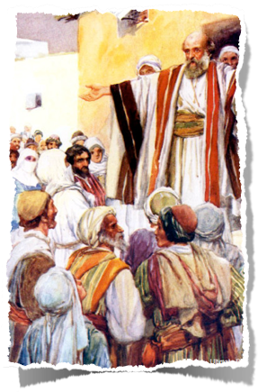
Is The Church of CHRIST A Biblical Church?
The N.T. Pattern For The Organization of A Local Church
Deacons To Serve
See Phili 1:1; Acts 6:1-7; 1 Tim 3:8-13
Deacon - (Vines) <G1249> διάκονος, diakonos - (Eng., "deacon"), primarily denotes a "servant," whether as doing servile work, or as an attendant rendering free service, . . .
Not overseers - they are special servants.
The need to note a distinction between the office of a deacon, (1 Tim 3:8-14), and the term used in its common, generic sense - (Rom 16:1; 13:4; 1 Cor 3:5; etc.)

Slide 23
Is The Church of CHRIST A Biblical Church?
The N.T. Pattern For The Organization of A Local Church
Evangelist, teachers, saints
Evangelist - See Eph 4:11; Phili 1:1
(Vines) <G2099> εὐαγγελιστής, euangelistēs - lit., "a messenger of good" (eu, "well," angelos, "a messenger"), denotes a "preacher of the Gospel," Acts 21:8; Eph. 4:11, which makes clear the distinctiveness of the function in the churches; 2 Tim. 4:5. Cp. euangelizō, "to proclaim glad tidings," and euangelion, "good news, gospel." Missionaries are "evangelists," as being essentially preachers of the Gospel.

Slide 24
Is The Church of CHRIST A Biblical Church?
The N.T. Pattern For The Organization of A Local Church
Evangelist, teachers, saints
Teachers - See Eph 4:11; Phili 1:1
(Vines) <G1320> - διδάσκαλος, didaskalos - a teacher (from didaskō, "to teach"), cp. didaskalia, "teaching, doctrine, instruction," is translated "doctors," with reference to the teachers of the Jewish religion, Luke 2:46. . ."
(Thayer) 6. of those who in the religious assemblies of Christians undertake the work of teaching, with the special assistance of the Holy Spirit: 1 Cor 12:28f; Ep 4:11; Acts. 13:1, cf. James 3:1.

Slide 25
Is The Church of CHRIST A Biblical Church?
The N.T. Pattern For The Organization of A Local Church
Evangelist, teachers, saints
Saints - See Phili 1:1; Acts 9:13,32; 26:10; Rom 1:7; 12:13; 15:25,26; 1 Cor. 1:2; 14:33; Eph 1:1 . . .
(Vines) <G40> ἅγιος, hagios - . . . used of believers, it designates all such and is not applied merely to persons of exceptional holiness, or to those who, having died, were characterized by exceptional acts of "saintliness." See especially 2 Thess. 1:10, where "His saints" are also described as "them that believed," i.e., the whole number of the redeemed.

Slide 26
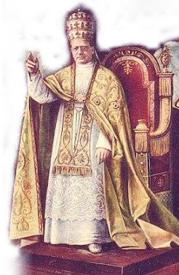
The Church - Growth & Apostasy
Warnings & Problems
Departures from God’s order & way should have come at no surprise
Changes In Organization
150 AD One elder exalted above the others (elder/bishop still one office)
200 AD One Bishop per church overseeing the eldership (elder/bishop two offices)
250 AD One diocesan Bishop overseeing other Bishops of other churches.
300 AD One Metropolitan Bishop overseeing other diocesan Bishops (Creeds replace Bible)
381 AD One Patriarch overseeing Metropolitans (Man replaces Creeds)

Slide 27
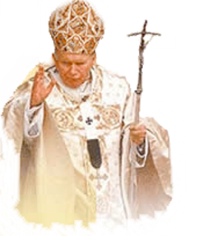
Is The Church of CHRIST A Biblical Church?
Organizational Changes
Step #5
Arch Bishops
588 – “Papa” John the Faster
Step #6
POPE –
Boniface III
606 AD
Step #4
Diocesan Bishop
Step #3
Metropolitan Bishops
Step #2
Elder – Bishop distinction
Step #1
Presiding elder
Elders
Elders
Elders
Elders
Elders
Elders
Elders
Elders
Notes:
I. Introduction
With this lesson the student of church history embarks upon a study of that long, dark process of apostasy which eventually culminated in the Roman Catholic Church. This apostasy unfolded very gradually.
II. The Rise of the Monarchical Episcopate
The first step which apostasy took in the church was in the corruption of its organization.
Presiding Elders – one elder had preeminence over the others -
Elder – Bishop distinction – The word bishop came to have reference to a different office – having greater authority -
Metropolitan Bishops – Bishop’s in larger cities oversaw rose to more preeminent status than did those in smaller locations
Diocesan Bishop – Churches within a particular region was grouped together in what came to be known as a diocese – One of the metropolitan bishops were chosen to oversee that diocese (all churches in that region)
Arch Bishops – (Alexandria, Jerusalem, Antioch, Constantinople, & Rome) – eventually – the Christian world was made up of five regions – the five men who oversaw these regions were known as Arch Bishops -
The Pope – (606 AD.) Boniface the 3rd – was the first recognized universal bishop – or pope.
John

Slide 28
Is The Church of CHRIST A Biblical Church?
‘Unscriptural” forms of organization …
Elders
Work To Be Done
Elders
Missionary Society
Elders
Sponsoring Church
Elders
Elders
Work To Be Done

Slide 29
Is The Church of CHRIST A Biblical Church?
‘Unscriptural” forms of organization …
Direct –
Does not relinquish oversight of work –
Does not infringe upon the autonomy of the local church -
Scriptural –
It works -
Elders
Scriptural pattern
Phili 4:15-18

Slide 30
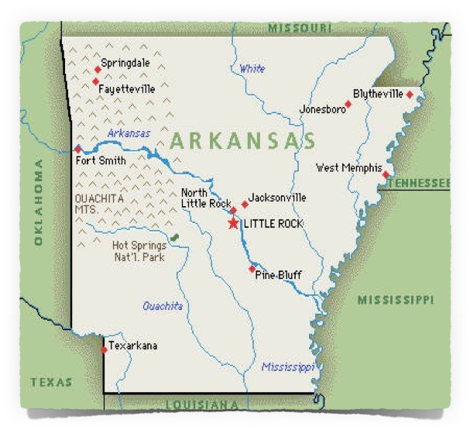
Is The Church of CHRIST A Biblical Church?
‘Unscriptural” forms of organization …
Bishops over a plurality of congregation’s
Elders
Elders
Elders
A Bishop over a plurality of congregation’s
Elders
Elders
Bishop

Slide 31
Is The Church of CHRIST A Biblical Church?
‘Unscriptural” forms of organization …
A single man over a single congregation
Elders
Pastor
Elders
A group over a plurality of congregation’s
Elders
Elders
Council

Slide 32
Is The Church of CHRIST A Biblical Church?
The N.T. Pattern For The Organization of A Local Church
Reflects our attitude toward the Lord & His pattern.
Fails to respect its divine purpose
Opens the door for widespread apostasy.

Slide 33
Don McClain
W 65th St church of Christ / October 19, 2008

Slide 34
Is The Church of CHRIST A Biblical Church?
The N.T. Pattern For The Organization of A Local Church

