Slide 1
That You May
”The Trial of Jesus” -
(John 18:12-19:16)

Slide 2
“The Unjust Trial of Jesus”
John 20:30-31 (NKJV) ³⁰ And truly Jesus did many other signs in the presence of His disciples, which are not written in this book; ³¹ but these are written that you may believe that Jesus is the Christ, the Son of God, and that believing you may have life in His name.

Slide 3
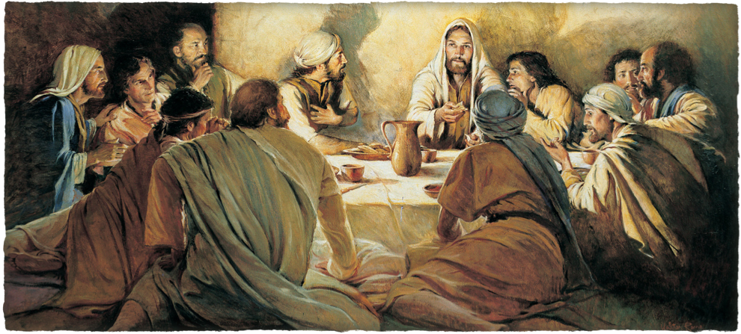
“The Unjust Trial of Jesus”
John 13:1–16:33

Slide 4
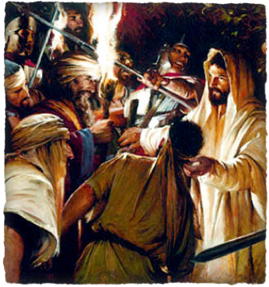
“The Unjust Trial of Jesus”
The plans of wicked men:
2:13-22; 5:16-18; 7:7-49; 8:21-59; 9:22; 10:22-39; 11:47-57; 12:9-11,19; 13:2,27-30
The plan of Almighty God
1:1,14; 3:14-16; 6:51-58; 7:30; 8:20,59; 10:14-18,31,39; 11:8-10; 12:20-36
Jesus does NOT appear in this narrative as a mere victim - nor is he overcome by an external superior power!
His death was entirely voluntary - 10:14-18; 14:30,31
None but Jesus has mastery of the circumstances -

Slide 5
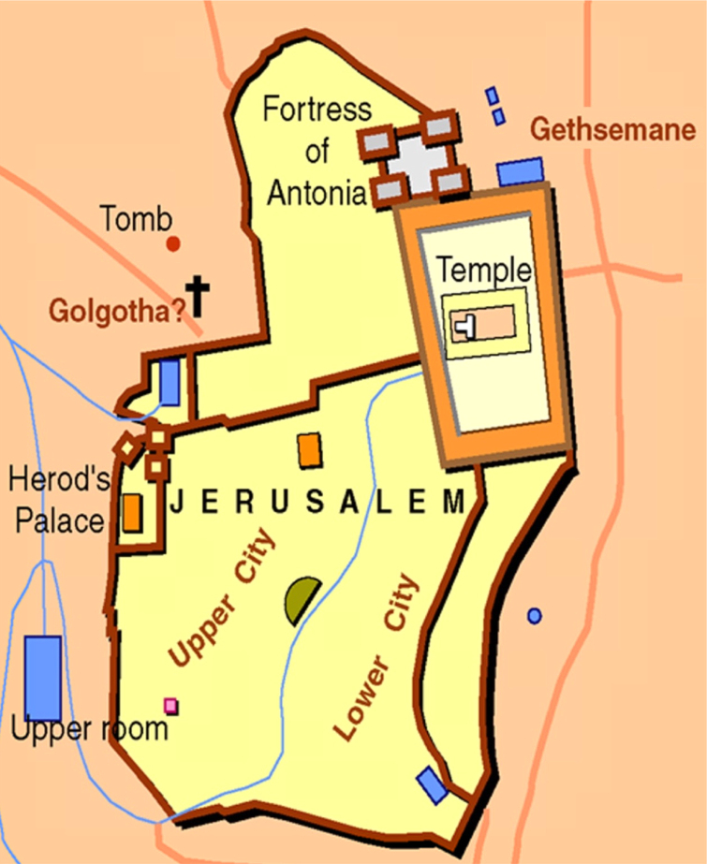
“The Unjust Trial of Jesus”
Jesus taken to Annas, - John 18:13-14, 19-24
Then to Caiaphas and SOME of the elders – John 18:24; Mat 26:57-68; Luke 66-71
Jesus sent to Pilate – Mat 27:1,2; Luke 23:1,2; John 18:28-38
Jesus sent to Herod “tetrarch of Galilee” (Luke 3:1) – Luke 23:6-12
Herod sends Jesus back to Pilate – Luke 23:11; John 19:39-16

Slide 6
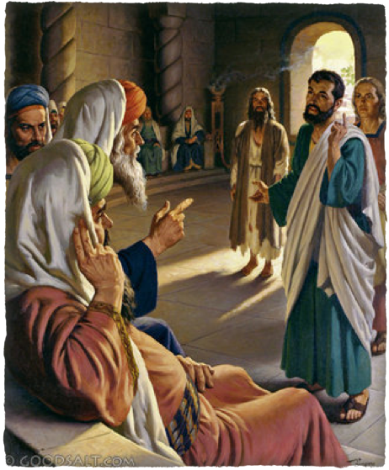
“The Unjust Trial of Jesus”
John 18:12-14,19-24
The events in the narrative in verses 12–27 are like a drama presented on two stages.
Jesus before Annas (12–14)
John & Peter enter the courtyard - Peter is recognized - First denial - (15–18).
Back to Annas - (19–24),
Peter denies twice more - (vv. 25–27).
¹³ And they led Him away to Annas first, for he was the father-in-law of Caiaphas who was high priest that year.

Slide 7
John 18:12–14 (NKJV)
¹² Then the detachment of troops and the captain and the officers of the Jews arrested Jesus and bound Him. ¹³ And they led Him away to Annas first, for he was the father-in-law of Caiaphas who was high priest that year. ¹⁴ Now it was Caiaphas who advised the Jews that it was expedient that one man should die for the people.

Slide 8
John 18:19–24 (NKJV)
¹⁹ The high priest then asked Jesus about His disciples and His doctrine. ²⁰ Jesus answered him, “I spoke openly to the world. I always taught in synagogues and in the temple, where the Jews always meet, and in secret I have said nothing. ²¹ Why do you ask Me? Ask those who have heard Me what I said to them. Indeed they know what I said.”

Slide 9
John 18:19–24 (NKJV)
²² And when He had said these things, one of the officers who stood by struck Jesus with the palm of his hand, saying, “Do You answer the high priest like that?” ²³ Jesus answered him, “If I have spoken evil, bear witness of the evil; but if well, why do you strike Me?” ²⁴ Then Annas sent Him bound to Caiaphas the high priest.

Slide 10
“The Unjust Trial of Jesus”
John 18:12-14,19-24
Before dawn
Father-N-Law to Caiaphas, high priest (13; Lk 22:54)
Former high priest removed by Rome (19,22)
Ask Jesus about His doctrine – (19)
Jesus struck by officers – (20-23; Luke 22:63–64)
Sent to Caiaphas – (24)
¹³ And they led Him away to Annas first, for he was the father-in-law of Caiaphas who was high priest that year.

Slide 11
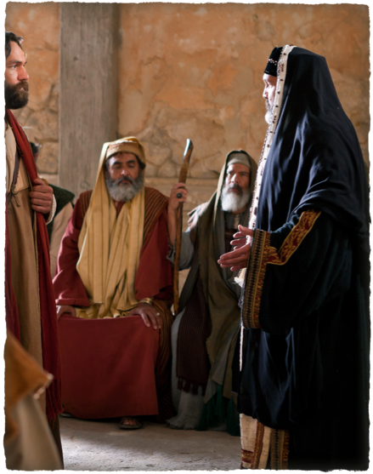
“The Unjust Trial of Jesus”
John 18:24
At dawn – Luke 22:66
Assembly of both chief priest, elders & scribes (Sanhedrin) - Luke 22:66
Sought false testimony - (Mat 26:59-61)
Questioned by Caiaphas and put under oath – (Mat 26:62,63)
Jesus’ answer – (Mat 26:64)
The response to Jesus’ answer – (Mat 26:65-68)
²⁴ Then Annas sent Him bound to Caiaphas the high priest.

Slide 12
John 18:28–38 (NKJV)
²⁸ Then they led Jesus from Caiaphas to the Praetorium, and it was early morning. But they themselves did not go into the Praetorium, lest they should be defiled, but that they might eat the Passover. ²⁹ Pilate then went out to them and said, “What accusation do you bring against this Man?”

Slide 13
John 18:28–38 (NKJV)
³⁰ They answered and said to him, “If He were not an evildoer, we would not have delivered Him up to you.” ³¹ Then Pilate said to them, “You take Him and judge Him according to your law.” Therefore the Jews said to him, “It is not lawful for us to put anyone to death,”

Slide 14
John 18:28–38 (NKJV)
³² that the saying of Jesus might be fulfilled which He spoke, signifying by what death He would die. ³³ Then Pilate entered the Praetorium again, called Jesus, and said to Him, “Are You the King of the Jews?” ³⁴ Jesus answered him, “Are you speaking for yourself about this, or did others tell you this concerning Me?”

Slide 15
John 18:28–38 (NKJV)
³⁵ Pilate answered, “Am I a Jew? Your own nation and the chief priests have delivered You to me. What have You done?” ³⁶ Jesus answered, “My kingdom is not of this world. If My kingdom were of this world, My servants would fight, so that I should not be delivered to the Jews; but now My kingdom is not from here.”

Slide 16
John 18:28–38 (NKJV)
³⁷ Pilate therefore said to Him, “Are You a king then?” Jesus answered, “You say rightly that I am a king. For this cause I was born, and for this cause I have come into the world, that I should bear witness to the truth. Everyone who is of the truth hears My voice.”

Slide 17
John 18:28–38 (NKJV)
³⁸ Pilate said to Him, “What is truth?” And when he had said this, he went out again to the Jews, and said to them, “I find no fault in Him at all.

Slide 18
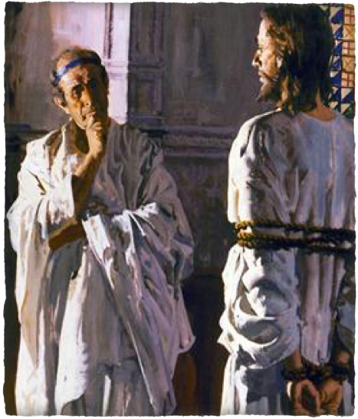
“The Unjust Trial of Jesus”
(John 18:28-38)
Early in the morning – (28)
Roman governor of Judea – (Mat 27:2)
Jews change charges - (30; Luke 23:2)
Perverting the nation –
Forbidding to pay taxes –
Self proclaimed king -
Questions Jesus but finds no fault – (33-38)
²⁸ Then they led Jesus from Caiaphas to the Praetorium, and it was early morning. But they themselves did not go into the Praetorium, lest they should be defiled, but that they might eat the Passover.

Slide 19
“The Unjust Trial of Jesus”
(John 18:28-38)
Pilate’s questions:
“Are You the King of the Jews?” - vs. 33 - (Jesus answers - vs. 34)
“Am I a Jew? Your own nation and the chief priests have delivered You to me. What have You done?” - vs. 35 - (Jesus answers - vs. 36)
“Are You a king then?” - vs. 37 - (Jesus answers vs. 37)
“What is truth?” - vs. 38
²⁸ Then they led Jesus from Caiaphas to the Praetorium, and it was early morning. But they themselves did not go into the Praetorium, lest they should be defiled, but that they might eat the Passover.

Slide 20
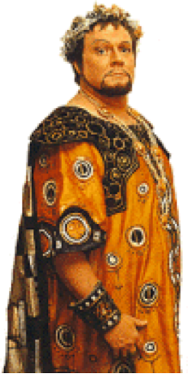
“The Unjust Trial of Jesus”
‘Herod the tetrarch’ (Lk. 3:19, etc.), bore the distinctive name of Antipas.
He married the daughter of the Nabataean king Aretas IV, but divorced her in order to marry Herodias, the wife of his half-brother Herod Philip
In the Gospels he is conspicuous chiefly for his part in the imprisonment and execution of John the Baptist (Mk. 6:14–28)
Jesus is recorded as having once described him as ‘that fox’ (Lk. 13:31f.).
Luke 23:6–7 (NKJV)
⁶ When Pilate heard of Galilee, he asked if the Man were a Galilean. ⁷ And as soon as he knew that He belonged to Herod’s jurisdiction, he sent Him to Herod, who was also in Jerusalem at that time.

Slide 21
“The Unjust Trial of Jesus”
Tetrarch of Galilee – (3:1)
Glad to see Jesus – (8)
Questioned Jesus, but Jesus did not answer - (9)
The Jews accuse Jesus – (10)
Treated Him with contempt – (11)
Mocked Him –Put a gorgeous robe on Him –Sent Him back to Pilate –(11,12)
Luke 23:6–7 (NKJV)
⁶ When Pilate heard of Galilee, he asked if the Man were a Galilean. ⁷ And as soon as he knew that He belonged to Herod’s jurisdiction, he sent Him to Herod, who was also in Jerusalem at that time.

Slide 22
John 18:39–19:16 (NKJV)
³⁹ “But you have a custom that I should release someone to you at the Passover. Do you therefore want me to release to you the King of the Jews?” ⁴⁰ Then they all cried again, saying, “Not this Man, but Barabbas!” Now Barabbas was a robber. ¹ So then Pilate took Jesus and scourged Him.

Slide 23
John 18:39–19:16 (NKJV)
² And the soldiers twisted a crown of thorns and put it on His head, and they put on Him a purple robe. ³ Then they said, “Hail, King of the Jews!” And they struck Him with their hands. ⁴ Pilate then went out again, and said to them, “Behold, I am bringing Him out to you, that you may know that I find no fault in Him.”

Slide 24
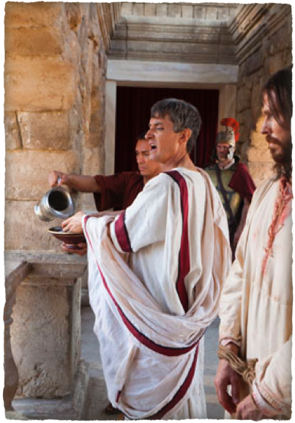
“The Unjust Trial of Jesus”
(John 18:39-19:16)
Warned by his wife – (Mat 27:19)
Tried to strike a deal – (18:39,40; Luke 23:13-18)
Jews demand Barabbas - (40; Mat 27:20-25; Luke 23:18-25)
Insurrection & murder – Mk 15:7
Sedition & murder – Lk 23:19,25
Robber – John 18:4
Murderer - Acts 3:14
³⁹ “But you have a custom that I should release someone to you at the Passover. Do you therefore want me to release to you the King of the Jews?”

Slide 25
“The Unjust Trial of Jesus”
(John 18:39-19:16)
“What then shall I do with Jesus who is called Christ?” (Mat 27:22)
Wanting to gratify the crowd – (Mark 15:15)
Washed his hands – (Mat 27:22-25)
Jesus scourged, mocked, humiliated and crowned with thorns – (19:1-3; Mat 27:27-31; Mark 15:16-20)
³⁹ “But you have a custom that I should release someone to you at the Passover. Do you therefore want me to release to you the King of the Jews?”

Slide 26
John 18:39–19:16 (NKJV)
⁵ Then Jesus came out, wearing the crown of thorns and the purple robe. And Pilate said to them, “Behold the Man!” ⁶ Therefore, when the chief priests and officers saw Him, they cried out, saying, “Crucify Him, crucify Him!” Pilate said to them, “You take Him and crucify Him, for I find no fault in Him.”

Slide 27
John 18:39–19:16 (NKJV)
⁷ The Jews answered him, “We have a law, and according to our law He ought to die, because He made Himself the Son of God.” ⁸ Therefore, when Pilate heard that saying, he was the more afraid, ⁹ and went again into the Praetorium, and said to Jesus, “Where are You from?” But Jesus gave him no answer.

Slide 28
John 18:39–19:16 (NKJV)
¹⁰ Then Pilate said to Him, “Are You not speaking to me? Do You not know that I have power to crucify You, and power to release You?” ¹¹ Jesus answered, “You could have no power at all against Me unless it had been given you from above. Therefore the one who delivered Me to you has the greater sin.”

Slide 29
John 18:39–19:16 (NKJV)
¹² From then on Pilate sought to release Him, but the Jews cried out, saying, “If you let this Man go, you are not Caesar’s friend. Whoever makes himself a king speaks against Caesar.” ¹³ When Pilate therefore heard that saying, he brought Jesus out and sat down in the judgment seat in a place that is called The Pavement, but in Hebrew, Gabbatha.

Slide 30
John 18:39–19:16 (NKJV)
¹⁴ Now it was the Preparation Day of the Passover, and about the sixth hour. And he said to the Jews, “Behold your King!” ¹⁵ But they cried out, “Away with Him, away with Him! Crucify Him!” Pilate said to them, “Shall I crucify your King?” The chief priests answered, “We have no king but Caesar!” ¹⁶ Then he delivered Him to them to be crucified. Then they took Jesus and led Him away.

Slide 31
“The Unjust Trial of Jesus”
What will I do with His doctrine – (Mark 16:16; Mat 28:18-20; 2 John 9)
Will I reject Him & His sacrifice – (Mat 15:7-9; Isa 53:4-8)
Will I try to be indifferent, indecisive? – (Mat 27:24)
The reality is - I will choose one way or the other whether I like it or not!

Slide 32
“The Unjust Trial of Jesus”
John 20:30-31 (NKJV) ³⁰ And truly Jesus did many other signs in the presence of His disciples, which are not written in this book; ³¹ but these are written that you may believe that Jesus is the Christ, the Son of God, and that believing you may have life in His name.

Slide 33
“The Lord’s Prayer” [part 1]
Charts by Don McClain
Prepared & Preached - March 15, 2015
West 65th Street church of Christ
P.O. Box 190062
Little Rock AR 72219
501-568-1062
Prepared using Keynote
Email – donmcclain@sbcglobal.net
More Keynote, PPT & Audio Sermons:
http://w65stchurchofchrist.org/coc/sermons/
Note – Many of the transition effects used in this presentation will be lost using PPT 2007 Viewer
http://www.microsoft.com/downloads/details.aspx?FamilyID=cb9bf144-1076-4615-9951-294eeb832823&displaylang=en

Slide 34
Luke 23:1–7 (NKJV)\
¹ Then the whole multitude of them arose and led Him to Pilate. ² And they began to accuse Him, saying, “We found this fellow perverting the nation, and forbidding to pay taxes to Caesar, saying that He Himself is Christ, a King.”

Slide 35
Luke 23:1–7 (NKJV)\
³ Then Pilate asked Him, saying, “Are You the King of the Jews?” He answered him and said, “It is as you say.” ⁴ So Pilate said to the chief priests and the crowd, “I find no fault in this Man.”

Slide 36
Luke 23:1–7 (NKJV)\
⁵ But they were the more fierce, saying, “He stirs up the people, teaching throughout all Judea, beginning from Galilee to this place.” ⁶ When Pilate heard of Galilee, he asked if the Man were a Galilean. ⁷ And as soon as he knew that He belonged to Herod’s jurisdiction, he sent Him to Herod, who was also in Jerusalem at that time.

