Slide 1
That You May
”The Crucifixion of Jesus”
John 19:17-30

Slide 2
“The Crucifixion of Jesus”
John 20:30-31 (NKJV) ³⁰ And truly Jesus did many other signs in the presence of His disciples, which are not written in this book; ³¹ but these are written that you may believe that Jesus is the Christ, the Son of God, and that believing you may have life in His name.

Slide 3
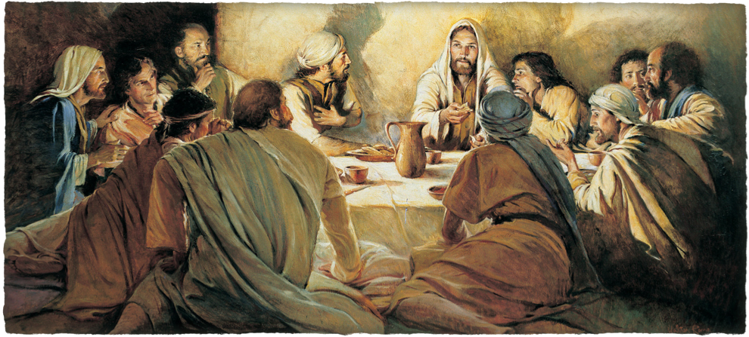
“The Crucifixion of Jesus”
John 13:1–16:33

Slide 4
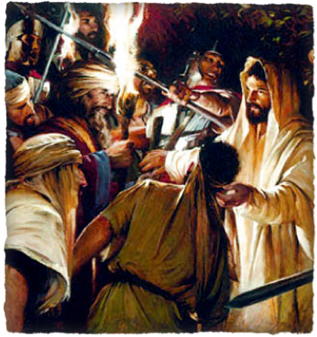
“The Crucifixion of Jesus”
The plans of wicked men:
2:13-22; 5:16-18; 7:7-49; 8:21-59; 9:22; 10:22-39; 11:47-57; 12:9-11,19; 13:2,27-30
The plan of Almighty God
1:1,14; 3:14-16; 6:51-58; 7:30; 8:20,59; 10:14-18,31,39; 11:8-10; 12:20-36
Jesus does NOT appear in this narrative as a mere victim - nor is he overcome by an external superior power!
His death was entirely voluntary - 10:14-18; 14:30,31
None but Jesus has mastery of the circumstances -

Slide 5
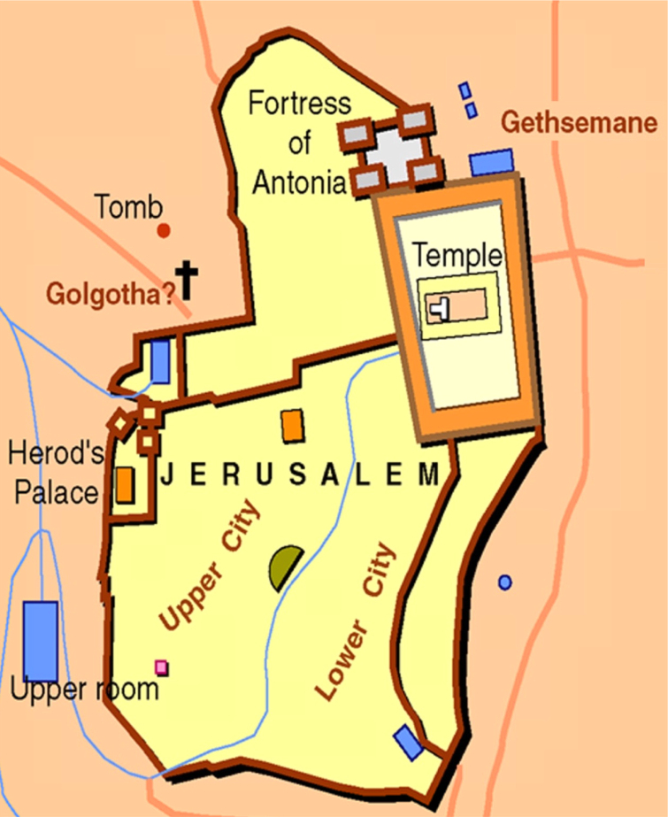
“The Crucifixion of Jesus”
Jesus taken to Annas, - John 18:13-14, 19-24
Then to Caiaphas and SOME of the elders – John 18:24; Mat 26:57-68; Luke 66-71
Jesus sent to Pilate – Mat 27:1,2; Luke 23:1,2; John 18:28-38
Jesus sent to Herod “tetrarch of Galilee” (Luke 3:1) – Luke 23:6-12
Herod sends Jesus back to Pilate – Luke 23:11; John 19:39-16

Slide 6
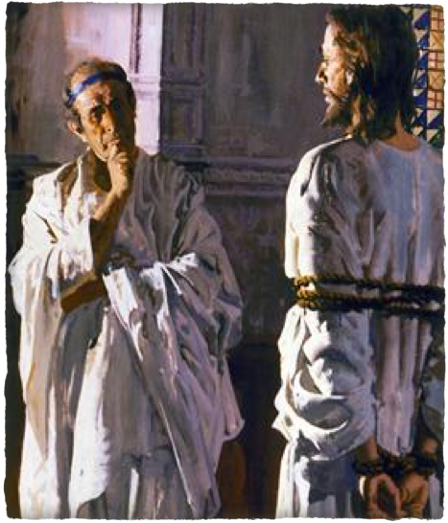
“The Crucifixion of Jesus”
John 19:15–16 (NKJV)
¹⁵ But they cried out, “Away with Him, away with Him! Crucify Him!” Pilate said to them, “Shall I crucify your King?” The chief priests answered, “We have no king but Caesar!” ¹⁶ Then he delivered Him to them to be crucified. Then they took Jesus and led Him away.

Slide 7
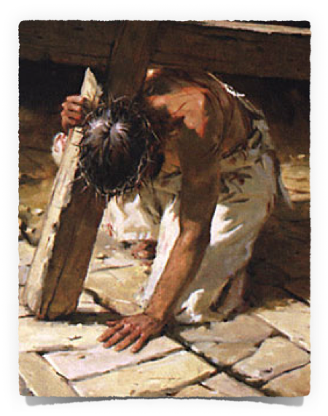
“The Crucifixion of Jesus”
“Crucifixion was a Roman, not a Jewish, form of punishment. It was usually preceded by scourging, which, carried out thoroughly, left the body a mass of swollen and bloody flesh ... the Romans, who thought it necessary to rule by terror, chose, for capital offenses by other than Roman citizens, what Cicero called ‘the most cruel and hideous of tortures.’ .” (Durant, Caesar And Christ, p. 572).
John 19:17 (NKJV)
¹⁷ And He, bearing His cross, went out to a place called the Place of a Skull, which is called in Hebrew, Golgotha,

Slide 8
“The Crucifixion of Jesus”
The Roman cross was like a capital “T.” The crossbeam (patibulum) weighed about 110 pounds—
it was tied across His shoulders and He was led out through a road now known as the Via Dolorosa. (Dr. D.C. Truman Davis). Despite His efforts to walk erect He falls and a Roman Centurion compels Simon to carry the cross the rest of the way from the Fortress Antonia to Calvary (Luke 23:26).
John 19:17 (NKJV)
¹⁷ And He, bearing His cross, went out to a place called the Place of a Skull, which is called in Hebrew, Golgotha,

Slide 9
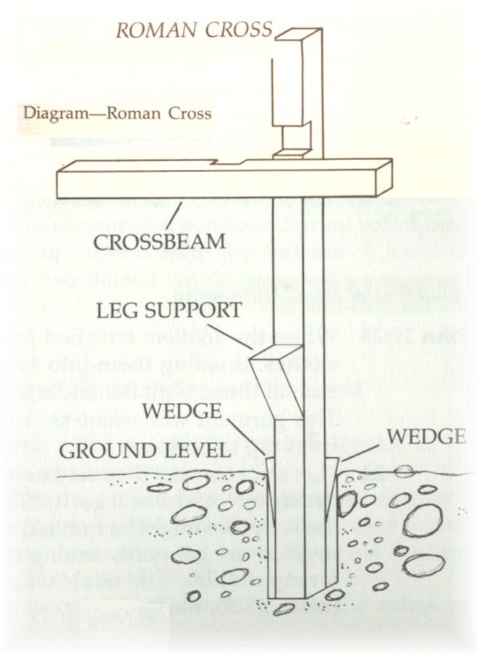
“The Crucifixion of Jesus”
John 19:17 (NKJV)
¹⁷ And He, bearing His cross, went out to a place called the Place of a Skull, which is called in Hebrew, Golgotha,

Slide 10
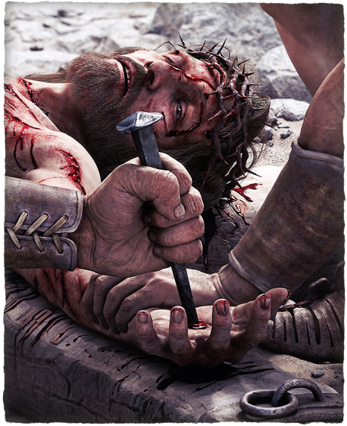
“The Crucifixion of Jesus”
John 19:17 (NKJV)
¹⁷ And He, bearing His cross, went out to a place called the Place of a Skull, which is called in Hebrew, Golgotha,
At Golgotha, Jesus is thrown back onto the rough wood and spikes are driven into His hands.
The cross beam is lifted up, and His left foot is pressed back against the right and a nail is driven in.

Slide 11
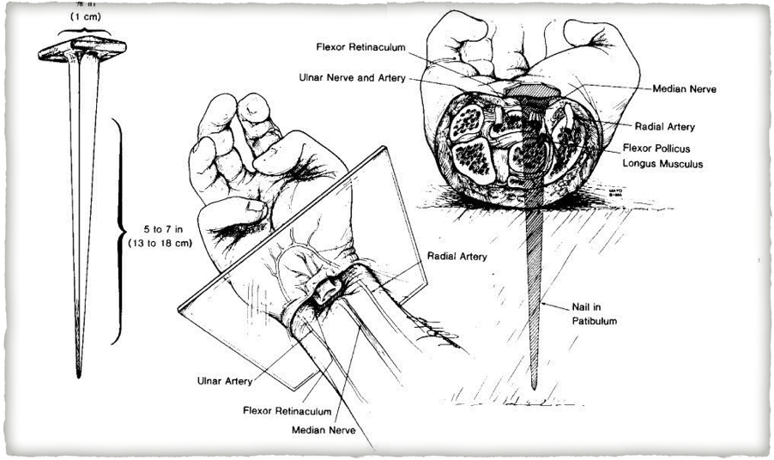
“The Crucifixion of Jesus”

Slide 12
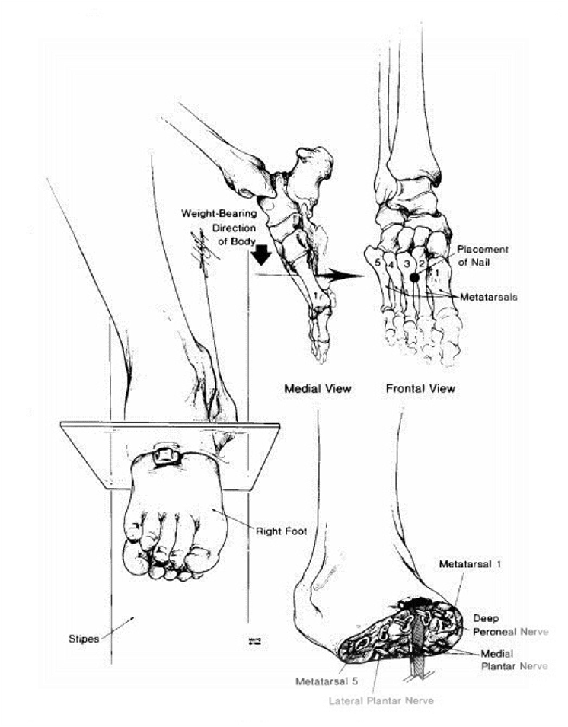
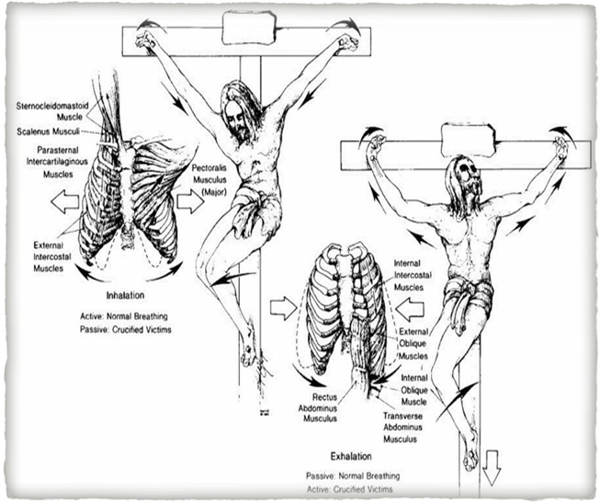
“The Crucifixion of Jesus”

Slide 13
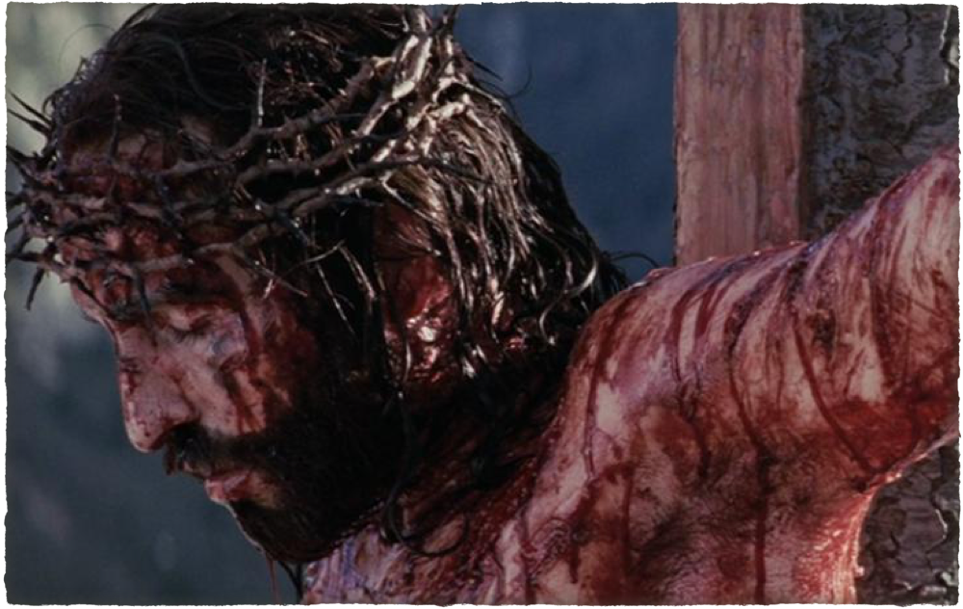
“The Crucifixion of Jesus”
The Son of God is crucified - “Now from the sixth hour until the ninth hour there was darkness over all the land” (Matt. 27:45).
John 19:18–19 (NKJV)
¹⁸ where they crucified Him, and two others with Him, one on either side, and Jesus in the center. ¹⁹ Now Pilate wrote a title and put it on the cross. And the writing was: JESUS OF NAZARETH, THE KING OF THE JEWS

Slide 14
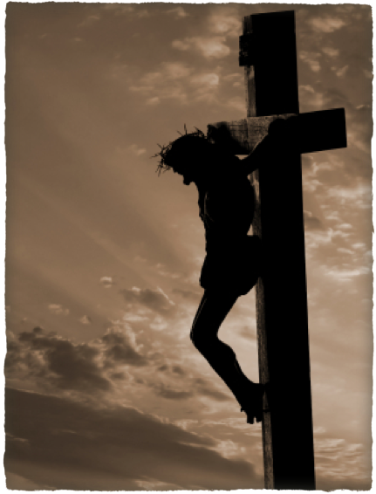
“The Crucifixion of Jesus”
. . . unless mercifully killed, the victim would linger there for two or three days, suffering the agony of immobility, unable to brush away the insects that fed upon his naked flesh, and slowly losing strength until the heart failed and brought an end. Even the Romans sometimes pitied the victim, and offered him a stupefying drink.” (Durant, Caesar And Christ, p. 572).
John 19:18–19 (NKJV)
¹⁸ where they crucified Him, and two others with Him, one on either side, and Jesus in the center. ¹⁹ Now Pilate wrote a title and put it on the cross. And the writing was:
JESUS OF NAZARETH, THE KING OF THE JEWS

Slide 15
John 19:17–42 (NKJV)
¹⁷ And He, bearing His cross, went out to a place called the Place of a Skull, which is called in Hebrew, Golgotha, ¹⁸ where they crucified Him, and two others with Him, one on either side, and Jesus in the center. ¹⁹ Now Pilate wrote a title and put it on the cross. And the writing was: JESUS OF NAZARETH, THE KING OF THE JEWS

Slide 16
John 19:17–42 (NKJV)
²⁰ Then many of the Jews read this title, for the place where Jesus was crucified was near the city; and it was written in Hebrew, Greek, and Latin. ²¹ Therefore the chief priests of the Jews said to Pilate, “Do not write, ‘The King of the Jews,’ but, ‘He said, “I am the King of the Jews.” ’ ”

Slide 17
John 19:17–42 (NKJV)
²² Pilate answered, “What I have written, I have written.” ²³ Then the soldiers, when they had crucified Jesus, took His garments and made four parts, to each soldier a part, and also the tunic. Now the tunic was without seam, woven from the top in one piece.

Slide 18
John 19:17–42 (NKJV)
²⁴ They said therefore among themselves, “Let us not tear it, but cast lots for it, whose it shall be,” that the Scripture might be fulfilled which says: “They divided My garments among them, And for My clothing they cast lots.” Therefore the soldiers did these things. ²⁵ Now there stood by the cross of Jesus His mother, and His mother’s sister, Mary the wife of Clopas, and Mary Magdalene.

Slide 19
John 19:17–42 (NKJV)
²⁶ When Jesus therefore saw His mother, and the disciple whom He loved standing by, He said to His mother, “Woman, behold your son!” ²⁷ Then He said to the disciple, “Behold your mother!” And from that hour that disciple took her to his own home. ²⁸ After this, Jesus, knowing that all things were now accomplished, that the Scripture might be fulfilled, said, “I thirst!”

Slide 20
John 19:17–42 (NKJV)
²⁹ Now a vessel full of sour wine was sitting there; and they filled a sponge with sour wine, put it on hyssop, and put it to His mouth. ³⁰ So when Jesus had received the sour wine, He said, “It is finished!” And bowing His head, He gave up His spirit. ³¹ Therefore, because it was the Preparation Day, that the bodies should not remain on the cross on the Sabbath (for that Sabbath was a high day), the Jews asked Pilate that their legs might be broken, and that they might be taken away.

Slide 21
John 19:17–42 (NKJV)
³² Then the soldiers came and broke the legs of the first and of the other who was crucified with Him. ³³ But when they came to Jesus and saw that He was already dead, they did not break His legs. ³⁴ But one of the soldiers pierced His side with a spear, and immediately blood and water came out. ³⁵ And he who has seen has testified, and his testimony is true; and he knows that he is telling the truth, so that you may believe.

Slide 22
John 19:17–42 (NKJV)
³⁶ For these things were done that the Scripture should be fulfilled, “Not one of His bones shall be broken.” ³⁷ And again another Scripture says, “They shall look on Him whom they pierced.” ³⁸ After this, Joseph of Arimathea, being a disciple of Jesus, but secretly, for fear of the Jews, asked Pilate that he might take away the body of Jesus; and Pilate gave him permission. So he came and took the body of Jesus.

Slide 23
John 19:17–42 (NKJV)
³⁹ And Nicodemus, who at first came to Jesus by night, also came, bringing a mixture of myrrh and aloes, about a hundred pounds. ⁴⁰ Then they took the body of Jesus, and bound it in strips of linen with the spices, as the custom of the Jews is to bury. ⁴¹ Now in the place where He was crucified there was a garden, and in the garden a new tomb in which no one had yet been laid. ⁴² So there they laid Jesus, because of the Jews’ Preparation Day, for the tomb was nearby.

Slide 24
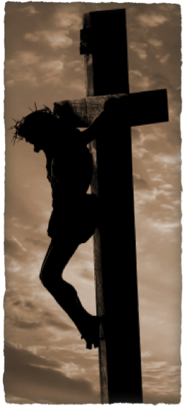
“The Crucifixion of Jesus”
Numbered with transgressors - John 19:18; Luke 23:32-33; Isaiah 53:12; Mat 27:38; Mark 15:27-28;
An inscription placed over Him - John 19:19-22; Matthew 27:37; Mark 15:26; Luke 23:38;
Soldiers casting lots for His clothes - John 19:23,24; Mat 27:35-36; Luk 23:34; Psa 22:18
Scripture fulfilled - (cast lots for tunic - John 19:24; Ps 22:18; I thirst - John 19:28; Ps 22:15)
Women who mourned - instructions to John to care for His mother - John 19:25-27; Lk 23:27-31
Wine mixed with myrrh & mocking – John 19:28-30; Mat 27:34,48; Psa 69:21; Mar 15:23;

Slide 25
“The Crucifixion of Jesus”
Insults hurled – “He saved others, let Him save Himself” - Mat 27:39-44; Ps 22:6-7, 22:17; Mark 15:29-30; Luke 23:35-39
A challenge – “Come down from the cross and we will believe in you” – Matt 27:42; Mark 15:32; Luke 23:39
A convert - One of the thieves defended Him and sought spiritual help - Luke 23:39-42
3 hours of Darkness - Matt 27:45; Mark 15:33; Luke 23:44

Slide 26
“The Crucifixion of Jesus”
Physical Pain & suffering – But opened not His mouth – Is 53:7
Rejection – Yet did not threaten or revile in return – 1 Peter 2:23
Love & Concern – For His mother and John – (John 19:26–27); For the thief (Luke 23:43) & everyone else! (Luke 23:34)
Loneliness – The removal of His Fathers protection - Matt. 27:46; Ps 22
Death - John 19:30; ch. 10:11, 18; Mat. 20:28; 27:50; Mar. 15:37; Lu. 23:46; Phi. 2:8; He. 2:14, 15.

Slide 27
“The Crucifixion of Jesus”
Isaiah 53:4–8 (NKJV)
⁴ Surely He has borne our griefs And carried our sorrows; Yet we esteemed Him stricken, Smitten by God, and afflicted. ⁵ But He was wounded for our transgressions, He was bruised for our iniquities; The chastisement for our peace was upon Him, And by His stripes we are healed. ⁶ All we like sheep have gone astray; We have turned, every one, to his own way; And the Lord has laid on Him the iniquity of us all

Slide 28
“The Crucifixion of Jesus”
Isaiah 53:4–8 (NKJV)
. ⁷ He was oppressed and He was afflicted, Yet He opened not His mouth; He was led as a lamb to the slaughter, And as a sheep before its shearers is silent, So He opened not His mouth. ⁸ He was taken from prison and from judgment, And who will declare His generation? For He was cut off from the land of the living; For the transgressions of My people He was stricken.

Slide 29
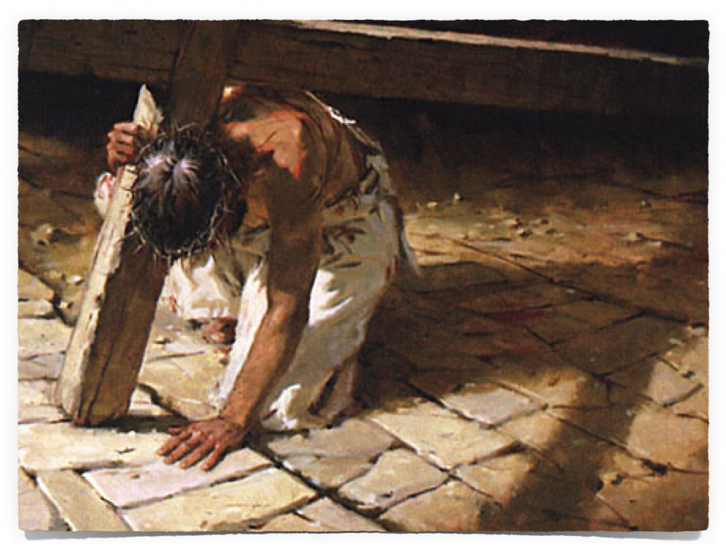
“The Crucifixion of Jesus”
The preaching of the cross – the central message of the gospel – (2:2; Luke 24:46,47)
To those that perish it is foolishness – (2 Thes 2:10)
To those who are “being saved,” (sozo – denotes linear action), it is the power of God – (Rom. 1:16,17; 2 Tim. 3:15-17; Jam. 1:21; 1 Pet. 1:22-25; Heb. 4:12)

Slide 30
“The Crucifixion of Jesus”
God’s love for man – John 3:16
God’s hatred of sin – Ps 45:7
The cost of our redemption – 1 Peter 1:18,19
Importance of obedience – Heb. 5:7-9
Provides motivation to live for the Lord Who died for us - 2 Cor. 5:14-15

Slide 31
“The Crucifixion of Jesus”
Do I See My Own Wickedness?
Do I See How Much The Sinless Son of God Suffered For Me?
Do I See How Much God Loves Me?
Do I See That My Only Hope Is By OBEYING & Giving My Life To The One Who Died For Me? (2 Cor 5:14:15)

Slide 32
“The Crucifixion of Jesus”
How do I handle rejection? Ridicule? Injustice? Suffering?
How grateful am I on a daily basis for what Jesus did for me?
Don’t just weep for him, live for him who died for you!!

Slide 33
“The Crucifixion of Jesus”
John 20:30-31 (NKJV) ³⁰ And truly Jesus did many other signs in the presence of His disciples, which are not written in this book; ³¹ but these are written that you may believe that Jesus is the Christ, the Son of God, and that believing you may have life in His name.

Slide 35
“The Crucifixion of Jesus”
Charts by Don McClain
Prepared & Preached - March 29, 2015
West 65th Street church of Christ
P.O. Box 190062
Little Rock AR 72219
501-568-1062
Prepared using Keynote
Email – donmcclain@sbcglobal.net
More Keynote, PPT & Audio Sermons:
http://w65stchurchofchrist.org/coc/sermons/
Note – Many of the transition effects used in this presentation will be lost using PPT 2007 Viewer
http://www.microsoft.com/downloads/details.aspx?FamilyID=cb9bf144-1076-4615-9951-294eeb832823&displaylang=en

Slide 36
Luke 23:44–49 (NKJV)
⁴⁴ Now it was about the sixth hour, and there was darkness over all the earth until the ninth hour. ⁴⁵ Then the sun was darkened, and the veil of the temple was torn in two.

Slide 37
Luke 23:44–49 (NKJV)
⁴⁶ And when Jesus had cried out with a loud voice, He said, “Father, ‘into Your hands I commit My spirit.’ ” Having said this, He breathed His last. ⁴⁷ So when the centurion saw what had happened, he glorified God, saying, “Certainly this was a righteous Man!”

Slide 38
Luke 23:44–49 (NKJV)
⁴⁸ And the whole crowd who came together to that sight, seeing what had been done, beat their breasts and returned. ⁴⁹ But all His acquaintances, and the women who followed Him from Galilee, stood at a distance, watching these things.

