Slide 1
That You May
”The Resurrected Christ Appears To His Disciples” -
(John 20:11-29)

Slide 2
“Christ Appears To His Disciples”
John 20:30-31 (NKJV) ³⁰ And truly Jesus did many other signs in the presence of His disciples, which are not written in this book; ³¹ but these are written that you may believe that Jesus is the Christ, the Son of God, and that believing you may have life in His name.

Slide 3
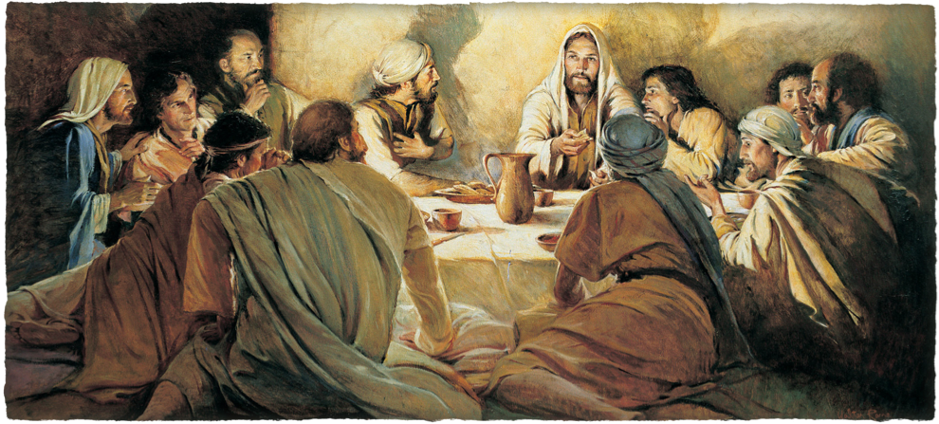
“Christ Appears To His Disciples”
John 13:1–17:26

Slide 4
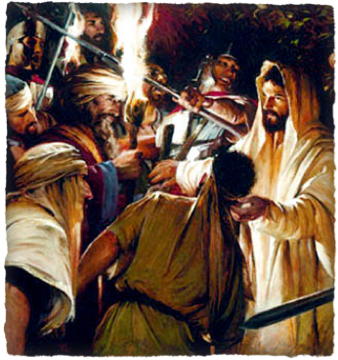
“Christ Appears To His Disciples”
The plans of wicked men:
2:13-22; 5:16-18; 7:7-49; 8:21-59; 9:22; 10:22-39; 11:47-57; 12:9-11,19; 13:2,27-30
The plan of Almighty God
1:1,14; 3:14-16; 6:51-58; 7:30; 8:20,59; 10:14-18,31,39; 11:8-10; 12:20-36
Jesus does NOT appear in this narrative as a mere victim - nor is he overcome by an external superior power!
His death was entirely voluntary - 10:14-18; 14:30,31
None but Jesus has mastery of the circumstances -

Slide 5
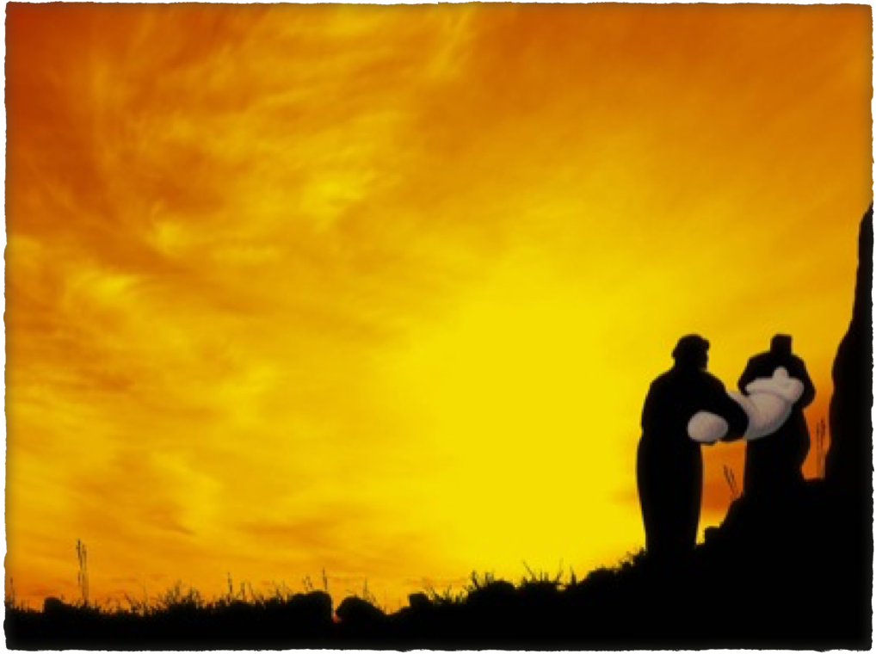
“Christ Appears To His Disciples”
The burial of Jesus is part of the gospel (“He was buried,” 1 Cor. 15:4; Rom 6:16,17).

Slide 6
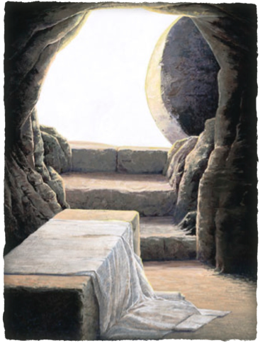
“Christ Appears To His Disciples”
The first day of the week, cf Mat 28:1; Luke 4:31; Acts 20:7.
Mary Magdalene & other womencame to the tomb. -(Mt. 28:1; Mk 16:1,9; Lk 24:10)
The women found an open & empty tomb.- (cf. John 19:26; Jn 20:2)
John beats Peter to the tomb -Peter arrives, he rushed in and sees- 5-7
John the enters & sees and believes.
John 20:1 (NKJV)
¹ Now the first day of the week Mary Magdalene went to the tomb early, while it was still dark, and saw that the stone had been taken away from the tomb.

Slide 7
“Christ Appears To His Disciples”
The Difficulty In Harmonizing The Accounts
For example, when identifying the women who went to the tomb John mentions Mary Magdalene, Matthew mentions Mary Magdalene and the other Mary, while Mark lists Mary Magdalene, Mary the mother of James, and Salome. None of the three accounts are wrong; however, none give a complete list of all the women who went to the tomb.

Slide 8
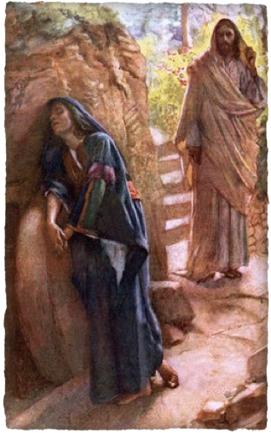
“Christ Appears To His Disciples”
Jesus’ first resurrection appearance was to Mary of Magdala, (Mark 16:9), out of whom He had cast seven demons (Luke 8:2). John is the only writer to mention the details of this appearing.
The disciples returned to their homes while Mary remained outside the tomb crying. (10,11)
Mary looked into the tomb and saw two individuals who were angels - (12)

Slide 9
“Christ Appears To His Disciples”
John 20:13–16 (NKJV)
¹³ Then they said to her, “Woman, why are you weeping?” She said to them, “Because they have taken away my Lord, and I do not know where they have laid Him.” ¹⁴ Now when she had said this, she turned around and saw Jesus standing there, and did not know that it was Jesus. ¹⁵ Jesus said to her, “Woman, why are you weeping? Whom are you seeking?”

Slide 10
“Christ Appears To His Disciples”
John 20:13–16 (NKJV)
She, supposing Him to be the gardener, said to Him, “Sir, if You have carried Him away, tell me where You have laid Him, and I will take Him away.” ¹⁶ Jesus said to her, “Mary!” She turned and said to Him, “Rabboni!” (which is to say, Teacher).

Slide 11
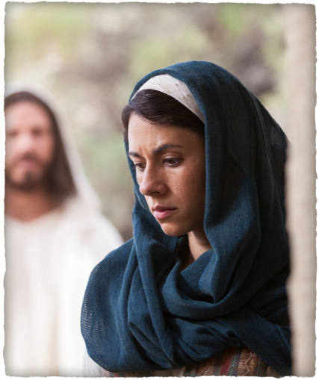
“Christ Appears To His Disciples”
NKJV correct - “Do not cling to Me” - Present middle imperative in prohibition with genitive case, meaning “cease clinging to me” rather than “Do not touch me.”
The expression indicates that the action was already in progress and Jesus urged her to let go.
She did not want to lose Jesus again - but He would soon, (40 days) ascend to the Father.
¹⁷ Jesus said to her, “Do not cling to Me, for I have not yet ascended to My Father; …

Slide 12
“Christ Appears To His Disciples”
“but go to my brethren” - Jesus instructs Mary to report what she has seen to “His brethren” —(Compare Mt 28:10; Heb 2:11, 17).
‘I am ascending” - Seeing this is in the present tense there is some question as tits meaning.
“to My Father and your Father…” - expressly designed to distinguish between what God is to Him and to us—(Jn 5:17,18)
¹⁷ … but go to My brethren and say to them, ‘I am ascending to My Father and your Father, and to My God and your God.’ …

Slide 13
“Christ Appears To His Disciples”
Angels had also appeared to the other women, telling them not to fear and announce that Jesus is resurrected (Matthew 28:5-7, Luke 24:4-8).
Mary and the other women told the news to the disciples, but according to Luke, they did not believe her or the other women “because their words seemed to them like nonsense” (Luke 24:11; cf. Luke 24:23).
¹⁸ Mary Magdalene came and told the disciples that she had seen the Lord, and that He had spoken these things to her

Slide 14
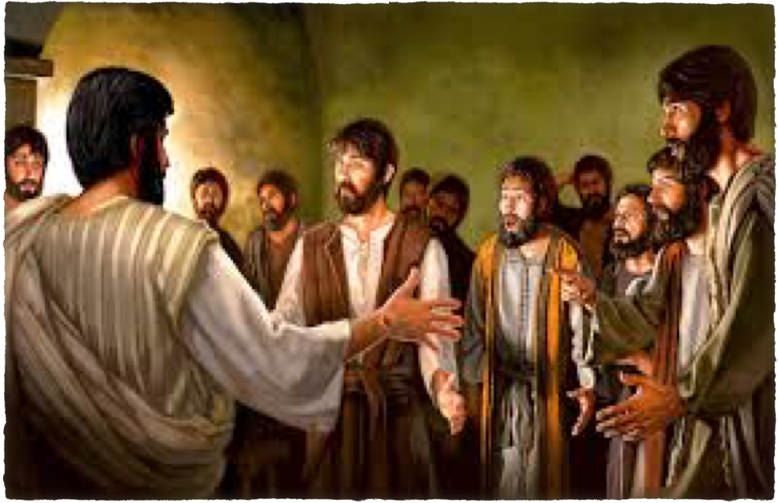
“Christ Appears To His Disciples”
The disciples hid in fear of death at the hands of the Jews (i.e., the Jewish authorities), so they met in secret, behind locked doors. Everything was about to change!
(What a contrast with their boldness about seven weeks later on the day of Pentecost!)

Slide 15
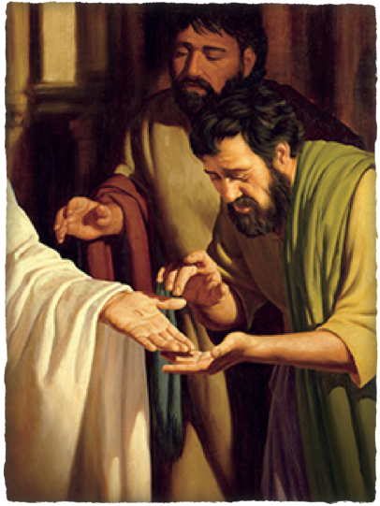
“Christ Appears To His Disciples”
John 20:19 (NKJV)
¹⁹ Then, the same day at evening, being the first day of the week, when the doors were shut where the disciples were assembled, for fear of the Jews, Jesus came and stood in the midst, and said to them, “Peace be with you.”
“When therefore it was evening on that day - understood and here for the time from six to nine (6:16)” - RWP

Slide 16
“Christ Appears To His Disciples”
The promise of 14:18ff & 16:16 fulfilled
After they had fled from the garden, Annas had inquired about them - (18:19)
Jesus had told them to expect to suffer - (Mat 16:24; Jn 15:18-20)
The doors were locked, yet He came and stood among them - - - How? - (cf. v. 26)

Slide 17
“Christ Appears To His Disciples”
His first words, “Peace be with you!” A conventional greeting similar to šālôm in Hebrew. But the words were now invested with a deeper and fuller meaning (cf. 14:27; 16:33; Rom. 5:1; Phil. 4:7).
Seeing the wounds in His pierced hands and side, they were overjoyed (though at first they were frightened, [Luke 24:37–44])

Slide 18
“Christ Appears To His Disciples”
Jesus then commissioned the disciples as His apostles: He was sending them as His representatives, as the Father had sent Him (cf. 17:18; Mat 28:16–20; Lke24:47–49).
This is the first of the three commissions given by the Risen Christ (another on the mountain in Galilee (Matt. 28:16–20; 1 Cor. 15:6), another on the Mount of Olives (Luke 24:44–51; Acts 1:3–11).
²¹ So Jesus said to them again, “Peace to you! As the Father has sent Me, I also send you.”

Slide 19
“Christ Appears To His Disciples”
This symbolic giving of the Spirit was in anticipation of the day of Pentecost - 50 days later - Acts 2
This is synonymous with what Jesus promised in Luke 24:47-49
²² And when He had said this, He breathed on them, and said to them, “Receive the Holy Spirit. ²³ If you forgive the sins of any, they are forgiven them; if you retain the sins of any, they are retained.

Slide 20
“Christ Appears To His Disciples”
Luke 24:47–49 (NKJV)
⁴⁷ and that repentance and remission of sins should be preached in His name to all nations, beginning at Jerusalem. ⁴⁸ And you are witnesses of these things. ⁴⁹ Behold, I send the Promise of My Father upon you; but tarry in the city of Jerusalem until you are endued with power from on high.”
²² And when He had said this, He breathed on them, and said to them, “Receive the Holy Spirit. ²³ If you forgive the sins of any, they are forgiven them; if you retain the sins of any, they are retained.

Slide 21
“Christ Appears To His Disciples”
When the gospel age began, (Acts 2), the terms of forgiveness were made known by the apostles - those who complied with those terms were forgiven - those who rejected the gospel were not - Acts 2:37-47; Acts 8; Acts 10 …
²² And when He had said this, He breathed on them, and said to them, “Receive the Holy Spirit. ²³ If you forgive the sins of any, they are forgiven them; if you retain the sins of any, they are retained.

Slide 22
“Christ Appears To His Disciples”
John 20:30-31 (NKJV) ³⁰ And truly Jesus did many other signs in the presence of His disciples, which are not written in this book; ³¹ but these are written that you may believe that Jesus is the Christ, the Son of God, and that believing you may have life in His name.

Slide 24
“The Empty Tomb”
Charts by Don McClain
Prepared & Preached - April 19, 2015
West 65th Street church of Christ
P.O. Box 190062
Little Rock AR 72219
501-568-1062
Prepared using Keynote
Email – donmcclain@sbcglobal.net
More Keynote, PPT & Audio Sermons:
http://w65stchurchofchrist.org/coc/sermons/
Note – Many of the transition effects used in this presentation will be lost using PPT 2007 Viewer
http://www.microsoft.com/downloads/details.aspx?FamilyID=cb9bf144-1076-4615-9951-294eeb832823&displaylang=en

Slide 25
Luke 24:36–43 (NKJV)
³⁶ Now as they said these things, Jesus Himself stood in the midst of them, and said to them, “Peace to you.” ³⁷ But they were terrified and frightened, and supposed they had seen a spirit. ³⁸ And He said to them, “Why are you troubled? And why do doubts arise in your hearts?

Slide 26
Luke 24:36–43 (NKJV)
³⁹ Behold My hands and My feet, that it is I Myself. Handle Me and see, for a spirit does not have flesh and bones as you see I have.” ⁴⁰ When He had said this, He showed them His hands and His feet. ⁴¹ But while they still did not believe for joy, and marveled,

Slide 27
Luke 24:36–43 (NKJV)
He said to them, “Have you any food here?” ⁴² So they gave Him a piece of a broiled fish and some honeycomb. ⁴³ And He took it and ate in their presence.

