Slide 1
This Is Not
Or Is It?
Or Is It?
(1 Corinthians 6:9-10; Revelation 21:8; Matthew 7:21-23; 2 John 9,10; Romans 14)

Slide 2
This Is Not
Or Is It?
What does the phrase
“salvation issue”
mean?
A salvation issue is usually defined as something for which a person will go to hell if he persists in and does not repent.

Slide 3
This Is Not
Or Is It?
What does the phrase
“salvation issue”
mean?
Often times when we have a scripture or topic come up that we have a disagreement with someone about - we might say that “it’s not a salvation issue so there’s no reason to discuss it.”

Slide 4
This Is Not
Or Is It?
What does the phrase
“salvation issue”
mean?
What exactly is and is not a salvation issue?
How do we know what is and is not a salvation issue?
And just as importantly, why do we feel qualified to say that something is not a salvation issue?

Slide 5
This Is Not
Or Is It?
God has clearly revealed some salvation issues
When God says those who practice certain things “will not inherit the kingdom of God” (1 Corinthians 6:9), then you we RIGHTLY & CONFIDENTLY call them salvation issues

Slide 6
This Is Not
Or Is It?
God has clearly revealed some salvation issues
Galatians 5:19–21 (NKJV)
¹⁹ Now the works of the flesh are evident, which are: adultery, fornication, uncleanness, lewdness, ²⁰ idolatry, sorcery, hatred, contentions, jealousies, outbursts of wrath, selfish ambitions, dissensions, heresies, ²¹ envy, murders, drunkenness, revelries, and the like; of which I tell you beforehand, just as I also told you in time past, that those who practice such things will not inherit the kingdom of God.

Slide 7
This Is Not
Or Is It?
God has clearly revealed some salvation issues
Revelation 21:8 (NKJV)
⁸ But the cowardly, unbelieving, abominable, murderers, sexually immoral, sorcerers, idolaters, and all liars shall have their part in the lake which burns with fire and brimstone, which is the second death.”

Slide 8
This Is Not
Or Is It?
God has clearly revealed some salvation issues
1 Corinthians 6:9–11 (NKJV)
⁹ Do you not know that the unrighteous will not inherit the kingdom of God? Do not be deceived. Neither fornicators, nor idolaters, nor adulterers, nor homosexuals, nor sodomites, ¹⁰ nor thieves, nor covetous, nor drunkards, nor revilers, nor extortioners will inherit the kingdom of God. ¹¹ And such were some of you. But you were washed, but you were sanctified, but you were justified in the name of the Lord Jesus and by the Spirit of our God.

Slide 9
This Is Not
Or Is It?
God has clearly revealed some salvation issues
Romans 3:23 (NKJV)
²³ for all have sinned and fall short of the glory of God,
Romans 3:23; 6:23 (NKJV)
²³ For the wages of sin is death, but the gift of God is eternal life in Christ Jesus our Lord.

Slide 10
This Is Not
Or Is It?
God has clearly revealed some salvation issues
Faith? - (John 8:24; Rom 10:9-17; Heb 11:6)
Confession? (Rom 10:9,10)
Repentance? (Luke 13:5; 17:30)
Baptism Into Jesus Christ? (Mark 16:16; Acts 2:38; Rom 6:3-6; Gal 3:26,27; 1 Pet 3:21)
Abiding In The Doctrine Of Jesus? (Acts 2:42; 2 John 1:9)

Slide 11
This Is Not
Or Is It?
God has clearly revealed some salvation issues
2 John 9–10 (NKJV)
⁹ Whoever transgresses and does not abide in the doctrine of Christ does not have God. He who abides in the doctrine of Christ has both the Father and the Son. ¹⁰ If anyone comes to you and does not bring this doctrine, do not receive him into your house nor greet him;

Slide 12
This Is Not
Or Is It?
God has clearly revealed some salvation issues
Matthew 7:21–23 (NKJV)
²¹ “Not everyone who says to Me, ‘Lord, Lord,’ shall enter the kingdom of heaven, but he who does the will of My Father in heaven. ²² Many will say to Me in that day, ‘Lord, Lord, have we not prophesied in Your name, cast out demons in Your name, and done many wonders in Your name?’ ²³ And then I will declare to them, ‘I never knew you; depart from Me, you who practice lawlessness!’

Slide 13
This Is Not
Or Is It?
God has clearly revealed some salvation issues
Luke 14:25–27 (NKJV)
²⁵ Now great multitudes went with Him. And He turned and said to them, ²⁶ “If anyone comes to Me and does not hate his father and mother, wife and children, brothers and sisters, yes, and his own life also, he cannot be My disciple. ²⁷ And whoever does not bear his cross and come after Me cannot be My disciple.

Slide 14
This Is Not
Or Is It?
God has clearly revealed some salvation issues

Slide 15
This Is Not
Or Is It?
God has clearly revealed some salvation issues
Are there any non-essential commands? - Acts 10:48; 17:30; John 4:24; 1 Cor 11:24-33; 14:33-38; 1 Cor 16:1,2
God has given us a pattern to follow - 2 Tim 1:13; 1 Thes 5:21
We must abide within what is written - we cannot go beyond what is written - 1 Cor 4:6; Rev 22:18,19; Deut 4:2; Lev 10:1-3

Slide 16
This Is Not
Or Is It?
Are We Qualified To Say Something That Is Not Specifically Revealed Is or Isn’t a “salvation issue?”
Can be known by the mature & knowledgeable - 2 Tim 3:16,17; Eph 3:3-5;Heb 5:12-14; Psalm 119:104; 2 Pet 3:18
Rightly dividing the word of truth - 2 Tim 2:15
Distinguishing between liberties within the faith - and sinful behavior contrary to the faith, (even matters of liberty can become salvation issue!) - Rom 14; 1 Cor. 6:12; Jud 3; (Rom 14:23)

Slide 17
This Is Not
Or Is It?
Are We Qualified To Say Something That Is Not Specifically Revealed Is or Isn’t a “salvation issue?”
Is it not presumptuous to say something is NOT a salvation issue when I have not objectively searched to see what God says about it? - (Mat 7:1-4; John 7:24)
When someone says, “I know this is probably wrong, but I can do whatever I want as long as it’s not a salvation issue,” hasn't his rebellious attitude made it a salvation issue? (cf Romans 14:23).

Slide 18
This Is Not
Or Is It?
Are We Qualified To Say Something That Is Not Specifically Revealed Is or Isn’t a “salvation issue?”
How should the church be organized? - Phil 1:1
What is the work of the church? - Rom 14:17; 1 Tim 5:16
Institutional support from treasury - (How should we be using Lord’s money)? - Acts 5:4
Experiential driven / focus in worship? - Jn 4:24

Slide 19
This Is Not
Or Is It?
Are We Qualified To Say Something That Is Not Specifically Revealed Is or Isn’t a “salvation issue?”
Abortion?
MDR / Divorce for any cause?
Gambling?
Using illegal drugs?
Social drinking?
Bikini’s / short shorts?
Casual clothing in worship?

Slide 20
This Is Not
Or Is It?
Are We Qualified To Say Something That Is Not Specifically Revealed Is or Isn’t a “salvation issue?”
Arianism? - Jn 8:24
Calvinism? - Rom 6:16,17
Premillennialism? - John 18:36
Denominationalism? - John 17:20,21; 1 Cor 1:10-12; Eph 4:1-7
Institutionalism? - 1 Pet 5:2
Emotionalism? - 1 Cor 14:33

Slide 21
This Is Not
Or Is It?
Are WE asking the Wrong question?
What type of attitude might we be displaying when we say, “Yeah, but is it really a salvation issue?” -
Prov 1:7,22,29,30; ch. 5:12, 13; 15:5; 18:2
Rom 1:18-25;
2 Thes 2:10-12
2 Tim 4:3

Slide 22
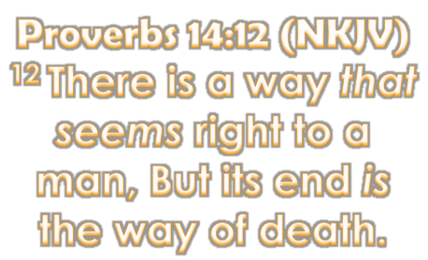
This Is Not
Or Is It?
Are WE asking the Wrong question?

Slide 23
This Is Not
Or Is It?
Are WE asking the Right question?
Isn’t the right question - “Is it pleasing to my Heavenly Father?” -
Rom 12:1,2
2 Cor 5:9;

Slide 24
This Is Not
Or Is It?
Romans 12:1–2 (NKJV)
¹ I beseech you therefore, brethren, by the mercies of God, that you present your bodies a living sacrifice, holy, acceptable to God, which is your reasonable service.
² And do not be conformed to this world, but be transformed by the renewing of your mind, that you may prove what is that good and acceptable and perfect will of God.

Slide 25
This Is Not
Or Is It?
2 Corinthians 5:7–10 (NKJV)
⁷ For we walk by faith, not by sight. ⁸ We are confident, yes, well pleased rather to be absent from the body and to be present with the Lord. ⁹ Therefore we make it our aim, whether present or absent, to be well pleasing to Him.
¹⁰ For we must all appear before the judgment seat of Christ, that each one may receive the things done in the body, according to what he has done, whether good or bad.

Slide 26
This Is Not
Or Is It?
Are WE asking the Right question?
We can KNOW WHAT IS PLEASING TO GOD!! -
2 Tim 3:16,17;
2 Cor 5:7;
Eph 5:15-17;
1 Thes 5:21

Slide 27
This Is Not
Or Is It?
Are We Committed & Determined To Find & Follow God’s Way?
Faith? - (John 8:24; Rom 10:9-17; Heb 11:6)
Confession? (Rom 10:9,10)
Repentance? (Luke 13:5; 17:30)
Baptism Into Jesus Christ? (Mark 16:16; Acts 2:38; Rom 6:3-6; Gal 3:26,27; 1 Pet 3:21)
Abiding In The Doctrine Of Jesus? (Acts 2:42; 2 John 1:9)

Slide 28
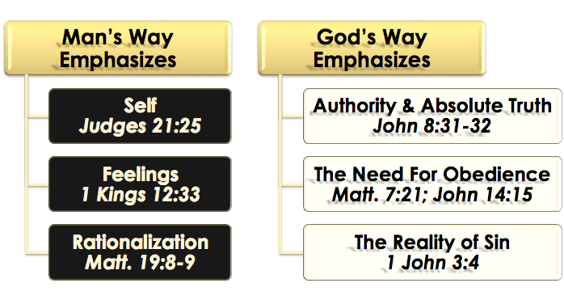
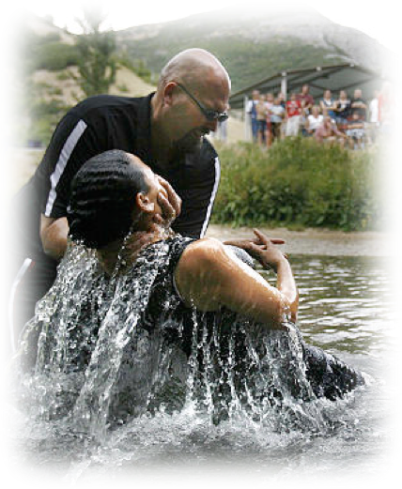
This Is Not
Or Is It?
Are We Committed & Determined To Find & Follow God’s Way?

Slide 29
This Is Not
Or Is It?
Are We Committed & Determined To Find & Follow God’s Way?
2 Timothy 2:15 (NKJV) ¹⁵ Be diligent to present yourself approved to God, a worker who does not need to be ashamed, rightly dividing the word of truth.

Slide 30
Don McClain

Slide 31
This Is Not
Or Is It?

Slide 32
1 Timothy 4:12–16 (NKJV)
¹² Let no one despise your youth, but be an example to the believers in word, in conduct, in love, in spirit, in faith, in purity. ¹³ Till I come, give attention to reading, to exhortation, to doctrine. ¹⁴ Do not neglect the gift that is in you, which was given to you by prophecy with the laying on of the hands of the eldership.

Slide 33
1 Timothy 4:12–16 (NKJV)
¹⁵ Meditate on these things; give yourself entirely to them, that your progress may be evident to all. ¹⁶ Take heed to yourself and to the doctrine. Continue in them, for in doing this you will save both yourself and those who hear you.

