Slide 1
Consider Your Ways …

Slide 2
Three sieges of Jerusalem by the Babylonians -
Three groups taken captive - 616-586
Jerusalem & temple finally destroyed 586 BC
Nebuchadnezzar dies, 562 B.C.
Almost 50,000 Jews allowed to return to Jerusalem with Zerubbabel (Ezra 1:2–4; cf. Isa. 44:28), Joshua the high priest and the Prophets Haggai and Zechariah.
Levitical sacrifices reinstituted on a rebuilt altar (Ezra 3:1–6), and in the 2nd year of the return - foundation of the temple laid (Ezra 3:8–13; 5:16).
Babylon defeated by Cyrus 539 B.C.
Decreed people could return to native lands & worship their gods again, 538 BC
609
597
586
562
539
-538
537-536

Slide 3
God raises up Haggai in the 2nd year of the Persian king, Darius Hystaspes (521–486 b.c.) to arouse the leaders & Judah from their spiritual lethargy & get back to work on the temple. - (Ezra 5:1–2; Hag. 1:1).
The initial success of Haggai in his mission (cf. 1:12–15) was supplemented by the continued efforts of Zechariah until the temple reconstruction was finished in 515 b.c.
People discouraged by smaller foundation (Ezra 3:12) - Samaritan harassment (Ezra 4:5), & King Cambyses ordering the work to stop (Ezra 4:6-24) brought a halt to the rebuilding of the temple. Then spiritual apathy set in; and for about 16 more years the construction of the temple was discontinued.
609
597
586
562
539
-538
537-536
520-515

Slide 4
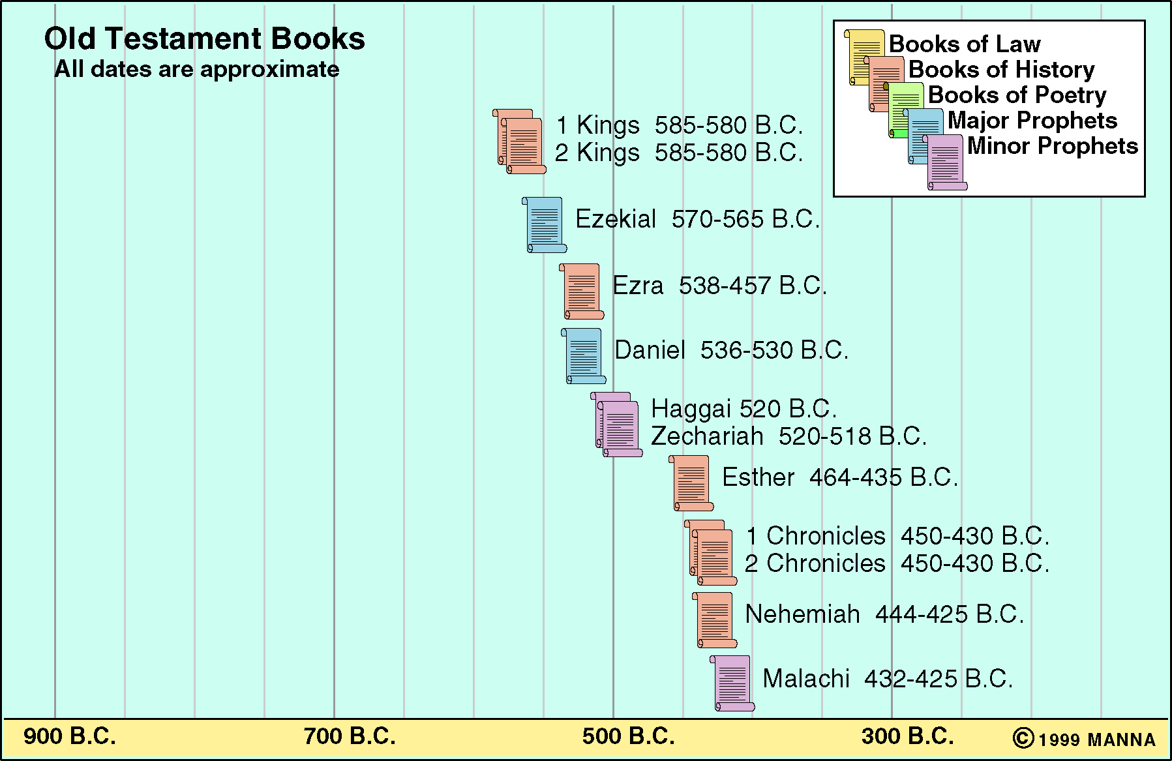

Slide 5
The People Rebuked
Haggai 1:1–5 (NKJV)
¹ In the second year of King Darius, in the sixth month, on the first day of the month, the word of the Lord came by Haggai the prophet to Zerubbabel the son of Shealtiel, governor of Judah, and to Joshua the son of Jehozadak, the high priest, saying, ² “Thus speaks the Lord of hosts, saying: ‘This people says, “The time has not come, the time that the Lord’s house should be built.” ’ ”

Slide 6
The People Rebuked
Haggai 1:1–5 (NKJV)
³ Then the word of the Lord came by Haggai the prophet, saying, ⁴ “Is it time for you yourselves to dwell in your paneled houses, and this temple to lie in ruins?” ⁵ Now therefore, thus says the Lord of hosts: “Consider your ways!

Slide 7
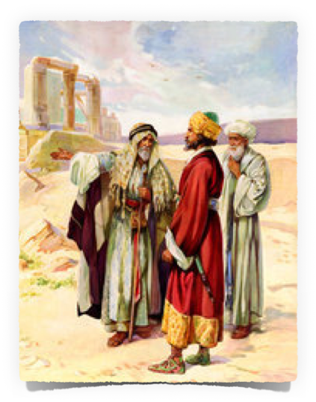
The People Rebuked
Haggai takes the Lord's message to Israel's leaders – 1:1
Zerubbabel the governor (lead first group of exiles back - Ezra 2:2; Neh 7:7; Zec 4:6)
Joshua - high priest, known as Jeshua -(Ezra 2:1-2,36,40; 3:2-8)

Slide 8
The People Rebuked
The Lord takes issue with what the people have been saying – 1:2-4
‘“The time has not come, the time that the Lord’s house should be built.” - (1:2)
The Lord asks if they should live in paneled houses while the temple lies in ruins (1:4)

Slide 9
The People Rebuked
The Lord MUST come First in everything.
Will a man rob God? - (Mal 3:8–12)
Seek first the kingdom of God & His righteousness - (Mat 6:28–33)
Before attending to physical priorities, we must have properly handled spiritual priorities - (Lk 9:23-25, 57-62; Mark 12:29-31)

Slide 10
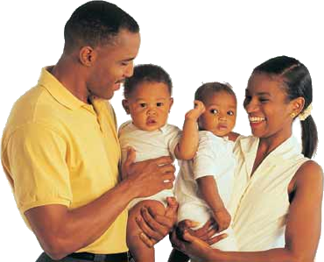
The People Rebuked
The Lord MUST come First in everything.
Before work & other financial priorities; before family & physical relationships / before homework, school & extracurriculars … etc
Do you really think He will take second place in your heart?! - Mat 6:19-24; Mark 12:29-31

Slide 11
The People Rebuked
Consider your Ways - Consider your Excuses
Attending worship services & Bible classes - Heb 10:24,25; Acts 2:42; 17:11,12
Encouraging & Building Up of Christians - Rom 12:9-16
Evangelism - teaching the word of God - Acts 8:4; 1 The 1:8
Salt & Light - Mat 5:13-16; Phili 2:14-16; Rom 2:17-24

Slide 12
The People Challenged
Haggai 1:5–11 (NKJV)
⁵ Now therefore, thus says the Lord of hosts: “Consider your ways! ⁶ “You have sown much, and bring in little; You eat, but do not have enough; You drink, but you are not filled with drink; You clothe yourselves, but no one is warm; And he who earns wages, Earns wages to put into a bag with holes.” ⁷ Thus says the Lord of hosts: “Consider your ways!

Slide 13
The People Challenged
Haggai 1:5–11 (NKJV)
⁸ Go up to the mountains and bring wood and build the temple, that I may take pleasure in it and be glorified,” says the Lord. ⁹ “You looked for much, but indeed it came to little; and when you brought it home, I blew it away. Why?” says the Lord of hosts. “Because of My house that is in ruins, while every one of you runs to his own house.

Slide 14
The People Challenged
Haggai 1:5–11 (NKJV)
¹⁰ Therefore the heavens above you withhold the dew, and the earth withholds its fruit. ¹¹ For I called for a drought on the land and the mountains, on the grain and the new wine and the oil, on whatever the ground brings forth, on men and livestock, and on all the labor of your hands.”

Slide 15
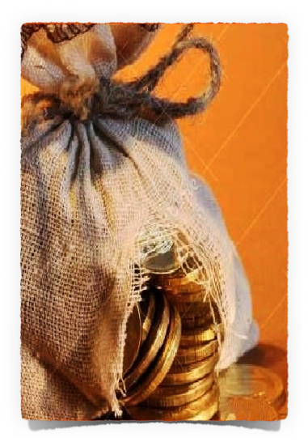
The People Challenged
Consider Your Ways …
Their efforts resulted in little - (1:6)
They looked for much, but God blew it away - (1:9)
While His house lay in ruins, they were busy building their own - God was not glorified - (1:9)
Therefore God had called for a drought on the land and its fruit - (1:10)

Slide 16
The People Challenged
Consider Your Ways …
The Lord challenges them to consider their ways, i.e., to examine themselves that they may realize their true condition and why – 1:5-6
To motivate them to get their priorities in order & build the temple, their trouble is explained – 1:7-11

Slide 17
The People Challenged
Nobody can truly prosper if the Lord is not first in their hearts! -Deut 28:1-15; 29:18-28; Psalm 107:34
Everything we may accomplish without the Lord will come to nothing - Psalm 127:1,2; Mat 16:26
True success depends on putting the Lord first IN OUR HEARTS & may not be recognizable to the carnal mind - 1 Pet 313-17

Slide 18
The People Challenged
ARE WE laboriously involved with our own affairs while neglecting our spiritual state, duties & responsibilities. - 2 Pet 1:5-10; Phili 2:12
What effect has our past priorities & emphasis had on our current spiritual knowledge & condition? - Eze 18:28; 2 Cor 13:5; Heb 12:15

Slide 19
The People Obey
Haggai 1:12–15 (NKJV)
¹² Then Zerubbabel the son of Shealtiel, and Joshua the son of Jehozadak, the high priest, with all the remnant of the people, obeyed the voice of the Lord their God, and the words of Haggai the prophet, as the Lord their God had sent him; and the people feared the presence of the Lord. ¹³ Then Haggai, the Lord’s messenger, spoke the Lord’s message to the people, saying, “I am with you, says the Lord.”

Slide 20
The People Obey
Haggai 1:12–15 (NKJV)
¹⁴ So the Lord stirred up the spirit of Zerubbabel the son of Shealtiel, governor of Judah, and the spirit of Joshua the son of Jehozadak, the high priest, and the spirit of all the remnant of the people; and they came and worked on the house of the Lord of hosts, their God, ¹⁵ on the twenty-fourth day of the sixth month, in the second year of King Darius.

Slide 21
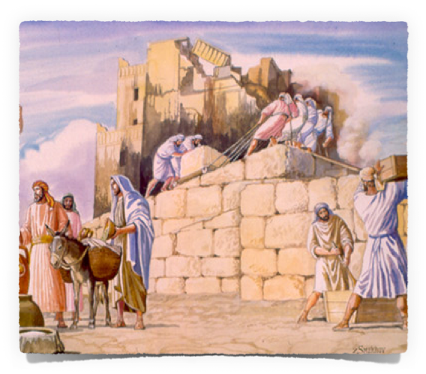
The People Obey
Zerubbabel & Joshua lead the people to obey – 1:12
The Lord promises to be with them – 1:13
Stirred up by the Lord, through His word, Zerubbabel & Joshua lead the remnant to resume work on the temple – 1:14-15

Slide 22
The People Obey
When there is respect for God & His word there will also be genuine obedience! - 1:12; Rom 6:16-18
Blessings follow obedience. - 1:13; Heb 5:8,9; 1 Pet 1:22,23
There is STILL power in God’s word - Heb 4:12; Rom 1:16; 2 Tim 4:2

Slide 23
The People Are Encouraged
Haggai 2:1–5 (NKJV)
¹ In the seventh month, on the twenty-first of the month, the word of the Lord came by Haggai the prophet, saying: ² “Speak now to Zerubbabel the son of Shealtiel, governor of Judah, and to Joshua the son of Jehozadak, the high priest, and to the remnant of the people, saying: ³ ‘Who is left among you who saw this temple in its former glory? And how do you see it now? In comparison with it, is this not in your eyes as nothing?

Slide 24
The People Are Encouraged
Haggai 2:1–5 (NKJV)
⁴ Yet now be strong, Zerubbabel,’ says the Lord; ‘and be strong, Joshua, son of Jehozadak, the high priest; and be strong, all you people of the land,’ says the Lord, ‘and work; for I am with you,’ says the Lord of hosts. ⁵ ‘According to the word that I covenanted with you when you came out of Egypt, so My Spirit remains among you; do not fear!’

Slide 25
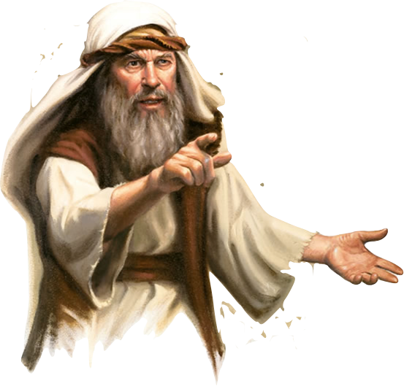
The People Are Encouraged
Haggai speaks to Zerubbabel, Joshua & the faithful remnant - asking “who saw the former temple in its glory” & then ask “how does it compare” – 2:1-3; cf. Ezr 3:12-13
The Lord encourages them to be strong, for He is with them – 2:4-5

Slide 26
The People Are Encouraged
We may get motivated to do God’s work - Then realize the work is hard and the results don’t measure up to expectations - Heb 12:3; Is 40:30,31; 2 Cor 4:16; Gal 6:9
God does NOT see or measure success the same as we often do - Is 55:8,9

Slide 27
The People Are Encouraged
We cannot succeed on our own - we are deponent upon God - Eph 6:10-18
Whether salvation, our spiritual growth, or the growth of the church, (spiritual or numerical) we are dependent on God, through our obedient faith - 1 Cor 3:5-16

Slide 28
The People Are Encouraged
Haggai 2:6–9 (NKJV)
⁶ “For thus says the Lord of hosts: ‘Once more (it is a little while) I will shake heaven and earth, the sea and dry land; ⁷ and I will shake all nations, and they shall come to the Desire of All Nations, and I will fill this temple with glory,’ says the Lord of hosts. ⁸ ‘The silver is Mine, and the gold is Mine,’ says the Lord of hosts. ⁹ ‘The glory of this latter temple shall be greater than the former,’ says the Lord of hosts. ‘And in this place I will give peace,’ says the Lord of hosts.”

Slide 29
The People Are Encouraged
The Lord promises to make the glory of this temple greater – 2:6-9
By shaking the nations and having them come to "the Desire of All Nations" – Seems to be Messianic hope - (cf. Isa. 60:5; Zech. 14:14; Heb 12:26-29).

Slide 30
The People Need To Be Holy
Haggai 2:10–14 (NKJV)
¹⁰ On the twenty-fourth day of the ninth month, in the second year of Darius, the word of the Lord came by Haggai the prophet, saying, ¹¹ “Thus says the Lord of hosts: ‘Now, ask the priests concerning the law, saying, ¹² “If one carries holy meat in the fold of his garment, and with the edge he touches bread or stew, wine or oil, or any food, will it become holy?” ’ ” Then the priests answered and said, “No.”

Slide 31
The People Need To Be Holy
Haggai 2:10–14 (NKJV)
¹³ And Haggai said, “If one who is unclean because of a dead body touches any of these, will it be unclean?” So the priests answered and said, “It shall be unclean.” ¹⁴ Then Haggai answered and said, “ ‘So is this people, and so is this nation before Me,’ says the Lord, ‘and so is every work of their hands; and what they offer there is unclean.

Slide 32
The People Need To Be Holy
Can something become holy through contact with something holy? No
Can something become unclean through contact with something unclean? Yes - (2:11-13)
So it is with the people: (2:14)
They were not holy simply because they offered sacrifices
They had become defiled by their sin and had not been faithful -

Slide 33
The People Need To Be Holy
If a Christian worships God while he is living in sin - will his worship be accepted? -
Hypocritical Jews - Rom 2:1,21-24
The one holding bitterness & hatred in his heart - unforgiving - Mat 5:23-26; 18:15-17
True outward worship requires genuine inward cleanliness - 2 Cor 6:14-7:1; Eph 5:1-16; 1 Pet 1:13-19

Slide 34
The People Get A New Start
Haggai 2:15–19 (NKJV)
¹⁵ ‘And now, carefully consider from this day forward: from before stone was laid upon stone in the temple of the Lord—¹⁶ since those days, when one came to a heap of twenty ephahs, there were but ten; when one came to the wine vat to draw out fifty baths from the press, there were but twenty. ¹⁷ I struck you with blight and mildew and hail in all the labors of your hands; yet you did not turn to Me,’ says the Lord.

Slide 35
The People Get A New Start
Haggai 2:15–19 (NKJV)
¹⁸ ‘Consider now from this day forward, from the twenty-fourth day of the ninth month, from the day that the foundation of the Lord’s temple was laid—consider it: ¹⁹ Is the seed still in the barn? As yet the vine, the fig tree, the pomegranate, and the olive tree have not yielded fruit. But from this day I will bless you.’ ”

Slide 36
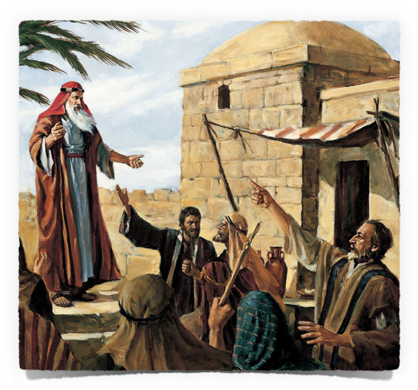
The People Get A New Start
First, consider what God has done in the past – 2:15-17
God had punished them with failed crops, burning winds, mildew, etc.
God wanted them to repent, but they didn’t

Slide 37
The People Get A New Start
Now, consider what God is promising to do – 2:18-23
Their faithful obedience in rebuilding would enable them to experience God’s blessing. 2:18-19
God promised that through “Zerubbabel My servant” He would make provision for victory! 2:20-23

Slide 38
The People Get A New Start
God’s forgiveness through Christ gives us a new start - 2 Cor 5:17; Rom 6:3-7; 1 Jn 1:9,10
In Christ we can accomplish all that God desires - if we by faith get busy and obediently serve Him! - Phili 2:14-16; Eph 6:10-18; 1 Pet 3:15

Slide 39
Consider Your Ways …
Are we allowing ANYTHING to hinder us in “building God’s house?” - Have we truly put God & His kingdom first?
Are you discouraged in the work? - It’s God’s work, He is with you, keep working

Slide 40
Consider Your Ways …
Just being a “church-goer” can’t make you righteous - even casual participation in sin defiles you & your service.
God gave us a fresh start in baptism - Don’t go back into the paths of sin - commit or recommit your life to Jesus - live for Him & His kingdom from this day forward - help in the building of His house!

Slide 42
My Christianity—A Matter of Convenience or Conviction

Slide 43
1 Corinthians 3:5–16 (NKJV)
⁵ Who then is Paul, and who is Apollos, but ministers through whom you believed, as the Lord gave to each one? ⁶ I planted, Apollos watered, but God gave the increase. ⁷ So then neither he who plants is anything, nor he who waters, but God who gives the increase. ⁸ Now he who plants and he who waters are one, and each one will receive his own reward according to his own labor.

Slide 44
1 Corinthians 3:5–16 (NKJV)
⁹ For we are God’s fellow workers; you are God’s field, you are God’s building. ¹⁰ According to the grace of God which was given to me, as a wise master builder I have laid the foundation, and another builds on it. But let each one take heed how he builds on it. ¹¹ For no other foundation can anyone lay than that which is laid, which is Jesus Christ.

Slide 45
1 Corinthians 3:5–16 (NKJV)
¹² Now if anyone builds on this foundation with gold, silver, precious stones, wood, hay, straw, ¹³ each one’s work will become clear; for the Day will declare it, because it will be revealed by fire; and the fire will test each one’s work, of what sort it is. ¹⁴ If anyone’s work which he has built on it endures, he will receive a reward.

Slide 46
1 Corinthians 3:5–16 (NKJV)
¹⁵ If anyone’s work is burned, he will suffer loss; but he himself will be saved, yet so as through fire. ¹⁶ Do you not know that you are the temple of God and that the Spirit of God dwells in you?

