Slide 1
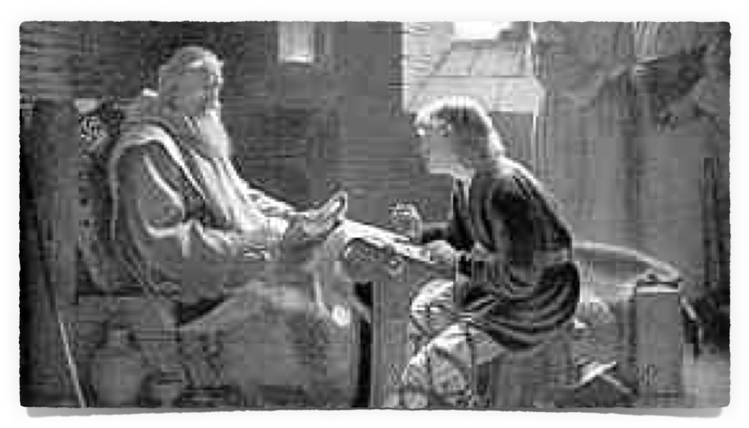
Lessons From
(1 Chronicles 28:1–13; 1 Kings 2:1-4)

Slide 2
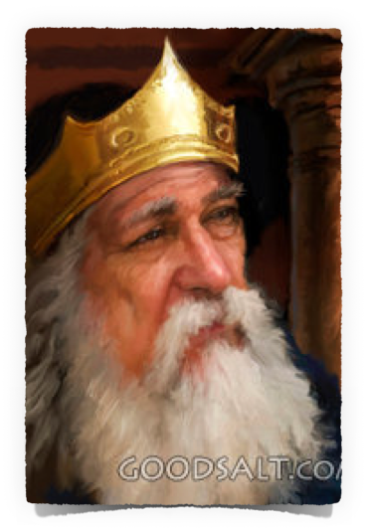
Lessons From
David has grown old & in bad health - 1 Kings 1:1-4
Adonijah, the son of Haggith, made himself king - 2 Sa 3:4; 1Ki 1:5-10
David had promised Bathsheba Solomon would succeed him as king, so Bathsheba & Nathan approach David about what Adonijah had done - 1 Chron 22:6-13; 1 Kin 1:11-27, 30
David swears by the Lord Solomon would be king - 1 Kings 1:29,30

Slide 3
Lessons From
David gives instructions to make Solomon king:
David called Zadok, Nathan, Benaiah, & the Jerusalem police - David told them to put Solomon on the king's mule, take him through the streets declaring him as David's choice to be king. - 1 Kin 2:31-38
Zadok anoints Solomon king in Gihon - 1 Kings 2:38,39
When the people saw what was done they rallied behind Solomon and shouted, "Long live king Solomon.” - 1 Kin 2:39,40

Slide 4
THE TWO CORONATIONS OF SOLOMON
FIRST CORONATION | SECOND CORONATION
1 Kings 1:28–2:11 | 1 Chronicles 28:1–29:30
At Gihon | At the Palace
Necessitated by Adonijah’s Actions | Planned by David’s Authority
Made King by David | Made King by the Assembly
Anointed by Zadok | Anointed by the assembly
“Then Solomon sat on the throne of Yahweh as king instead of David his father” (1 Chr 29:23).
Smith, J. E. (1995). The Books of History (1 Ki 2:1–4). Joplin, MO: College Press.

Slide 5
1 Chronicles 28:1–13 (NKJV)
¹ Now David assembled at Jerusalem all the leaders of Israel: the officers of the tribes and the captains of the divisions who served the king, the captains over thousands and captains over hundreds, and the stewards over all the substance and possessions of the king and of his sons, with the officials, the valiant men, and all the mighty men of valor. ² Then King David rose to his feet and said, “Hear me, my brethren and my people: I had it in my heart to build a house of rest for the ark of the covenant of the Lord, and for the footstool of our God, and had made preparations to build it. ³ But God said to me, ‘You shall not build a house for My name, because you have been a man of war and have shed blood.’

Slide 6
1 Chronicles 28:1–13 (NKJV)
⁴ However the Lord God of Israel chose me above all the house of my father to be king over Israel forever, for He has chosen Judah to be the ruler. And of the house of Judah, the house of my father, and among the sons of my father, He was pleased with me to make me king over all Israel. ⁵ And of all my sons (for the Lord has given me many sons) He has chosen my son Solomon to sit on the throne of the kingdom of the Lord over Israel. ⁶ Now He said to me, ‘It is your son Solomon who shall build My house and My courts; for I have chosen him to be My son, and I will be his Father.

Slide 7
1 Chronicles 28:1–13 (NKJV)
⁷ Moreover I will establish his kingdom forever, if he is steadfast to observe My commandments and My judgments, as it is this day.’ ⁸ Now therefore, in the sight of all Israel, the assembly of the Lord, and in the hearing of our God, be careful to seek out all the commandments of the Lord your God, that you may possess this good land, and leave it as an inheritance for your children after you forever.

Slide 8
1 Chronicles 28:1–13 (NKJV)
⁹ “As for you, my son Solomon, know the God of your father, and serve Him with a loyal heart and with a willing mind; for the Lord searches all hearts and understands all the intent of the thoughts. If you seek Him, He will be found by you; but if you forsake Him, He will cast you off forever. ¹⁰ Consider now, for the Lord has chosen you to build a house for the sanctuary; be strong, and do it.”

Slide 9
1 Chronicles 28:1–13 (NKJV)
¹¹ Then David gave his son Solomon the plans for the vestibule, its houses, its treasuries, its upper chambers, its inner chambers, and the place of the mercy seat; ¹² and the plans for all that he had by the Spirit, of the courts of the house of the Lord, of all the chambers all around, of the treasuries of the house of God, and of the treasuries for the dedicated things; ¹³ also for the division of the priests and the Levites, for all the work of the service of the house of the Lord, and for all the articles of service in the house of the Lord.

Slide 10
¹ Now David assembled at Jerusalem all the leaders of Israel: the officers of the tribes and the captains of the divisions who served the king, the captains over thousands and captains over hundreds, and the stewards over all the substance and possessions of the king and of his sons, with the officials, the valiant men, and all the mighty men of valor.
David calls a public assembly to address the building of the temple & solidify Solomon’s place as king
All the princes of Israel - 27:16-22.
The captains of the companies - 27:1-15.
The rulers of the affairs of state - 27:25-31.
All the mighty men of the nation. - everyone who was anyone.

Slide 11
King David rose to his feet: it was a dramatic scene - he was in declining health (1 Kings 1:1-4)
David wanted to build a house of rest for the ark of the covenant, … and for the footstool of our God - vs 2,3
God said no, but chose David to be king over king over all Israel - vs 4
God gave David many sons, but chose Solomon to be king in his stead - vs 5
Solomon would build the temple - vs 6

Slide 12
1 Chronicles 28:6–7 (NKJV)
⁶ Now He said to me, ‘It is your son Solomon who shall build My house and My courts; for I have chosen him to be My son, and I will be his Father. ⁷ Moreover I will establish his kingdom forever, if he is steadfast to observe My commandments and My judgments, as it is this day.’
1 Chronicles 28:6–7 (NKJV)
⁶ Now He said to me, ‘It is your son Solomon who shall build My house and My courts; for I have chosen him to be My son, and I will be his Father. ⁷ Moreover I will establish his kingdom forever, if he is steadfast to observe My commandments and My judgments, as it is this day.’

Slide 13
For the kingdom to continue - Solomon would have to faithfully follow the law of God - (28:5–7).
David’s instructions to Solomon later in private – 1 Kings 2:1-4

Slide 14
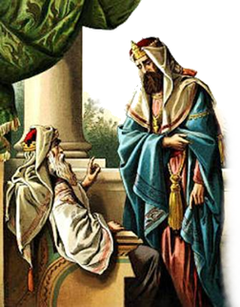
1 Kings 2:1–4 (NKJV)
² “I go the way of all the earth; be strong, therefore, and prove yourself a man. ³ And keep the charge of the Lord your God: to walk in His ways, to keep His statutes, His commandments, His judgments, and His testimonies, as it is written in the Law of Moses, that you may prosper in all that you do and wherever you turn;
if he is steadfast to observe My commandments and My judgments,

Slide 15
David concluded his address to the assembly by exhorting them to observe all the commandments of Yahweh. - 28:8
Only then would their descendants enjoy the good land of Canaan - (28:8; cf De. 4:1; 5:32, 33; 6:1–3; 28-30)
^{8 …} be careful to seek out all the commandments of the Lord your God, that you may possess this good land,

Slide 16
We TOO MUST be careful to seek out all the commandments of Jesus Christ - (Eph 5:15,16)
We too are under law, (not a system ONLY of law) – Mat 17:5; Luke 6:46;
Law of faith – Rom 3:27
Law of the Spirit – Rom 8:2
Law of Christ – Gal. 6:2
Law of Liberty – James 1:25
^{8 …} be careful to seek out all the commandments of the Lord your God, that you may possess this good land,

Slide 17
We need to carefully seek out and follow ALL of Jesus’ teaching – Jn 6:27; 2 Jn 1:9
To enter the kingdom – Mat 7:21-23; Rom 6:16,17; Jn 3:5
To receive the Holy Spirit – Acts 2:38; 5:32; 1 Cor 6:17-20
To receive eternal salvation – Heb. 5:8.9; LK 6:46; Phili 2:12; Re 22:14
Condemned if disobedient – Rom. 2:5-11; 2 Thes 1:7-9
^{8 …} be careful to seek out all the commandments of the Lord your God, that you may possess this good land,

Slide 18
We are NO LESS required to obey Jesus than they were required to obey MOSES! - Heb 10:26-31
“All things that I have commanded you” Mat. 28:20
“. . . Him you shall hear in all things, whatever He says to you.” Acts 3:22
“. . . he will keep My word; and My Father will love him, and We will come to him and make Our home with him.” John 14:23
^{8 …} be careful to seek out all the commandments of the Lord your God, that you may possess this good land,

Slide 19
OUR OBEDIENCE OR DISOBEDIENCE HAS FAR REACHING CONSEQUENCES
THE DANGER OF ONE GENERATION FORGETTING GOD IS CATASTROPHIC FOR GENERATIONS TO COME - JUDGES 2:10,11
⁸… and leave it as an inheritance for your children after you forever.

Slide 20
Know the God of your father - (9)
Serve him with a whole heart - (9)
Serve him … with a willing mind - (9)
The Lord searches all hearts & understands every plan & thought. (9)
If you seek him, he will be found by you, - (9)
But if you forsake him, he will cast you off forever - (9)
⁹ "As for you, my son Solomon, know the God of your father, and serve Him with a loyal heart and with a willing mind; …

Slide 21
We know we know Him if we keep His commandments - 1 John 2:3-6; 5:3
Cannot have divided loyalties– Mat 6:24; Luke 16:13
Serving God must be our top priority – Mat 6:33; Mark 12:29-31
We must have a willing attitude – John 7:17; 2 Cor 8:3,12
⁹ "As for you, my son Solomon, know the God of your father, and serve Him with a loyal heart and with a willing mind; …

Slide 22
There is NOTHING hidden from our Omniscient God– Heb 4:13; Rev. 2:23; Psalm 139:1-12
Our obedience and service MUST be from the heart – Rom 6:16-19
Must bring even our thoughts under obedience to Christ – 2 Cor. 10:5
Our actions proceed from the heart – Mat 12:34,35; 15:18,19
⁹ … for the Lord searches all hearts and understands all the intent of the thoughts.

Slide 23
Seek and you will find – Mat 7:7,8; James 4:8-10
We need to seek the Lord while we have opportunity – Isa. 55:6,7
We must seek with “all our heart” – Jer. 29:13
The Lord is with you while you are with Him – 2 Chr. 15:2
But if we forsake Him, He will cast us off – Heb 10:26-39
⁹ … If you seek Him, He will be found by you; but if you forsake Him, He will cast you off forever.

Slide 24
Solomon Initially did seek God -
(2 Chron 1:5),
But sadly, his divided devotion led ultimately to Him forsaking the Lord - (1 Kings 11:1-13).
⁹ … If you seek Him, He will be found by you; but if you forsake Him, He will cast you off forever.

Slide 25
David wanted to build the temple but was not permitted to do so – 1 Chron. 28:1-4
God chose Solomon to build the temple – 1 Chron. 28,5,6
David now tells his son “be strong and do it” - 1 Chron 28:10
Solomon would need courage to build the temple and follow the pattern given to him by his father - 1 Chron 28:11,12
¹⁰ Consider now, for the Lord has chosen you to build a house for the sanctuary; be strong, and do it.”

Slide 26
God does not dwell in temples made with hands – Acts 7:48; 17:24; but God does dwell with His people who are holy - 1 Cor 6:14-7:1
Our bodies are spoken of as being a temple for God – 1 Cor. 6:19; 1 John 4:15,16
The church is the temple of God – 1 Cor. 3:16; Eph 2:22
It takes strength & courage to be the holy people God demands - 1 Pet 1:13-16
¹⁰ Consider now, for the Lord has chosen you to build a house for the sanctuary; be strong, and do it.”

Slide 27
⁸ … be careful to seek out all the commandments of the Lord your God, that we may be blessed and those after us -
⁹ … know God, and serve Him with a loyal heart and with a willing mind;
for the Lord searches all hearts and understands all the intent of the thoughts.
If you seek Him, He will be found by you; but if you forsake Him, He will cast you off forever.
¹⁰ Consider now, . . . build a house for the sanctuary; be strong, and do it.”

Slide 28
Don McClain
W. 65th St church of Christ / February 8, 2009

Slide 29
Lessons From
(1 Chronicles 28:1–13; 1 Kings 2:1-4)

Slide 30
1 Kings 2:1–4 (NKJV)
¹ Now the days of David drew near that he should die, and he charged Solomon his son, saying: ² “I go the way of all the earth; be strong, therefore, and prove yourself a man. ³ And keep the charge of the Lord your God: to walk in His ways, to keep His statutes, His commandments, His judgments, and His testimonies, as it is written in the Law of Moses, that you may prosper in all that you do and wherever you turn;

Slide 31
1 Kings 2:1–4 (NKJV)
⁴ that the Lord may fulfill His word which He spoke concerning me, saying, ‘If your sons take heed to their way, to walk before Me in truth with all their heart and with all their soul,’ He said, ‘you shall not lack a man on the throne of Israel.’

