Slide 1
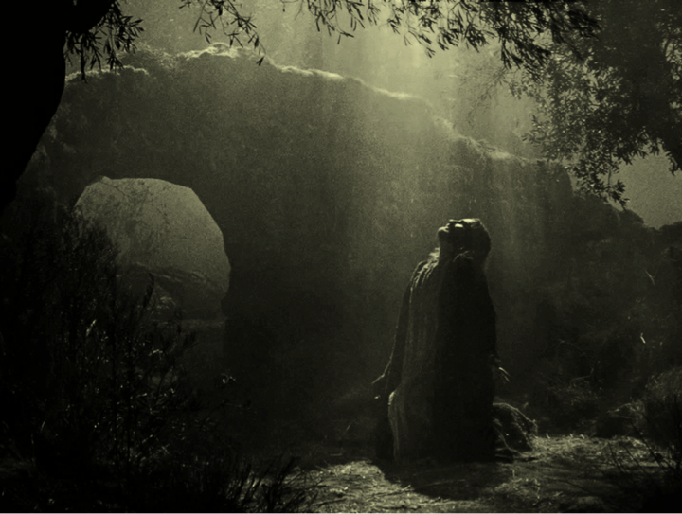
“Not My Will, But YOURS Be Done!”
Matthew 26:36-46
What Effect Does God’s Word Have In Your Life?
James 1:17-27

Slide 2
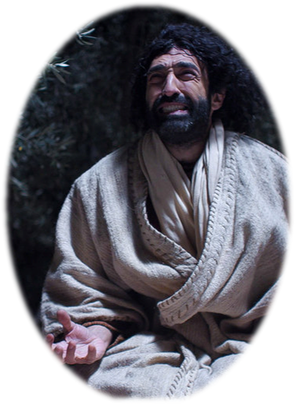
What Effect Does God’s Word Have In Your Life?
“Not My Will, But YOURS Be Done!”
Jesus was COMMITTED to obeying His Father - Mat 26:36-46
Jesus was obedient to His Father in ALL THINGS! - Phili 2:6-10; Heb 5:8,9
What is our ATTITUDE toward God’s word? - Ps 119:97-104; Mat 7:24-25

Slide 3
James 1:17–27 (NKJV)
¹⁷ Every good gift and every perfect gift is from above, and comes down from the Father of lights, with whom there is no variation or shadow of turning. ¹⁸ Of His own will He brought us forth by the word of truth, that we might be a kind of firstfruits of His creatures.

Slide 4
James 1:17–27 (NKJV)
¹⁹ So then, my beloved brethren, let every man be swift to hear, slow to speak, slow to wrath; ²⁰ for the wrath of man does not produce the righteousness of God.

Slide 5
James 1:17–27 (NKJV)
²¹ Therefore lay aside all filthiness and overflow of wickedness, and receive with meekness the implanted word, which is able to save your souls. ²² But be doers of the word, and not hearers only, deceiving yourselves.

Slide 6
James 1:17–27 (NKJV)
²³ For if anyone is a hearer of the word and not a doer, he is like a man observing his natural face in a mirror; ²⁴ for he observes himself, goes away, and immediately forgets what kind of man he was. ²⁵ But he who looks into the perfect law of liberty and continues in it, and is not a forgetful hearer but a doer of the work, this one will be blessed in what he does.

Slide 7
James 1:17–27 (NKJV)
²⁶ If anyone among you thinks he is religious, and does not bridle his tongue but deceives his own heart, this one’s religion is useless. ²⁷ Pure and undefiled religion before God and the Father is this: to visit orphans and widows in their trouble, and to keep oneself unspotted from the world.

Slide 8
What Effect Does God’s Word Have In Your Life?
“God Is Good!”
Don’t blame God for Your trials - (1:2-12)
Don’t blame God for your temptations - (1:13-16)
God is the source of all that is good - (Ps 84:11; Mat 7:11; Luke 11:11)
God is not moody - (Mal 3:6; Heb 1:12; 13:8)
¹⁷ Every good gift and every perfect gift is from above, and comes down from the Father of lights, with whom there is no variation or shadow of turning.

Slide 9
What Effect Does God’s Word Have In Your Life?
God’s greatest gift
“Of His own will” - God's begetting us is of his own free will (Jn 1:12-14, Eph 1:3-6). He was and is under no constraint or obligation to man.
God’s offer of salvation was a conscience choice proceeding from His love & mercy - (Jn 3:16; Rom 5:8; Eph 2:5-10; Tit 3:3-5)
¹⁸ Of His own will He brought us forth by the word of truth, that we might be a kind of firstfruits of His creatures.

Slide 10
What Effect Does God’s Word Have In Your Life?
God’s greatest gift
Vs. 14-15 gave the genealogy of sin. Vs. 18 gives the genealogy of righteousness.
“The word of truth” - is God’s means of saving, i.e. regenerating men - (Acts 2:37; Rom. 1:16,17; 10:14-17; 2 Thes 2:13-15; 1 Pet 1:22-2:3)
¹⁸ Of His own will He brought us forth by the word of truth, that we might be a kind of firstfruits of His creatures.

Slide 11
What Effect Does God’s Word Have In Your Life?
Christians Belong To God
As regenerated people, we ourselves become the firstfruits, new creatures - (1 Pet 1:3-5; 22,23, 2 Cor 5:17, Gal 6:15).
For this reason, it is only reasonable that we present our bodies as living sacrifices to him - (Rom 12:1; 1 Cor 6:20;).
¹⁸ Of His own will He brought us forth by the word of truth, that we might be a kind of firstfruits of His creatures.

Slide 12
What Effect Does God’s Word Have In Your Life?
Be Silent & Listen To God
“Know this” (ESV) or “This you know” (NASB) - (1:19) - Because of the reasons just before presented - (only good comes from God - especially His word by which we can be saved)
Many are not good learners because they are not good listeners - (filled with pride & selfishness) - Ez 33:30-32
¹⁹ So then, my beloved brethren, let every man be swift to hear, slow to speak, slow to wrath; ²⁰ for the wrath of man does not produce the righteousness of God.

Slide 13
What Effect Does God’s Word Have In Your Life?
Be Silent & Listen To God
Swift to hear - (Prov 2:2; 4:20; cf Prov 4:1-19; 22:17-21) an ear bent to hearing God’s word
Slow to speak - (Eccl 5:2,3) - Can’t hear God’s word while blaming Him for our problems & sin - speaking our opinions & preconceived ideas.
Slow to wrath - (cf Acts 7:51-58; 26:9-11) Wrath can prevent an honest investigation of the truth.
¹⁹ So then, my beloved brethren, let every man be swift to hear, slow to speak, slow to wrath; ²⁰ for the wrath of man does not produce the righteousness of God.

Slide 14
What Effect Does God’s Word Have In Your Life?
Be Silent & Listen To God
“Selfish anger” doesn't bring about the will of God and keeps one from being right with God. - (Luke 4:28)
An angry man and his tongue - (James 3:8-12; Eph 4:31),
An angry man & mercy - (Romans 12:19; Mat 6:38-42)
An angry man & love - (Mat 5:43-48; cf. Mat 5:21-26)
¹⁹ So then, my beloved brethren, let every man be swift to hear, slow to speak, slow to wrath; ²⁰ for the wrath of man does not produce the righteousness of God.

Slide 15
What Effect Does God’s Word Have In Your Life?
Have Ears To Hear
Concerning John the baptizer – Mat. 11:15
The parable of the sower – Mat. 13:9, 13-17
Explanation of the parable of the tares – Mat 13:43
Seven churches of Asia – Rev 2:7,11,17,29: 3:6,13,22
James 1:21 (NKJV)
²¹ Therefore lay aside all filthiness and overflow of wickedness, and receive with meekness the implanted word, which is able to save your souls.

Slide 16
What Effect Does God’s Word Have In Your Life?
Have Ears To Hear
“Therefore lay aside” - (1:21)
"Get rid of" - in the original language, means to strip away, to take off -
It is in the passive voice meaning that it is something we are to do ourselves - (Rom 13:12; Eph 4:22; Col. 3:5-8; Heb 12:1; 1 Pet 2:1)
James 1:21 (NKJV)
²¹ Therefore lay aside all filthiness and overflow of wickedness, and receive with meekness the implanted word, which is able to save your souls.

Slide 17
What Effect Does God’s Word Have In Your Life?
Have Ears To Hear
“Therefore lay aside” - (1:21)
All filthiness” - ῥυπαρία, rhyparia - only here in NT - denotes "dirt, filth" . . . used metaphorically of moral "defilement" - Vine's -
“Overflow of wickedness” - κακία, kakia - primarily, "badness" in quality (akin to A, No. 1), denotes (a) "wickedness, depravity, malignity," - Vine's - (cf Rom 13:12; Eph 4:22; Col. 3:5-8)
James 1:21 (NKJV)
²¹ Therefore lay aside all filthiness and overflow of wickedness, and receive with meekness the implanted word, which is able to save your souls.

Slide 18
What Effect Does God’s Word Have In Your Life?
Have Ears To Hear
“Receive with meekness the implanted word” - (1:21)
“Receive” - a deliberate and ready acceptance - requires prepared soil, Mat 13:23
“with meekness” - the opposite of wrath - willing to be taught and led by God - (1 Thes 2:13)
“The implanted word” - that which you have been taught - (Luke 8:11)
James 1:21 (NKJV)
²¹ Therefore lay aside all filthiness and overflow of wickedness, and receive with meekness the implanted word, which is able to save your souls.

Slide 19
What Effect Does God’s Word Have In Your Life?
Have Ears To Hear
“Receive with meekness the implanted word” - (1:21)
Which is able to save your souls” - faith comes by hearing the word of God - (Rom 10:17; John 6:44,45)
The gospel is God’s power to save - (Rom 1:16,17)
Must hold on to the gospel - (1 Cor 15:1,2)
James 1:21 (NKJV)
²¹ Therefore lay aside all filthiness and overflow of wickedness, and receive with meekness the implanted word, which is able to save your souls.

Slide 20
What Effect Does God’s Word Have In Your Life?
Be A Doer of The Word
Faith without works is dead - (James 2:14-26; Heb 11:1-12:2)
We must hear the message, cooperate with the message, conform to the message and submit to the message - Rom 10:17; Luke 6:46; Mat 7:21-23; John 14:15; Heb 5:8,9
We have a very active role to play in the purposes of God and our own salvation - Phili 2:12
James 1:22 (NKJV)
²² But be doers of the word, and not hearers only, deceiving yourselves.

Slide 21
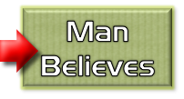
What Effect Does God’s Word Have In Your Life?
Be A Doer of The Word
Salvation by grace through faith -
The Principle -
Noah - Gen. 6:8,13-17; 22; 7:5; Heb 11:7
Abraham – Gen 12:4; 15:6; 17:10,23; 22:3,16-18
Israel – Exo. 12:13; 14:30; Deut 30:15-19; Jos 6; 1 Cor 10:1-13
Us – Mark 16:16; Acts 2:38; 8:12,37; Rom 6:3-6; 10:9-13; Gal. 3:26,27; Col. 2:11-13; 1 Pet 3:21;

Slide 22
What Effect Does God’s Word Have In Your Life?
The danger of self deception
How easy is it to deceive ourselves? - vs 16; Gal 6:7; 1 Cor. 15:33; 2 Cor 13:5
The illustration - 23-25 - A man who is a hearer but not a doer of the word is like a man who looks at himself in a mirror - and the turns away forgets what he looked like.
James 1:22 (NKJV)
²² But be doers of the word, and not hearers only, deceiving yourselves.

Slide 23
What Effect Does God’s Word Have In Your Life?
“The Perfect Law of Liberty”
To be blessed in what we do, we must “look into the perfect law of liberty and continue in it” - and be a “doer of the work” - vs. 25
The gospel of Christ is referred to as LAW - Rom 8:2; Gal. 6:2
It delivers men from slavery of sin This is true liberty. (John 8:32; Rom 5:9; Rom 7; Gal 5:1-4)
James 1:25 (NKJV)
²⁵ But he who looks into the perfect law of liberty and continues in it, and is not a forgetful hearer but a doer of the work, this one will be blessed in what he does.

Slide 24
What Effect Does God’s Word Have In Your Life?
“Pure & Undefiled Religion”
We bridle our tongue - (cursing, gossip; slander; lying, etc). - James 3
James 1:26–27 (NKJV)
²⁶ If anyone among you thinks he is religious, and does not bridle his tongue but deceives his own heart, this one’s religion is useless.

Slide 25
What Effect Does God’s Word Have In Your Life?
“Pure & Undefiled Religion”
We bridle our tongue - (cursing, gossip; slander; lying, etc). - James 3
We visit, (help) those less fortunate, (orphans and widows) - 27; Acts 6:1-7; 1 Tim 5:3-16
We keep ourselves unspotted from the world - (1 John 2:15-17; 2 Cor. 6:14-7:1; Titus 2:11,12; 1 Thes 5:21,22; 1 Pet 4:1-4)
James 1:26–27 (NKJV)
²⁷ Pure and undefiled religion before God and the Father is this: to visit orphans and widows in their trouble, and to keep oneself unspotted from the world.

Slide 26
What Effect Does God’s Word Have In Your Life?
Some Are Hearers But NOT Doers
Explains Why:
Plain passages are sometimes rejected.
Many people will not engage in Bible study and discussion.
It is hard to explain things to some folks.
Preaching the truth on a problem doesn’t always solve the problem.
James 1:25 (NKJV)
²⁵ But he who looks into the perfect law of liberty and continues in it, and is not a forgetful hearer but a doer of the work, this one will be blessed in what he does.

Slide 27
What Effect Does God’s Word Have In Your Life?
Keys To Being Doers & Not Hearers Only
Fear - Prov. 1:7; Eccl. 12:13
Humility – Mat 5:3; Jer. 10:23; Isaiah 66:2;
Meekness - James 1:21
Honesty / Integrity – Acts 17:11;
Study / Examination – Acts 17:11; 2 Cor. 13:5; 2 Tim 3:16,17
Application – James 1:22-26
Diligence – 2 Peter 1:5,10; 3:14
James 1:25 (NKJV)
²⁵ But he who looks into the perfect law of liberty and continues in it, and is not a forgetful hearer but a doer of the work, this one will be blessed in what he does.

Slide 28
Let us ALWAYS be like our Lord - & always have a submissive & obedient heart!
“Not My Will, But YOURS Be Done!”
Matthew 26:36-46

Slide 29
“Not My Will, But YOURS Be Done!”
Matthew 26:36-46
What Effect Does God’s Word Have In Your Life?
James 1:17-27

Slide 30
Don McClain
W 65th St church of Christ / July 20, 2008

Slide 31
“Not My Will, But YOURS Be Done!”

Slide 32
Matthew 7:21–27 (NKJV)
²¹ “Not everyone who says to Me, ‘Lord, Lord,’ shall enter the kingdom of heaven, but he who does the will of My Father in heaven. ²² Many will say to Me in that day, ‘Lord, Lord, have we not prophesied in Your name, cast out demons in Your name, and done many wonders in Your name?’

Slide 33
Matthew 7:21–27 (NKJV)
²³ And then I will declare to them, ‘I never knew you; depart from Me, you who practice lawlessness!’ ²⁴ “Therefore whoever hears these sayings of Mine, and does them, I will liken him to a wise man who built his house on the rock:

Slide 34
Matthew 7:21–27 (NKJV)
²⁵ and the rain descended, the floods came, and the winds blew and beat on that house; and it did not fall, for it was founded on the rock. ²⁶ “But everyone who hears these sayings of Mine, and does not do them, will be like a foolish man who built his house on the sand:

Slide 35
Matthew 7:21–27 (NKJV)
²⁷ and the rain descended, the floods came, and the winds blew and beat on that house; and it fell. And great was its fall.”

