Slide 1
Revelation 21:5–8 (NKJV)

Slide 2
Revelation 21:5–8 (NKJV)
⁵ Then He who sat on the throne said, “Behold, I make all things new.” And He said to me, “Write, for these words are true and faithful.” ⁶ And He said to me, “It is done! I am the Alpha and the Omega, the Beginning and the End. I will give of the fountain of the water of life freely to him who thirsts.

Slide 3
Revelation 21:5–8 (NKJV)
⁷ He who overcomes shall inherit all things, and I will be his God and he shall be My son. ⁸ But the cowardly, unbelieving, abominable, murderers, sexually immoral, sorcerers, idolaters, and all liars shall have their part in the lake which burns with fire and brimstone, which is the second death.”

Slide 4
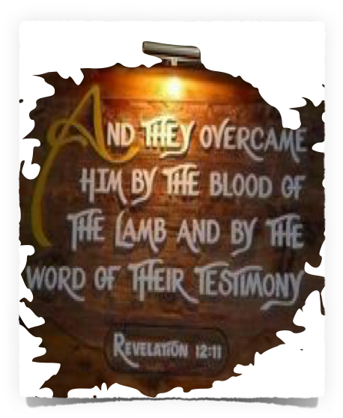
Must overcome:
Fear
Unbelief
Defilement
Murder / Hatred
Sexual immorality
Sorcery / false religion
Dishonesty

Slide 5
CHURCH | CONDITION | PROMISE IF THEY OVERCOME
Ephesus (Rev 2:1-7) | Right doctrine - fought error - but left first love | … I will give to eat from the tree of life
Smyrna (Rev 2:8-11) | Persecuted but faithful | Shall not be hurt by the second death.
Pergamos (Rev 2:12-17) | Compromised with false teachers | … some of the hidden manna … a white stone, … a new name” ’
Thyatira (Rev 2:18-29) | Corrupted by immorality - allowed Jezebel | … keeps My works until the end, … power over the nations … the morning star.
Sardis (Rev 3:1-6) | Had a name they were alive - but were dead | … white garments, … will not blot out his name from the Book of Life; … confess name before My Father and angels.
Philadelphia (Rev 3:7-13) | A faithful church - kept Jesus’ word | I will make him a pillar in the temple of My God, … shall go out no more. … I will write on him My new name.
Laodicea (Rev 3:14-22) | Lukewarm - materially rich but spiritually bankrupt | I will grant to sit with Me on My throne, as I also overcame and sat down with My Father on His throne.

Slide 6
Those who overcome:
Satan - Mat 4:1-11; Luke 11:22; Col. 2:15; 1 Jno. 2:13,14; 3:8; 2 Cor. 11:13-15
The World - John 16:33; 1 John 2:15-17; 4:4; 5:4,5; 2 Pet 2:20
Self - 1 John 2:16,17; Cor. 9:24-27; Gal 5:22,23; Col 3:5; 2 Pet 1:6

Slide 7
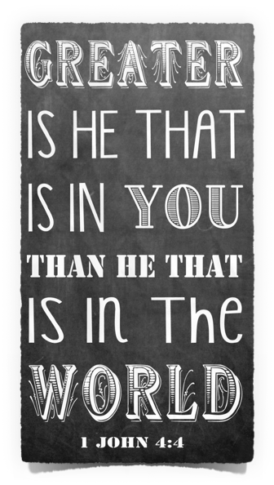
1 John 5:1–5 (NKJV)
¹ Whoever believes that Jesus is the Christ is born of God, and everyone who loves Him who begot also loves him who is begotten of Him. ² By this we know that we love the children of God, when we love God and keep His commandments. ³ For this is the love of God, that we keep His commandments. And His commandments are not burdensome. ⁴ For whatever is born of God overcomes the world. And this is the victory that has overcome the world—our faith. ⁵ Who is he who overcomes the world, but he who believes that Jesus is the Son of God?

Slide 8
Being Born of God:
Regenerated - John 3:5; Titus 3:5; 1 Pet 1:22,23
Converted - Ez. 18:30-32; Mat. 18:3; Acts 2:38; 3:19; 26:18-20; Col 1:13
Renewed - Rom 12:1,2
Abides In God – John 15:1-10; 1 John 3:6-9; 5:1-3

Slide 9
overcomes the world:
The lust of the flesh - (immorality, inordinate emotions)
The lust of the eyes - (materialism, greed, covetousness)
The pride of life -(vainglory, boasting, arrogance)

Slide 10
Faith In Who Jesus Is - (1 John 1:1-3; 4:4; 5:5; John 1:1,2; 8:24; Col. 1:13-17; Heb 1:1,2)
Faith In What Jesus Did – (1 Jn 4:2; 3:16; 2:2; 1 Tim 2:5; Heb 7:25)
Faith In What Jesus Has Said - (Mt 17:5; Luke 6:46; Luke 13:3; Mt 10:32; Mark 16:16; Mt 28:18-20)
Faith in what Jesus does - (1 Jn 2:2; 1 Tim 2:5; Heb 7:24,25; 9:24)
Faith in what Jesus will do - (2 Cor 5:10; Acts 17:30,31; Mt 25:31-46)

Slide 11
overcome the world:
Sin - (guilt; power & consequences)
Worry - (Anxiety; fear; emotional distress)
Discontentment – (dissatisfaction; unhappiness; murmuring)
Depression – (despair; helplessness)
Illness – (pain, hardship; can’t function)
Grief - (Deep mental anguish)
Loneliness - (even if around people)
Death – (The resurrection)

Slide 12
Those who overcome:
Walk in the light - 1 Jn 1:5-7
Believe that Jesus is the Christ - 1 Jn 5:1,5; Rom 10:9,10
Confess their sin - 1 Jn 1:8-10
Keep His commandments - 1 John 2:3-6; 5:2,3; Mat 17:5; Luke 6:46; Heb 5:8,9
Love the brethren - 1 John 2:9-11; 3:10-23; 4:7-5:1

Slide 13
Ephesians 6:10–17 (NKJV)
¹⁰ Finally, my brethren, be strong in the Lord and in the power of His might. ¹¹ Put on the whole armor of God, that you may be able to stand against the wiles of the devil. ¹² For we do not wrestle against flesh and blood, but against principalities, against powers, against the rulers of the darkness of this age, against spiritual hosts of wickedness in the heavenly places.

Slide 14
Ephesians 6:10–17 (NKJV)
¹³ Therefore take up the whole armor of God, that you may be able to withstand in the evil day, and having done all, to stand. ¹⁴ Stand therefore, having girded your waist with truth, having put on the breastplate of righteousness, ¹⁵ and having shod your feet with the preparation of the gospel of peace; ¹⁶ above all, taking the shield of faith with which you will be able to quench all the fiery darts of the wicked one. ¹⁷ And take the helmet of salvation, and the sword of the Spirit, which is the word of God;

Slide 15
1 Corinthians 10:13 (NKJV)
¹³ No temptation has overtaken you except such as is common to man; but God is faithful, who will not allow you to be tempted beyond what you are able, but with the temptation will also make the way of escape, that you may be able to bear it.

Slide 16
Philippians 4:13 (NKJV)
¹³ I can do all things through Christ who strengthens me.

Slide 17
1 Corinthians 15:57–58 ^{(NKJV)}
⁵⁷ But thanks be to God, who gives us the victory through our Lord Jesus Christ. ⁵⁸ Therefore, my beloved brethren, be steadfast, immovable, always abounding in the work of the Lord, knowing that your labor is not in vain in the Lord.

Slide 18
Revelation 22:12–17 (NKJV)
¹² “And behold, I am coming quickly, and My reward is with Me, to give to every one according to his work. ¹³ I am the Alpha and the Omega, the Beginning and the End, the First and the Last.” ¹⁴ Blessed are those who do His commandments, that they may have the right to the tree of life, and may enter through the gates into the city. ¹⁵ But outside are dogs and sorcerers and sexually immoral and murderers and idolaters, and whoever loves and practices a lie.

Slide 19
Revelation 22:12–17 (NKJV)
¹⁶ “I, Jesus, have sent My angel to testify to you these things in the churches. I am the Root and the Offspring of David, the Bright and Morning Star.” ¹⁷ And the Spirit and the bride say, “Come!” And let him who hears say, “Come!” And let him who thirsts come. Whoever desires, let him take the water of life freely.

Slide 20
We are EITHER OVERCOMING the world through FAITH IN JESUS - or we are being overcome by the world - 2 Peter 2:19–20
We will either INHERIT ALL THINGS or we will lose all things - Mat 16:26

Slide 21
YOU CHOOSE FOR YOURSELF - AND YOU WILL CHOOSE NOW!

Slide 22
Don McClain
W. 65th St church of Christ / June 29, 2008

Slide 23
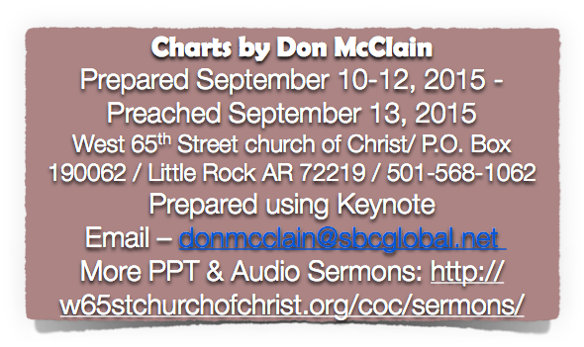
Revelation 21:5–8 (NKJV)

Slide 24
1 John 4:20–5:5 (NKJV)
²⁰ If someone says, “I love God,” and hates his brother, he is a liar; for he who does not love his brother whom he has seen, how can he love God whom he has not seen? ²¹ And this commandment we have from Him: that he who loves God must love his brother also.

Slide 25
1 John 4:20–5:5 (NKJV)
¹ Whoever believes that Jesus is the Christ is born of God, and everyone who loves Him who begot also loves him who is begotten of Him. ² By this we know that we love the children of God, when we love God and keep His commandments.

Slide 26
1 John 4:20–5:5 (NKJV)
³ For this is the love of God, that we keep His commandments. And His commandments are not burdensome. ⁴ For whatever is born of God overcomes the world. And this is the victory that has overcome the world—our faith. ⁵ Who is he who overcomes the world, but he who believes that Jesus is the Son of God?

