Slide 1
In
& Things That Destroy It!
1 Corinthians 1:1-13; Ephesians 4:1-6; Philippians 2:1-5; James 3:13-18

Slide 2
& Things That Destroy It!
When one becomes a Christian – that person enters into a relationship with the Father, Son & Holy Spirit & with other Christians- (Mat 28:18-20; Rom 12:5; 1 Cor 12:13-14)

Slide 3
& Things That Destroy It!
The very nature of the relationship should produce unity, cohesion, joint labor & joint success - (1 Pet 3:8; Ep. 2:21, 22; 1 Pe. 2:5).

Slide 4
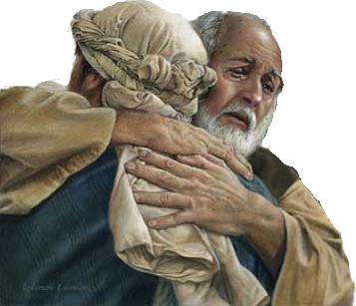
& Things That Destroy It!
This unity is dependent upon two primary things:
Our submission to the authority of Jesus the Christ.
The application of the attitudes commanded by Jesus we are to have toward one another.

Slide 5
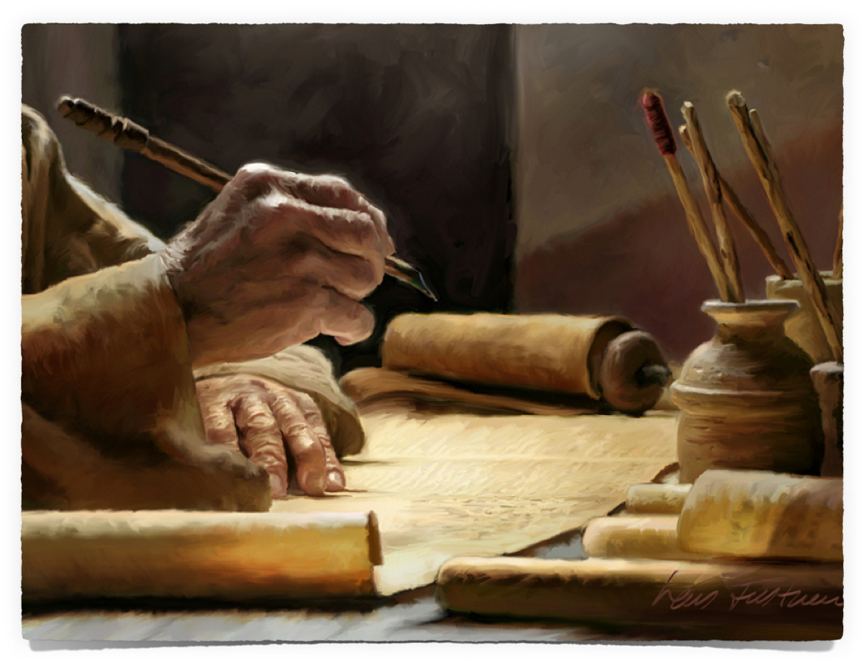
& Things That Destroy It!
We Should Make Every Effort To Be & Remain United

Slide 6
& Things That Destroy It!
We Should Make Every Effort To Be & Remain United

Slide 7
& Things That Destroy It!
We Should Make Every Effort To Be & Remain United

Slide 8
& Things That Destroy It!
1 Corinthians 1:10–13 (NKJV)
¹⁰ Now I plead with you, brethren, by the name of our Lord Jesus Christ, that you all speak the same thing, and that there be no divisions among you, but that you be perfectly joined together in the same mind and in the same judgment. ¹¹ For it has been declared to me concerning you, my brethren, by those of Chloe’s household, that there are contentions among you.

Slide 9
& Things That Destroy It!
1 Corinthians 1:10–13 (NKJV)
¹² Now I say this, that each of you says, “I am of Paul,” or “I am of Apollos,” or “I am of Cephas,” or “I am of Christ.” ¹³ Is Christ divided? Was Paul crucified for you? Or were you baptized in the name of Paul?

Slide 10
& Things That Destroy It!
1 Corinthians 1:10–13
Promotes Unity
Destroys Unity
Respect The Authority of Christ – (1-10)
Speak where the Bible speaks – (10; cf. 1 Pet 4:11)
Have The Same Mind & Judgment – i.e. follow the same leader – Jesus Christ – (10-13)
Disrespect Christ’s Authority – (10)
Push opinions & doctrines of men – (10)
Carnality – following men & their doctrines rather than Jesus Christ – (preacheritis) (10-13)
–Johnny Appleseed

Slide 11
& Things That Destroy It!
Ephesians 4:1–6 (NKJV)
¹ I, therefore, the prisoner of the Lord, beseech you to walk worthy of the calling with which you were called, ² with all lowliness and gentleness, with longsuffering, bearing with one another in love, ³ endeavoring to keep the unity of the Spirit in the bond of peace.

Slide 12
& Things That Destroy It!
Ephesians 4:1–6 (NKJV)
⁴ There is one body and one Spirit, just as you were called in one hope of your calling; ⁵ one Lord, one faith, one baptism; ⁶ one God and Father of all, who is above all, and through all, and in you all.

Slide 13
& Things That Destroy It!
Ephesians 4:1–6
Promotes Unity
Destroys Unity
Holiness – (1)
Humility – (2)
Meekness – (2)
Long-suffering – (2)
Bearing w/ one another – (2)
Earnest effort – (3)
Truth – (4-6)
Unholy living – (1)
Pride – (2)
Harshness – (2)
Impatience – (2)
Selfish / neglecting others needs– (2)
Indifference – (3)
Error – (4-6)

Slide 14
& Things That Destroy It!
Ephesians 4:1–6
Promotes Unity
Destroys Unity
One body – 4
One Spirit – 4
One Hope - 4
One Lord – 5
One Faith – 5
One Baptism – 5
One God – 6
Many bodies - 4
Many revelations - 4
Many hopes - 4
A different Jesus - 5
Any faith … - 5
Many baptism - 5
Different God - 6

Slide 15
& Things That Destroy It!
Philippians 2:1–5 (NKJV)
¹ Therefore if there is any consolation in Christ, if any comfort of love, if any fellowship of the Spirit, if any affection and mercy, ² fulfill my joy by being like-minded, having the same love, being of one accord, of one mind.

Slide 16
& Things That Destroy It!
Philippians 2:1–5 (NKJV)
³ Let nothing be done through selfish ambition or conceit, but in lowliness of mind let each esteem others better than himself. ⁴ Let each of you look out not only for his own interests, but also for the interests of others. ⁵ Let this mind be in you which was also in Christ Jesus,

Slide 17
& Things That Destroy It!
Philippians 2:1–5
Promotes Unity
Destroys Unity
Being like minded – (2)
Having same love - (2)
Being of one accord – (2)
Being of one mind – (2)
Humility in serving - (3)
Mutual respect – (3)
Helping one another – actually putting others first - (4)
Different priorities – (1)
Differing values – (2)
Differing affections – (2)
Differing focus – (2)
Pride, do my thing - (3)
Disdain for others – (3)
Serving self – putting self first & the needs of others aside - (4)

Slide 18
& Things That Destroy It!
James 3:13–18 (NKJV)
¹³ Who is wise and understanding among you? Let him show by good conduct that his works are done in the meekness of wisdom. ¹⁴ But if you have bitter envy and self-seeking in your hearts, do not boast and lie against the truth. ¹⁵ This wisdom does not descend from above, but is earthly, sensual, demonic.

Slide 19
& Things That Destroy It!
James 3:13–18 (NKJV)
¹⁶ For where envy and self-seeking exist, confusion and every evil thing are there. ¹⁷ But the wisdom that is from above is first pure, then peaceable, gentle, willing to yield, full of mercy and good fruits, without partiality and without hypocrisy. ¹⁸ Now the fruit of righteousness is sown in peace by those who make peace.

Slide 20
& Things That Destroy It!
James 3:13–18
Promotes Unity
Destroys Unity
Wisdom from above – (13)
Righteousness & purity – (13,17)
Meekness – (13,17)
Peaceable – (17)
Willing to yield – (17)
Mercy & good fruits – (17)
Impartiality – (17)
Sincerity – (17)
Earthly wisdom – (13)
Iniquity & impurity - (13,17)
Harshness, rude – (13,17)
Warmongers – (17)
Obstinate / stubborn– (17)
Unforgiving, evil – (17)
Partiality – (17)
Hypocrisy – (17)

Slide 21
& Things That Destroy It!
Romans 14:1-15:6 & 1 Cor. 8-14 (NKJ)
Respecting the conscience of others – Rom.14:12,13,19-23; 1 Cor. 8:8-13
Being patient while we learn & grow – Rom. 15:1-6
Do things that will lead to edification – Rom 14:19; 1 Cor. 14:26
Walk in love – Rom 14:15; Col 3:12-15; 1 Cor. 13

Slide 22
& Things That Destroy It!
God’s will is that we be united – 1 Cor. 1:10
God has provided a common standard through which unity is possible – Eph. 5:17
Unity depends upon our submission to the Divine standard – not just in doctrine – but also in practice!!
Unity & Peace WILL NOT accidentally, or automatically happen!

Slide 23
& Things That Destroy It!
Unity by believing ONLY what the scriptures SAY! – John 17:20,21; Eph 4:4-6, 1 Cor. 1:10; 2 Tim. 3:16
Unity by preaching and teaching ONLY things authorized by the scriptures – 1 Peter 4:11; 2 Tim. 4:2
Unity by staying within the boundaries established by the scriptures - Col. 3:17; 2 Cor. 5:7; Rom. 10:17; 2 John 1:9

Slide 24
& Things That Destroy It!
Unity by developing the attitudes COMMANDED in the scriptures –
Colossians 3:12–15 (NKJV)
¹² Therefore, as the elect of God, holy and beloved, put on tender mercies, kindness, humility, meekness, longsuffering; ¹³ bearing with one another, and forgiving one another, if anyone has a complaint against another; even as Christ forgave you, so you also must do. ¹⁴ But above all these things put on love, which is the bond of perfection. ¹⁵ And let the peace of God rule in your hearts, to which also you were called in one body; and be thankful.

Slide 25
& Things That Destroy It!
Is your desire to know and follow the TRUTH? Mat 26:39
Are you willing to lay aside, or at least NOT bind your opinions upon others for the sake of unity?
Superficial approaches to division will never solve the problem - ONLY by truly conforming our hearts to the Lord’s teaching will we ever truly achieve unity!

Slide 26
Don McClain
W. 65th St church of Christ / February 3, 2008

Slide 27
& Things That Destroy It!

Slide 28
1 Corinthians 13:8–13 (NKJV)
⁸ Love never fails. But whether there are prophecies, they will fail; whether there are tongues, they will cease; whether there is knowledge, it will vanish away. ⁹ For we know in part and we prophesy in part. ¹⁰ But when that which is perfect has come, then that which is in part will be done away.

Slide 29
1 Corinthians 13:8–13 (NKJV)
¹¹ When I was a child, I spoke as a child, I understood as a child, I thought as a child; but when I became a man, I put away childish things. ¹² For now we see in a mirror, dimly, but then face to face. Now I know in part, but then I shall know just as I also am known. ¹³ And now abide faith, hope, love, these three; but the greatest of these is love.

