Slide 1
Ephesians 2:1-10
Luke 9:60; 1 Tim 5:6; 1 Pet 4:6

Slide 2
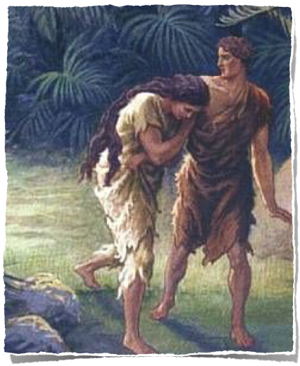
The Biblical concept of death is basically the idea of SEPARATION.
There are three different categories of death in the Bible: Spiritual Death, Physical Death, and Second Death.

Slide 3
Those physically dead but spiritually alive - “God is not the God of the dead, but the living” - Luke 20:35-38
1 Cor 15:14-19,29-34; Luke 16:25; John 8:52,53;
Revelation 14:13 (NKJV)
¹³ Then I heard a voice from heaven saying to me, “Write: ‘Blessed are the dead who die in the Lord from now on.’ ” “Yes,” says the Spirit, “that they may rest from their labors, and their works follow them.”

Slide 4
Those physically dead & eternally separated from God -
Luke 16:22-31; 1 Pet 3:18-20; Mat 7:23; 25:41,46; Rev 21:8
Proverbs 14:32 (NKJV)
³² The wicked is banished in his wickedness, But the righteous has a refuge in his death.

Slide 5
Those physically alive & spiritually alive -
Rom 6:3-6; (dead to sin but alive to God - Rom 6:11-13; 8:10,11; Eph 2:1,5; Col 2:12,13
Romans 6:10–11 (NKJV)
¹⁰ For the death that He died, He died to sin once for all; but the life that He lives, He lives to God. ¹¹ Likewise you also, reckon yourselves to be dead indeed to sin, but alive to God in Christ Jesus our Lord.

Slide 6
Those physically alive but spiritually dead -
Let the dead bury their own dead - Luke 9:60;
Dead while she lives - 1 Tim 5:6
Gospel preached to the dead - 1 Pet 4:6
Luke 15:23–24 (NKJV)
²³ And bring the fatted calf here and kill it, and let us eat and be merry; ²⁴ for this my son was dead and is alive again; he was lost and is found.’ And they began to be merry.

Slide 7
Ephesians 2:1–10 (NKJV)
¹ And you He made alive, who were dead in trespasses and sins, ² in which you once walked according to the course of this world, according to the prince of the power of the air, the spirit who now works in the sons of disobedience, ³ among whom also we all once conducted ourselves in the lusts of our flesh, fulfilling the desires of the flesh and of the mind, and were by nature children of wrath, just as the others.

Slide 8
Ephesians 2:1–10 (NKJV)
⁴ But God, who is rich in mercy, because of His great love with which He loved us, ⁵ even when we were dead in trespasses, made us alive together with Christ (by grace you have been saved), ⁶ and raised us up together, and made us sit together in the heavenly places in Christ Jesus, ⁷ that in the ages to come He might show the exceeding riches of His grace in His kindness toward us in Christ Jesus.

Slide 9
Ephesians 2:1–10 (NKJV)
⁸ For by grace you have been saved through faith, and that not of yourselves; it is the gift of God, ⁹ not of works, lest anyone should boast. ¹⁰ For we are His workmanship, created in Christ Jesus for good works, which God prepared beforehand that we should walk in them.

Slide 10
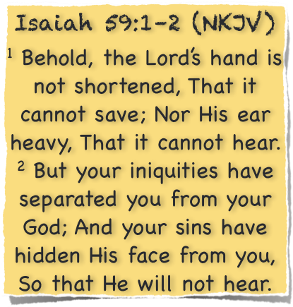
The alien sinner - Eph 2:12; Col 1:21
The hypocrite - Mat 23:25-28
The apostate - Luke 15:24; Gal 5:1-4; Heb 10:26-32
The child of God who is inactive, apathetic - Jam 4:17; Rev 3:1,16,19

Slide 11
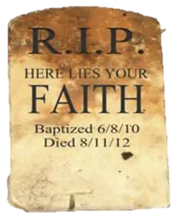

Slide 12
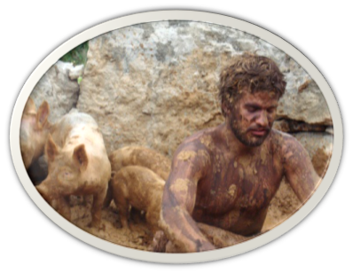
When Bible study doesn’t interest you - 2 Tim 2:15; Acts 17:11,12
Worldly things attract you - James 4:4; 1 Jn 2:15-17
Frequently absent from services - Heb 10:24,25
Inactive in worship/work of the church - Ephesians 4:16; 1 Cor 12:12-28

Slide 13
Romans 6:23 (NKJV)
²³ For the wages of sin is death, but the gift of God is eternal life in Christ Jesus our Lord.
You have a choice “Life or Death” - (Deut 30:19-20; Rom 6:16-19)

Slide 14
Romans 8:1–11 (NKJV)
¹ There is therefore now no condemnation to those who are in Christ Jesus, who do not walk according to the flesh, but according to the Spirit. ² For the law of the Spirit of life in Christ Jesus has made me free from the law of sin and death. … ⁵ For those who live according to the flesh set their minds on the things of the flesh, but those who live according to the Spirit, the things of the Spirit. ⁶ For to be carnally minded is death, but to be spiritually minded is life and peace. …

Slide 15
Romans 8:1–11 (NKJV)
¹⁰ And if Christ is in you, the body is dead because of sin, but the Spirit is life because of righteousness. ¹¹ But if the Spirit of Him who raised Jesus from the dead dwells in you, He who raised Christ from the dead will also give life to your mortal bodies through His Spirit who dwells in you.

Slide 16
National Israel - Ezekiel 37 - ⁷ … there was a noise, and suddenly a rattling; and the bones came together, bone to bone. ⁸ Indeed, as I looked, the sinews and the flesh came upon them, and the skin covered them over; but there was no breath in them. . . . ¹⁰ So I prophesied as He commanded me, and breath came into them, and they lived, and stood upon their feet, an exceedingly great army.

Slide 17
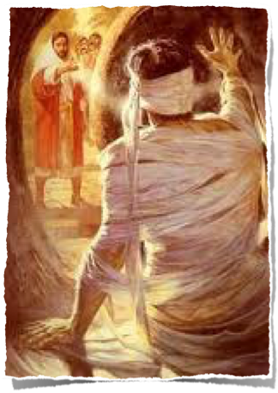
The physical dead brought back to physical life (resuscitated) - Mat 9:24; 11:25; Luke 7:15,22; John 11:14-44
Jesus brought back to life, (resurrected) - Mat 27; Acts 2:29-36; 3:15; 4:10; 13:30,34; 17:31; 26:23; 1 Cor. 15:20-21, 29; Eph 1:20; 1 Pet 1:3,21; Rev 1:18; 2:8

Slide 18
All Men Will Be Raised
Mat 25:31; John 5:28; 1 Cor 15:20-22; Acts 23:6; 24:15,21; 2 Tim 4:1; 1 Pet 4:5; Rev 20:12,13

Slide 19
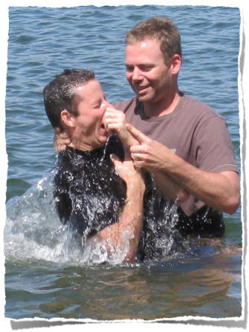
God - Gen 1:27; 2:7; Ac 17:25-27
Jesus - John 14:6; Acts 4:12
Grace - Eph 2:8,9
Faith - John 8:24; Heb 11:6
Repentance - Luke 13:3
Confession - Mat 10:32–33
Baptism - Rom 6:3-6
Faithfulness - Rev 2:10

Slide 20
Romans 6:23 (NKJV)
²³ For the wages of sin is death, but the gift of God is eternal life in Christ Jesus our Lord.
You have a choice “Life or Death” - (Deut 30:19-20; Rom 6:16-19)

Slide 22
Luke 9:60; 1 Tim 5:6; 1 Pet 4:6
Ephesians 2:1-10

Slide 23
The multitudes, the crowds of people Nameless sea of humanity Undone by sin, the walking dead The heart of Jesus longs for these Deceived and loving their deception Plunging deeper into sin They think not that the Lord is watching They feel no need to repent Death approaches yet they mock No fear of God before their eyes But judgment waits beyond this life Before the Christ they have despised As I look into each face Their countenance shows forth no life And my heart breaks, they are so lost And yet they see no need for Christ My heart is deeply stirred within me I can sit no longer idly by As precious souls that Jesus loves Are doomed to the eternal fires So let me be an instrument A vessel for the Masters use A life surrendered to His plans To be used as He would choose Also I heard the voice of the Lord, saying: "Whom shall I send, And who will go for Us?" Then I said, "Here am I! Send me." Isaiah 6:8

Slide 24
Romans 7:7–12 (NKJV)
⁷ What shall we say then? Is the law sin? Certainly not! On the contrary, I would not have known sin except through the law. For I would not have known covetousness unless the law had said, “You shall not covet.” ⁸ But sin, taking opportunity by the commandment, produced in me all manner of evil desire. For apart from the law sin was dead.

Slide 25
Romans 7:7–12 (NKJV)
⁹ I was alive once without the law, but when the commandment came, sin revived and I died. ¹⁰ And the commandment, which was to bring life, I found to bring death. ¹¹ For sin, taking occasion by the commandment, deceived me, and by it killed me. ¹² Therefore the law is holy, and the commandment holy and just and good.

