Slide 1
of All
Comfort

Slide 2
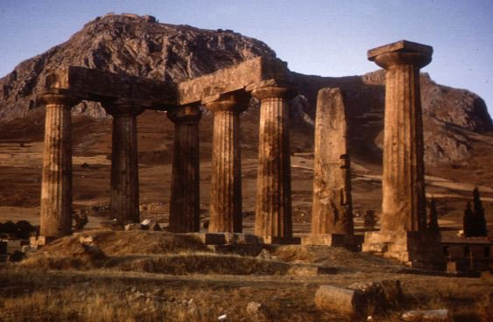
Introduction To The Second Epistle To The Church At Corinth
2 Corinthians 1:1–2 (NKJV)
¹ Paul, an apostle of Jesus Christ by the will of God, and Timothy our brother, To the church of God which is at Corinth, with all the saints who are in all Achaia: ² Grace to you and peace from God our Father and the Lord Jesus Christ.

Slide 3
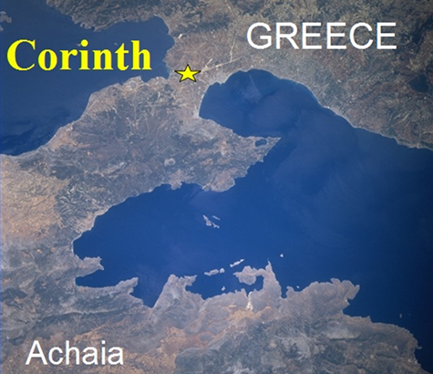
Corinth is located on an isthmus, the typical seaport town of its day.
Homosexuality, prostitution and idolatry all rampant— (likely over 1,000 prostitutes there)
The term "Corinthian," came to represent moral laxity.

Slide 4
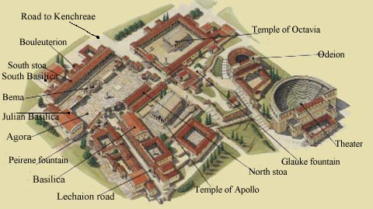
550 BC
Notes:
The “Odeion” was a small roofed theater where plays and various performances were given.
The Bema, or “judgment seat” – Acts 18:12-17 - Paul spent 18 months in the city before the Jews of the city charged him with breaking the law and brought him before Gallio at the city's place of judgment (bema). The mention of Gallio provides an anchor for New Testament chronology as we know from Roman sources that Gallio was proconsul of Achaia from June 51 to May 52. Standing on this platform, the proconsul dismissed the charges against Paul as a dispute of Jewish law and not of a criminal nature.
Temple of Apollo - The seven surviving monolithic Doric columns of the temple of Apollo. The temple is dated around 550 BC. It was built in the same place, where an older temple of Apollo existed in the years of Kypselidae, 100 years before.
Octavia’s Temple: The three surviving columns of the great temple built in memory of Octavia.
Acrocorinth. The Acropolis of Corinth. The summit is 1800 feet above sea level. Many shrines dedicated to female deities were built there, including the famous and wealthy temple of Aphrodite.

Slide 5
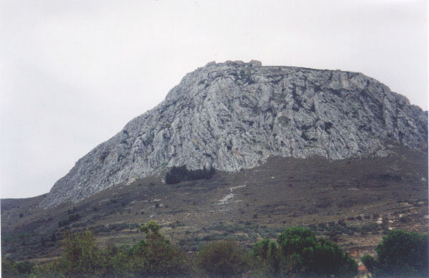
Introduction To The Second Epistle To The Church At Corinth
Acrocorinth. The Acropolis of Corinth.
The summit is 1800 feet above sea level. Many shrines dedicated to female deities were built there, including the famous and wealthy temple of Aphrodite.

Slide 6
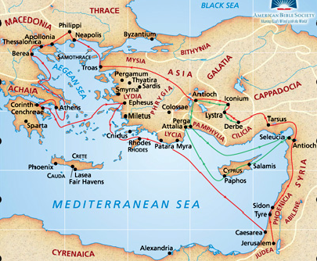
Beginning of the church recorded in Acts 18 on Paul’s Second Missionary Tour, A.D. 49-52
First converts: Crispus and his household specifically mentioned, (Acts 18:8), but likely others were Christians first (Aquila & Priscilla, Justus, (Acts 18:1-7).

Slide 7
Introduction To The Second Epistle To The Church At Corinth
Paul’s First Stay (Acts 18)
Paul spent 18 months in the city before the Jews of the city charged him with breaking the law and brought him before Gallio at the city's place of judgment (bema).
The mention of Gallio provides an anchor for NT chronology as we know from Roman sources that Gallio was proconsul of Achaia from June 51 to May 52.
The proconsul dismissed the charges against Paul as a dispute of Jewish law and not of a criminal nature.

Slide 8
Introduction To The Second Epistle To The Church At Corinth
Paul’s Subsequent Ministry In Corinth
Paul addressed at least three letters to this church.
a. Ante-Corinthians (I Corinthians 5:9)
b. 1 Corinthians (1:1) – (54 or 55 AD)
c. 2 Corinthians (1:1) – (56 or 57 AD)
Paul visited Corinth at least twice after his initial visit.
a. Paul visited on the last leg of the 3rd trip (Acts 20:1–3).
b. Yet, Paul calls this trip “the 3rd time” (II Cor 12:14; 13:1).
Notes:
Paul visited Corinth at least twice after his initial visit.
a. Paul visited on the last leg of the third journey (Acts 20:1–3).
(1) This trip was not according to the original plan which may have been announced in missing “Ante-Corinthians” (II Corinthians 1:15– 16).
(2) This plan would have never been known were it not that Paul was charged with being indecisive and fickle (cf. I Corinthians 16:1–9; Acts 20:1–5).
b. Yet, Paul calls this trip “the third time” (II Corinthians 12:14; 13:1).
(1) It is not possible for II Corinthians to have been written later than during the third journey from Macedonia (Acts 20:2–3; cf. II Corinthians 8–9). Therefore, Paul must have made a trip to Corinth between the visits of 18:1 and 20:2.
(2) In that I Corinthians was written in the last year of Paul’s residence in Ephesus (16:7–8) and Acts 19:10 indicates that he was in the “school of Tyrannus” for two years, it seems most likely that Paul’s journey occurred at the end of that second year and that I Corinthians was written shortly after his return to Ephesus (Acts 19:21ff.).
c. Thus, the “second” trip recorded in Acts 20:1–3 is actually the “third time” of II Corinthians 12:14 and 13:1 (See: A Harmony of the Life of St. Paul by Frank J. Goodwin, pp. 94, 209–210).

Slide 9
Introduction To The Second Epistle To The Church At Corinth
To encourage them in trials
To express joy over the success of his corrective efforts in 1 Corinthians.
To remind the Corinthians of the collection for the poor saints at Jerusalem.
To defend his apostleship.

Slide 10
Introduction To The Second Epistle To The Church At Corinth
New problems hat had developed: Jewish Christians causing turmoil.
They claimed to be apostles & had letters of recommendation — 2 Cor 3:1; 11:5,13.
They had pretended great piety & evidently won a sympathetic following — 2 Cor. 11:20-23
They sought to undermine Paul’s authority. 2 Cor. 10:1-12

Slide 11
Introduction To The Second Epistle To The Church At Corinth
In Chapters 1-7, Paul defended his ministry; Chapters 10-13 defended his authority and apostolic office.
In Chapters 8 and 9, he stirred up the brethren to carry out their intention to send a contribution to the poor saints in Jerusalem.

Slide 12
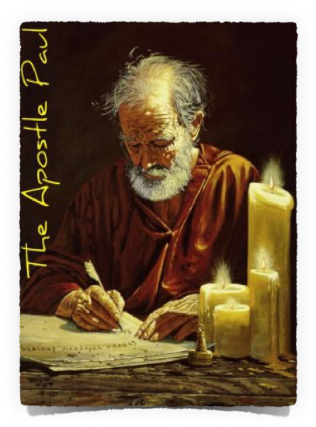
of All
Comfort
One recurring thought throughout the epistle is Paul’s suffering for the gospel—(cf. 1:8-10; 6:4-10; 11:23-27; 12:10)
We need to turn to God, who comforted Paul in His various trials, that we too may be comforted — Ro. 8:17, 18; 2 Th. 1:4–7; 2 Ti. 3:12; Ja. 1:2–4, 12.

Slide 13
of All
Comfort
2 Corinthians 1:3–11 (NKJV)
³ Blessed be the God and Father of our Lord Jesus Christ, the Father of mercies and God of all comfort, ⁴ who comforts us in all our tribulation, that we may be able to comfort those who are in any trouble, with the comfort with which we ourselves are comforted by God.

Slide 14
of All
Comfort
2 Corinthians 1:3–11 (NKJV)
⁵ For as the sufferings of Christ abound in us, so our consolation also abounds through Christ. ⁶ Now if we are afflicted, it is for your consolation and salvation, which is effective for enduring the same sufferings which we also suffer. Or if we are comforted, it is for your consolation and salvation.

Slide 15
of All
Comfort
2 Corinthians 1:3–11 (NKJV)
⁷ And our hope for you is steadfast, because we know that as you are partakers of the sufferings, so also you will partake of the consolation. ⁸ For we do not want you to be ignorant, brethren, of our trouble which came to us in Asia: that we were burdened beyond measure, above strength, so that we despaired even of life.

Slide 16
of All
Comfort
2 Corinthians 1:3–11 (NKJV)
⁹ Yes, we had the sentence of death in ourselves, that we should not trust in ourselves but in God who raises the dead, ¹⁰ who delivered us from so great a death, and does deliver us; in whom we trust that He will still deliver us,

Slide 17
of All
Comfort
2 Corinthians 1:3–11 (NKJV)
¹¹ you also helping together in prayer for us, that thanks may be given by many persons on our behalf for the gift granted to us through many.

Slide 18
of All
Comfort
All face trials, hardships & sufferings - most seek comfort in all the wrong places -
Many turn to alcohol & drugs —
Some turn to bitterness & vengeance.
Some turn to money & possessions — Eccl. 7:12
Some turn to companions, friends — Prov 1:10-28 / Heb 10:24,25; 2 Cor 1:3; 1 Thes 4:18 …

Slide 19
of All
Comfort
God is the ONLY true source of mercy & comfort (1:3; Ps. 86:17; 103:13)
The term comfort means more than “soothing sympathy”— it bestows courage, enabling us to cope with our pain & sufferings, that we may persevere. (Heb 12:12)

Slide 20
of All
Comfort
God comforts us in all our tribulation — (1:4; 1 Cor 10:13; 2 Thes 2:16,17; Heb 13:5)
When we receive God’s comfort, we are better able to comfort others - (the comfort of God is channeled through people (cf. Acts 9:10–19; 2 Cor. 7:6)

Slide 21
of All
Comfort
Our comfort is found in Christ — (1:5,6; Eph 1:3)
His sacrifice, though which we can be reconciled to God — (2 Cor 5:18-21; Eph 2:16)
Avenues through which comfort is dispensed...
The Word of God - cf. Ro 15:4; Titus 1:2; Heb 6:19
Prayer - cf. Php 4:6-7

Slide 22
of All
Comfort
The trouble Paul had in Ephesus and many other places — (1:7-10; Acts 19; 2 Cor 4:7-5:8).
Paul is thankful for the Corinthians prayers for him (see also Rom 15:30-31; Phili 1:9; Col 4:12).

Slide 23
of All
Comfort
Are we in need of God’s comfort?
The harshness of the world?
Guilt & regret for sin?
Suffering for the sake of the Gospel?
Submit to God - trust Him!

Slide 25
of All
Comfort

Slide 26
Psalm 86:11–17 (NKJV)
¹¹ Teach me Your way, O Lord; I will walk in Your truth; Unite my heart to fear Your name. ¹² I will praise You, O Lord my God, with all my heart, And I will glorify Your name forevermore. ¹³ For great is Your mercy toward me, And You have delivered my soul from the depths of Sheol.

Slide 27
Psalm 86:11–17 (NKJV)
¹⁴ O God, the proud have risen against me, And a mob of violent men have sought my life, And have not set You before them. ¹⁵ But You, O Lord, are a God full of compassion, and gracious, Longsuffering and abundant in mercy and truth.

Slide 28
Psalm 86:11–17 (NKJV)
¹⁶ Oh, turn to me, and have mercy on me! Give Your strength to Your servant, And save the son of Your maidservant. ¹⁷ Show me a sign for good, That those who hate me may see it and be ashamed, Because You, Lord, have helped me and comforted me.

