Slide 1
(2 Corinthians 2:12-17)

Slide 2
2 Corinthians 2:12–17 (NKJV)
¹² Furthermore, when I came to Troas to preach Christ’s gospel, and a door was opened to me by the Lord, ¹³ I had no rest in my spirit, because I did not find Titus my brother; but taking my leave of them, I departed for Macedonia. ¹⁴ Now thanks be to God who always leads us in triumph in Christ, and through us diffuses the fragrance of His knowledge in every place.

Slide 3
2 Corinthians 2:12–17 (NKJV)
¹⁵ For we are to God the fragrance of Christ among those who are being saved and among those who are perishing. ¹⁶ To the one we are the aroma of death leading to death, and to the other the aroma of life leading to life. And who is sufficient for these things? ¹⁷ For we are not, as so many, peddling the word of God; but as of sincerity, but as from God, we speak in the sight of God in Christ.

Slide 4
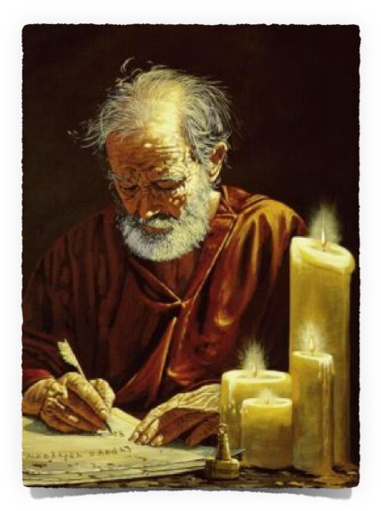
Series of painful experiences:
Afflictions in Asia - 1:8-10
Decision not to visit Corinth - 2:1
The difficult task of writing the letter of rebuke - 2:4
Looking for Titus in Troas - 2:12,13
2 Corinthians 2:12 (NKJV)
¹² Furthermore, when I came to Troas to preach Christ’s gospel, and a door was opened to me by the Lord,

Slide 5
Paul had planned to meet Titus at Troas to be apprised of the Corinthian situation.
Paul visited Troas in his second missionary journey where he was called to Macedonia. (Acts 16:8-11)
The Lord had opened a door (cf. 1 Cor. 16:9; Col. 4:3), [i.e, circumstances were favorable for preaching Christ), but he was hindered. The opportunity would present itself again later - (Acts 20:4-12; 2 Tim 4:13)
2 Corinthians 2:12 (NKJV)
¹² Furthermore, when I came to Troas to preach Christ’s gospel, and a door was opened to me by the Lord,

Slide 6
In addition to his apprehension about the church in Corinth, Paul was now also concerned about Titus’ safety.
Paul had no peace of mind (anesin tō pneumati, lit., “relief in spirit”; anesin is also used in 7:5 and 8:13).
Pressed with his need to find Titus, the great potential for ministry in Troas had to wait, (cf. 7:5–6) Paul said good-by and pushed on to Macedonia.
2 Corinthians 2:13 (NKJV)
¹³ I had no rest in my spirit, because I did not find Titus my brother; but taking my leave of them, I departed for Macedonia.

Slide 7
At this juncture Paul broke off his narrative to the Corinthians, not to resume it until 7:5. (Cf. “Macedonia” in 2:13 and 7:5.) But this transition is fitting.
Even when troubled - there was much to be thankful to God for -
Paul uses a term associated with the Roman triumphant parades
The gospel brings victory - even in the midst of “apparent defeat.” - cf - 1 Cor 4:9-13; 2 Cor 4:7-5:8; 11:22-33
2 Corinthians 2:14 (NKJV)
¹⁴ Now thanks be to God who always leads us in triumph in Christ, and through us diffuses the fragrance of His knowledge in every place.

Slide 8
In a Roman triumph processional incense was burned. Paul compared this to the knowledge of Christ, which like a fragrance was diffused everywhere throughout the world via the preaching of the gospel.
Not twenty-five years after the Crucifixion, the gospel had been very widely preached in Asia and Europe (Romans 15:18, 19; Col. 1:5; 23).
2 Corinthians 2:14 (NKJV)
¹⁴ Now thanks be to God who always leads us in triumph in Christ, and through us diffuses the fragrance of His knowledge in every place.

Slide 9
In the Septuagint the term “aroma” (euōdia) was used of Old Testament sacrifices (Gen. 8:21; Ex. 29:18; Lev. 1:9; Num. 15:3). Paul’s life was a sacrificial offering (Rom. 12:1), well-pleasing to God.
The course of his life in proclaiming God’s message while at the same time suffering rejection and attack by many was an extension of Jesus’ life as the Servant of God (cf. Col. 1:24).
2 Corinthians 2:15 (NKJV)
¹⁵ For we are to God the fragrance of Christ among those who are being saved and among those who are perishing.

Slide 10
To those who rejected the gospel and disbelieved the message of Christ crucified and raised, Paul was like the stench of death in their nostrils (Acts 17:32).
But to those who believe, their salvation leads on to glorification (cf. 2 Cor. 4:17; Rom. 8:18, 30).
2 Corinthians 2:15 (NKJV)
¹⁵ For we are to God the fragrance of Christ among those who are being saved and among those who are perishing.

Slide 11
There are winners & losers in battle - the triumphant parade. with its sweet aroma to the victors, meant doom for the losers. - Lu. 2:34; Jno 9:39; Ac. 13:45–47; 1 Pet. 2:7,8.
The gospel is divisive - Mat 10:34,35; Lu. 12:49–53. Jno. 7:40–52. Ac. 13:45–50; 14:2, 4.
Who is equal to such a task? He answered this question later (2 Cor. 3:5–6)
2 Corinthians 2:16 (NKJV)
¹⁶ To the one we are the aroma of death leading to death, and to the other the aroma of life leading to life. And who is sufficient for these things?

Slide 12
The ministry of the many false apostles was a matter of self-interest. - (cf. 2 Peter 2:1).
They served themselves, not God whom Paul represented. They were “greedy for money” (1 Peter 5:2), an evidence of their falsehood.
Their methods and their teaching are constantly alluded to in these Epistles (1 Cor1:17, 31; 2:1-4; 2 Cor 10:12, 15; 11:13-15, etc.),
2 Corinthians 2:17 (NKJV)
¹⁷ For we are not, as so many, peddling the word of God; but as of sincerity, but as from God, we speak in the sight of God in Christ.

Slide 13
Paul spoke from the sincerity of his heart (2 Cor 1:12; 4:2; Ac. 20:20, 27; Heb. 11:27) and by the inspiration of God (1 Cor 14:25).
The whole Gospel must be delivered such as it is, without concession to men's corruptions, and without selfish aims, if it is to be blessed with success (Ac 20:27; Gal. 1:6-10).
2 Corinthians 2:17 (NKJV)
¹⁷ For we are not, as so many, peddling the word of God; but as of sincerity, but as from God, we speak in the sight of God in Christ.

Slide 14
What of our love for one another?
Despite apparent defeats, and difficult struggles with evil - do we see ourselves as victors in Christ?
Are our lives a sweet smelling aroma before God?
Are we sincere servants of God - holding steadfastly to His word?

Slide 16
(2 Corinthians 2:12-17)

Slide 17
Matthew 10:32–42 (NKJV)
³² “Therefore whoever confesses Me before men, him I will also confess before My Father who is in heaven. ³³ But whoever denies Me before men, him I will also deny before My Father who is in heaven. ³⁴ “Do not think that I came to bring peace on earth. I did not come to bring peace but a sword. ³⁵ For I have come to ‘set a man against his father, a daughter against her mother, and a daughter-in-law against her mother-in-law’;

Slide 18
Matthew 10:32–42 (NKJV)
³⁶ and ‘a man’s enemies will be those of his own household.’ ³⁷ He who loves father or mother more than Me is not worthy of Me. And he who loves son or daughter more than Me is not worthy of Me. ³⁸ And he who does not take his cross and follow after Me is not worthy of Me. ³⁹ He who finds his life will lose it, and he who loses his life for My sake will find it.

Slide 19
Matthew 10:32–42 (NKJV)
⁴⁰ “He who receives you receives Me, and he who receives Me receives Him who sent Me. ⁴¹ He who receives a prophet in the name of a prophet shall receive a prophet’s reward. And he who receives a righteous man in the name of a righteous man shall receive a righteous man’s reward. ⁴² And whoever gives one of these little ones only a cup of cold water in the name of a disciple, assuredly, I say to you, he shall by no means lose his reward.”

