Slide 1
65th St church of Christ
January 10, 2016

Slide 2
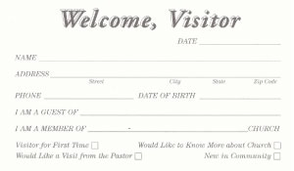
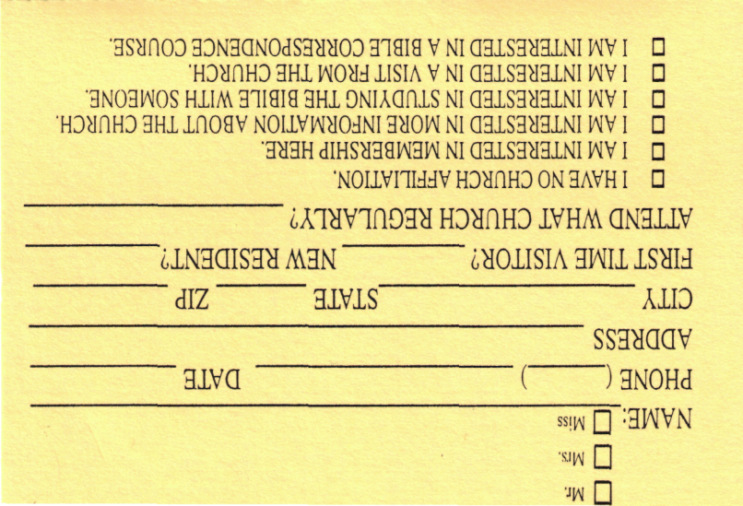
Welcome
VISITORS…
Please complete a visitor’s card and give it to one of the members . . . then stick around after services and let us get to know you!

Slide 3
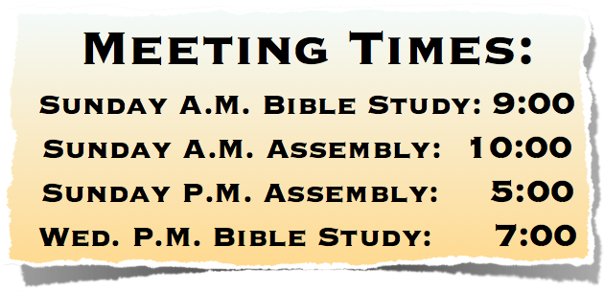
Welcome
65th St church of Christ
You Are Welcome At Any And All of Our Services!
Notes:
You Are Welcome At Any And All of Our Services!

Slide 4
Welcome
Updated: December 24, 2015
Polly Geren - Presb. Village—510 N. Brookside Dr. LR AR 72205-
Debbie Stephens—Please keep Debbie in your prayers—Debbie has also requested prayers for her mother—501-562-7391
Fayetta Biggers—Needs our prayers, encouragement, and assistance!—She has been placed under in home hospice care—(562-0130)
Ruby Bishop—needs our prayers 225-2972—
Lillian & Parker Allen—Needs your continued prayers —501-562-6009
James Allen—(Son of Mary Beatrice Allen) —551-8131
Billy Huckaby—continue to need our prayers, encouragement & assistance.—501-554-3440

Slide 5
Welcome
Call In Your Questions & Comments! 1-855-568-1062

Slide 6
John 6:22–29 (NKJV)
²² On the following day, when the people who were standing on the other side of the sea saw that there was no other boat there, except that one which His disciples had entered, and that Jesus had not entered the boat with His disciples, but His disciples had gone away alone—

Slide 7
John 6:22–29 (NKJV)
²³ however, other boats came from Tiberias, near the place where they ate bread after the Lord had given thanks—²⁴ when the people therefore saw that Jesus was not there, nor His disciples, they also got into boats and came to Capernaum, seeking Jesus.

Slide 8
John 6:22–29 (NKJV)
²⁵ And when they found Him on the other side of the sea, they said to Him, “Rabbi, when did You come here?” ²⁶ Jesus answered them and said, “Most assuredly, I say to you, you seek Me, not because you saw the signs, but because you ate of the loaves and were filled.

Slide 9
John 6:22–29 (NKJV)
²⁷ Do not labor for the food which perishes, but for the food which endures to everlasting life, which the Son of Man will give you, because God the Father has set His seal on Him.” ²⁸ Then they said to Him, “What shall we do, that we may work the works of God?” ²⁹ Jesus answered and said to them, “This is the work of God, that you believe in Him whom He sent.”

Slide 10
Don McClain
West 65th St church of Christ / September 9, 2007

Slide 11
“Church Social Meals?”
Is there positive Divine Authority For The Local Church To Provide Social & Recreational Activities For Its Members?
Notes:
Take a break. Break some bread with a friend. Watch the big-screen TV, or watch what's going on in the PVFLC Gym. And watch your weight at the same time.
As well as your budget. A little coffee break won't break your bank, or cost you too much bread here.
And you can chat with Sandy or Celese about catering an event - or a recurring meeting - in the PV facility.
Open Monday - Friday
Breakfast 7:00am-10:00am
Lunch 11:00am - 2:00pm
(Payment by Cash or Check Only Credit / Debit Coming Soon)
Schedule of Activities Daily events in the Gym, track, training areas
Aerobic Class Schedule Teacher-led aerobics lessons; some for seniors, some with childcare available
Policies, Procedures
FLC Manager Barry Marshall
SUNDAYS
UPWARD Basketball Practice, 1:00-4:30 pm (Gym )
Men’s Ministry, 6:00-10:00pm (Gym)
MONDAYS
Men’s Basketball, 6:00-7:00am (Gym)
Step Aerobics Class, 8:45-9:45am (Gym)
TUESDAYS
High-Low Impact Aerobics, 8:05-9:05am (Gym)
Stretch/Tone Aerobics Class for Seniors, 12:15-12:45pm (Gym)
Open Gym 10:00am-2:00pm
Body Sculpting Aerobics Class, 5:30-6:15pm (Gym - Childcare)
WEDNESDAYS
Men’s Basketball, 6:00 -7:00am (Gym)
Pilates Class , 8:45-9:45 am (Gym - beginning April 5 )
GYM CLOSED, 3:00-5:00pm, (Gym-floor cleaning)
Senior Ladies Basketball, 5:00-6:00pm (Gym)
THURSDAYS
Step Aerobics, 8:45-9:45am (Gym)
Open Gym 10:00am-2:00pm
Stretch/Tone Aerobics Class for Seniors, 12:15-12:45 pm (Gym)
Body Sculpting Aerobics Class, 5:30-6:15 pm (Gym - Childcare)
UPWARD Cheerleaders 6:30pm-8:30pm (E-Wing)
UPWARD Basketball Practice, 6:30-8:30pm (Gym)
PV Singles/College Basketball, 8:30-10:00pm (Gym)
FRIDAYS
Men’s Basketball, 6:00-7:00 am (Gym)
Volleyball, 7:00-10:00pm (Gym)
SATURDAYS
UPWARD Basketball Games, 8:00am-2:00 pm (Gym, Rms. 117, 118, 119, 120 )
Track and Training Room Hours:
6:00 am– 8:30 pm Mon., Tue., Thu.; 6:00 am–5:00 pm Wed., Fri.

Slide 12
“Church Social Meals?”
What The Issue Is NOT!
It is not water coolers
It is not rest rooms, sinks or refrigerators
It is not the brethren socializing in the foyer
It is not the preacher eating his lunch in the meetinghouse
IT IS NOT EATING IN THE BUILDING!

Slide 13
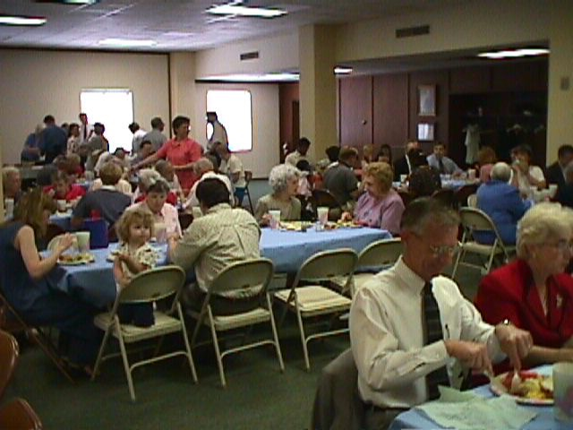
“Church Social Meals?”
What is the Issue?
Whether or not the local church may provide, oversee and pay for the Social & recreational activities of of the church!
http://www.pvcc.org

Slide 14
“Church Social Meals?”
What is the Issue?
Incidental Matters While At Building | Planned & Sponsored By the Church
Talk about politics | Political rally
Sell/deliver a sold item | Church in business
Seek medical advice | Church hospital / clinic
Eating on property | Church kitchen / dinner

Slide 15
“Church Social Meals?”
Can The CHURCH Provide … ?
“Fellowship” Halls
Family Life Centers
“Multipurpose” Rooms
Gymnasiums
Game & Party Rooms
Ball Teams
Scout Troops
Etc. …

Slide 16
“Church Social Meals?”
The Work of the Church … ?
Evangelism - Mark 16:15
Edification - Ephesians 4:12
Benevolence - Acts 6:3
Is not the work of Evangelism
Is Not the work of Edification
Is Not the work of Benevolence

Slide 17
“Church Social Meals?”
Where Did God Authorize Them?
Is there …
To authorize the church to arrange / support a common meal for social and recreational purposes.
Command/ Direct Statement
Approved Example
Necessary Inference
If There Is, Where Is The Passage?

Slide 18
“Church Social Meals?”
1 Corinthians 11:17-34 (NKJV) ¹⁷ Now in giving these instructions I do not praise you, since you come together not for the better but for the worse. ¹⁸ For first of all, when you come together as a church, I hear that there are divisions among you, and in part I believe it. ¹⁹ For there must also be factions among you, that those who are approved may be recognized among you. ²⁰ Therefore when you come together in one place, it is not to eat the Lord's Supper

Slide 19
“Church Social Meals?”
1 Corinthians 11:17-34 (NKJV) ²¹ For in eating, each one takes his own supper ahead of others; and one is hungry and another is drunk. ²² What! Do you not have houses to eat and drink in? Or do you despise the church of God and shame those who have nothing? What shall I say to you? Shall I praise you in this? I do not praise you. ²³ For I received from the Lord that which I also delivered to you: that the Lord Jesus on the same night in which He was betrayed took bread;

Slide 20
“Church Social Meals?”
1 Corinthians 11:17-34 (NKJV) ²⁴ and when He had given thanks, He broke it and said, "Take, eat; this is My body which is broken for you; do this in remembrance of Me.“ ²⁵ In the same manner He also took the cup after supper, saying, "This cup is the new covenant in My blood. This do, as often as you drink it, in remembrance of Me." ²⁶ For as often as you eat this bread and drink this cup, you proclaim the Lord's death till He comes.

Slide 21
“Church Social Meals?”
1 Corinthians 11:17-34 (NKJV) ²⁷ Therefore whoever eats this bread or drinks this cup of the Lord in an unworthy manner will be guilty of the body and blood of the Lord. ²⁸ But let a man examine himself, and so let him eat of the bread and drink of the cup. ²⁹ For he who eats and drinks in an unworthy manner eats and drinks judgment to himself, not discerning the Lord's body. ³⁰ For this reason many are weak and sick among you, and many sleep.

Slide 22
“Church Social Meals?”
1 Corinthians 11:17-34 (NKJV) ³¹ For if we would judge ourselves, we would not be judged. ³² But when we are judged, we are chastened by the Lord, that we may not be condemned with the world. ³³ Therefore, my brethren, when you come together to eat, wait for one another. ³⁴ But if anyone is hungry, let him eat at home, lest you come together for judgment. And the rest I will set in order when I come.

Slide 23
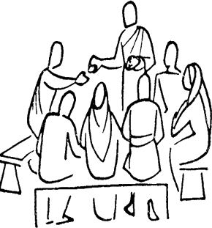
“Church Social Meals?”
1 Corinthians 11:20-34
What was being abused?
The Assembly (vs. 17)
“come together ... for the worse”
“come together in the church”
“come together into one place”
The Lord’s Supper (vs. 20)
“to eat the Lord’s Supper”
“This is my body”
“This cup is ...my blood”
The Poor Brethren (vs. 21)
“divisions among you”
“shame them that have not”

Slide 24
“Church Social Meals?”
1 Corinthians 11:20-34
What does Paul correct?
The Assembly (vs. 22)
Their assembling together for the worse
If hungry eat at home
The Lord’s Supper (vs. 23)
“This do ...”
“In remembrance ...”
The Brethren (vs. 28)
“Let a man examine himself ...”
“If we would judge ourselves ...”

Slide 25
“Church Social Meals?”
1 Corinthians 11:20-34
What does Paul Rebuke?
Their meal was congregational but not for the better but worse - (1 Cor. 11:17,22).
Their meal was a common meal not the Lord’s supper - (1 Cor. 11:21,22,34).
Their meal was for social purposes which was causing division - (1 Cor. 11:18,22,33).
Notes:
(1) Their meal was congregational (1 Cor. 11:17,22).
(a) This was something they did in their assembled church capacity. This was a “church” function. It was “church” work.
(b) Brethren miss the point and say that what was wrong here was the co-opting of the Lord’s Supper. However, Paul’s solution does not simply restore the Lord’s Supper, it eliminates the congregational meal.
(2) Their meal was a common meal (1 Cor. 11:21,22,34).
(a) It had as a part of its design the mere satisfaction of hunger (11:21,34).
(b) While the church may certainly feed the hungry (Acts 6:1-6), in the context of Paul’s instruction to the Corinthians, such a meal has no spiritual function in the regular assembling of the saints together. It does not serve the ends or designs of the assembling of the saints (Heb. 10:25-26).
(3) Their meal was for social purposes (1 Cor. 11:18,22,33).
(a) That the brethren at Corinth used this meal for socializing is easily established by the process of elimination.
(b) It was not for benevolent purposes. Such meals are authorized in the New Testament and are an acceptable part of the church’s work if necessary (Acts 6:1- 6). Paul would not be condemning what he himself will later authorize in this same letter (1 Cor. 16:1-4). Furthermore, the ones that were doing the eating were not the ones in need (1 Cor. 11:22).
(b) It was not for spiritual purposes. The only congregational meal of which we read that has any spiritual purpose is the Lord’s Supper. Paul clearly says that what they were eating was not the Lord’s Supper (1 Cor. 11: 20).
(c) These meals were not just ordinary meals for hunger in order to expedite worship (cf. Acts 20:11). Had they been Paul would not have condemned them and none would have gone hungry (1 Cor. 11:21).
(d) No, these meals were socializing events in which a clique within the church met and excluded others in the church from the meals (1 Cor. 11:33,34).

Slide 26
“Church Social Meals?”
1 Corinthians 11:20-34
What does Paul Command?
On the Assembly (vs. 33)
All Come together into one place
For the “better”
On the Lord’s Supper (vs. 23)
As “I delivered unto you”
“Show the Lord’s death”
“Discerning the Lord’s body”
On The Brethren (vs. 33)
Shame not ...
“Tarry one for another”
On Common Meals (vs. 22,34)
Do you not have houses to eat & drink in? ...
“If anyone is hungry, let him eat at home
Notes:
(3) What does Paul command?
(a) Paul commands that they assemble only for that which is authorized (vs. 33).
(1) Paul makes a distinction between the work of the church and the work of the home. He does not condemn their social activities except as they are made a function of the church.
(2) We recognize that there are things which are morally right but religiously wrong. Eating and socializing are not sinful; however, they are not the work of the local church.
(b) Paul commands that they observe the Lord’s Supper just as Christ delivered it (vs. 23).
(1) There is no arguing that Paul allowed the “agape” as it is called in later Christian literature as a part of the Lord’s Supper. Paul specifies the elements, the design and the order which are to be followed.
(2) Note that Paul restores what he had delivered once before. Indicating that there is no modification or tradition that is to supplant what is delivered (cf. 1 Cor. 4:6; 2 Thess. 3:6).
(c) Paul commands that the brethren remember who they are (vs. 33).
(1) Paul uses the phrase “tarry one for another” (vs. 33). The phrase “one another” occurs over 100 times in the New Testament designating nearly fifty responsibilities which brethren have to each other. The phrase signifies reciprocity and mutual care.
(2) Paul solves the abuses at Corinth with a strong reminder that they must remember that they are members of one another (cf. 12:25-27). And as members of one another they must have the same care for each other. This will eliminate all schism in the body.

Slide 27
“Church Social Meals?”
Where Did God Authorize Them?
A Difference In The
Individual & The Church
1 Timothy 5:16 (NKJV)
16 If any believing man or woman has widows, let them relieve them, and do not let the church be burdened, that it may relieve those who are really widows.
Don McClain
West 65th St church of Christ / September 9, 2007

Slide 28
“Church Social Meals?”
An Expedient To Edification?
Expediency in human wisdom involves the right of choice within the realm of those things included in what God has authorized –
Is not the work of Evangelism
Is Not the work of Edification
Is Not the work of Benevolence

Slide 29
“Church Social Meals?”
An Expedient To Edification?
General
Authority
A
L
L
T
H
E
F
A
C
T
S
(Allows for expediencies within things authorized)
Statements
Examples
Implications
Specific
Authority
(Includes only what is specified)
2 Cor 5:7; 2 Tim 1:13

Slide 30
“Church Social Meals?”
An Expedient To Edification?
For Noah’s Ark
A
L
L
T
H
E
F
A
C
T
S
“Make yourself an ark of gopher wood...” (Gen 6:14)
Statements
Examples
Implications
“450’ long, 75’ wide, 45’ tall ...” (Gen. 6:15)
“. . . a window . . . And set a door . . . With lower, 2nd and 3rd decks” (Gen. 6:16)
2 Cor 5:7; 2 Tim 1:13

Slide 31
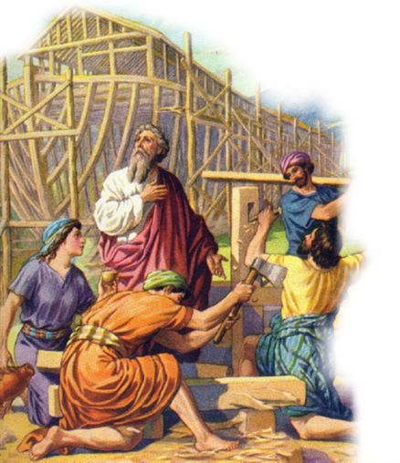
“Church Social Meals?”
An Expedient To Edification?
For Noah’s Ark
Expedients: Tools & Size of material dependent upon specific need
Liberty: Source and means of transporting materials
General Authority
Specific Authority
Gopher wood; Compartments (14); 450’ Long; 75’ Wide; 45’ Tall (15); 1 Window & Door; 3 Stories (16)
2 Cor 5:7; 2 Tim 1:13

Slide 32
“Church Social Meals?”
An Expedient To Edification?
For assembling To Worship
A
L
L
T
H
E
F
A
C
T
S
“Not forsaking the assembling of ourselves together ... (Heb. 10:25)
Statements
Examples
Implications
“With one accord in the temple ...” (Acts 2:46)
“When ye come together into one place…” (1 Cor. 11:18,20;14:8,9)
2 Cor 5:7; 2 Tim 1:13
Don McClain
West 65th St church of Christ / September 9, 2007

Slide 33
“Church Social Meals?”
An Expedient To Edification?
For assembling To Worship
Meetinghouse, pews, lights, HVAC, water fountain, rest rooms, chairs, pulpit, lectern, parking lot, morning or evening, Wednesday or Thursday ...
General Authority
Specific Authority
An assembly of the church in which some or all acts of worship occur ... Praying, Singing, Communing, Giving, Studying, unto edification.
2 Cor 5:7; 2 Tim 1:13
Don McClain
West 65th St church of Christ / September 9, 2007

Slide 34
“Church Social Meals?”
An Expedient To Edification?
Aids & Additions
Authorized | Essential | Aids | Not Authorized | Additions
Sing- (Eph. 5:19) | Song | Book | Play | Piano
Immerse (Acts 8:38) | Much Water | Baptistry | Sprinkle | Font
Assemble (Heb. 10:25) | Place | Meeting House | Social Meals | “Annex”
Don McClain
West 65th St church of Christ / September 9, 2007

Slide 35
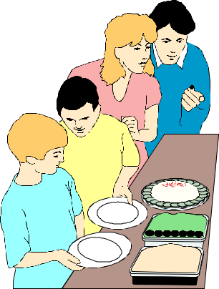
“Church Social Meals?”
An Expedient To Edification?
The Local Church Can Make Provision For:
Assembling
To Worship?
Church Sponsored Recreation?
Authorized?
Specified?
Approved Examples?
Directly Aides?
Forbidden?
Don McClain

Slide 36
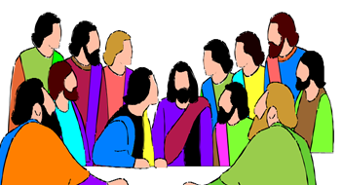
“Church Social Meals?”
Arguments Answered …
L.S. Established During Passover - (Lk. 22:20)
Jesus Fed People – (John 6:5-14)
The Church Met In Homes – (Acts 12:12; 16:40; 18:7)
The Love Feast – (Jude 12)
Was the Passover a social meal? (Exo. 13:14-16)
The Passover no part of the Supper (Lk. 22:20).
The practice is condemned by Paul (1 Cor. 11:22,34).
Notes:
Was the Passover a social meal? (Exo. 13:14-16)
The Passover no part of the Supper (Lk. 22:20).
The practice is condemned by Paul (1 Cor. 11:22,34).

Slide 37
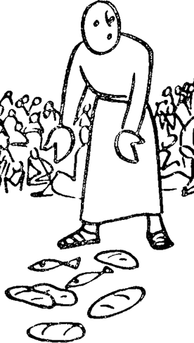
“Church Social Meals?”
Arguments Answered …
L.S. Established During Passover - (Lk. 22:20)
Jesus Fed People – (John 6:5-14)
The Church Met In Homes – (Acts 12:12; 16:40; 18:7)
The Love Feast – (Jude 12)
Jesus fed the multitudes. (Mt. 16:9; Mt. 15:32,33)
Jesus STOPPED & would not feed the bread seekers - (Jn. 6:26,27).
Notes:
Jesus fed the multitudes.
a miracle (Mt. 16:9)
in the wilderness (Mt. 15:33)
act of compassion (Mt. 15:32)
Jesus would not feed the bread seekers (Jn. 6:26,27).
Came not for the miracle
Came to be fed
Is your practice the same as Jesus’ practice?
Expedient

Slide 38
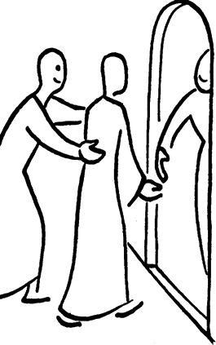
“Church Social Meals?”
Arguments Answered …
L.S. Established During Passover - (Lk. 22:20)
Jesus Fed People – (John 6:5-14)
The Church Met In Homes – (Acts 12:12; 16:40; 18:7)
The Love Feast – (Jude 12)
Churches met in houses. – (Acts 12:12; 16:40; 18:7; Rom 16:23)
Saints ate in those houses. – (Acts 11:3; 16:15; Phile 2,22)
Does that authorize a Church meal for social purposes?
Notes:
Churches met in houses.
Acts 12:12
Acts 16:40
Acts 18:7
Romans 16:23
Saints ate in those houses.
Acts 11:3
Acts 16:15
Philemon 2,22
Does that authorize a Church meal for social purposes?

Slide 39
“Church Social Meals?”
Arguments Answered …
L.S. Established During Passover - (Lk. 22:20)
Jesus Fed People – (John 6:5-14)
The Church Met In Homes – (Acts 12:12; 16:40; 18:7)
The Love Feast – (Jude 12)
A common meal?
Addressed to a church?
The Lord authorized what was being done?
The conduct of the participants approved?
Compare with 1 Cor 11:17-34; 2 Peter 2
Notes:
Apostate participants
Ungodly men (Jude 4)
False teachers (2 Pt. 2:1)
Denying Jesus (Jude 4)
Lascivious behavior
Spiteful (Jude 8)
Irreverent (Jude 12)
Shameful (Jude 13)
Riotous (2 Pt. 2:13)

Slide 40
“Church Social Meals?”
Arguments Answered …
L.S. Established During Passover - (Lk. 22:20)
Jesus Fed People – (John 6:5-14)
The Church Met In Homes – (Acts 12:12; 16:40; 18:7)
The Love Feast – (Jude 12)
None of These Provide Biblical Authority For Local Churches to Facilitate, Pay For, or Even Plan For The Recreational Activities” of Their Members!
Notes:
Was the Passover a social meal? (Exo. 13:14-16)
The Passover no part of the Supper (Lk. 22:20).
The practice is condemned by Paul (1 Cor. 11:22,34).

Slide 41
“Church Social Meals?”
The Church limited on relieving widows
How Then Could The Lords Money Be Spent On A Place To Eat and Have Fun????
1 Timothy 5:9-11 (NKJV)
9 Do not let a widow under sixty years old be taken into the number, and not unless she has been the wife of one man, 10 well reported for good works: if she has brought up children, if she has lodged strangers, if she has washed the saints' feet, if she has relieved the afflicted, if she has diligently followed every good work. 11 But refuse the younger widows; for when they have begun to grow wanton against Christ, they desire to marry,

Slide 42
“Church Social Meals?”
What is the Issue?
The Church Is Not A Social Order | The Gospel Is Not A Social Gospel
Rom. 14:17 | John 6:26-27
John 18:36 | Rom. 1:16-17
1 Pet. 2:5 | 1 Cor. 1:18, 21; 2:2-5

Slide 43
“Church Social Meals?”
The scriptures do not authorize “The local church” to sponsor social meals & recreational activities.
If we are using the Lord’s body & money for things He has not authorized - are we abiding in His will?

Slide 44
Don McClain
West 65th St church of Christ / September 9, 2007

Slide 45
“Church Social Meals?”
Charts by Don McClain
Prepared January 10, 2016 - Preached - January 10, 2016
West 65th St church of Christ / P.O. Box 190062 / Little Rock AR 72219
501-568-1062
Prepared using Keynote
Email – donmcclain@sbcglobal.net
More Keynote, PPT & Audio Sermons:
http://w65stchurchofchrist.org/coc/sermons/

Slide 46
John 6:22–29 (NKJV)
²² On the following day, when the people who were standing on the other side of the sea saw that there was no other boat there, except that one which His disciples had entered, and that Jesus had not entered the boat with His disciples, but His disciples had gone away alone—

Slide 47
John 6:22–29 (NKJV)
²³ however, other boats came from Tiberias, near the place where they ate bread after the Lord had given thanks—²⁴ when the people therefore saw that Jesus was not there, nor His disciples, they also got into boats and came to Capernaum, seeking Jesus.

Slide 48
John 6:22–29 (NKJV)
²⁵ And when they found Him on the other side of the sea, they said to Him, “Rabbi, when did You come here?” ²⁶ Jesus answered them and said, “Most assuredly, I say to you, you seek Me, not because you saw the signs, but because you ate of the loaves and were filled.

Slide 49
John 6:22–29 (NKJV)
²⁷ Do not labor for the food which perishes, but for the food which endures to everlasting life, which the Son of Man will give you, because God the Father has set His seal on Him.” ²⁸ Then they said to Him, “What shall we do, that we may work the works of God?” ²⁹ Jesus answered and said to them, “This is the work of God, that you believe in Him whom He sent.”

