Slide 1
A Defense of Biblical Eschatology - (1 Cor 15:50-58)
What Are The Signs of The End?
Does The Bible Speak of A Coming Seven Year Tribulation?

Slide 2
A millennial?
Pre millennial?
Post millennial?

Slide 3
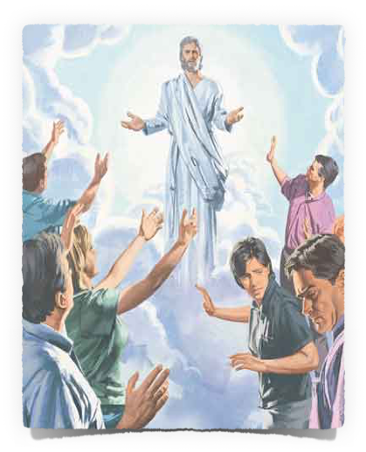
With noise – shout, voice of the archangel & the trumpet of God - 1 Thess. 4:16
With His holy angels - Matt. 25:31; 2 Thess. 1:7-8
Suddenly and unexpected - 1 Thess. 5:1-4; 2 Pet. 3:10; Rev. 22:20
Visibly - Acts 1:9-11; Rev. 1:7 “and every eye will see Him” -

Slide 4
The Day of the Lord Will Come
Matthew 24:36-39 (NKJV)
³⁶ "But of that day and hour no one knows, not even the angels of heaven, but My Father only. ³⁷ But as the days of Noah were, so also will the coming of the Son of Man be. ³⁸ For as in the days before the flood, they were eating and drinking, marrying and giving in marriage, until the day that Noah entered the ark, 39 and did not know until the flood came and took them all away, so also will the coming of the Son of Man be.

Slide 5
The Day of the Lord Will Come
Mt 24:42,44 — Watch therefore, for you do not know what hour your Lord is coming. 44 Therefore you also be ready, for the Son of Man is coming at an hour you do not expect.
Mt 25:13 — Watch therefore, for you know neither the day nor the hour in which the Son of Man is coming.
Mk 13:32 — "But of that day and hour no one knows, not even the angels in heaven, nor the Son, but only the Father.

Slide 6
The Day of the Lord Will Come
1Th 5:2 — For you yourselves know perfectly that the day of the Lord so comes as a thief in the night.
2Pe 3:10 — But the day of the Lord will come as a thief in the night, . . .
Rev 16:15 — "Behold, I am coming as a thief. Blessed is he who watches, and keeps his garments, lest he walk naked and they see his shame.”

Slide 7
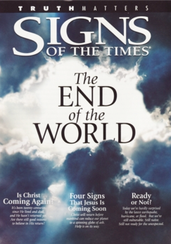
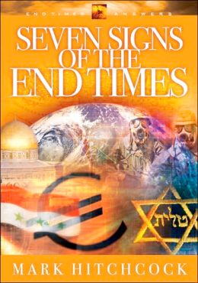
Signs of The

Slide 8
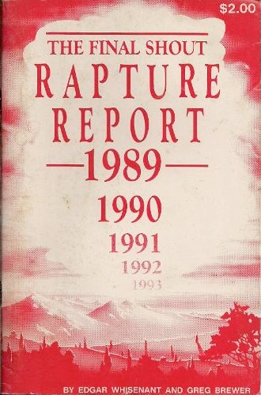
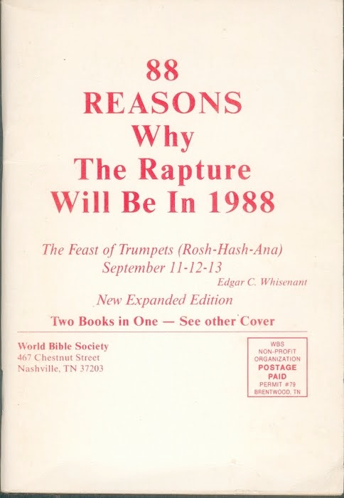
Date Setters - (False Prophets)
Hal Lindsey boldly declared that "The Rapture" would occur before Dec. 31, 1981
Edgar C. Whisenant’s book “88 Reasons Why the Rapture is in 1988" came out only a few months before the event was to take place - Sept 11-13

Slide 9
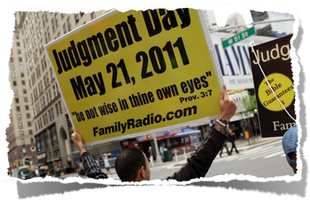
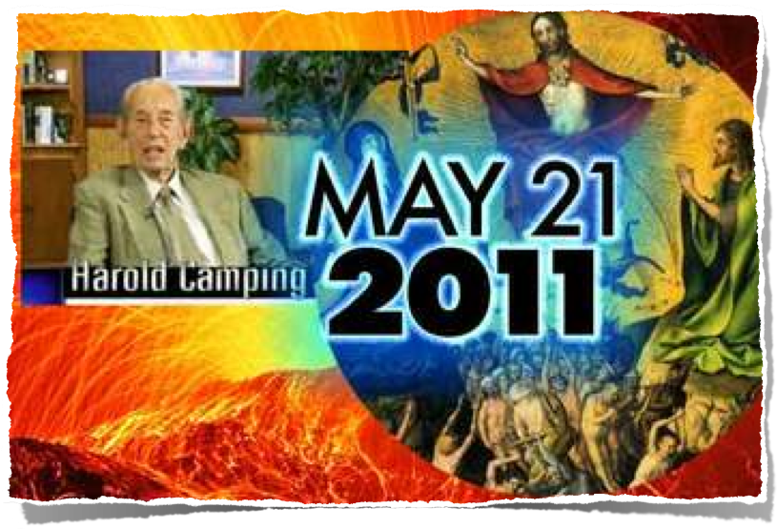
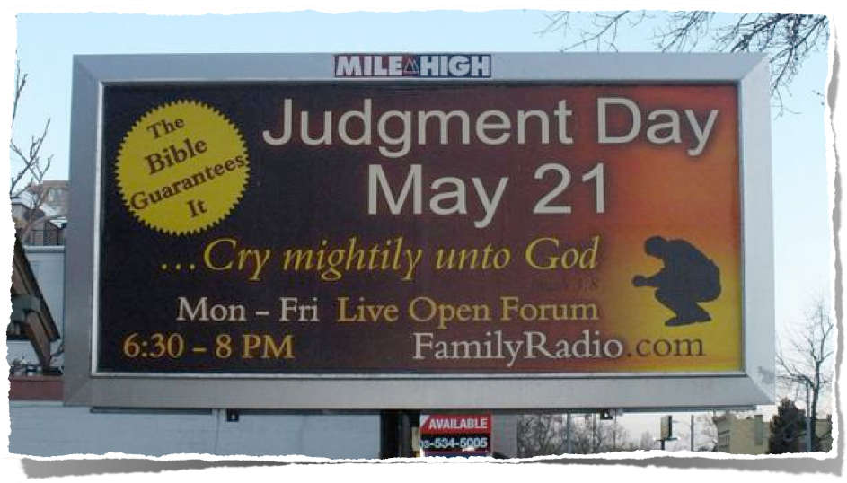
Date Setters - (False Prophets)

Slide 10
Date Setters - (False Prophets)

Slide 11
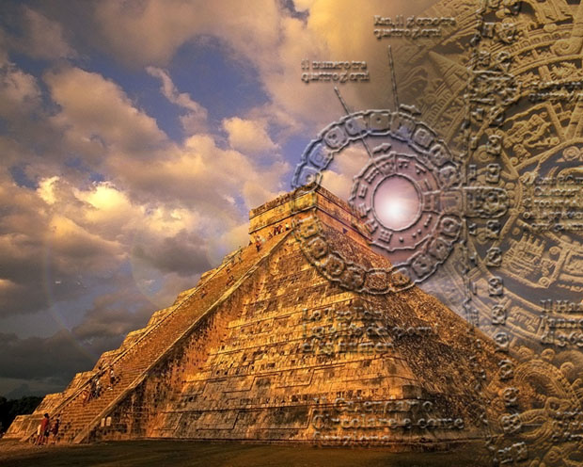
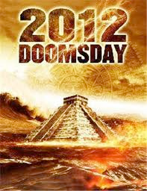
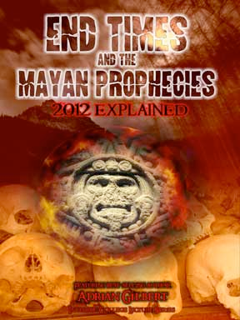
Date Setters - (False Prophets)

Slide 12
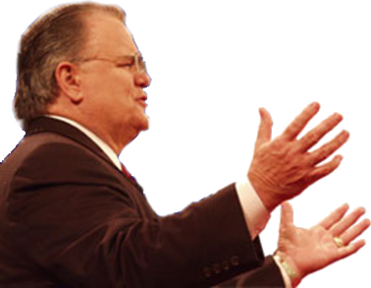
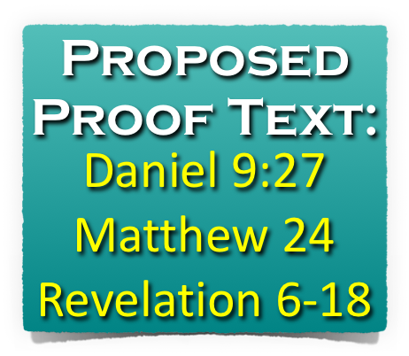
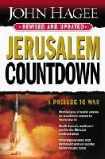

Slide 13
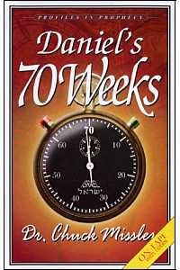
Daniel 9:23-27 (NKJV)
²⁴ "Seventy weeks are determined For your people and for your holy city, To finish the transgression, To make an end of sins, To make reconciliation for iniquity, To bring in everlasting righteousness, To seal up vision and prophecy, And to anoint the Most Holy.

Slide 14
Daniel 9:23-27 (NKJV)
²⁵ "Know therefore and understand, That from the going forth of the command To restore and build Jerusalem Until Messiah the Prince, There shall be seven weeks and sixty-two weeks; The street shall be built again, and the wall, Even in troublesome times.

Slide 15
Daniel 9:23-27 (NKJV)
²⁶ "And after the sixty-two weeks Messiah shall be cut off, but not for Himself; And the people of the prince who is to come Shall destroy the city and the sanctuary. The end of it shall be with a flood, And till the end of the war desolations are determined.

Slide 16
Daniel 9:23-27 (NKJV)
²⁷ Then he shall confirm a covenant with many for one week; But in the middle of the week He shall bring an end to sacrifice and offering. And on the wing of abominations shall be one who makes desolate, Even until the consummation, which is determined, Is poured out on the desolate.“

Slide 18
7 sevens
City rebuilt by 432 BC
Covenant confirmed
Cut Off
62 sevens
1 seven
69 sevens to Messiah
End to sacrifice & offering - 30 AD /
Abomination of Desolation
70 AD / Fall of Rome – 476 AD
Cyrus’ Proclamation 536 BC. - Ezra 1:1-4; Isaiah 44:28;45:13
Artaxerxes – 457 BC.
Artaxerxes second decree – 444,445 BC.

Slide 19
Matthew 24:15 (NKJV) ¹⁵ "Therefore when you see the 'abomination of desolation,' spoken of by Daniel the prophet, standing in the holy place" (whoever reads, let him understand),
Mark 13:14 (NKJV) ¹⁴ "So when you see the 'abomination of desolation,' spoken of by Daniel the prophet, standing where it ought not" (let the reader understand), "then let those who are in Judea flee to the mountains.
Luke 21:20-22 (NKJV) ²⁰ "But when you see Jerusalem surrounded by armies, then know that its desolation is near. ²¹ Then let those who are in Judea flee to the mountains, let those who are in the midst of her depart, and let not those who are in the country enter her. ²² For these are the days of vengeance, that all things which are written may be fulfilled.

Slide 20
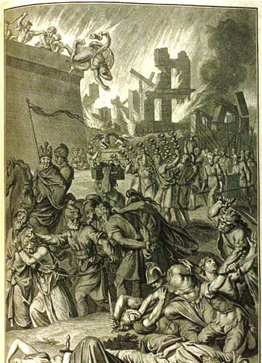
Matthew 23:33-38 (NKJV)
³³ Serpents, brood of vipers! How can you escape the condemnation of hell? ³⁴ Therefore, indeed, I send you prophets, wise men, and scribes: some of them you will kill and crucify, and some of them you will scourge in your synagogues and persecute from city to city,

Slide 21
Matthew 23:33-38 (NKJV)
³⁵ that on you may come all the righteous blood shed on the earth, from the blood of righteous Abel to the blood of Zechariah, son of Berechiah, whom you murdered between the temple and the altar. ³⁶ Assuredly, I say to you, all these things will come upon this generation.

Slide 22
Matthew 23:33-38 (NKJV)
³⁷ "O Jerusalem, Jerusalem, the one who kills the prophets and stones those who are sent to her! How often I wanted to gather your children together, as a hen gathers her chicks under her wings, but you were not willing! ³⁸ See! Your house is left to you desolate; . . .

Slide 23
Matthew 24:34 (NKJV)
³⁴ Assuredly, I say to you, this generation will by no means pass away till all these things take place.

Slide 24
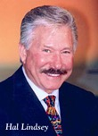
WE ARE THE GENERATION (JESUS) WAS TALKING ABOUT! I say that because, unmistakably, for the first time in history, all the signs are coming together at an accelerating rate"
(Hal Lindsey, The 1980's: Countdown To Armageddon, p. 162).

Slide 25
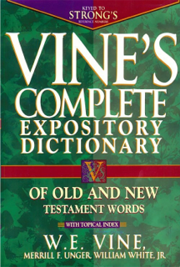
Generation - γενεά, genea - Strong‘s: <G1074> Noun
Usage Notes: . . . that which has been begotten, a family; or successive members of a genealogy, Matt. 1:17, or of a race of people, possessed of similar characteristics, pursuits, etc., . . .of the whole multitude of men living at the same time, Matt. 24:34; Mark 13:30; Luke 1:48; Luke 21:32; Phil. 2:15, and especially of those of the Jewish race living at the same period, Matt. 11:16, etc. Transferred from people to the time in which they lived, the word came to mean "an age," i.e., a period ordinarily occupied by each successive generation, say, of thirty or forty years, Acts 14:16; Acts 15:21; Eph. 3:5; Col. 1:26; see also, e.g., Gen. 15:16.

Slide 26
Mark 8:12 (NKJV)
¹² But He sighed deeply in His spirit, and said, "Why does this generation seek a sign? Assuredly, I say to you, no sign shall be given to this generation."

Slide 27
Luke 11:50-51 (NKJV)
⁵⁰ that the blood of all the prophets which was shed from the foundation of the world may be required of this generation, ⁵¹ from the blood of Abel to the blood of Zechariah who perished between the altar and the temple. Yes, I say to you, it shall be required of this generation.

Slide 28
Luke 17:25 (NKJV)
²⁵ But first He must suffer many things and be rejected by this generation.

Slide 29
Matthew 24:33-34 (NKJV) ³³ So you also, when you see all these things, know that it is near--at the doors! ³⁴ Assuredly, I say to you, this generation will by no means pass away till all these things take place.
Mark 13:29-30 (NKJV) ²⁹ So you also, when you see these things happening, know that it is near--at the doors! ³⁰ Assuredly, I say to you, this generation will by no means pass away till all these things take place.
Luke 21:31-32 (NKJV) ³¹ So you also, when you see these things happening, know that the kingdom of God is near. ³² Assuredly, I say to you, this generation will by no means pass away till all things take place.
Occurred During The Generation Then Living!

Slide 30
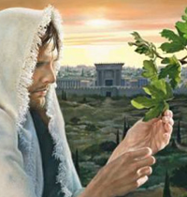
“You” - 2, 4, 9, 15, 20, 23, 25, 26, 33
“False Christ” 5 - (Acts 5:36, Theudas, 8:9, Simon)
“Wars, rumors, Natural Disasters & persecution, Betrayal” - 6-13

Slide 31
Wars & Rumors of Wars
(Tacitus, The Histories, 1:2).
“The history on which I am entering is that of a period rich in disasters, terrible with battles, torn by civil struggles, horrible even in peace. Four emperors fell by the sword; there were three civil wars, more foreign wars, and often both at the same time.”

Slide 32
Famines
(Josephus - Antiquities, 20:2:5).
"Now her coming was of very great advantage to the people of Jerusalem; for whereas a famine did oppress them at that time, and many people died for want of what was necessary to produce food withal, queen Helena sent some of her servants to Alexandria with money to buy a great quantity of corn, and others to Cyprus, to bring a cargo of dried figs"

Slide 33
Pestilences
(Tacitus, The Annals of Imperial Rome, 12:43)
"Many prodigies occurred during the year. Ominous birds took their seat on the Capitol; houses were overturned by repeated shocks of earthquake, and, as the panic spread, the weak were trampled underfoot in the trepidation of the crowd. A shortage of corn, again, and the famine which resulted, were construed as a supernatural warning."

Slide 34
Earthquakes
J. Marcellus Kik (An Eschatology Of Victory, p. 93).
"And as to earthquakes, many are mentioned by writers during a period just previous to 70 A.D. There were earthquakes in Crete, Smyrna, Miletus, Chios, Samos, Laodicea, Hierapolis, Colosse, Campania, Rome, and Judea. It is interesting to note that the city of Pompeii was much damaged by an earthquake occurring on February 5, 63 A.D."

Slide 35
“Gospel of the kingdom preached” - 14 (Col 1:6,23)
“Abomination of Desolation” - 15 – (Dan. 9:27; 12:11; Luke 20-24)

Slide 36
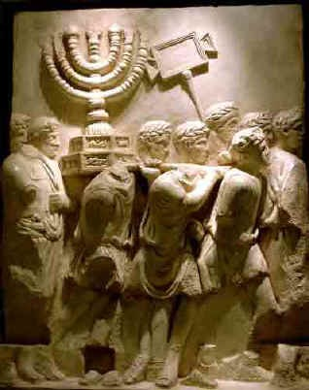
Abomination of Desolation
Jesus gave the Olivet discourse in about 30 A.D.; Jerusalem was destroyed by Titus, the Roman General, in 70 A.D.

Slide 37
Abomination of Desolation
(Josephus - The Wars Of The Jews, 4:3:10).
"Agnus stood in the midst of them, and casting his eyes frequently at the temple, and having a flood of tears in his eyes he said, 'Certainly, it had been good for me to die before I had seen the house of God full of so many abominations, or these sacred places that ought not to be trodden upon at random, filled with the feet of these bloodshedding villains'"

Slide 38
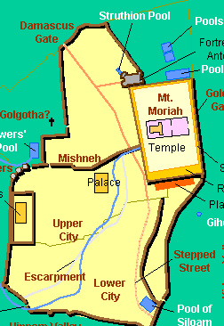
“A local tribulation” 16-28
Those in Judea flee . . . (16)
On the house top . . . (17)
In the field . . . (18)
The pregnant . . . (19)
Pray that your flight may not be in the winter or on the Sabbath . . . (20)
Was Escapable

Slide 39
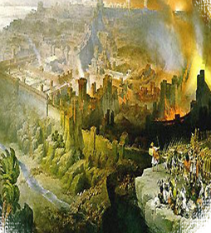
“Judgment upon National Israel”
27-35 (23:34-38)
Babylon (Isa. 13:10, 13)
Edom (Isa. 34:4-6)
The Peoples (Isa. 51:5-6)
Judah (Jer. 4:1-6, 23-28)
Egypt (Ezek. 32:7-8)
The Nations (Joel 3:15-16)
Nineveh (Nah. 1:1-5)
Israel (Amos 8:1-2, 9)
Apocryphal Language Describing Judgment upon National Israel

Slide 40
“Judgment upon National Israel”
27-35 (23:34-38)
Over 1 million Jews died in the destruction of Jerusalem – thousands more were killed outside of the city and in other cities in Judea – over 97,000 were carried away captive . . .
Apocryphal Language Describing Judgment upon National Israel

Slide 41
Matthew 24:33-34 (NKJV) ³³ So you also, when you see all these things, know that it is near--at the doors! ³⁴ Assuredly, I say to you, this generation will by no means pass away till all these things take place.
Mark 13:29-30 (NKJV) ²⁹ So you also, when you see these things happening, know that it is near--at the doors! ³⁰ Assuredly, I say to you, this generation will by no means pass away till all these things take place.
Luke 21:31-32 (NKJV) ³¹ So you also, when you see these things happening, know that the kingdom of God is near. ³² Assuredly, I say to you, this generation will by no means pass away till all things take place.
Occurred During The Generation Then Living!

Slide 42
Revelation 1:1 (NKJV)
¹ The Revelation of Jesus Christ, which God gave Him to show His servants--things which must shortly take place. And He sent and signified it by His angel to His servant John,

Slide 43
Revelation 1:3 (NKJV)
³ Blessed is he who reads and those who hear the words of this prophecy, and keep those things which are written in it; for the time is near.

Slide 44
Revelation 1:19 (NKJV)
¹⁹ Write the things which you have seen, and the things which are, and the things which will take place after this.

Slide 45
Revelation 22:6 (NKJV)
⁶ Then he said to me, "These words are faithful and true." And the Lord God of the holy prophets sent His angel to show His servants the things which must shortly take place.

Slide 46
Revelation 22:10 (NKJV)
¹⁰ And he said to me, "Do not seal the words of the prophecy of this book, for the time is at hand.

Slide 47
Revelation 22:10 (NKJV)
⁹ I, John, both your brother and companion in the tribulation and kingdom and patience of Jesus Christ, was on the island that is called Patmos for the word of God and for the testimony of Jesus Christ.

Slide 48
1. Written PRIMARILY to encourage Christians then living.
2. Written largely in symbolic language, . . . must strive to be certain interpretation agrees with the context of the book AS WELL as with the rest of the Bible!
3. Uses O. T. terminology with New Testament meaning . . . .over 400 allusions to the Old Testament are made in Revelation.
4. Must seek to grasp the vision or series of visions as a whole without pressing the details of each symbol.
5. Understand the difficult passages in the light of clearer passages. Make all interpretations consistent with the teaching of the whole Bible.

Slide 49
With noise – shout, voice of the archangel & the trumpet of God - 1 Thess. 4:16
With His holy angels - Matt. 25:31; 2 Thess. 1:7-8
Suddenly and unexpected - 1 Thess. 5:1-4; 2 Pet. 3:10; Rev. 22:20
Visibly - Acts 1:9-11; Rev. 1:7 “and every eye will see Him” -

Slide 50
2 Peter 3:10–14 (NKJV)
¹⁰ But the day of the Lord will come as a thief in the night, in which the heavens will pass away with a great noise, and the elements will melt with fervent heat; both the earth and the works that are in it will be burned up. ¹¹ Therefore, since all these things will be dissolved, what manner of persons ought you to be in holy conduct and godliness,

Slide 51
2 Peter 3:10–14 (NKJV)
¹² looking for and hastening the coming of the day of God, because of which the heavens will be dissolved, being on fire, and the elements will melt with fervent heat? ¹³ Nevertheless we, according to His promise, look for new heavens and a new earth in which righteousness dwells.

Slide 52
2 Peter 3:10–14 (NKJV)
¹⁴ Therefore, beloved, looking forward to these things, be diligent to be found by Him in peace, without spot and blameless;

Slide 54
A Defense of Biblical Eschatology - (1 Cor 15:50-58)
What Are The Signs of The End?
Does The Bible Speak of A Coming Seven Year Tribulation?
Charts by Don McClain
Prepared & Preached February 21, 2016
West 65th Street church of Christ / P.O. Box 190062; Little Rock AR 72219 / 501-568-1062
Email – donmcclain@sbcglobal.net - http://w65stchurchofchrist.org/coc/

Slide 55
1 Corinthians 15:50–58 (NKJV)
⁵⁰ Now this I say, brethren, that flesh and blood cannot inherit the kingdom of God; nor does corruption inherit incorruption. ⁵¹ Behold, I tell you a mystery: We shall not all sleep, but we shall all be changed—⁵² in a moment, in the twinkling of an eye, at the last trumpet. For the trumpet will sound, and the dead will be raised incorruptible, and we shall be changed.

Slide 56
1 Corinthians 15:50–58 (NKJV)
⁵³ For this corruptible must put on incorruption, and this mortal must put on immortality. ⁵⁴ So when this corruptible has put on incorruption, and this mortal has put on immortality, then shall be brought to pass the saying that is written: “Death is swallowed up in victory.” ⁵⁵ “O Death, where is your sting? O Hades, where is your victory?” ⁵⁶ The sting of death is sin, and the strength of sin is the law.

Slide 57
1 Corinthians 15:50–58 (NKJV)
⁵⁷ But thanks be to God, who gives us the victory through our Lord Jesus Christ. ⁵⁸ Therefore, my beloved brethren, be steadfast, immovable, always abounding in the work of the Lord, knowing that your labor is not in vain in the Lord.

