Slide 2
Joshua 1:1–9 (NKJV)
¹ After the death of Moses the servant of the Lord, it came to pass that the Lord spoke to Joshua the son of Nun, Moses’ assistant, saying: ² “Moses My servant is dead. Now therefore, arise, go over this Jordan, you and all this people, to the land which I am giving to them—the children of Israel. ³ Every place that the sole of your foot will tread upon I have given you, as I said to Moses.

Slide 3
Joshua 1:1–9 (NKJV)
⁴ From the wilderness and this Lebanon as far as the great river, the River Euphrates, all the land of the Hittites, and to the Great Sea toward the going down of the sun, shall be your territory. ⁵ No man shall be able to stand before you all the days of your life; as I was with Moses, so I will be with you. I will not leave you nor forsake you.

Slide 4
Joshua 1:1–9 (NKJV)
⁶ Be strong and of good courage, for to this people you shall divide as an inheritance the land which I swore to their fathers to give them. ⁷ Only be strong and very courageous, that you may observe to do according to all the law which Moses My servant commanded you; do not turn from it to the right hand or to the left, that you may prosper wherever you go.

Slide 5
Joshua 1:1–9 (NKJV)
⁸ This Book of the Law shall not depart from your mouth, but you shall meditate in it day and night, that you may observe to do according to all that is written in it. For then you will make your way prosperous, and then you will have good success. ⁹ Have I not commanded you? Be strong and of good courage; do not be afraid, nor be dismayed, for the Lord your God is with you wherever you go.”

Slide 6
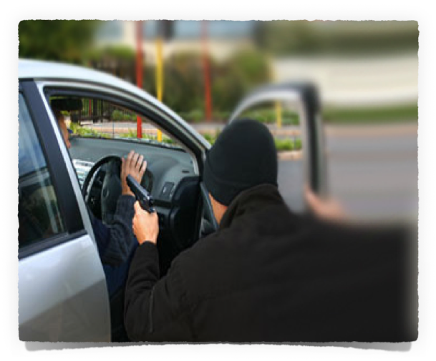
Hi-Jacked Biblical Concepts
Love
Faith
Courage

Slide 7
Courage
the quality of mind or spirit that enables a person to face difficulty, danger, pain, etc., without fear; bravery.
Courage
mental or moral strength to venture, persevere, and withstand danger, fear, or difficulty

Slide 8
Fortitude
Mental and emotional strength in facing difficulty, adversity, danger, or temptation courageously:
Fortitude
strength of mind that enables a person to encounter danger or bear pain or adversity with courage

Slide 9
REAL COURAGE / FORTITUDE
TRUSTING GOD & HIS PROMISES - (1-6)
OBEYING GOD, NOT MEN - HOLDING FAST TO GOD”S LAW - (7,8)
STANDING FIRM IN THE FACE OF ADVERSITY - (9)

Slide 10
Faithful Servant / Courageous Soldier
⁹ And Moses said to Joshua, “Choose us some men and go out, fight with Amalek. Tomorrow I will stand on the top of the hill with the rod of God in my hand.” ¹⁰ So Joshua did as Moses said to him, and fought with Amalek. …
Exodus 17:9–14 (NKJV)

Slide 11
Faithful Servant / Courageous Soldier
¹³ So Joshua defeated Amalek and his people with the edge of the sword. ¹⁴ Then the Lord said to Moses, “Write this for a memorial in the book and recount it in the hearing of Joshua, that I will utterly blot out the remembrance of Amalek from under heaven.”
Exodus 17:9–14 (NKJV)

Slide 12
Faithful Servant / Humble Learner
Ascended Sinai with Moses / not in the camp when they made the golden calf - Exo 24:13; 32:17
Exodus 24:13 (NKJV)
¹³ So Moses arose with his assistant Joshua, and Moses went up to the mountain of God.
Exodus 32:17 (NKJV)
¹⁷ And when Joshua heard the noise of the people as they shouted, he said to Moses, “There is a noise of war in the camp.”

Slide 13
Faithful Servant / Humble Learner
Stayed at the tabernacle when Moses would go out to the people - Exo 33:11
Exodus 33:11 (NKJV)
¹¹ So the Lord spoke to Moses face to face, as a man speaks to his friend. And he would return to the camp, but his servant Joshua the son of Nun, a young man, did not depart from the tabernacle.

Slide 14
Faithful Servant / Strong Believer
One of the 12 spies sent into Canaan -
Num 13:8,16; 14:6-10, 28-30,38
Numbers 13:8 (NKJV)
⁸ from the tribe of Ephraim, Hoshea the son of Nun;
Numbers 13:16 (NKJV)
¹⁶ These are the names of the men whom Moses sent to spy out the land. And Moses called Hoshea the son of Nun, Joshua.

Slide 15
Faithful Servant / Strong Believer
One of the 12 spies sent into Canaan -
Num 13:8,16; 14:6-10, 28-30,38
Numbers 14:6–10 (NKJV)
⁶ But Joshua the son of Nun and Caleb the son of Jephunneh, who were among those who had spied out the land, tore their clothes; ⁷ and they spoke to all the congregation of the children of Israel, saying: … ⁸ If the Lord delights in us, then He will bring us into this land and give it to us, … the Lord is with us. Do not fear them.”

Slide 16
Faithful Servant / Strong Believer
One of the 12 spies sent into Canaan -
Num 13:8,16; 14:6-10, 28-30,38
Numbers 32:11–12 (NKJV)
¹¹ ‘Surely none of the men who came up from Egypt, from twenty years old and above, shall see the land of which I swore to Abraham, Isaac, and Jacob, because they have not wholly followed Me, ¹² except Caleb the son of Jephunneh, the Kenizzite, and Joshua the son of Nun, for they have wholly followed the Lord.’

Slide 17
Faithful Servant / Effective Leader
Appointed leader & chosen to take them into Canaan - Num 27:18-23; Deut 3:21,28
Numbers 27:18–23 (NKJV)
¹⁸ And the Lord said to Moses: “Take Joshua the son of Nun with you, a man in whom is the Spirit, and lay your hand on him; ¹⁹ set him before Eleazar the priest and before all the congregation, and inaugurate him in their sight. ²⁰ And you shall give some of your authority to him, that all the congregation of the children of Israel may be obedient.

Slide 18
Faithful Servant / Effective Leader
Appointed leader & chosen to take them into Canaan - Num 27:18-23; Deut 3:21,28
Numbers 27:18–23 (NKJV)
²¹ He shall stand before Eleazar the priest, who shall inquire before the Lord for him by the judgment of the Urim. At his word they shall go out, and at his word they shall come in, he and all the children of Israel with him—all the congregation.”

Slide 19
Faithful Servant / Effective Leader
Appointed leader & chosen to take them into Canaan - Num 27:18-23; Deut 3:21,28
Numbers 27:18–23 (NKJV)
²² So Moses did as the Lord commanded him. He took Joshua and set him before Eleazar the priest and before all the congregation. ²³ And he laid his hands on him and inaugurated him, just as the Lord commanded by the hand of Moses.

Slide 20
Faithful Servant / Effective Leader
Appointed leader & chosen to take them into Canaan - Num 27:18-23; Deut 3:21,28
Deuteronomy 3:21 (NKJV)
²¹ “And I commanded Joshua at that time, saying, ‘Your eyes have seen all that the Lord your God has done to these two kings; so will the Lord do to all the kingdoms through which you pass.

Slide 21
Faithful Servant / Effective Leader
Appointed leader & chosen to take them into Canaan - Num 27:18-23; Deut 3:21,28
Deuteronomy 3:28 (NKJV)
²⁸ But command Joshua, and encourage him and strengthen him; for he shall go over before this people, and he shall cause them to inherit the land which you will see.’

Slide 22
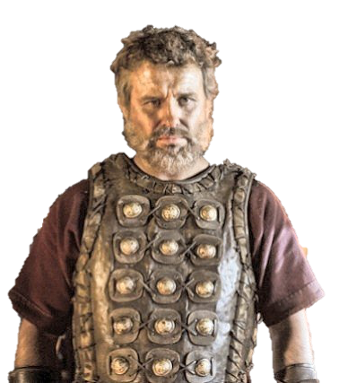
Faithful Servant of God / Courageous Leader
Joshua Leads The People Into Canaan With Victories Over The Cities & Kings - Joshua 1-12
Joshua divides Land & Establishes Cities of Refuge & for the Levites - Joshua 13-22
Joshua’s Exhortations Before His Death - Joshua 23-24
Joshua 24:29 (NKJV)
²⁹ Now it came to pass after these things that Joshua the son of Nun, the servant of the Lord, died, being one hundred and ten years old.

Slide 23
Faithful Servant of God / Courageous Leader
Confident Faith: Num 14:6-8, Jos 3:5
Courageous: Jos 1:6-9, 5:1-8,
Humble: Ex 17:10; 33:11; Jos 5:14
Encourager: Nu 14:6-8; Jos 10:25
Obedient: Jos 11:15
Decisive: Jos 23:1-11; 24:15
Joshua 24:29 (NKJV)
²⁹ Now it came to pass after these things that Joshua the son of Nun, the servant of the Lord, died, being one hundred and ten years old.

Slide 24
Faithful Servant of God / Courageous Leader
Obedience – Jos. 6
Disappointments & Setbacks – Jos. 7
Deception & Compromise – Jos. 9; 23:11-13
Commitment – Jos. 24:15-24, 31
Joshua 24:29 (NKJV)
²⁹ Now it came to pass after these things that Joshua the son of Nun, the servant of the Lord, died, being one hundred and ten years old.

Slide 25
Faithful Servant of God / Courageous Leader
Trust God In All Circumstances!
Follow God God Despite Majority
Trust In God To Fight Your Battles
Fully & Courageously Follow Christ - Num 32:12, Jos 24:15
We NEED Leaders Who Do Not Compromise On Character - Deut 1:38
Be Diligent To Enter God’s Rest - Hebrews 4:8-13

Slide 26
Final Exhortations - Joshua 23,24
Take notice of ALL GOD HAS DONE - 23:3,4,12,13; Heb 1-4; Ep 1:3ff
Believe in God’s PROMISES - 23:5;12,13,15,16; He 6:13-20; 1 Co 10:13; Gal 6:7-9
Be VERY COURAGEOUS & obey God in every detail - 23:6; 1 Cor 16:13; Eph 6:10-18;

Slide 27
Final Exhortations - Joshua 23,24
Refuse to compromise with the world - hold fast to the Lord & gain victory - 23:7-10; Gal 5:1-4; 2 Cor 6:14-7:1; John 16:33
Take careful heed to yourselves, that you love the Lord your God - 23:11,12; Mk 12:29-31;
Fear the Lord, serve Him in sincerity & truth - 24:14; Ecc 12:13; Jn 4:24

Slide 28
Choose this day whom you will serve -
Joshua 24:15; Rom 6:16,17
Open your hearts to the truth & hear it - Rom 10:17; Jam 1:21
Believe - Mat 17:5; John 3:16; 8:24
Confess - Mt 10:32,33; Ro 10:9,10
Repent - Luke 13:3,5; Acts 17:30
Be baptized into Christ - Mk 16:16; Acts 2:38; Rom 6:3-6
Be faithful - 1 Cor 15:58; 16:13; Heb 3,4

Slide 30
Charts by Don McClain
Prepared August 12,13, 2016 / Preached August 14, 2016
West 65th Street church of Christ / P.O. Box 190062
Little Rock AR 72219 / 501-568-1062
Email – donmcclain@sbcglobal.net
http://w65stchurchofchrist.org/coc/

Slide 31
1 Corinthians 16:5–13 (NKJV)
⁵ Now I will come to you when I pass through Macedonia (for I am passing through Macedonia). ⁶ And it may be that I will remain, or even spend the winter with you, that you may send me on my journey, wherever I go. ⁷ For I do not wish to see you now on the way; but I hope to stay a while with you, if the Lord permits. ⁸ But I will tarry in Ephesus until Pentecost.

Slide 32
1 Corinthians 16:5–13 (NKJV)
⁹ For a great and effective door has opened to me, and there are many adversaries. ¹⁰ And if Timothy comes, see that he may be with you without fear; for he does the work of the Lord, as I also do. ¹¹ Therefore let no one despise him. But send him on his journey in peace, that he may come to me; for I am waiting for him with the brethren.

Slide 33
1 Corinthians 16:5–13 (NKJV)
¹² Now concerning our brother Apollos, I strongly urged him to come to you with the brethren, but he was quite unwilling to come at this time; however, he will come when he has a convenient time. ¹³ Watch, stand fast in the faith, be brave, be strong.

