Slide 1
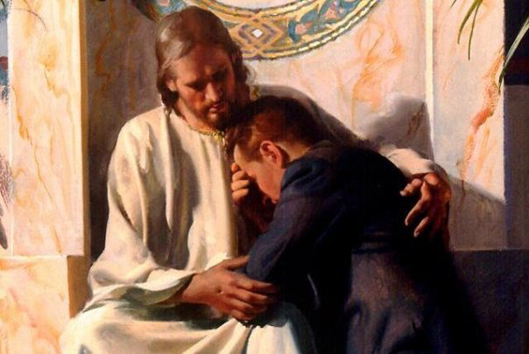
Being A Bondservant Of Christ
What It Really Means To Be A Christian
Matthew 6:24; 10:24; Luke 17:6-10; Galatians 1:10

Slide 2
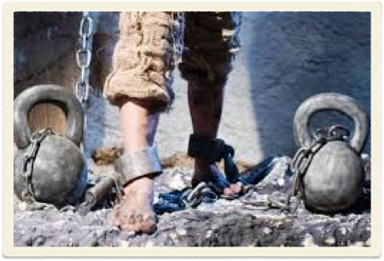
Being A Bondservant Of Christ
The Question IS To Whom?
What It Really Means To Be A Christian
Matthew 6:24; 10:24; Luke 17:6-10; Galatians 1:10

Slide 3
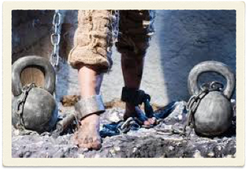
A Bondservant Of Christ
What It Really Means To Be A Christian
What exactly is our relationship to God?
What is our relationship to Christ?
How are we best to understand it?
Bondservant
[1528] δοῦλος doulos 126x

Slide 4
A Bondservant Of Christ
What It Really Means To Be A Christian
Bondservant
A misunderstood concept - (How does this perspective of the Christian harmonize with the concepts of being children of God? Grace? etc? the purpose of this lesson is to explain exactly what it means to be a bondservant of Jesus).
A forgotten concept among MANY - (modern day evangelist often emphasize grace, liberty, individualism, happiness, physical health & wealth, etc. and completely ignore an essential aspect of what it means to be a Christian).
[1528] δοῦλος doulos 126x
of Jesus Christ

Slide 5
A Bondservant Of Christ
What It Really Means To Be A Christian
The term slave immediately generates disgust & strong emotions when we hear it and rightfully so!
Slavery was a well known and identifiable concept for the first century church. (1 Pet 2:18-25; Ep. 6:5–7; Col. 3:22–25; 1 Ti. 6:1–3.;Tit. 2:9, 10)
Bondservant
[1528] δοῦλος doulos 126x

Slide 6
A Bondservant Of Christ
What It Really Means To Be A Christian
Slaves were viewed as the bottom of society and no one wanted to be a slave.
Slaves in the Roman world had no rights except those extend to them by their owners.
Slaves who had good masters were cared for, protected and even loved - (Phile.; Mt 8:5-13)
The gospel, as it permeated society eventually destroyed ‘slavery’ as a way of life.
Bondservant
[1528] δοῦλος doulos 126x

Slide 7
A Bondservant Of Christ
What It Really Means To Be A Christian
Bondservant
Being enslaved to sin, things and other human beings SHOULD always engender negative emotions and even a reaction of disgust!
Would it surprise you to learn that the Christian and His relationship to Christ is often described by the term δοῦλος doulos (most often translated ‘servant’ or ‘bondservant)’ which literally means SLAVE?
[1528] δοῦλος doulos 126x

Slide 8
A Bondservant Of Christ
What It Really Means To Be A Christian
Matthew 6:19–24 (NKJV)
¹⁹ “Do not lay up for yourselves treasures on earth, where moth and rust destroy and where thieves break in and steal; ²⁰ but lay up for yourselves treasures in heaven, where neither moth nor rust destroys and where thieves do not break in and steal. ²¹ For where your treasure is, there your heart will be also. ²² “The lamp of the body is the eye. If therefore your eye is good, your whole body will be full of light. ²³ But if your eye is bad, your whole body will be full of darkness. If therefore the light that is in you is darkness, how great is that darkness!
Bondservant
[1528] δοῦλος doulos 126x

Slide 9
A Bondservant Of Christ
What It Really Means To Be A Christian
Matthew 6:19–24 (NKJV)
²⁴ “No one can serve two masters; for either he will hate the one and love the other, or else he will be loyal to the one and despise the other. You cannot serve God and mammon.
Bondservant
[1528] δοῦλος doulos 126x
1398. δουλεύω douleuō; from 1401; to be a slave, to serve:—bondage(1), enslaved(3), render service(1), serve(10), served(1), serves(1), serving(4), slavery(1), slaves(3).
Thomas, R. L. (1998). New American Standard Hebrew-Aramaic and Greek dictionaries : updated edition. Anaheim: Foundation Publications, Inc.

Slide 10
Bondservant / Servant / Slave - 126 times in 118 verses in the NT

Slide 11
Bondservant / Servant / Slave - 126 times in 118 verses in the NT
To Define
SLAVE, BONDSERVANT, BONDMAID
[1528] δοῦλος doulos 126x or servant, of various degrees, Mt 8:9, et al. freq.; a servitor, person of mean condition, Phil 2:7; fem. δούλη, a female slave; a handmaiden, Lk 1:38, 48; Acts 2:18; δοῦλος, used figuratively, in a bad sense, one involved in moral or spiritual thraldom, Jn 8:34; Rom 6:17, 20; 1 Cor. 7:23; 2 Pet. 2:19; in a good sense, a devoted servant or minister, Acts 16:17; Rom 1:1; one pledged or bound to serve, 1 Cor. 7:22; 2 Cor. 4:5 [1400, 1401] See servant; slave.
Mounce, W. D. (2006). Mounce’s Complete Expository Dictionary of Old & New Testament Words (p. 1128). Grand Rapids, MI: Zondervan.

Slide 12
Bondservant / Servant / Slave - 126 times in 118 verses in the NT
To Define
BONDMAN, BONDMAID
doulos (δου̂λος, 1401), from deo, “to bind,” “a slave,” originally the lowest term in the scale of servitude, came also to mean “one who gives himself up to the will of another,” e.g., 1 Cor. 7:23; Rom. 6:17, 20, and became the most common and general word for “servant,” as in Matt. 8:9, without any idea of bondage. In calling himself, however, a “bondslave of Jesus Christ,” e.g., Rom. 1:1, the apostle Paul intimates (1) that he had been formerly a “bondslave” of Satan, and (2) that, having been bought by Christ, he was now a willing slave, bound to his new Master. See servant.
Vine, W. E., Unger, M. F., & White, W., Jr. (1996). Vine’s Complete Expository Dictionary of Old and New Testament Words (Vol. 2, p. 73). Nashville, TN: T. Nelson.

Slide 13
Bondservant / Servant / Slave - 126 times in 118 verses in the NT
To Define
BONDMAN, BONDMAID
δοῦλος, σύνδουλος, δούλη, δουλεύω, δουλεία
All the words in this group serve either to describe the status of a slave or an attitude corresponding to that of a slave. δοῦλος is a “slave,” δούλη a “female slave,” δουλεύω “to be a slave,” “to stand in the relationship of a slave,” δουλεία “slavery,” σύνδουλος a “fellow-slave,” the adj. δοῦλοσ-η-ον “enslaved” or “performing the service of a slave.” … Hence we have a service which is not a matter of choice for the one who renders it, which he has to perform whether he likes or not, because he is subject as a slave to an alien will, to the will of his owner. … in δοῦλος the stress is on the slave’s dependence on his lord, …
Kittel, G., Bromiley, G. W., & Friedrich, G. (Eds.). (1964–). Theological dictionary of the New Testament (electronic ed., Vol. 2, p. 261). Grand Rapids, MI: Eerdmans.

Slide 14
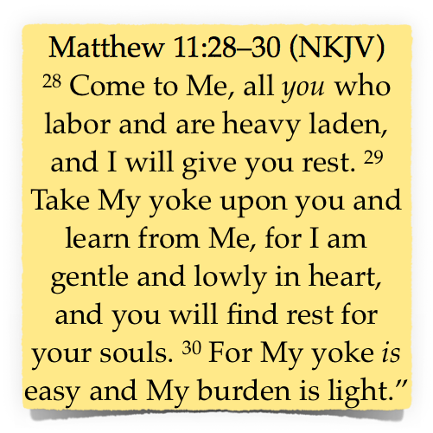
A Bondservant Of Christ
What It Really Means To Be A Christian
Galatians 4:7 (NKJV)
⁷ Therefore you are no longer a slave but a son, and if a son, then an heir of God through Christ.
Philemon 16 (NKJV)
¹⁶ no longer as a slave but more than a slave—a beloved brother, especially to me but how much more to you, both in the flesh and in the Lord.
Bondservant
[1528] δοῦλος doulos 126x
of Jesus Christ

Slide 15
A Bondservant Of Christ
What It Really Means To Be A Christian
Bondservant
Slavery = bondage, ownership, complete submission, the surrendering of one’s own will to that of another.
Subtract the concept of harsh bondage and what do you have? - (1 Jn 5:3)
The Greek literally refers to Christians as “SLAVES” of Jesus Christ!
[1528] δοῦλος doulos 126x
of Jesus Christ

Slide 16
A Bondservant Of Christ
What It Really Means To Be A Christian
The heart of a bondservant
Bondservant
[1528] δοῦλος doulos 126x
of Jesus Christ
Pierce My Ear (spiritual hymn)
Pierce my ear, O Lord, my God. Take me to Your door this day. I will serve no other god. Lord, I'm here to stay.
For You have paid the price for me. With Your blood You ransomed me. I will serve You eternally. A free man I'll never be.
Deuteronomy 15:16–17 (NKJV)
¹⁶ And if it happens that he says to you, ‘I will not go away from you,’ because he loves you and your house, since he prospers with you, ¹⁷ then you shall take an awl and thrust it through his ear to the door, and he shall be your servant forever. …

Slide 17
A Bondservant Of Christ
What It Really Means To Be A Christian
The heart of a bondservant
Bondservant
[1528] δοῦλος doulos 126x
of Jesus Christ
Luke 17:1–10 (NKJV) Context
A warning to those who cause offenses (1.2)
The need to show mercy & forgive others (3,4)
The plea “Lord increase our faith” (5)
Faith in the authority of Jesus (6)
The servants place is to serve - (7-9)
We need to understand WHO Jesus is and who we are - (10)
Luke 17:10 (NKJV)
¹⁰ So likewise you, when you have done all those things which you are commanded, say, ‘We are unprofitable servants. We have done what was our duty to do.’ ”

Slide 18
A Bondservant Of Christ
What It Really Means To Be A Christian
The heart of a bondservant
Bondservant
[1528] δοῦλος doulos 126x
of Jesus Christ
The Christian has been BOUGHT with a price - 1 Cor. 6:20; 7:23; 1 Pet 1:18,19
Jesus HAS all authority - Mat 28:18. The Christian yields to His authority - Col. 3:17
The Christian has surrendered his will completely to Jesus Christ - Mat 16:24

Slide 19
A Bondservant Of Christ
What It Really Means To Be A Christian
Viewing Ourselves As Bondservants
Bondservant
[1528] δοῦλος doulos 126x
“Paul, a bondservant of Jesus Christ, …” Rom 1:1 (cf Titus 1:1; Philippians 1:1; 2 Corinthians 4:5)
“Simon Peter, a bondservant and apostle of Jesus Christ, …” 2 Peter 1:1
“James, a bondservant of God and of the Lord Jesus Christ, …” James 1:1
Jude, a bondservant of Jesus Christ, … Jude 1
of Jesus Christ

Slide 20
A Bondservant Of Christ
What It Really Means To Be A Christian
Viewing Ourselves As Bondservants
Bondservant
[1528] δοῦλος doulos 126x
of Jesus Christ
“As free, yet not using liberty as a cloak for vice, but as bondservants of God.” - 1 Peter 2:16 (NKJV)
“Epaphras, who is one of you, a bondservant of Christ, greets you, always laboring fervently for you in prayers, … Colo. 4:12 (NKJV) -
“But made Himself of no reputation, taking the form of a bondservant, and coming in the likeness of men.” - Phili 2:7 (NKJV)

Slide 21
A Bondservant Of Christ
What It Really Means To Be A Christian
Viewing Ourselves As Bondservants
Bondservant
[1528] δοῦλος doulos 126x
Starts with voluntarily giving up our will to His. - Mat 26:39
It coincides with a commitment to serve only GOD. - 1 Thes 1:9
It is combined with the knowledge of the love and price paid on our behalf. - 2 Cor 5:14; 1 Pet 1:17-21
Dependent & fully trusting in Jesus’ loving authority & promises - 2 Cor 5:14; Heb 6:9-20
of Jesus Christ

Slide 22
A Bondservant Of Christ
What It Really Means To Be A Christian
Viewing Ourselves As Bondservants
Bondservant
[1528] δοῦλος doulos 126x
Matthew 20:27 (NKJV) - And whoever desires to be first among you, let him be your slave— cf. Matt. 18:1–5; Luke 9:46–50
Acts 4:29 (NKJV) - Now, Lord, look on their threats, and grant to Your servants that with all boldness they may speak Your word,
Ephesians 6:6 (NKJV) - not with eyeservice, as men-pleasers, but as bondservants of Christ, doing the will of God from the heart,
of Jesus Christ

Slide 23
A Bondservant Of Christ
What It Really Means To Be A Christian
Viewing Ourselves As Bondservants
Bondservant
[1528] δοῦλος doulos 126x
of Jesus Christ
In service to the Lord.
Serving your family. - Col 3:18-21; Eph 5:22-6:4
Serving your brethren. - Acts 2:42-46; 1 Cor 8:1-9
Serving your neighbor. - Gal 6:10; Rom 13:8-10
Serving community, nation - 1 Tim 2:1-4; Rom 13:1-7

Slide 24
A Bondservant Of Christ
What It Really Means To Be A Christian
Bondservant
Being enslaved to sin, things and other human beings SHOULD always engender a negative and even disgusting reaction - and rightfully so!
But there is a sense in which we SHOULD, and in fact MUST, recognize ourselves as BONDSERVANTS of Christ! (The whole concept of Jesus being our Lord is to be viewed from this perspective.)
[1528] δοῦλος doulos 126x

Slide 25
A Bondservant Of Christ
What It Really Means To Be A Christian
How are we best to understand the relationship of a Christian with God?
A bondservant? YES, but with the privileges of a son which is entered into by our own free volition.
We belong to Jesus our master Who loves us and gave Himself for us - we MUST honor & serve Him!
Bondservant
[1528] δοῦλος doulos 126x

Slide 26
Being A Bondservant Of Christ
The Question IS To Whom?
What It Really Means To Be A Christian
Matthew 6:24; 10:24; Luke 17:6-10; Galatians 1:10

Slide 27
A Bondservant Of Christ
What It Really Means To Be A Christian
What exactly is YOUR relationship to God?
What is YOUR relationship to Christ?
Are you willing to obey Jesus & will you give yourself, your life, your will & body to live for Him Who died for you?
Bondservant
[1528] δοῦλος doulos 126x

Slide 29
Being A Bondservant Of Christ
The Question IS To Whom?

Slide 30
Scripture Reading June 12, 2016
Luke 17:6–10 (NKJV)
⁶ So the Lord said, “If you have faith as a mustard seed, you can say to this mulberry tree, ‘Be pulled up by the roots and be planted in the sea,’ and it would obey you. ⁷ And which of you, having a servant plowing or tending sheep, will say to him when he has come in from the field, ‘Come at once and sit down to eat’?

Slide 31
Scripture Reading June 12, 2016
Luke 17:6–10 (NKJV)
⁸ But will he not rather say to him, ‘Prepare something for my supper, and gird yourself and serve me till I have eaten and drunk, and afterward you will eat and drink’? ⁹ Does he thank that servant because he did the things that were commanded him? I think not.

Slide 32
Scripture Reading June 12, 2016
Luke 17:6–10 (NKJV)
¹⁰ So likewise you, when you have done all those things which you are commanded, say, ‘We are unprofitable servants. We have done what was our duty to do.’ ”

