Slide 1
Genesis 19:17

Slide 2
Genesis 19:12–17 (NKJV)
¹² Then the men said to Lot, “Have you anyone else here? Son-in-law, your sons, your daughters, and whomever you have in the city—take them out of this place! ¹³ For we will destroy this place, because the outcry against them has grown great before the face of the Lord, and the Lord has sent us to destroy it.”

Slide 3
Genesis 19:12–17 (NKJV)
¹⁴ So Lot went out and spoke to his sons-in-law, who had married his daughters, and said, “Get up, get out of this place; for the Lord will destroy this city!” But to his sons-in-law he seemed to be joking. ¹⁵ When the morning dawned, the angels urged Lot to hurry, saying, “Arise, take your wife and your two daughters who are here, lest you be consumed in the punishment of the city.”

Slide 4
Genesis 19:12–17 (NKJV)
¹⁶ And while he lingered, the men took hold of his hand, his wife’s hand, and the hands of his two daughters, the Lord being merciful to him, and they brought him out and set him outside the city. ¹⁷ So it came to pass, when they had brought them outside, that he said, “Escape for your life! Do not look behind you nor stay anywhere in the plain. Escape to the mountains, lest you be destroyed.”

Slide 5
Genesis 19:17
Tuesday September 11, 2001
At 8:45 a.m., American Airlines Boeing 767, Flight 11, loaded with 20,000 gallons of jet fuel crashed into the north tower (93rd to 99th floors), of the World Trade Center in New York City,.
Notes:
On September 11, 2001, at 8:45 a.m. on a clear Tuesday morning, an American Airlines Boeing 767 loaded with 20,000 gallons of jet fuel crashed into the north tower of the World Trade Center in New York City. The impact left a gaping, burning hole near the 80th floor of the 110-story skyscraper, instantly killing hundreds of people and trapping hundreds more in higher floors. … Then, 18 minutes after the first plane hit, a second Boeing 767–United Airlines Flight 175–appeared out of the sky, turned sharply toward the World Trade Center and sliced into the south tower near the 60th floor. Close to 3,000 people died in the World Trade Center and its vicinity, including a staggering 343 firefighters and paramedics, 23 New York City police officers and 37 Port Authority police officers.
American Airlines Flight 77 circled over downtown Washington, D.C., and slammed into the west side of the Pentagon military headquarters at 9:45 a.m. - 125 military personnel and civilians were killed in the Pentagon, along with all 64 people aboard the airliner.
Meanwhile, a fourth California-bound plane–United Flight 93–was hijacked about 40 minutes after leaving Newark International Airport in New Jersey.. The passengers fought the four hijackers and are suspected to have attacked the cockpit with a fire extinguisher. The plane then flipped over and sped toward the ground at upwards of 500 miles per hour, crashing in a rural field in western Pennsylvania at 10:10 a.m. All 45 people aboard were killed.
http://www.history.com/topics/9-11-attacks

Slide 6
Genesis 19:17
Tuesday September 11, 2001
18 minutes later, a second Boeing 767–United Airlines Flight 175–struck the south tower near the 60th floor.

Slide 7
Genesis 19:17
Tuesday September 11, 2001
Approximately 17,400 civilians were in the World Trade Center twin towers at the time of the attacks.

Slide 8
Genesis 19:17
Tuesday September 11, 2001
American Airlines Flight 77 circled over downtown Washington, D.C., and slammed into the west side of the Pentagon military headquarters at 9:45 a.m.

Slide 9
Tuesday September 11, 2001
A fourth California-bound plane–United Flight 93–was hijacked after leaving Newark International Airport in New Jersey.. Passengers successfully overcame the hijackers causing the plane to crash in a rural field in western Pennsylvania at 10:10 a.m. All 45 people aboard were killed.

Slide 10
Tuesday September 11, 2001
The September 11 attacks killed 2,996 people and injured more than 6,000 others. These immediate deaths included 265 on the four planes, 2,606 in the World Trade Center and in the surrounding area, and 125 at the Pentagon.

Slide 11
Tuesday September 11, 2001
Many were fortunate to escape with their lives!
Caused MANY to reexamine their priorities!
MANY HAVE FORGOTTEN!
TOO MANY ONLY see the URGENCY of ESCAPE when calamity is UPON them!

Slide 12
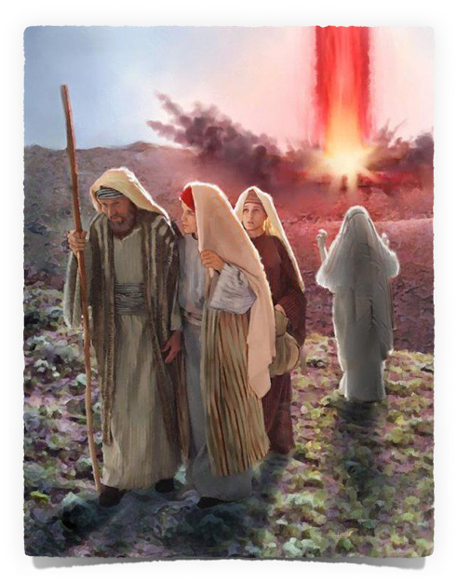
God informs Abraham of His intentions to destroy Sodom & Gomorrah – 18:20
Abraham intercedes for the cities of the plain – 18:21-33
Two angels taken in and protected by Lot – 19:1-11
Lot warned to flee - 19:12-17
Lot pleads for permission to flee to Zoar – 19:18-22
Sodom & Gomorrah is destroyed – 19:23-29

Slide 13
ThE Judgment of God Is Coming!
Ecclesiastes 12:13–14 (NKJV)
¹³ Let us hear the conclusion of the whole matter: Fear God and keep His commandments, For this is man’s all. ¹⁴ For God will bring every work into judgment, Including every secret thing, Whether good or evil.

Slide 14
ThE Judgment of God Is Coming!
Acts 17:30–31 (NKJV)
³⁰ Truly, these times of ignorance God overlooked, but now commands all men everywhere to repent, ³¹ because He has appointed a day on which He will judge the world in righteousness by the Man whom He has ordained. He has given assurance of this to all by raising Him from the dead.”

Slide 15
ThE Judgment of God Is Coming!
2 Corinthians 5:10–11 (NKJV)
¹⁰ For we must all appear before the judgment seat of Christ, that each one may receive the things done in the body, according to what he has done, whether good or bad. ¹¹ Knowing, therefore, the terror of the Lord, we persuade men; but we are well known to God, and I also trust are well known in your consciences.

Slide 16
ThE Judgment of God Is Coming!
2 Peter 3:10 (NKJV)
¹⁰ But the day of the Lord will come as a thief in the night, in which the heavens will pass away with a great noise, and the elements will melt with fervent heat; both the earth and the works that are in it will be burned up.

Slide 17
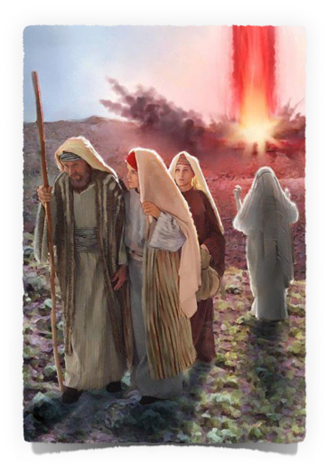
ThE NEED To Escape SIN!
We have ALL sinned - Rom 3:23; 6:23
Sin cannot be escaped through our own efforts apart from faith in Christ!
Mere morality, good works and even law-keeping cannot deliver us apart from faith in Christ - Eph 2:8-10; Tit 3:3-5; Rom 7; Heb 11:6
Must be in Christ - Eph 1:3-12; Rom 6:3-8:11; Gal. 3:26-27

Slide 18
ThE NEED To Escape SIN!
Escape sexual immorality – (Gen 39:7-10; cf. Prov. 5:8; 6:5; 1 Cor. 6:18; 2 Tim 2:24)
Escape idolatry – (Exo. 13,14; Acts 7:32-36; 1 Cor. 10:1-13)
Temptation is serious and dangerous – (Mat. 5:28,29; 18:8,9; Rom 6:23)
Sin is enslaving and destructive – (Mat. 26:31; Prov 5:22; Mat. 18:8,9; Acts 8:23; John 8:34; Rom. 6:23; James 1:13-16)

Slide 19
ThE NEED To Escape Evil Companions:
Example of Lot – (Gen 13:12,13; 2 Pet 2:6-9)
Warning to Israel – (Exodus 34:12-16; Ezra 9:1-12; 10:19)
Warnings in Proverbs – (Prov 1:11-19; 4:14,15; 13:20)
Warnings to us – (Eph. 5:6-11; 1 Cor. 15:11; 2 Cor. 6:14-7:1; 1 Pet 4:3-7)

Slide 20
ThE NEED To Escape Religious Error:
Example of Israel – (Acts 7:38-43; 2 Kings 17:15)
Warning to Israel – (Deut 13:1-3; Jer. 23:16; 27:9-17)
There are MANY false teachers – (Acts 20:29,30; 2 Cor. 11:13-15; 1 Tim. 4:1-3; 2 Peter 2:1)
Warnings to us – (Mat 7:15; 15:7-9; Col. 2:8,18; Rom. 16:17; 2 Tim 3:5,6; Tit. 3:9-11; 2 John 1:9-10)

Slide 21
ThE NEED To Escape From The World:
Example of Noah – (Gen. 6,7)
Example of Moses – (Heb 11:24-27)
We are to be in the world but not of the world – (John 17:14-16; 2 Cor. 6:14-7:1)
Do not Love the world – (Mat. 6:19-34; 1 John 2:15-17)
The way of escape – (Mat. 7:13,14; Jn 14:6; 17:17; Mk 16:16; 1 Pt. 3:20,21)

Slide 22
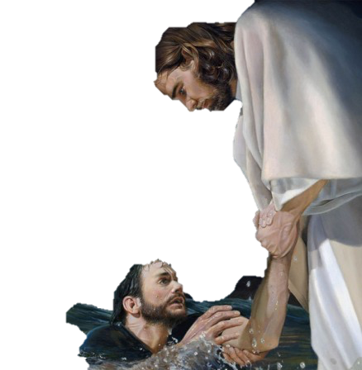
Will You Escape Condemnation?
God has given us warning – Acts 17:30,31; 2 Cor. 5:10
Jesus has made salvation possible – John 3:16; Heb 12:1,2

Slide 23
Heaven Is A Prepared Place
For A Prepared People:
Requires intent – Mat 7:13,14
Requires faith – John 8:24; Heb 11:6
Requires repentance – Acts 17:30,31
Requires confession – Mat. 10:32; Rom 10:9,10
Requires baptism & continued obedience – Mark 16:16; Acts 2:38; Rom. 6:3-6,16,17; Heb. 5:8,9
Requires purpose – Acts 11:23
Requires diligence – 2 Pet 3:5-11

Slide 24
Genesis 19:17
For the thousands of people who perished or escaped with their life - all material and earthly concerns meant NOTHING!
If YOU are NOT prepared when judgment day comes - NO ONE CAN SAVE YOU FROM ETERNAL DOOM! - Mat 23:33

Slide 25
Genesis 19:17
Hebrews 2:1-3 (NKJV)
1 Therefore we must give the more earnest heed to the things we have heard, lest we drift away. 2 For if the word spoken through angels proved steadfast, and every transgression and disobedience received a just reward, 3 how shall we escape if we neglect so great a salvation, which at the first began to be spoken by the Lord, and was confirmed to us by those who heard Him,

Slide 27
Genesis 19:17

Slide 28
2 Peter 2:4–11 (NKJV)
⁴ For if God did not spare the angels who sinned, but cast them down to hell and delivered them into chains of darkness, to be reserved for judgment; ⁵ and did not spare the ancient world, but saved Noah, one of eight people, a preacher of righteousness, bringing in the flood on the world of the ungodly;

Slide 29
2 Peter 2:4–11 (NKJV)
⁶ and turning the cities of Sodom and Gomorrah into ashes, condemned them to destruction, making them an example to those who afterward would live ungodly; ⁷ and delivered righteous Lot, who was oppressed by the filthy conduct of the wicked ⁸ (for that righteous man, dwelling among them, tormented his righteous soul from day to day by seeing and hearing their lawless deeds)—

Slide 30
2 Peter 2:4–11 (NKJV)
⁹ then the Lord knows how to deliver the godly out of temptations and to reserve the unjust under punishment for the day of judgment, ¹⁰ and especially those who walk according to the flesh in the lust of uncleanness and despise authority. They are presumptuous, self-willed. They are not afraid to speak evil of dignitaries, ¹¹ whereas angels, who are greater in power and might, do not bring a reviling accusation against them before the Lord.

