Slide 1
GODLY

Slide 2
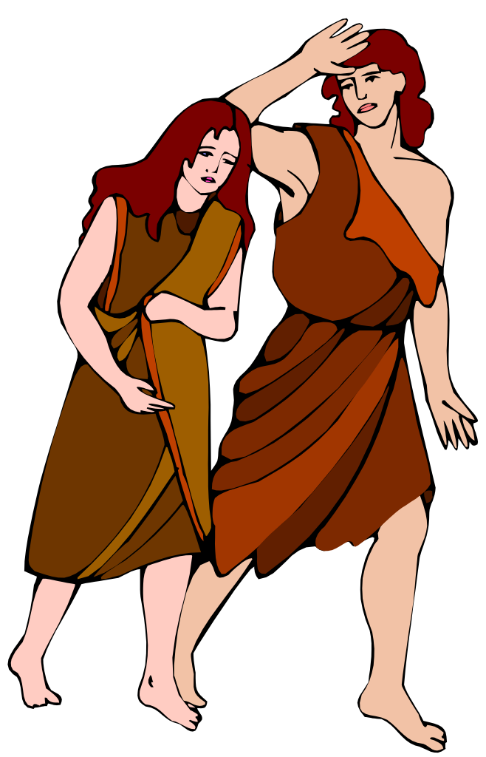
Does The Bible Give Guidelines On How We Should Dress In Public?
Genesis 3:7 (NKJV)
⁷ Then the eyes of both of them were opened, and they knew that they were naked; and they sewed fig leaves together and made themselves coverings. …
Genesis 3:10–11 (NKJV)
¹⁰ So he said, “I heard Your voice in the garden, and I was afraid because I was naked; and I hid myself.” ¹¹ And He said, “Who told you that you were naked? Have you eaten from the tree of which I commanded you that you should not eat?”
Genesis 3:21 (NKJV)
²¹ Also for Adam and his wife the Lord God made tunics of skin, and clothed them.
Apron
V. 7 Naked (Nude)
V. 10,11,21
Not Sufficiently Clothed

Slide 3
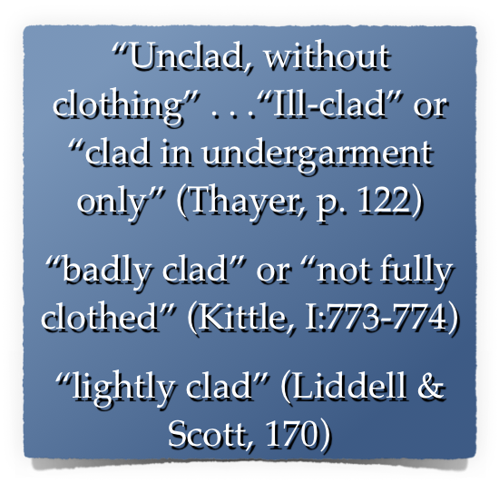
Does The Bible Give Guidelines On How We Should Dress In Public?
V. 7 (Nude)
Apron
V. 10,11,21
Not Sufficiently Clothed
Still Naked

Slide 4
Does The Bible Give Guidelines On How We Should Dress In Public?
4189 כֻּתֹּנֶת (kǔt·tō·něṯ): n.fem.; ≡ Str 3801; TWOT 1058a—1. LN 6.152–6.187 tunic, garment, i.e., clothing as a covering more complete than a loincloth, a basic garment reaching the knees and so a common garment for common wear and work (Ge 3:21; SS 5:3)
Swanson, J. (1997). Dictionary of Biblical Languages with Semantic Domains : Hebrew (Old Testament) (electronic ed.). Oak Harbor: Logos Research Systems, Inc.

Slide 5
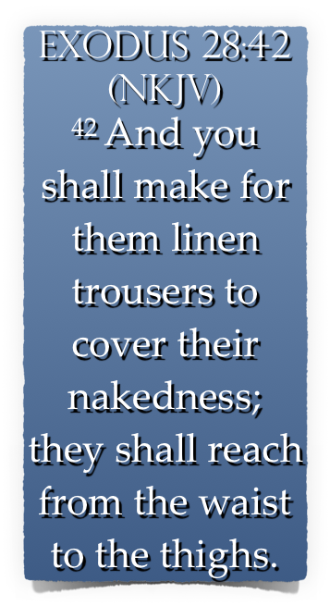
Does The Bible Give Guidelines On How We Should Dress In Public?

Slide 6
The Bible Instructs On How We Should Dress In Public!
1 Peter 3:1–4 (NKJV)
¹ Wives, … ² when they observe your chaste conduct accompanied by fear. ³ Do not let your adornment be merely outward—arranging the hair, wearing gold, or putting on fine apparel—⁴ rather let it be the hidden person of the heart, with the incorruptible beauty of a gentle and quiet spirit, which is very precious in the sight of God.

Slide 7
The Bible Instructs On How We Should Dress In Public!
Titus 2:3–5 (NKJV)
³ the older women likewise, that they be reverent in behavior, not slanderers, not given to much wine, teachers of good things—⁴ that they admonish the young women to love their husbands, to love their children, ⁵ to be discreet, chaste, homemakers, good, obedient to their own husbands, that the word of God may not be blasphemed.

Slide 8
The Bible Instructs On How We Should Dress In Public!
1 Timothy 2:9–10 (NKJV)
⁹ in like manner also, that the women adorn themselves in modest apparel, with propriety and moderation, not with braided hair or gold or pearls or costly clothing, ¹⁰ but, which is proper for women professing godliness, with good works.

Slide 9
The Bible Instructs On How We Should Dress In Public!
"Respectable; honorable" — (Arndt and Gingrich, 445).
"Orderly; well-arranged; decent" — (Vine)
"The well-ordering is not of dress and demeanor only, but the inner life’s uttering indeed, and expressing itself in the outward conversation" — (Trench’s Syn. 346).

Slide 10
The Bible Instructs On How We Should Dress In Public!
“In simple attire which doesn’t attract attention.” — The People’s New Testament Commentary
“An appearance that is simple, moderate, judicious, and free from ostentation. . . . Christians must be careful about letting a pagan culture set their fashions.” — Bible Knowledge Commentary

Slide 11
The Bible Instructs On How We Should Dress In Public!
Reserved
Humble
Respectable
Decent
Orderly

Slide 12
The Bible Instructs On How We Should Dress In Public!
(aidos) (αἰδώς, 127), “a sense of shame, modesty,” is used regarding the demeanor of women in the church, 1 Tim. 2:9 — Shamefastness is that modesty which is ‘fast’ or rooted in the character — (Vine’s Complete Expository Dictionary of Old and New Testament Words (Vol. 2, p. 568).
(aidos) – “bashfulness, reverence, regard for others, respect” - "A sense of shame" — (Thayer, 14).
MANY have lost the ability to blush! — (Jeremiah 6:15; 8:12)

Slide 13
The Bible Instructs On How We Should Dress In Public!
sophrosune (σωφροσύνη, 4997) denotes “soundness of mind”, Acts 26:25, “soberness”; 1 Tim. 2:9, 15, “sobriety”; “sound judgment” practically expresses the meaning; “it is that habitual inner self-government, with its constant rein on all the passions and desires, which would hinder the temptation to these from arising, or at all events from arising in such strength as would overbear the checks and barriers which aidos (shamefastness) opposed to it” (Trench Syn. Sec.xx, end) - (Vine’s Complete Expository Dictionary of Old and New Testament Words (Vol. 2, p. 583).

Slide 14
The Bible Instructs On How We Should Dress In Public!
88.93 σωφρονισμόςb, οῦ m; σωφροσύνηb, ης f: to behave in a sensible manner, with the implication of thoughtful awareness of what is best—‘moderation, sensibility.’ — (Louw, J. P., & Nida, E. A. (1996). Greek-English lexicon of the New Testament: based on semantic domains (electronic ed. of the 2nd edition., Vol. 1, p. 752).
To behave discreetly, to be in harmony with the will of God, being thoughtful of how our actions affect others.

Slide 15
The Bible Instructs On How We Should Dress In Public!
theosebeia (θεοσέβεια, 2317) denotes “the fear or reverence of God,” — (Vine’s Complete Expository Dictionary of Old and New Testament Words (Vol. 2, p. 273).
53.1 θρησκεία, … f: appropriate beliefs and devout practice of obligations relating to supernatural persons and powers—‘religion, piety.’ … ‘if he does not control his tongue, he deceives himself, and his religion is worthless’ Jas 1:26. Louw, J. P., & Nida, E. A. (1996). Greek-English lexicon of the New Testament: based on semantic domains

Slide 16
The Bible Instructs On How We Should Dress In Public!
Attention Drawing APPAREL - Wearing fancy clothes & jewelry in order to make a fashion statement! - (1 Tim 2:9; 1 Pet 3:2)
It CAN BE just as IMMODEST to go to the other extreme FOR the PURPOSE of drawing attention to ourselves!
Immodesty is a pride issue. —“Look at how RICH I am,” or, “Look how trendy I am,” or “LOOK HOW GODLY I AM”

Slide 17
The Bible Instructs On How We Should Dress In Public!
REVEALING APPAREL - When a woman wears short shorts, low cut dresses, mini skirts, bikinis — she is communicating pride in her body. — When a man goes without a shirt & wears short shorts, he too is communicating pride.
Christians should NOT conduct themselves in such a way!

Slide 18
The Bible Instructs On How We Should Dress In Public!
REVEALING APPAREL -
Too short, (revealing the thighs).
Too low off the shoulders, (showing cleavage/ chest/ back).
Too sheer (can see through).
Too tight (Too suggestive - leaving nothing for the imagination).

Slide 19
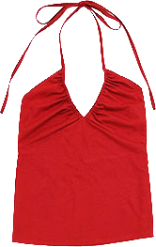
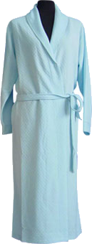
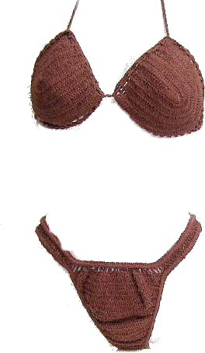
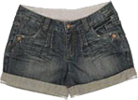
Someone’s at the door – Could someone answer it – I’m not dressed!
I’m dressed – I’ll get it
It’s probably my friends – we are going to Wild River Country
Don McClain
W. 65th St church of Christ / May 17, 2009

Slide 20
The Bible Instructs On How We Should Dress In Public!
REVEALING APPAREL -
“I look good in this and I’m going to wear it REGARDLESS of how it affects others.” - Rom 12:3,9,10; 13:10
“I WANT THE OPPOSITE SEX TO NOTICE ME” - Mat 5:28-30; 18:6-10
“Everyone else is wearing this” - Deut 23:2; Prov 4:14
Reveal your godliness & humility!

Slide 21
The Bible Instructs On How We Should Dress In Public!
The Christian woman’s attire should be her “good works.”
“The hidden person of the heart, with the incorruptible beauty of a gentle and quiet spirit, which is very precious in the sight of God.” — 1 Pet 3:4
“Loving their husbands, their children, homemakers, good, obedient to their own husbands, that the word of God may not be blasphemed.” — Tit 2:4,5

Slide 22
The Bible Instructs On How We Should Dress In Public!
Note To Parents -
Begin early - don't allow immodesty until 12 or 13, and then expect sudden correction.
Teach your children; don't wait for someone else to do it.
Teach children in both word & deed - - inconsistency is destructive!
Mothers, do not undermine godly husbands & fathers as they teach.

Slide 23
BETTER Than
others

Slide 24
SEXY

Slide 25
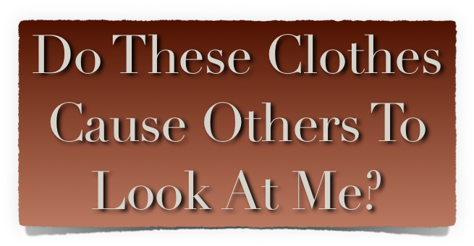

Slide 26
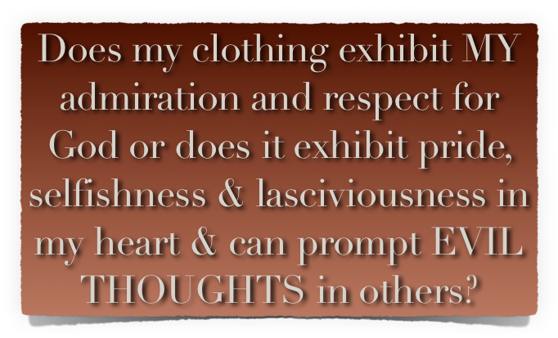

Slide 27
Be Modest – reserved, decent, respectable
Exhibit Propriety – have shame, discretion
Use Good Judgment – Think of others
Show Godliness – devoted to God / Holiness
Respect Others – If someone stumbles over your beauty, let it not be your fault!

Slide 29
GODLY

Slide 30
Don McClain
W. 65th St church of Christ / May 17, 2009

Slide 31
GODLY

Slide 32
Jeremiah 6:10–20 (NKJV)
¹⁰ To whom shall I speak and give warning, That they may hear? Indeed their ear is uncircumcised, And they cannot give heed. Behold, the word of the Lord is a reproach to them; They have no delight in it. ¹¹ Therefore I am full of the fury of the Lord. I am weary of holding it in. “I will pour it out on the children outside, And on the assembly of young men together; For even the husband shall be taken with the wife, The aged with him who is full of days.

Slide 33
Jeremiah 6:10–20 (NKJV)
¹² And their houses shall be turned over to others, Fields and wives together; For I will stretch out My hand Against the inhabitants of the land,” says the Lord. ¹³ “Because from the least of them even to the greatest of them, Everyone is given to covetousness; And from the prophet even to the priest, Everyone deals falsely. ¹⁴ They have also healed the hurt of My people slightly, Saying, ‘Peace, peace!’ When there is no peace. ¹⁵ Were they ashamed when they had committed abomination? No! They were not at all ashamed; Nor did they know how to blush. Therefore they shall fall among those who fall; At the time I punish them, They shall be cast down,” says the Lord.

Slide 34
Jeremiah 6:10–20 (NKJV)
¹⁶ Thus says the Lord: “Stand in the ways and see, And ask for the old paths, where the good way is, And walk in it; Then you will find rest for your souls. But they said, ‘We will not walk in it.’ ¹⁷ Also, I set watchmen over you, saying, ‘Listen to the sound of the trumpet!’ But they said, ‘We will not listen.’ ¹⁸ Therefore hear, you nations, And know, O congregation, what is among them.

Slide 35
Jeremiah 6:10–20 (NKJV)
¹⁹ Hear, O earth! Behold, I will certainly bring calamity on this people— The fruit of their thoughts, Because they have not heeded My words Nor My law, but rejected it. ²⁰ For what purpose to Me Comes frankincense from Sheba, And sweet cane from a far country? Your burnt offerings are not acceptable, Nor your sacrifices sweet to Me.”

