Slide 1
Psalm 2:1-12
Revelation 5:5; 6:1
(NKJV)
⁵ … “Do not weep. Behold, the Lion of the tribe of Judah, the Root of David, has prevailed to open the scroll and to loose its seven seals.” … 1 Now I saw when the Lamb opened one of the seals;

Slide 2
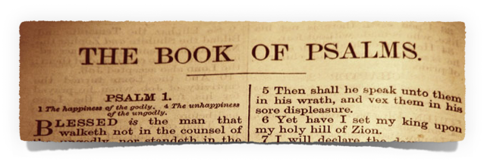
Wisdom - Ps 1; 37; 73; 112; 119; 128; etc
Penitential - Ps 6; 32; 38; 51; 102; 130; etc.
Thanksgiving - 18; 21; 30; 32; 34; 40; 92; 118, 138, etc.
Historical Salvation - 8*; 105-106; 135; 136; etc.
Lament - 3-5; 7; 9-10; 13; 14; 17; 22; 25; 26; 139; 141; 142; etc.
Imprecatory - 35; 69; 83; 88; 109; 137; 140; etc.
Messianic - 2; 16; 22; 23; 40; 45; 97; 110; 118; etc
Different Kinds of Psalms

Slide 3
Messianic | Psalm | NT Quote
The Nature of Christ | Psa. 45:6-7 | Heb. 1:8-9
Christ’s Work | Psa. 40:7-8 | Heb. 10:7
Christ’s Priesthood | Psa. 110:4 | Heb. 5:6,10; 6:20; 7:17,21
Christ’s Rule | Psa. 2:6-9; 45:6-7; 110:1-2 | Heb. 1:8-9; Acts 2:34-35; 4:23-31; 1 Cor. 15:25
The Rejection of Christ | Psa. 118:22-23 | Mt. 21:42; Mk. 12:10-11; Lk. 20:17; Acts 4:11; etc.
Jesus’ Suffering / Death | Psa. 22:1-18 | Mt. 27:46; Mk. 15:34; etc
The Resurrection | Psa. 16:8-10 | Acts 2:29-31; 13:35-37
Messianic Psalms
Notes:
A Study of Messianic Psalms
BY JASON JACKSON
.byline
Shortly before his ascension, Christ reminded the disciples concerning some of the things he had taught them. He brought to their attention the truth that “all things must needs be fulfilled, which are written in the law of Moses, and the prophets, and the psalms, concerning me” (Lk. 24:44).
From Genesis to Malachi, one can see the progressive message of the coming Savior, the Anointed, the Seed of David, the suffering Servant, the Prince of peace. As the remarks of the Lord reveal, the book of Psalms also previewed his coming and his work.
What are the criteria for classifying a psalm as Messianic? First, Jesus said the Psalms spoke of him (Lk. 24:44). Second, specific psalms are designated as Messianic by inspired New Testament writers.
The Nature of Christ
The nature of Christ is one area the Messianic psalms preview. The name for deity, God, is applied to Christ by none less than the Father himself. “Thy throne, O God, is for ever and ever” (Psa. 45:6-7; Heb. 1:8-9).
Jesus is also called the Son of God. “Thou art my son. This day have I begotten thee” (Psa. 2:7; Heb. 1:5). As one who possesses the nature of God, Jesus is worthy of worship. “And let all the angels worship him” (Psa. 97:7; Heb. 1:6).
Likewise, the prophetic Scriptures recognize his humanity. “What is man, that thou art mindful of him? Or the son of man, that thou visitest him? Thou madest him a little lower than the angels? But we behold him who hath been made a little lower than the angels, even Jesus?” (Heb. 1:6-7,9; cf. Psa. 8:4-6).
Christ’s Work
In addition to the nature of Christ, the Psalms also anticipated his work. “I come to do thy will, O God” (Psa. 40:7-8; Heb. 10:7). The roles of both king and priest would be an integral part in his work. “Your throne, O God, is for ever and ever. A sceptre of equity is the sceptre of your kingdom” (Psa. 45:6-7; Heb. 1:8-9).
David wrote, “Jehovah saith unto my Lord, Sit thou at my right hand until I make thine enemies thy footstool. Jehovah will send forth the rod of thy strength out of Zion: Rule thou in the midst of thine enemies” (Psa. 110:1-2; Mt. 22:43-44; Mk. 12:36; Lk. 20:42-43; Acts 2:34-35; 1 Cor. 15:25; Heb. 1:13; 10:12-13).
Christ’s atoning work as priest is observed in the following prophetic declaration: “Thou art a priest for ever, after the order of Melchizedek” (Psa. 110:4; Heb. 5:6,10; 6:20; 7:17,21).
The Rejection of Christ
As the Gospel records indicate, Jesus Christ was rejected by the Jews. This was no surprise to the Father, the Son, nor the Holy Spirit. The fact of his rejection was noted in Messianic psalms centuries before (as well as other passages like Isaiah 53). In opposition to the popular theory of dispensational premillennialism, which views the Jews’ rejection as an unexpected ordeal, the Scriptures had declared: “The stone which the builders rejected is become the head of the corner” (Psa. 118:22-23; Mt. 21:42; Mk. 12:10-11; Lk. 20:17; Acts 4:11; Eph. 2:20; 1 Pet. 2:7).
In connection with this foreknown rejection, the Psalms displayed an awareness of the Lord’s betrayal. Christ quoted from Psalm 41:9, saying: “I speak not of all of you: I know whom I have chosen: but that the scripture may be fulfilled, he that eateth my bread lifted up his heel against me” (Jn. 13:18).
Interestingly, in this quotation Christ omits the phrase, “in whom I trusted” (vs. 9). The situation of the Psalmist typified the Lord’s own circumstances; however, while the picture of a friend’s betrayal was generally appropriate, the one element which the Lord excludes was not characteristic of his relationship with Judas. He knew in advance that Judas would betray him; it could not be said that the Lord “trusted” him (Jn. 6:64).
Psalm 41:9 illustrates how the experiences faced by the psalmists were often types of the kinds of ordeals that Christ would experience. A type involves similarities, not an exact duplication.
Psalm 69 contains a great deal of Messianic material, but the entire Psalm is not Messianic. In view of the flawless character of Jesus, verse five was obviously applicable only to the inspired composer, for he said: “O God, thou knowest my foolishness; and my sins are not hid from thee.” The correct interpretation of Messianic psalms is known by the light of the New Testament and its usage of them.
Jesus’ Suffering and Death
No passage in all of the Bible predicts the suffering and death of Christ in the way Psalm 22 does. “My God, my God, why hast thou forsaken me?” (Psa. 22:1; Mt. 27:46; Mk. 15:34). The antagonism and malice of the crowd is observed. “Commit yourself unto Jehovah, let him deliver you” (Psa. 22:8; Mt. 27:43). Details relating to his death were previewed. “They pierced my hands and my feet” (Psa. 22:16; Jn. 20:25). “They part my garments among them” (Psa. 22:18; Mt. 27:35; Lk. 23:34; Jn. 19:24).
The Resurrection
One of the most remarkable features of the Messianic psalms is found in the prophecy of Jesus’ resurrection.
“I have set Jehovah always before me: Because he is at my right hand, I shall not be moved. Therefore, my heart is glad, and my glory rejoiceth: My flesh also shall dwell in safety. For thou wilt not leave my soul to Sheol; neither wilt thou suffer thy holy one to see corruption” (Psa. 16:8-10).
This Psalm does not portray some experience of the writer which finds its fulfillment in the life of Christ. To the contrary, it is a prediction by the prophet David which has nothing to do with his own death.
The New Testament commentary of the inspired Peter is this:
“Brethren, I may say unto you freely of the patriarch David, that he both died and was buried, and his tomb is with us unto this day. Being therefore a prophet, and knowing that God had sworn with an oath to him, that of the fruit of his loins he would set one upon his throne, he foreseeing this spake of the resurrection of the Christ, that neither was he left unto Hades, nor did his flesh see corruption” (Acts 2:29-31).
Anthony Ash comments on Psalm 16:10 in the following way:
“In Acts 2, Peter, quoting from the LXX, applies this verse to Jesus’ resurrection. Pit has the same consonants as the word for ‘corruption’ (the LXX translation), which lends itself to Peter’s argument (see also Acts 13:35). However Peter may have been guided by God in applying this text, the psalmist is not teaching resurrection here” (75; emphasis added).
The problem is: Peter’s language does not lend itself to Ash’s argument. Ash implies that even though the psalmist was not teaching the resurrection, God could have guided Peter to say that the psalmist was speaking of the resurrection.
Peter, by the Spirit of truth (Jn. 16:13), affirmed that David was a prophet, and that he foresaw, and spake of the resurrection of the Christ (Acts 2:30-31). It is incredible that one should claim: “The psalmist is not teaching resurrection here.” Peter does not suggest that the language of Psalm 16:10 is simply a fitting way to speak of Christ’s resurrection. He argues, in the clearest terms possible, that David was prophesying about the resurrection of Jesus when he wrote Psalm 16:10. Paul makes the same point in Acts 13:35-37.
Ash’s statements contradict the inspired commentary of the New Testament. His thoughts must be rejected. Interestingly, the gentleman says elsewhere: “If the New Testament use of the Old Testament does not suit our conditions of understanding, it is we who must change” (29). We might say to him this parable, “Physician, heal thyself.”
Conclusion
The book of Psalms provides a thrilling study of Christ. His nature, work, rejection, betrayal, suffering, death, and resurrection are all previewed there.
“Now therefore be wise, O ye kings: Be instructed, ye judges of the earth. Serve Jehovah with fear, And rejoice with trembling. Kiss the son, lest he be angry, and ye perish in the way. For his wrath will soon be kindled. Blessed are all they that take refuge in him” (Psa. 2:10-12).

Slide 4
Psalm 2:1-12
The Rebellious Nations - 2:1-3
God’s Response & Judgment - 2:4-5
God’s Decree & Empowerment of His Son - 2:6-9
Our Obligation & God’s Invitation - 2:10-12
Revelation 5:5; 6:1
(NKJV)
⁵ … “Do not weep. Behold, the Lion of the tribe of Judah, the Root of David, has prevailed to open the scroll and to loose its seven seals.” … 1 Now I saw when the Lamb opened one of the seals;

Slide 5
Psalm 2:1–12 (NKJV)
¹ Why do the nations rage, And the people plot a vain thing? ² The kings of the earth set themselves, And the rulers take counsel together, Against the Lord and against His Anointed, saying, ³ “Let us break Their bonds in pieces And cast away Their cords from us.” ⁴ He who sits in the heavens shall laugh; The Lord shall hold them in derision. ⁵ Then He shall speak to them in His wrath, And distress them in His deep displeasure:

Slide 6
Psalm 2:1–12 (NKJV)
⁶ “Yet I have set My King On My holy hill of Zion.” ⁷ “I will declare the decree: The Lord has said to Me, ‘You are My Son, Today I have begotten You. ⁸ Ask of Me, and I will give You The nations for Your inheritance, And the ends of the earth for Your possession. ⁹ You shall break them with a rod of iron; You shall dash them to pieces like a potter’s vessel.’ ”

Slide 7
Psalm 2:1–12 (NKJV)
¹⁰ Now therefore, be wise, O kings; Be instructed, you judges of the earth. ¹¹ Serve the Lord with fear, And rejoice with trembling. ¹² Kiss the Son, lest He be angry, And you perish in the way, When His wrath is kindled but a little. Blessed are all those who put their trust in Him.

Slide 8
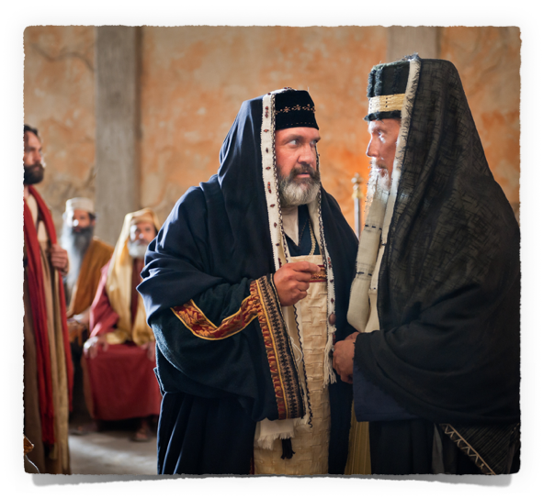
Notice the accumulated words and phrases:
“rage,
plot …
set themselves …
taking counsel…”
Jews & Gentiles set themselves against Jesus
¹ Why do the nations rage, And the people plot a vain thing? ² The kings of the earth set themselves, And the rulers take counsel together, Against the Lord and against His Anointed, saying, ³ “Let us break Their bonds in pieces And cast away Their cords from us.”

Slide 9
Acts 4:25–28 (NKJV)
²⁵ who by the mouth of Your servant David have said: ‘Why did the nations rage, And the people plot vain things? ²⁶ The kings of the earth took their stand, And the rulers were gathered together Against the Lord and against His Christ.’ ²⁷ “For truly against Your holy Servant Jesus, whom You anointed, both Herod and Pontius Pilate, with the Gentiles and the people of Israel, were gathered together ²⁸ to do whatever Your hand and Your purpose determined before to be done.
¹ Why do the nations rage, And the people plot a vain thing? ² The kings of the earth set themselves, And the rulers take counsel together, Against the Lord and against His Anointed, saying, ³ “Let us break Their bonds in pieces And cast away Their cords from us.”

Slide 10
Vain attempts to fight against God …
Gen 3 - Satan
Gen 6 - wicked men
Gen 11 - Babel
Gen 37 - 10 brothers
Ex 7-14 - Pharaoh
Est 3-7 - Haman’s plot
Mat 26 - Jews plot
Rom 9 - Jewish rejection
Rev - Roman persecution
¹ Why do the nations rage, And the people plot a vain thing? ² The kings of the earth set themselves, And the rulers take counsel together, Against the Lord and against His Anointed, saying, ³ “Let us break Their bonds in pieces And cast away Their cords from us.”

Slide 11
Vain attempts to fight against God …
Atheism / Post Moderns
False religion / teachers - (Eastern cults / Islam / Judaism / Catholicism / Denominationalism …)
Rejection of Christ’s authority - (over emphasis on grace / ridiculing “precision obedience” / charge of legalism …)
¹ Why do the nations rage, And the people plot a vain thing? ² The kings of the earth set themselves, And the rulers take counsel together, Against the Lord and against His Anointed, saying, ³ “Let us break Their bonds in pieces And cast away Their cords from us.”

Slide 12
⁴ He who sits in the heavens shall laugh; The Lord shall hold them in derision. ⁵ Then He shall speak to them in His wrath, And distress them in His deep displeasure:
God is sovereign - His will & purposes cannot be thwarted - (Ps. 11:4; 68:33; 115:3. Is. 40:22; 57:15; 66:1; Acts 5:38,39; Gal 7:7-9; Jude 18; 2 Pet 3:3-10).
Historically - all who have rejected God’s will have perished - (Ge 6,7; Ex 14:27-31; 2 Pet 2:4-8; 3:6-8; Mat 24 …)

Slide 13
⁴ He who sits in the heavens shall laugh; The Lord shall hold them in derision. ⁵ Then He shall speak to them in His wrath, And distress them in His deep displeasure:
The atheist / humanist - Ps 14:1; 53:1; Rom 1:28
The immoral / ungodly - Rom 1:18-32; 1 Cor 6:9-10; Gal 5:19-21; Rev 21:8
False teachers / deceived - 2 Pet 2:18-20; 2 Thes 2:10-12
Those rejecting His authority - Mat 7:21-23; 2 Jn 9; Jude 8

Slide 14
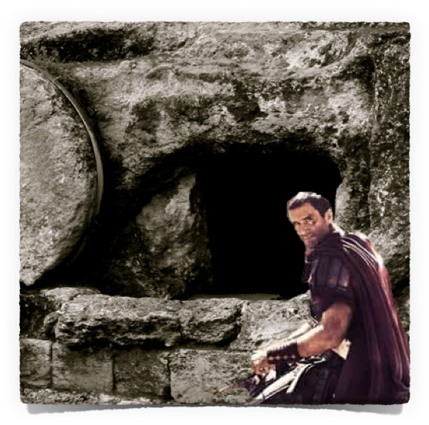
⁶ “Yet I have set My King On My holy hill of Zion.” ⁷ “I will declare the decree: The Lord has said to Me, ‘You are My Son, Today I have begotten You.
Despite man’s attempt to withstand God’s purpose - He would set “install” His king in Zion - (Dan. 2:44,45; Mat 16:18; Mat 28:18; Joel 2:32; Gal. 4:26; Heb 12:22; Phili 3:20; Rev 3:12; 21:2,10)
“You are my Son” - (Mt. 3:17; 8:29; 16:16; 17:5; Ac. 8:37; 13:33; Ro. 1:4. He. 1:5; 3:6; 5:5, 8)

Slide 15
⁶ “Yet I have set My King On My holy hill of Zion.” ⁷ “I will declare the decree: The Lord has said to Me, ‘You are My Son, Today I have begotten You.
“Today I have begotten You” (Refers to the resurrection of Christ in the NT) - Heb 1:5
Raised to sit on David’s throne - Ac. 2:30-36; 13:33-37;
Declared to be the Son of God with power by the resurrection - Ro. 1:4;
Raised to be our High Priest - 5:5; 6:20; Ps. 110:4

Slide 16
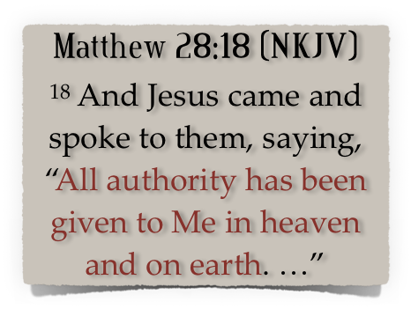
⁸ Ask of Me, and I will give You The nations for Your inheritance, And the ends of the earth for Your possession. ⁹ You shall break them with a rod of iron; You shall dash them to pieces like a potter’s vessel.’ ”
Jesus Is, NOW, Lord of lord’s & King of kings -

Slide 17
⁸ Ask of Me, and I will give You The nations for Your inheritance, And the ends of the earth for Your possession. ⁹ You shall break them with a rod of iron; You shall dash them to pieces like a potter’s vessel.’ ”
Jesus Is, NOW, Lord of lord’s & King of kings -
Ephesians 1:20–23 (NKJV)
²⁰ which He worked in Christ when He raised Him from the dead and seated Him at His right hand in the heavenly places,

Slide 18
⁸ Ask of Me, and I will give You The nations for Your inheritance, And the ends of the earth for Your possession. ⁹ You shall break them with a rod of iron; You shall dash them to pieces like a potter’s vessel.’ ”
Jesus Is, NOW, Lord of lord’s & King of kings -
Ephesians 1:20–23 (NKJV)
²¹ far above all principality and power and might and dominion, and every name that is named, not only in this age but also in that which is to come.

Slide 19
⁸ Ask of Me, and I will give You The nations for Your inheritance, And the ends of the earth for Your possession. ⁹ You shall break them with a rod of iron; You shall dash them to pieces like a potter’s vessel.’ ”
Jesus Is, NOW, Lord of lord’s & King of kings -
Ephesians 1:20–23 (NKJV)
²² And He put all things under His feet, and gave Him to be head over all things to the church, ²³ which is His body, the fullness of Him who fills all in all.

Slide 20
⁸ Ask of Me, and I will give You The nations for Your inheritance, And the ends of the earth for Your possession. ⁹ You shall break them with a rod of iron; You shall dash them to pieces like a potter’s vessel.’ ”
Jesus Is, NOW, Lord of lord’s & King of kings -
Colossians 1:18 (NKJV)
¹⁸ And He is the head of the body, the church, who is the beginning, the firstborn from the dead, that in all things He may have the preeminence.

Slide 21
⁸ Ask of Me, and I will give You The nations for Your inheritance, And the ends of the earth for Your possession. ⁹ You shall break them with a rod of iron; You shall dash them to pieces like a potter’s vessel.’ ”
Jesus Is, NOW, Lord of lord’s & King of kings -
Acts 10:36 - “He is Lord of all”
1 Tim. 6:15 “only Potentate, the King of kings, & Lord of lords;”
Rev. 17:14 “… for he is Lord of lords, & King of kings:
Rev. 19:16 “… KING OF KINGS, & LORD OF LORDS.”

Slide 22
⁸ Ask of Me, and I will give You The nations for Your inheritance, And the ends of the earth for Your possession. ⁹ You shall break them with a rod of iron; You shall dash them to pieces like a potter’s vessel.’ ”
Jesus is also judge - all who reject His authority will be completely and irreparably destroyed.
All judgment committed to the Son - John 5:22,23; 12:48
Jesus will judge the living & dead - Acts 10:42; 17:30,31
All must stand before Him - 2 Cor 5:10; 2 Pt 3:7; Jude 14,15

Slide 23
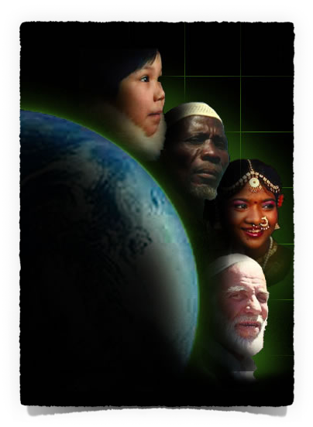
Transform our mind - “be wise, be instructed” - Hos 14:9; Rom 12:1,2
Yield our will - “Serve the Lord with fear” - Phili 2:12; Heb 4:1; 12:28,29
Govern our attitude - “rejoice with trembling” - Acts 5:41; 16:25; Phili 4:4; Jam 1:2; Rom 5:2,3; 1 Pet 4:13
¹⁰ Now therefore, be wise, O kings; Be instructed, you judges of the earth. ¹¹ Serve the Lord with fear, And rejoice with trembling.

Slide 24
Transform our mind - “be wise, be instructed” - Hos 14:9; Rom 12:1,2
Yield our will - “Serve the Lord with fear” - Phili 2:12; Heb 4:1; 12:28,29
Govern our attitude - “rejoice with trembling” - Acts 5:41; 16:25; Phili 4:4; Jam 1:2; Rom 5:2,3; 1 Pet 4:13
Worship & obey with reverence - Jn 4:24; Hb 5:8,9; 12:28,29; Mt 7:21-23 …
¹² Kiss the Son, lest He be angry, And you perish in the way, When His wrath is kindled but a little. Blessed are all those who put their trust in Him.

Slide 25
The Son has wrath (John 2:13-17; Rom 14:10-12; 2 Thess 1:6-9; Heb 9:27-28).
The blessed are those who put their trust in Him! (Psalm 5:1; 34:22; Prov 3:5; Mark 16:16; Acts 2:38; Heb 5:8.9).
¹² Kiss the Son, lest He be angry, And you perish in the way, When His wrath is kindled but a little. Blessed are all those who put their trust in Him.

Slide 26
Psalm 2:1-12
The Rebellious Nations - 2:1-3
God’s Response & Judgment - 2:4-5
God’s Decree & Empowerment of His Son - 2:6-9
Our Obligation & God’s Invitation - 2:10-12
Revelation 5:5; 6:1
(NKJV)
⁵ … “Do not weep. Behold, the Lion of the tribe of Judah, the Root of David, has prevailed to open the scroll and to loose its seven seals.” … 1 Now I saw when the Lamb opened one of the seals;

Slide 27
Psalm 2:1-12
³⁸ Then Peter said to them, “Repent, and let every one of you be baptized in the name of Jesus Christ for the remission of sins; and you shall receive the gift of the Holy Spirit.
⁴⁷ “Can anyone forbid water, that these should not be baptized who have received the Holy Spirit just as we have?” ⁴⁸ And he commanded them to be baptized in the name of the Lord. Then they asked him to stay a few days.
Acts 2:38; 10:47,48
(NKJV)

Slide 28
Psalm 2:1-12
¹⁴ Blessed are those who do His commandments, that they may have the right to the tree of life, and may enter through the gates into the city. … ¹⁶ “I, Jesus, have sent My angel to testify to you these things in the churches. I am the Root and the Offspring of David, the Bright and Morning Star.” ¹⁷ And the Spirit and the bride say, “Come!” And let him who hears say, “Come!” And let him who thirsts come. Whoever desires, let him take the water of life freely.
Revelation 22:14,17
(NKJV)

Slide 29
Don McClain
W. 65th St church of Christ / December 16, 2007

Slide 30
Psalm 2:1-12
Charts by Don McClain
Prepared March 17-19, 2016 / Preached March 20, 2016
West 65th Street church of Christ / P.O. Box 190062; Little Rock AR 72219 / 501-568-1062
Email – donmcclain@sbcglobal.net - http://w65stchurchofchrist.org/coc/

Slide 31
Acts 4:23–31 (NKJV)
²³ And being let go, they went to their own companions and reported all that the chief priests and elders had said to them. ²⁴ So when they heard that, they raised their voice to God with one accord and said: “Lord, You are God, who made heaven and earth and the sea, and all that is in them,

Slide 32
Acts 4:23–31 (NKJV)
²⁵ who by the mouth of Your servant David have said: ‘Why did the nations rage, And the people plot vain things? ²⁶ The kings of the earth took their stand, And the rulers were gathered together Against the Lord and against His Christ.’

Slide 33
Acts 4:23–31 (NKJV)
²⁷ “For truly against Your holy Servant Jesus, whom You anointed, both Herod and Pontius Pilate, with the Gentiles and the people of Israel, were gathered together ²⁸ to do whatever Your hand and Your purpose determined before to be done.

Slide 34
Acts 4:23–31 (NKJV)
²⁹ Now, Lord, look on their threats, and grant to Your servants that with all boldness they may speak Your word, ³⁰ by stretching out Your hand to heal, and that signs and wonders may be done through the name of Your holy Servant Jesus.”

Slide 35
Acts 4:23–31 (NKJV)
³¹ And when they had prayed, the place where they were assembled together was shaken; and they were all filled with the Holy Spirit, and they spoke the word of God with boldness.

